Slide 1
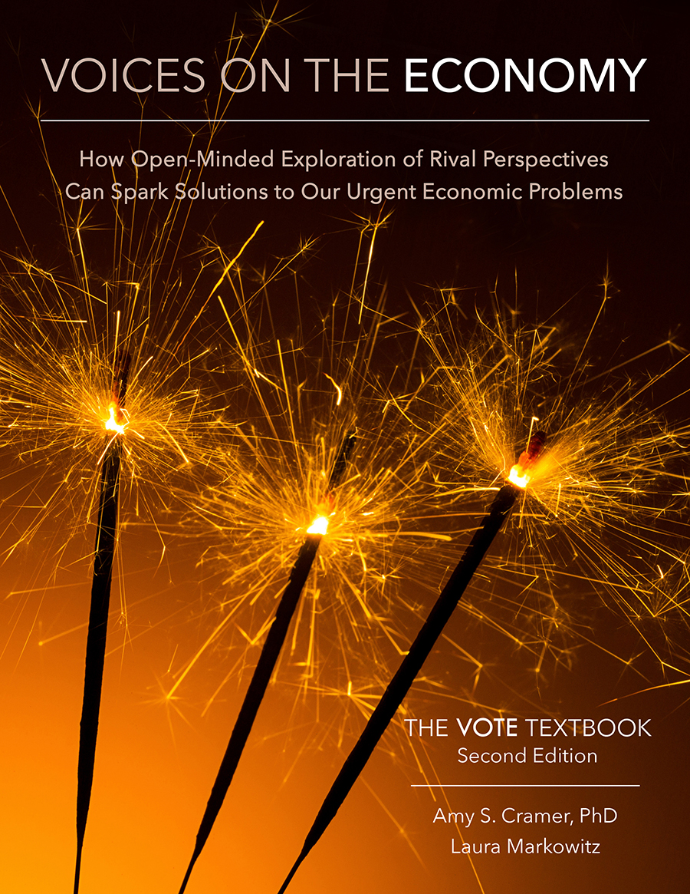
From The VOTE Textbook Second Edition Copyright © 2023

Slide 2


From The VOTE Textbook Second Edition Copyright © 2023
Notes:
2

Slide 3
From The VOTE Textbook Second Edition Copyright © 2023
Notes:
3

Slide 4
The VOTE Textbook Chapters
From The VOTE Textbook Second Edition Copyright © 2023
Notes:
4

Slide 5
1
2
3
4
5
6
7
8
9
10
11
12
13
14
15
16
17
18
19
20
21
From The VOTE Textbook Second Edition Copyright © 2023
Notes:
5

Slide 6
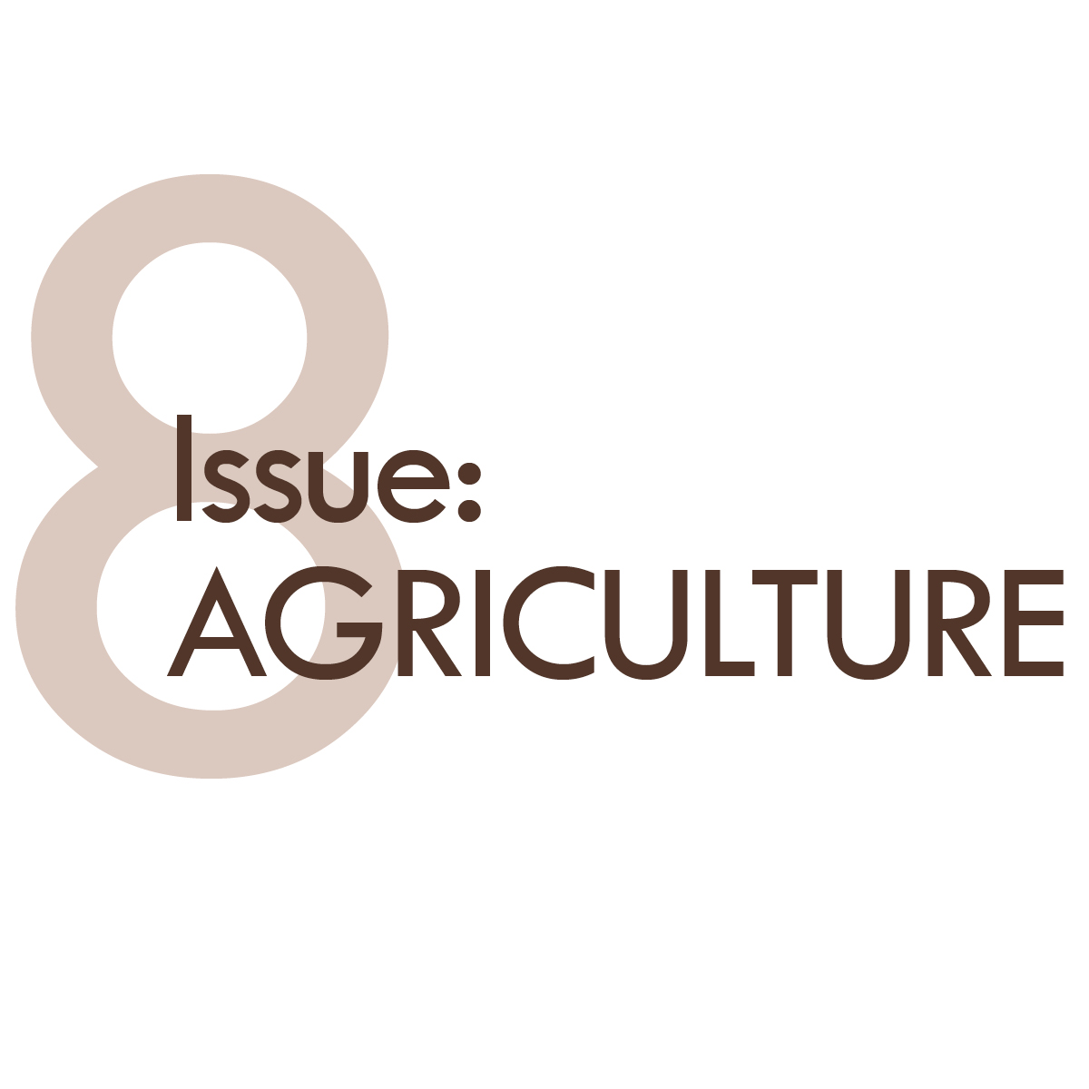
From The VOTE Textbook Second Edition Copyright © 2023

Slide 7

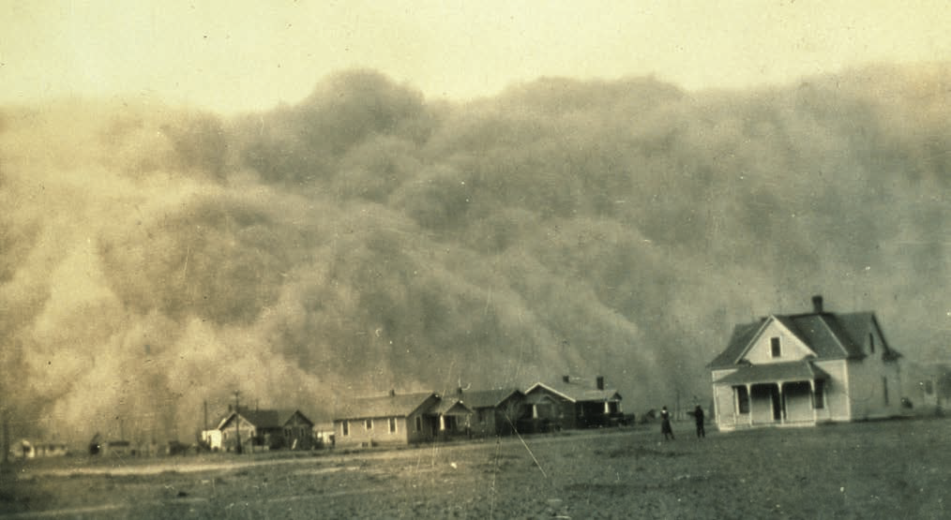
Discussion story: The Dust Bowl
Agriculture
Discussion Story
The Dust Bowl
Agriculture
From The VOTE Textbook Second Edition Copyright © 2023

Slide 8
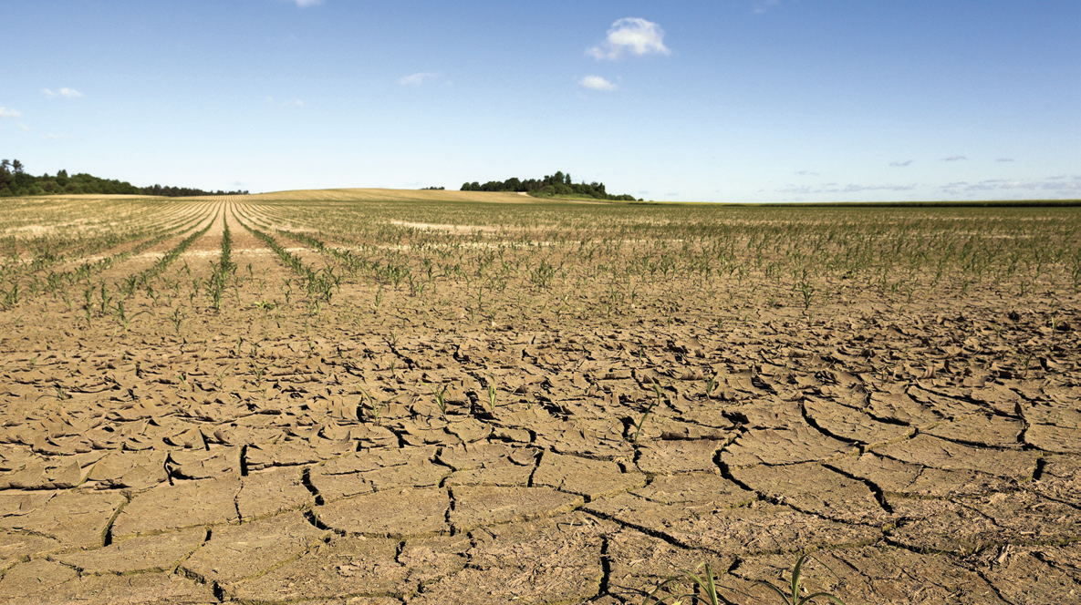
Discussion story: The Dust Bowl, cont’d
The Golden Moment
Shared Problem:
Shared Goal:
Instability in farming threatens food security
A secure food system
From The VOTE Textbook Second Edition Copyright © 2023
Notes:
8

Slide 9
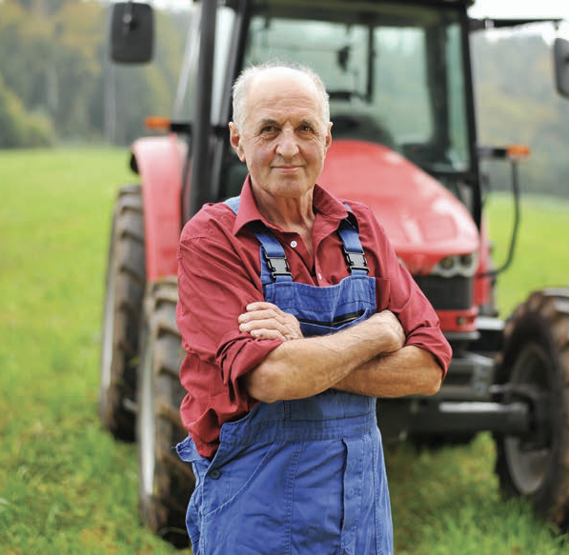
Section: Understanding the Issue of Agriculture
“My grandfather used
to say that once in your life you need a doctor,
a lawyer, a policeman and a preacher. But every day, three times a day, you need a farmer!”
Brenda Schoepp
Inspirational Speaker
From The VOTE Textbook Second Edition Copyright © 2023

Slide 10
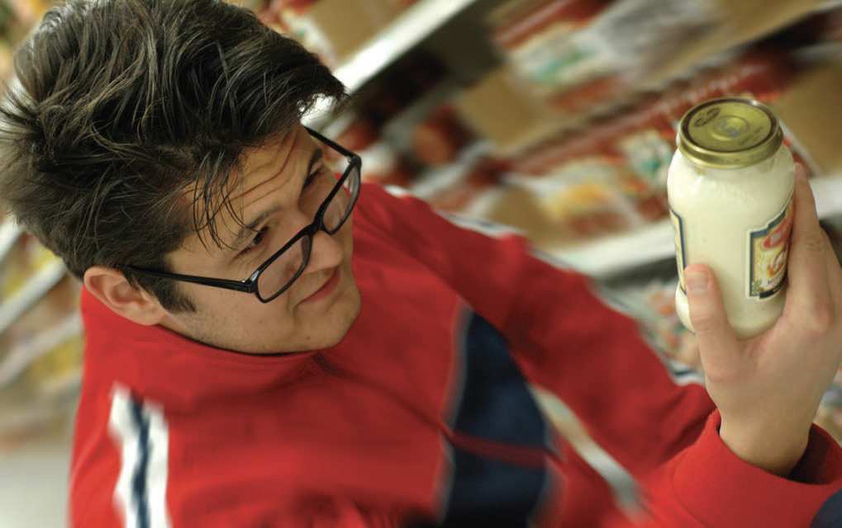
Section: Understanding the Issue of Agriculture, cont’d
Activity: What types of food do you buy at the grocery store? Make a list of at least five items.
From The VOTE Textbook Second Edition Copyright © 2023

Slide 11
Polling Question
Grocery Store
What types of food do you buy at the grocery store? Choose all that apply.
Bread, crackers
Fruits, vegetables
Rice, pasta, quinoa
Snack food, including chips
Cereal, protein bars, other breakfast grab-and-go items
Dairy products, including milk and yogurt
Soda, seltzer, juice
Cookies, ice cream, sweets
Meat, fish, tofu, eggs
Other
From The VOTE Textbook Second Edition Copyright © 2023

Slide 12
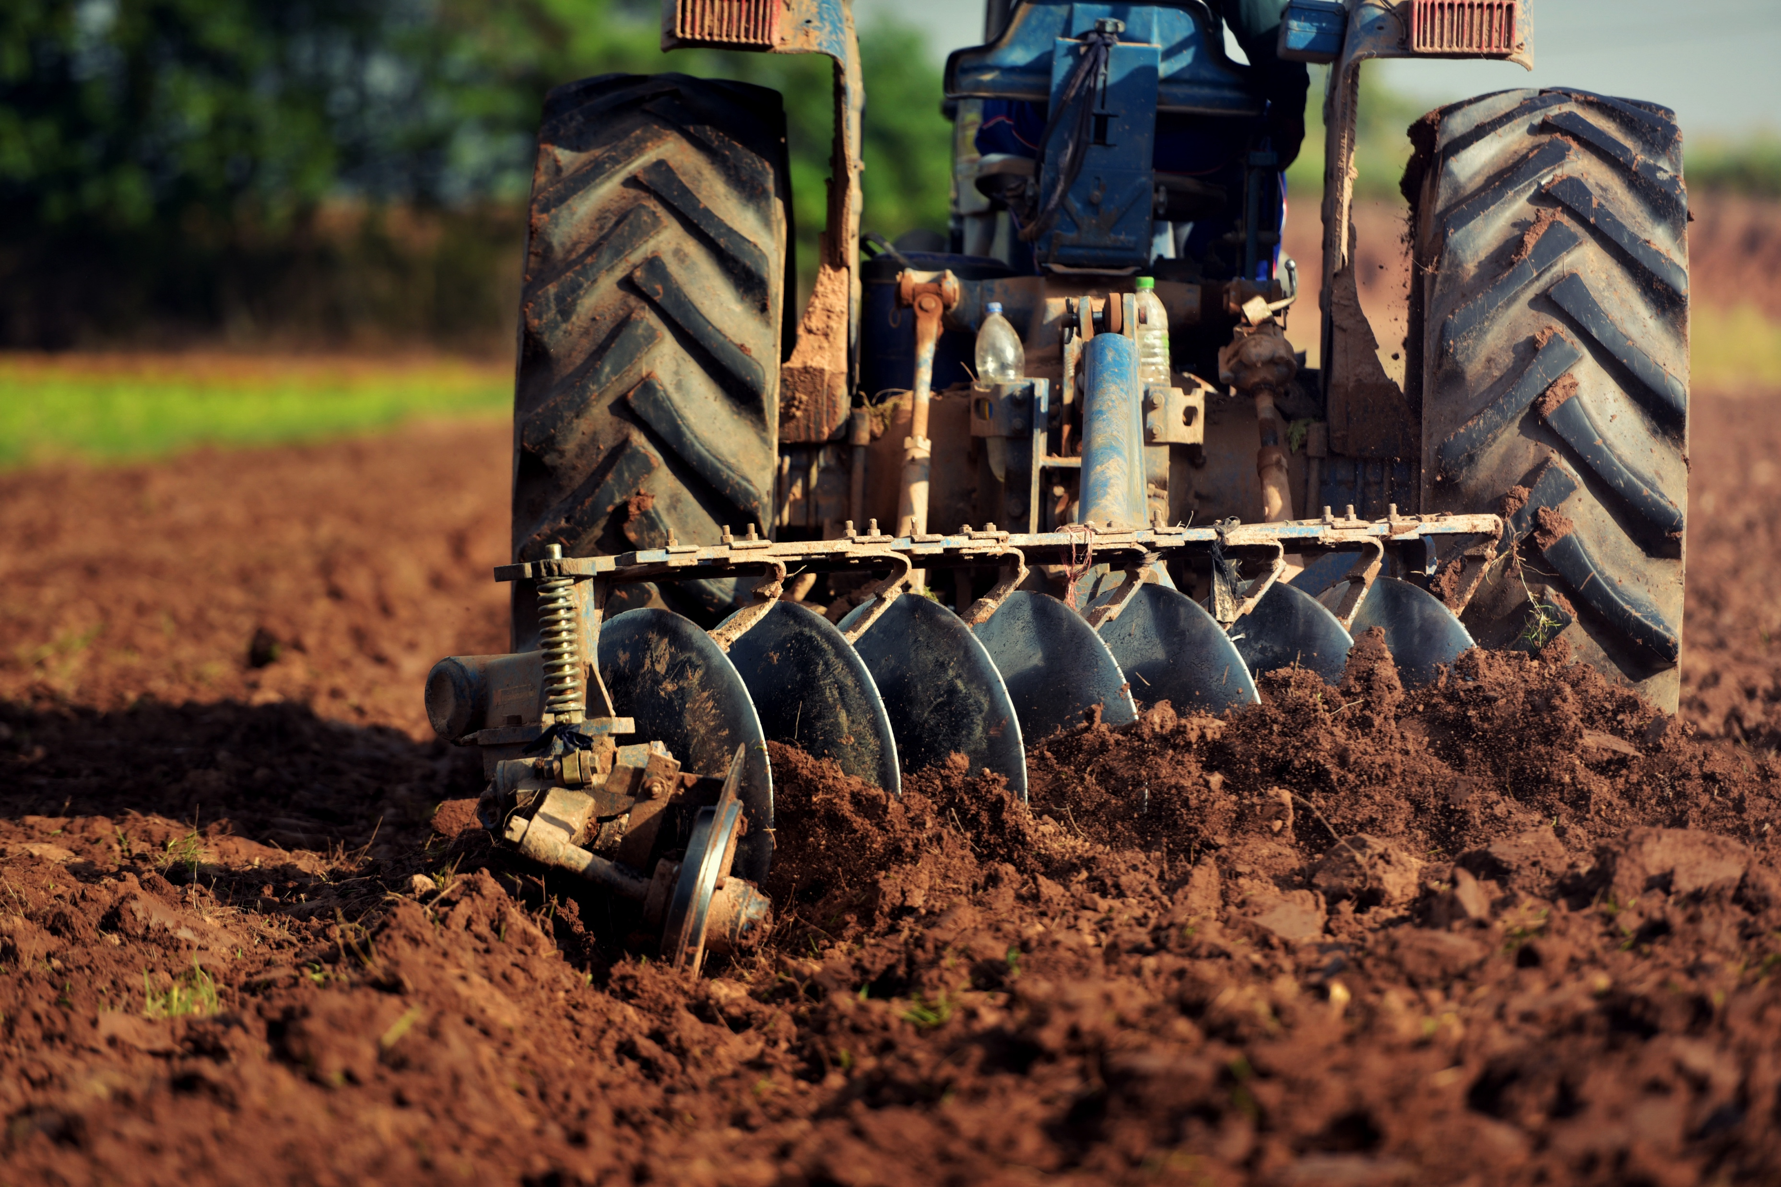
Section: Understanding the Issue of Agriculture, cont’d
Agriculture
This is the science and practice of farming for the purpose of growing crops and raising animals to sustain us with food and clothing.
From The VOTE Textbook Second Edition Copyright © 2023

Slide 13
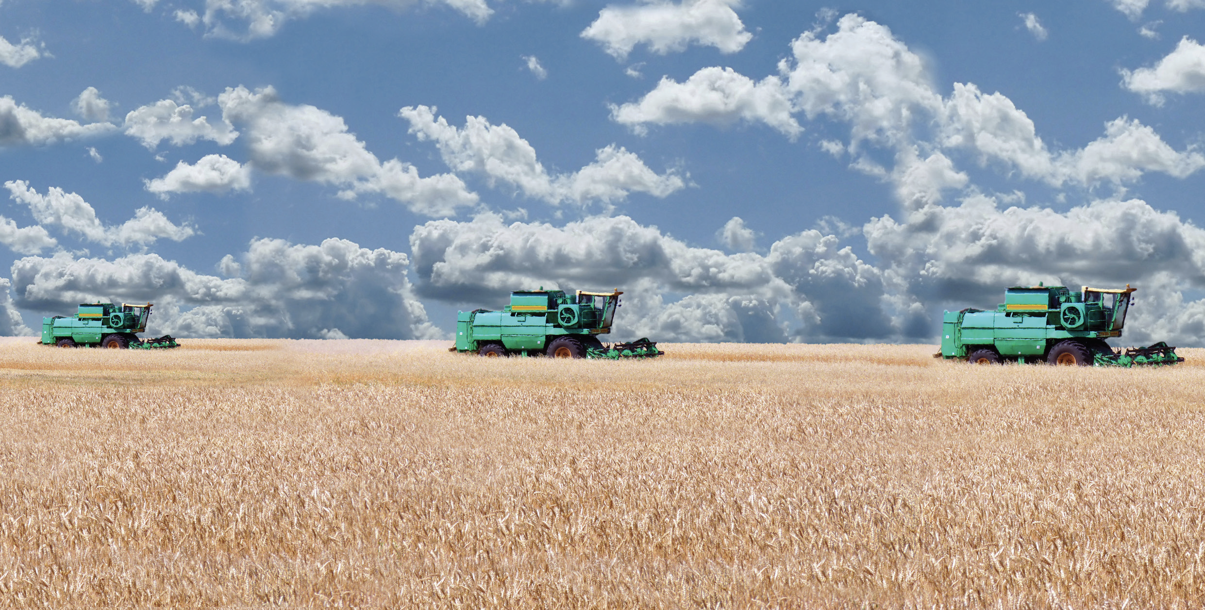
Section: Understanding the Issue of Agriculture, cont’d
In 2017 more than 900 million acres in the U.S. were used for farming, and close to 70 percent of the farmland in the nation was controlled by the top 10 percent of farming enterprises. These large-scale agricultural firms are called big ag (big agribusiness) or corporate ag.
From The VOTE Textbook Second Edition Copyright © 2023

Slide 14
Section: Understanding the Issue of Agriculture, cont’d
Farmers have been subsidized since the Department of Agriculture (USDA) was created by President Lincoln in 1862.
From The VOTE Textbook Second Edition Copyright © 2023

Slide 15
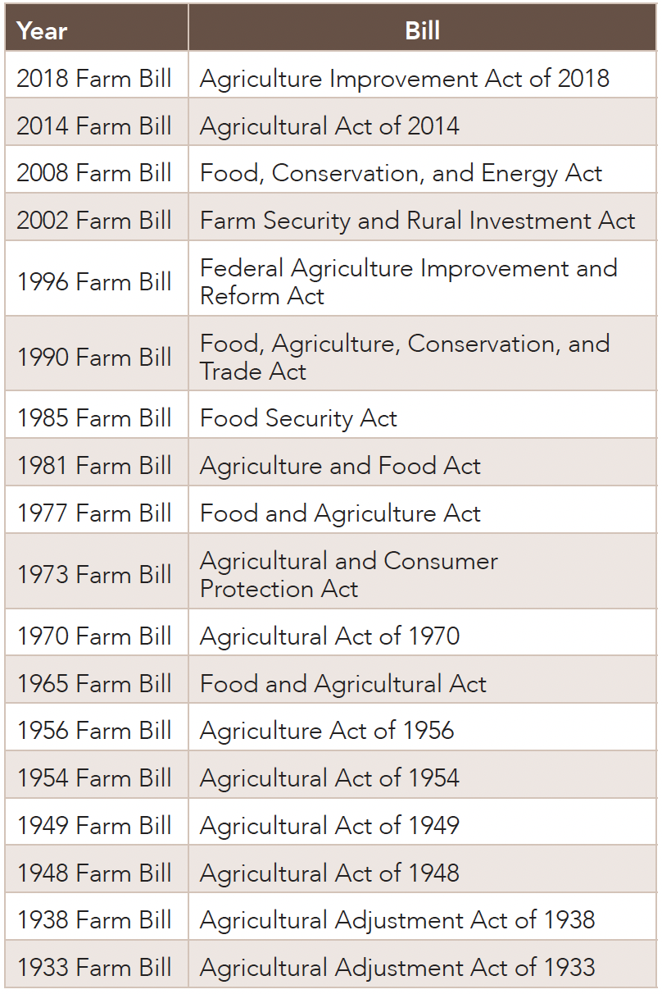
Farm Bills
Section: Understanding the Issue of Agriculture, cont’d
President F. D. Roosevelt signed the Agricultural Adjustment Act of 1933, which we now refer to as the first Farm Bill.
The Farm Bill is the federal government’s policy to address everything related to agriculture, including farming, ranching, nutrition, and more.
In 1938 Congress passed
a new version of the Farm Bill and agreed that the issue of agriculture was so important that it should be reconsidered every five years moving forward.
From The VOTE Textbook Second Edition Copyright © 2023

Slide 16
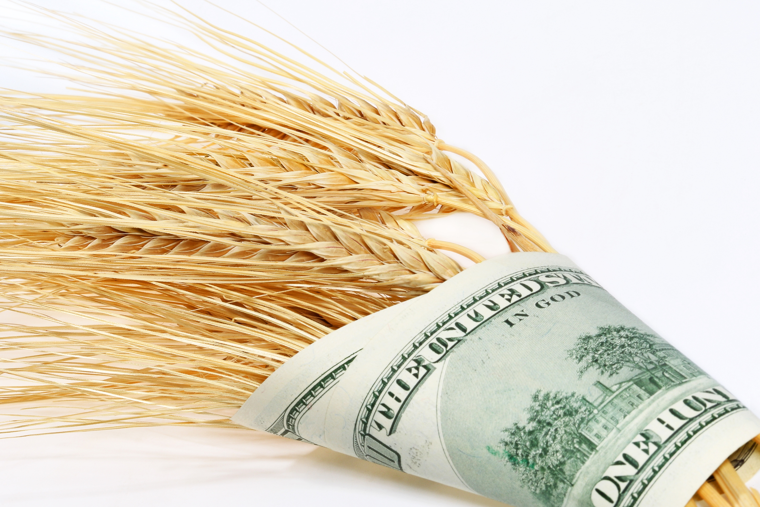
Section: Understanding the Issue of Agriculture, cont’d
Types of Subsidies
Crop insurance
Loan programs for
farmers
Disaster assistance
Direct payments
Conservation reserve
Crop commodity
programs
Food promotion
Agricultural research
From The VOTE Textbook Second Edition Copyright © 2023

Slide 17
Section: Understanding the Issue of Agriculture, cont’d
More than one hundred different crops are subsidized. The top five have traditionally been wheat, corn, rice, soy, and cotton.
Check your grocery list. Does anyone have at least one item made from a subsidized crop?
The fact that most of us purchase subsidized food is just one reason why this issue is relevant to our lives. Agriculture determines what’s in your lunch box, hanging in your closet, and on the menu at your favorite restaurant.
DAILY
DOUBLE
From The VOTE Textbook Second Edition Copyright © 2023

Slide 18

Note: We present each perspective as if we wholeheartedly agree with it. We do this on purpose to present each point of view in its best light, but please imagine each time that we are wearing a mask—as if we are actors playing three different roles.
From The VOTE Textbook Second Edition Copyright © 2023

Slide 19
C
Section: Voices on Agriculture, cont’d
onservative
Free-Market Capitalism
Agriculture
When the government decided to give away land for free, farmers didn’t make profit-based decisions and ended up destroying the land.
From The VOTE Textbook Second Edition Copyright © 2023

Slide 20
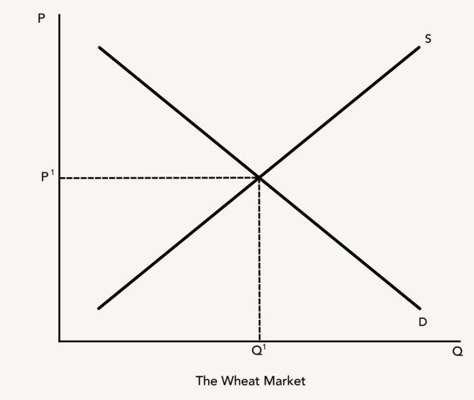
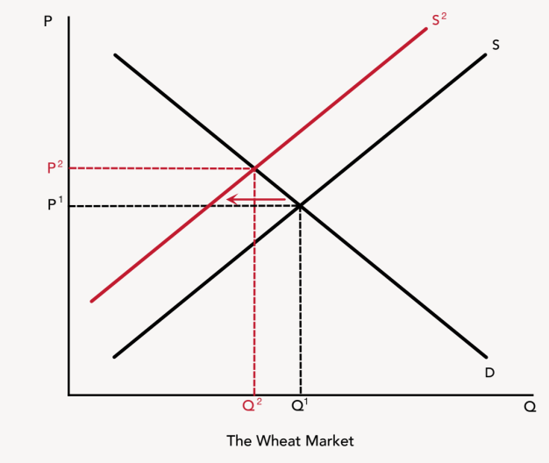
C
Section: Voices on Agriculture, cont’d
onservative
Free-Market Capitalism
BIG PICTURE
When we leave markets alone to self-adjust, firms adapt and innovate, and we get
the food we want at the right price.
POLICY POSITION
Instability in farming threatens food security, but…
Liberal policies distort price signals, throwing markets off
balance and ruin international relations.
Radical policies jeopardize our ability to feed ourselves
because there is no profit motive and because no one
can act without committee approval.
SOLUTION
Reject agricultural subsidies and replace them with
unfettered price signals to ensure a secure food system:
Private crop insurance markets emerge
Futures trading keeps farmers in business.
Agriculture
From The VOTE Textbook Second Edition Copyright © 2023

Slide 21
Section: Voices on Agriculture, cont’d
Agriculture Talking Points: Conservative
1. Capitalism works best when we leave it alone. The free-market approach is simple and elegant: the consumer and the farmer meet in a market without any government interference, and since farmers want to make money, they’ll produce what people want to buy. That’s how we get the food we want at the right price. The free market is a win-win every time for suppliers and demanders.
2. There’s a saying that every crisis is an opportunity. Crisis and opportunity are two sides of the same coin. Instability in agriculture gives farmers an opportunity to innovate and adapt. For instance, since they know there will be years of drought, firms have an incentive to develop crops that use less water. Innovation is how we get a growing and healthy economy. Firms that are flexible and can respond to change will survive, and that’s how it should be.
3. Liberal subsidies are supposed to fix a problem, but they end up creating more problems because government handouts reward firms for stagnating. Why should farmers adopt better business practices or meet changing market demands when the heavy hand of government pays them not to? The solution is simple: get rid of subsidies and let farmers come up with their own creative solutions. Let’s stop enabling an entire industry to run on welfare.
4. Agricultural subsidies are a huge waste of taxpayer dollars. We pay farmers to overproduce crops that nobody wants. All that excess food floods the market, and we end up wasting our scarce resources. And it gets worse—because then we dump those products on developing countries, which pushes their own farmers out of business and causes international trade crises. Liberals, you’ve been running this scam on the American taxpayer for nearly a hundred years. It’s time to get rid of subsidies.
5. No one can possibly plan the economy by committee—and that’s especially true in agriculture. The radical idea of food security councils is a disaster waiting to happen. They are doomed to fail because there is no possible way any one person or group could ever figure out how to allocate resources to the right place, at the right time, in the right amounts to give us the wide variety of food we want in the quantities we need.
6. Radicals, your emergency and innovation fund can’t solve the problem of instability in agriculture because your democratic socialist economy generates no money. Why? Because you reject the profit motive. That means there’s no incentive for anyone to work hard or innovate. It’s the profit motive that leads agribusiness to invest in research and development so we can go to the store and buy food that’s more nutritious and won’t spoil as quickly. Without the profit motive, our ability to feed ourselves is doomed to fail.
7. Is there instability in agriculture? Of course there is! That’s why farmers buy crop insurance policies to mitigate the risk of loss in case of a disaster. And that’s why they make deals with buyers to sell a portion of their future harvest at a fixed price. They can take measures on their own to make it possible to stay in business even if the price falls. This is how farmers have historically adapted and innovated to ensure that we get the food we want and need.
8. Our nation is most secure and our farming industry is most robust when we produce efficiently, which means leaving markets alone to self-adjust. That brings us the variety of foods we want in the right quantities at the right prices. We can choose whatever diets we want without the government imposing its will on our dinner plates. All we need to do is to let the invisible hand guide farmers to produce the food our nation actually wants and needs.
From The VOTE Textbook Second Edition Copyright © 2023

Slide 22
L
Section: Voices on Agriculture, cont’d
iberal
Fair-Market Capitalism
Agriculture
It was right for the government to open up more land for farming to feed the nation, but more oversight was needed to protect the land.
From The VOTE Textbook Second Edition Copyright © 2023

Slide 23
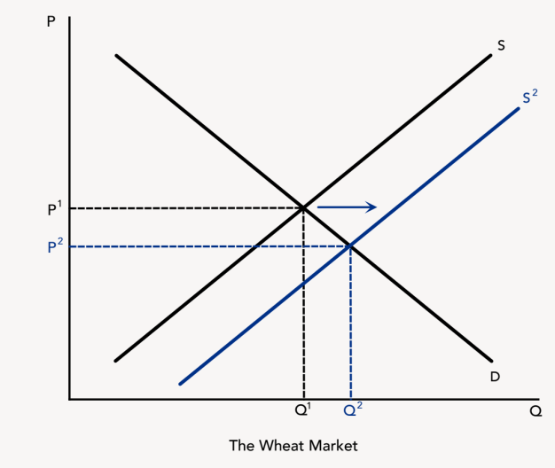

L
Section: Voices on Agriculture, cont’d
iberal
Fair-Market Capitalism
BIG PICTURE
The public-private partnership secures our food supply by preserving our farming
industry, which protects our national security and brings us the food we want and need.
POLICY POSITION
Instability in farming threatens food security, but…
Radical policies are just subsidies by a different name,
but burdened with suffocating red tape, limited
choices, and food shortages.
Conservative policies give us a four-way loss: bad
for farmers, bad for consumers, bad for national
security, and bad for international relations.
SOLUTION
Strengthen agricultural subsidies to ensure a secure
food system:
Expand protections for our food independence.
Preserve the nation’s farmland.
Agriculture
From The VOTE Textbook Second Edition Copyright © 2023

Slide 24
Section: Voices on Agriculture, cont’d
Agriculture Talking Points: Liberal
1. Farmers are the quiet, hardworking heroes of our country. Without putting on a uniform or taking up arms, they safeguard our national security by ensuring our food independence. The public-private partnership keeps us from becoming vulnerable to foreign powers for our very survival because government helps farms stay in production. It also gives farmers peace of mind when their livelihoods—and our nation’s food security—are threatened.
2. Agriculture is a risky business. No one can predict the weather or any other unexpected event that interrupts food production, such as terrorism, wars, or a pandemic. But while those factors could affect our food supply, they don’t because of fair-market capitalism. We don’t have to worry about empty shelves at the grocery store, because our farming industry is protected by responsible government intervention.
3. The radical idea to use food security councils to create emergency and innovation funds is what we already have. It’s called “subsidies.” They just came up with a fancy new name for crop insurance, disaster assistance, and more. But their food security councils are impractical. We can’t ask people with busy lives and businesses to sit through endless committee meetings. The USDA has paid experts and mechanisms in place to get feedback from stakeholders. Radicals waste time trying to fix what isn’t broken.
4. Radicals, if you want organic, free-range, non-GMO products, fair-market capitalism protects farmers and ensures that your local store is stocked with safe, reliable food. But, without the profit motive and private ownership, we’ll be left with food shortages, higher prices, and fewer choices. You throw out the very system that creates our wealth. Democratic socialism has the equation wrong: it’s democracy plus capitalism with a government partner, not democracy plus dead-end socialism, which brings us maximum well-being.
5. The conservative idea that in times of crisis farmers adapt and innovate sounds good on paper, but without subsidies, farmers “adapt” by selling off their land to developers. Once farmland is turned into a housing development, a shopping mall, or a parking lot, it’s lost forever to food production. Without arable land, our whole nation becomes dependent on other countries for our food. This is a disaster for national sovereignty.
6. Conservatives, farmers can’t afford private insurance on their own, and futures markets are a gamble that could easily lose them the farm. Leave it to you to reject farm subsidies, which have worked for decades. Of course there’s instability in every industry, but agriculture isn’t just any industry. We can’t survive without food. We don’t want high prices and limited products at the grocery store every time there’s a drought or hurricane. Agricultural subsidies keep farmers producing in a high-risk industry.
7. Everyone needs to eat. Food is the foundation of our well-being, so it makes perfect sense to support and protect our food source—the farming industry. The helping hand of government makes it possible for farmers to sleep well at night knowing that their businesses won’t go under the next time there’s a weather event or human-made disaster. We can sleep well at night knowing that tomorrow, and next week, and ten years from now, our nation will be able to feed itself.
8. Can you imagine the chaos and frustration that would occur if every time there was a drought or a hurricane, we would all have to wonder if we could find the ingredients for dinner at the store, and if we could afford them? Agricultural subsidies give us a four-way win: farmers win because they stay in business, consumers win with low prices and availability of the food we want, the country wins because we can depend on ourselves for a secure food system, and the developing world wins when we give it our surplus food.
From The VOTE Textbook Second Edition Copyright © 2023

Slide 25
R
Section: Voices on Agriculture, cont’d
adical
Democratic Socialism
Agriculture
Driven to make a profit in capitalism, private owners with no ties to the community prioritized short-term gains, which devastated the land.
From The VOTE Textbook Second Edition Copyright © 2023

Slide 26
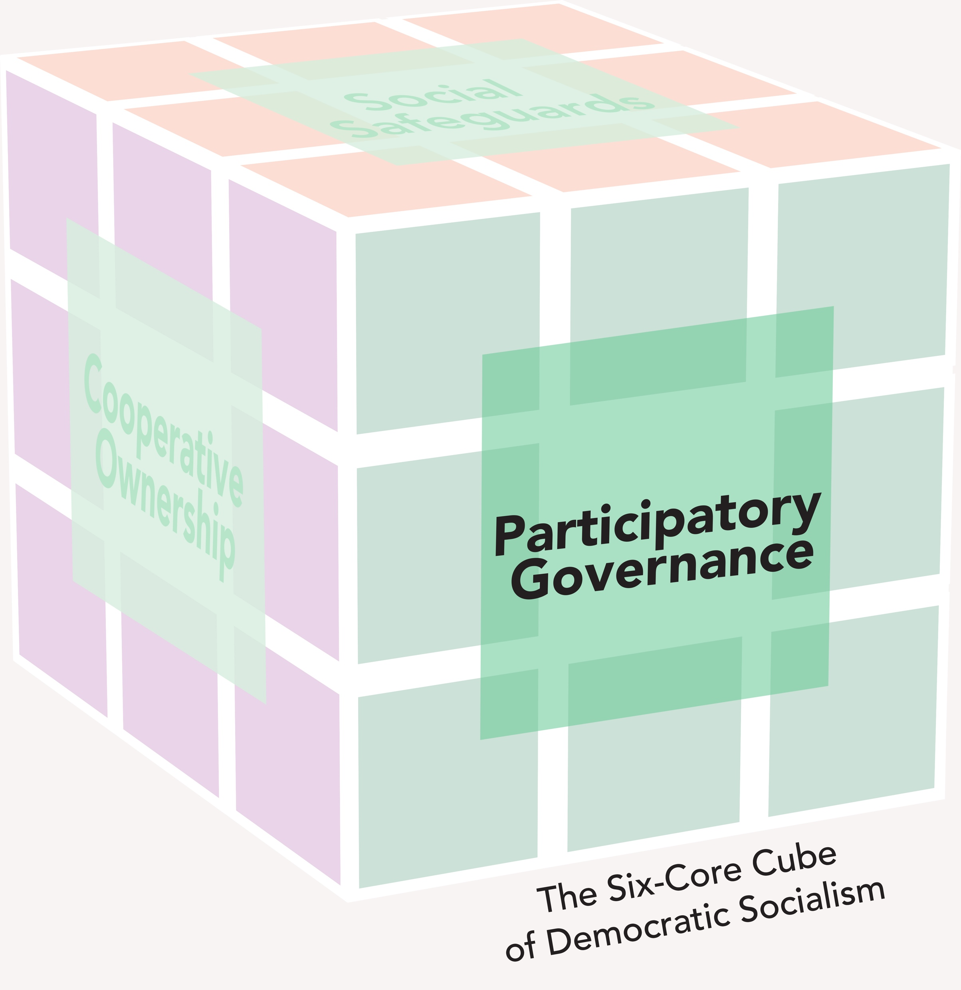
R
Section: Voices on Agriculture, cont’d
adical
Democratic Socialism
Agriculture
BIG PICTURE
Participatory governance brings the nation a stable, healthy, and balanced food
system by funding innovation and best practices to plan and prepare for catastrophes.
POLICY POSITION
Instability in farming threatens food security, but...
Conservative policies enable big ag to give us unhealthy, addictive food
and the illusion of choice.
Liberal policies only serve to feed big ag, which exploits
workers, ruins the land, and destroys farming communities.
SOLUTION
Replace agricultural subsidies in capitalism with food security
council policies in democratic socialism to ensure a secure
food system:
Create emergency and innovation funds.
Preserve and support farming communities.
From The VOTE Textbook Second Edition Copyright © 2023

Slide 27
Section: Voices on Agriculture, cont’d
Agriculture Talking Points: Radical
1. With participatory governance, we plan ahead instead of waiting for disaster to strike farms and wipe them out. Food security councils invest in research and development of drought-resistant crops, water-harvesting systems, and sustainable equipment. When all the stakeholders have a place at the table and real power to make decisions, we can fund innovations and best practices to make our food system more secure. This is how we get a sustainable and secure food system.
2. Everybody’s gotta eat! Food security councils make sure we have the food we want because they understand what it takes for farms to succeed, what consumers want, and how to feed our nation. Why? The people at the table represent all the stakeholders. They are the farmers, the consumers, the industry experts, the environmentalists, the hydrologists, our public officials, and more. With policies in hand, the elected officials are tasked with representing those decisions in their larger legislative arenas.
3. Conservatives, you say the profit motive makes our lives better, but all I see are supermarkets filled with foods that make us sick. Big ag is killing us with obesity, diabetes, and heart disease. Because of capitalist competition, they hire food scientists to design our meals, snacks, and drinks to be addictive so we’ll keep buying more and more. Instead of being in the business of feeding people healthy food that sustains us, their business is all about making the most profit. In the meantime, we get sicker and more addicted.
4. The conservative idea to do nothing is dangerous. The food system is vulnerable to weather and human-made disasters. Without a plan in place, the most vulnerable farms go under, and greedy multinational corporations happily swoop in and buy them up for a pittance. We can’t afford to lose farming communities to outside investors. We need people who care for the land because they live and work there, and because they want to sustain it for their children and grandchildren.
5. The liberal policy of subsidies underwrites big ag’s destruction of our food system, our health, and our future. Our tax dollars fund unsustainable, dangerous practices like producing dairy with hormones and spraying our vegetables with toxic chemicals. Then liberals turn around and dump the leftovers on poor countries. This drives their farmers out of business, and entire nations become dependent on our handouts to survive. Liberals’ intentions may have been humanitarian, but their policies destroy food systems throughout the world.
6. Let’s be honest about what’s really going on here, liberals: rich agribusiness pays off politicians to push farm subsidies in their favor. This is an example of crony capitalism at its worst. Your subsidies are a well-packaged scam to make taxpayers believe we’re participating in a patriotic act to save the country’s family farms. But in reality you have us subsidizing companies that have more money than many nations, traumatize our food system, and are in zero danger of going out of business.
7. A stable food system isn’t just about having a lot of food on the store shelves; it’s about having healthy, affordable choices. In democratic socialism, we know that the farmers who produce our food care about the land and use best practices because they live in the communities where they farm, and their food not only feeds the nation, it also feeds their families and their neighbors. We can trust that the food on our plates nourishes our bodies and our whole society.
8. We all plan ahead for possible calamities. That just makes good sense. Through participatory governance, food security councils give farmers emergency and innovation funds to prepare, adapt, and recover from disasters. Farmers are not left on their own to sink or swim. With money set aside for the express purpose of helping them in times of crisis, and with research and development to strengthen their farming operations, we all win with thriving farming communities and a secure food system.
From The VOTE Textbook Second Edition Copyright © 2023

Slide 28
Section: The Shared Outcome
Now you’ve heard the arguments from all three perspectives.
They all want a
secure food system for the nation.
It’s time for you to
join the
conversation!
From The VOTE Textbook Second Edition Copyright © 2023

Slide 29

Section: Activity: Debate
Agriculture Activity: Debate
“Point-Counterpoint”
From The VOTE Textbook Second Edition Copyright © 2023
Notes:
Michael – The three figures are just a screenshot. Could you please fix?

Slide 30
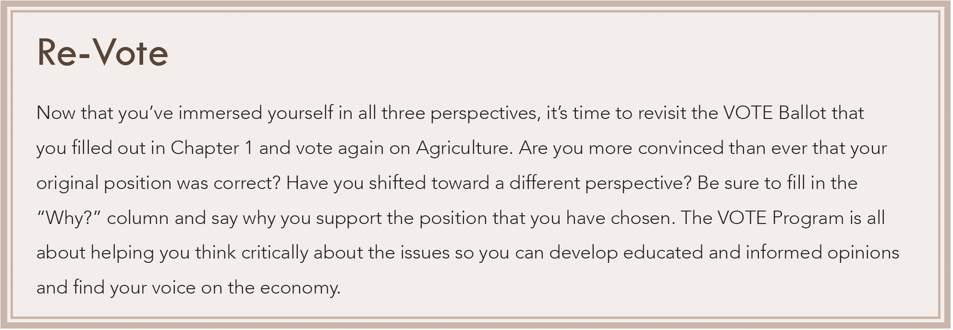
Section: Activity: Debate
Agriculture: Re-Vote
From The VOTE Textbook Second Edition Copyright © 2023
Notes:
Michael – This is a screenshot, but I think it looks okay. You?

Slide 31

Chapter 8
Check out the book for more!
Test Yourself • Key Terms • Answer Key
From The VOTE Textbook Second Edition Copyright © 2023

