Slide 1

From The VOTE Textbook Second Edition Copyright © 2023

Slide 2


From The VOTE Textbook Second Edition Copyright © 2023
Notes:
2

Slide 3
From The VOTE Textbook Second Edition Copyright © 2023
Notes:
3

Slide 4
The VOTE Textbook Chapters
From The VOTE Textbook Second Edition Copyright © 2023
Notes:
4

Slide 5
1
2
3
4
5
6
7
8
9
10
11
12
13
14
15
16
17
18
19
20
21
From The VOTE Textbook Second Edition Copyright © 2023
Notes:
5

Slide 6

From The VOTE Textbook Second Edition Copyright © 2023

Slide 7

Opening story: Island of cannibals
Here is a popular joke about economists:
A traveler visits an island inhabited by cannibals. He sees a butcher shop that specializes in human brains. The sign in the window reads:
The traveler says, ”Wow! Those economists' brains must be popular!" To which the butcher replies, "Are you kidding? Do you have any idea how many economists you have to kill to get a pound of brains?!"
From The VOTE Textbook Second Edition Copyright © 2023
Notes:
7

Slide 8
Opening story: Island of cannibals, cont’d
The VOTE Program analyzes this joke from different perspectives.
A shopper blames the shop owner for cornering the market and jacking up the prices.
The shop owner blames the high cost of economist brains and the reality of supply and demand.
The apprentice blames the drive for profit and calls for worker ownership.
Which of the above is the liberal? The conservative? The radical?
Liberal: shopper; Conservative: shop owner; Radical: apprentice
We don’t live on an island of cannibals so we can’t have an informed opinion about this debate, but we can start to discuss the economic debates that shape your life. Good news: you already have the foundation you need to get started.
From The VOTE Textbook Second Edition Copyright © 2023
Notes:
8

Slide 9

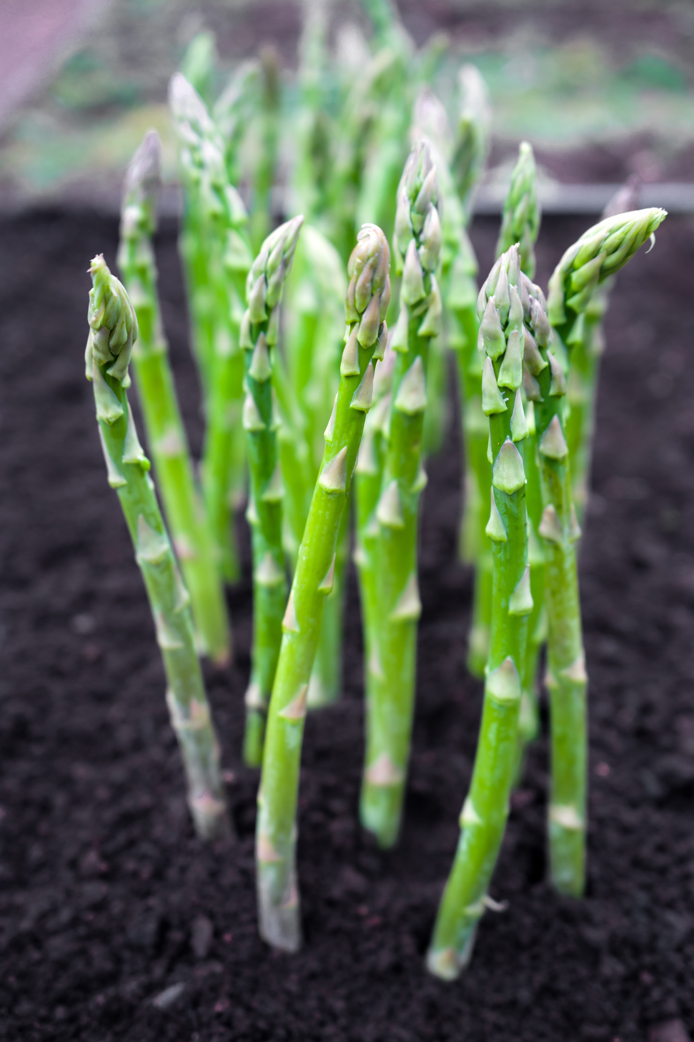
Section: Challenging Stereotypes
Shared Tools
Challenging Stereotypes
for all three perspectives
From The VOTE Textbook Second Edition Copyright © 2023

Slide 10
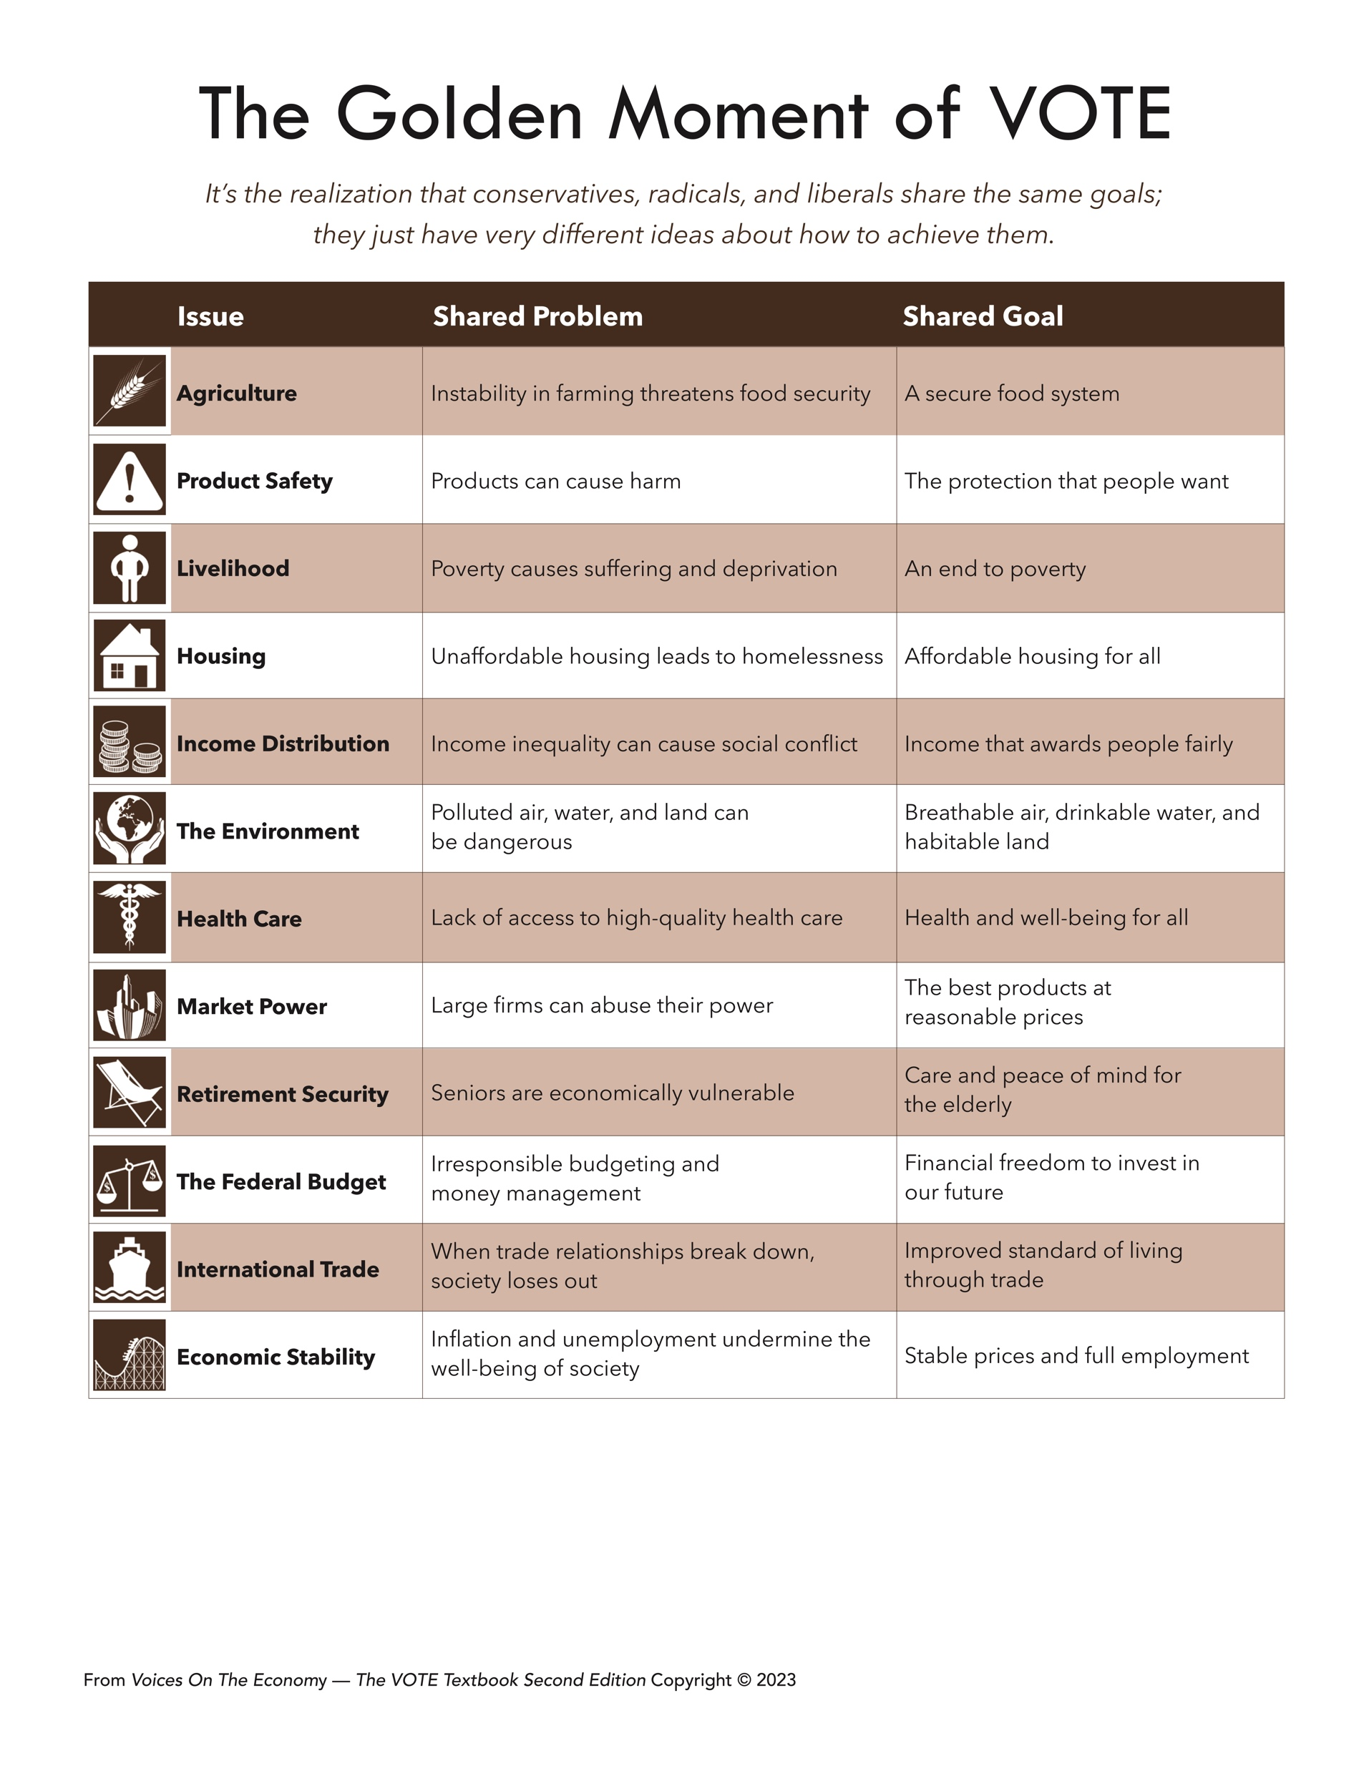
Form: The Golden Moment of VOTE
From The VOTE Textbook Second Edition Copyright © 2023

Slide 11
Section: Challenging Stereotypes, cont’d
The Golden Moment
With the Golden Moment in mind, you can be inspired by different ideas and let that inspiration spark brilliant new solutions!
From The VOTE Textbook Second Edition Copyright © 2023
Notes:
11

Slide 12
Polling Question
The Golden Moment
What is the Golden Moment?
Stereotypes about liberals, conservatives, and radicals are roundly rejected.
Realizing that all perspectives share the same goals; they just have very different ways of achieving them.
There is no agreement among perspectives about economic problems or goals.
Ultimately, all perspectives will come to agreement about how to solve economic problems.
From The VOTE Textbook Second Edition Copyright © 2023

Slide 13
Section: Challenging Stereotypes, cont’d
A stereotype is an oversimplified— and often unflattering—idea about a group of people.
These unfair, insulting, ignorant preconceived notions can be conscious and unconscious.
Not only are we sometimes stereotyped, but we also stereotype others.
“Students have it easy—summers off and holidays!”
”
Unfair!
“Students are lazy!”
Insulting!
“College students get drunk every weekend!”
Ignorant!
From The VOTE Textbook Second Edition Copyright © 2023

Slide 14

Section: Challenging Stereotypes, cont’d
Stereotypes are conversation-stoppers.
Stereotyping is a lazy habit. It makes it impossible to hear other people’s perspectives with an open mind.
Please note: In the VOTE Program, we address economic issues, not social issues.
From The VOTE Textbook Second Edition Copyright © 2023

Slide 15
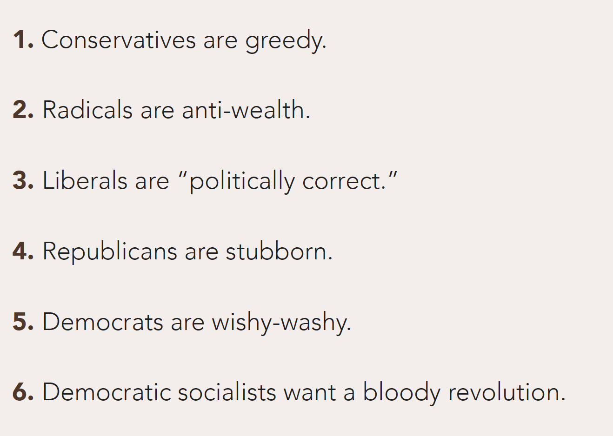

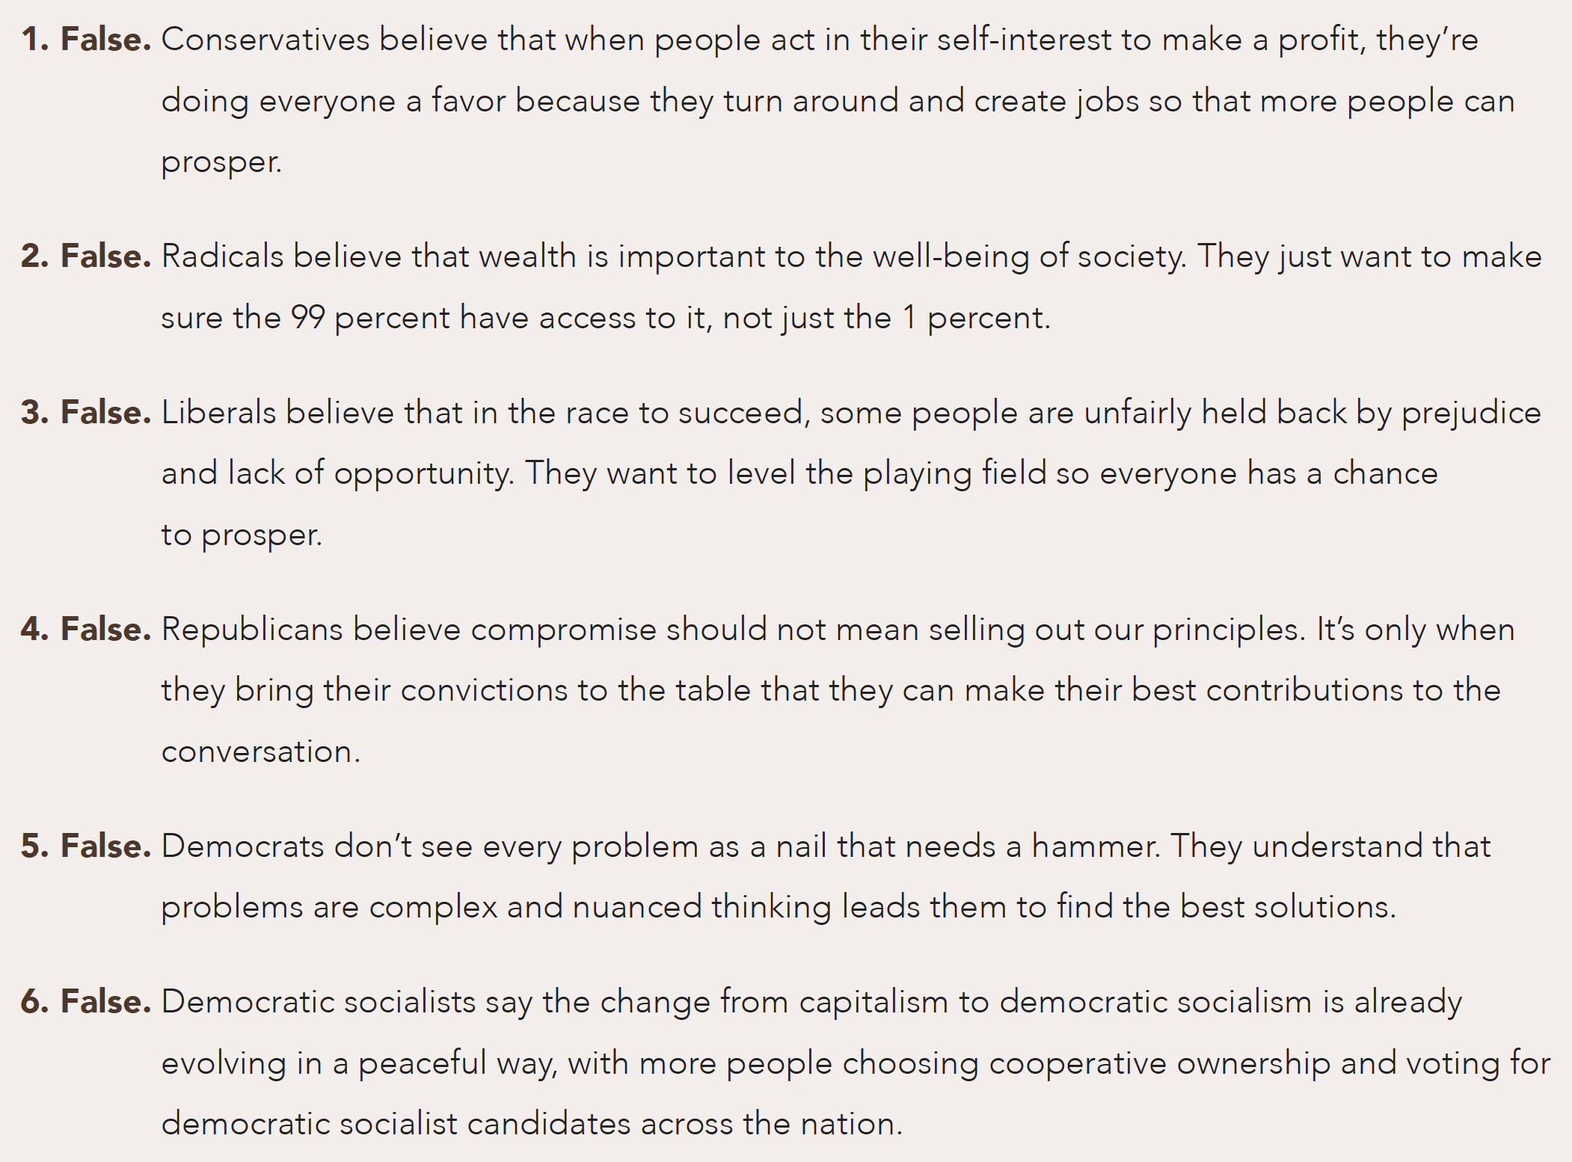
Exercise 7.1: Think Again
Exercise: Think Again
Respond to the following statements with ”True” or “False.”
If false, explain your thinking.
DAILY
DOUBLE
From The VOTE Textbook Second Edition Copyright © 2023

Slide 16
Exercise 7.1: Think Again
Exercise: Think Again, cont’d
Respond to the following statements with ”True” or “False.”
If false, explain your thinking.
From The VOTE Textbook Second Edition Copyright © 2023

Slide 17
Exercise 7.1: Think Again
Exercise: Think Again, cont’d
Respond to the following statements with ”True” or “False.”
If false, explain your thinking.
From The VOTE Textbook Second Edition Copyright © 2023

Slide 18
Exercise 7.1: Think Again
Exercise: Think Again, cont’d
Respond to the following statements with ”True” or “False.”
If false, explain your thinking.
From The VOTE Textbook Second Edition Copyright © 2023

Slide 19
Exercise 7.1: Think Again
Exercise: Think Again, cont’d
Respond to the following statements with ”True” or “False.”
If false, explain your thinking.
From The VOTE Textbook Second Edition Copyright © 2023

Slide 20
Exercise 7.1: Think Again
Exercise: Think Again, cont’d
Respond to the following statements with ”True” or “False.”
If false, explain your thinking.
From The VOTE Textbook Second Edition Copyright © 2023

Slide 21
Section: Challenging Stereotypes, cont’d
These Stereotypes Are ALL False
Conservatives are greedy and heartless.
Liberals believe the solution to all problems is a government handout.
Radicals are a bunch of idealistic hippies.
Democrats are the party of the elite and the wishy-washy.
Democratic Socialists are anti-wealth.
Republicans are the party of the rich.
Radicals want to pay an uneducated janitor the same as an inventor with a PhD.
Conservatives want to pretend everyone has an equal chance to succeed.
Liberals are “politically correct.”
Liberals are antibusiness.
Radicals want a revolution.
Conservatives are stubborn and pigheaded.
From The VOTE Textbook Second Edition Copyright © 2023

Slide 22
Section: Conventional Theory Tools
Conventional Theory Tools
(Conservative and Liberal)
Equilibrium and Social Welfare
* These tools are built on the foundation presented in Chapter 5.
From The VOTE Textbook Second Edition Copyright © 2023

Slide 23
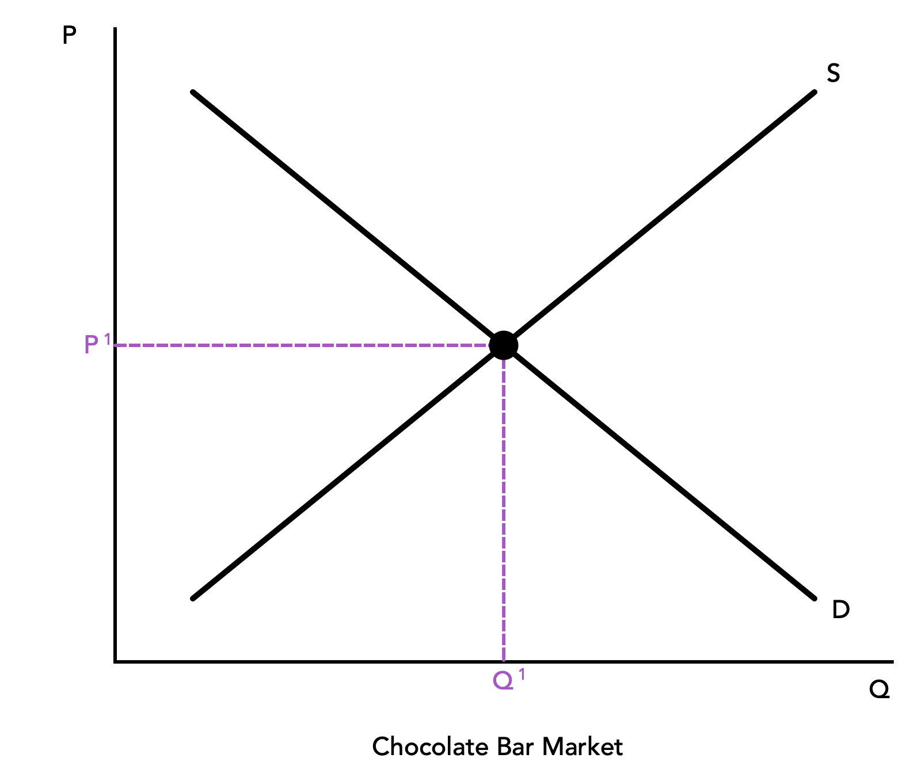
Section: Conventional Theory Tools, cont’d
  Practice: Draw the six components of the Asparagus Market
  graph.
(1)
(4)
(5)
(3)
(2)
(6)
Asparagus Market
From The VOTE Textbook Second Edition Copyright © 2023

Slide 24
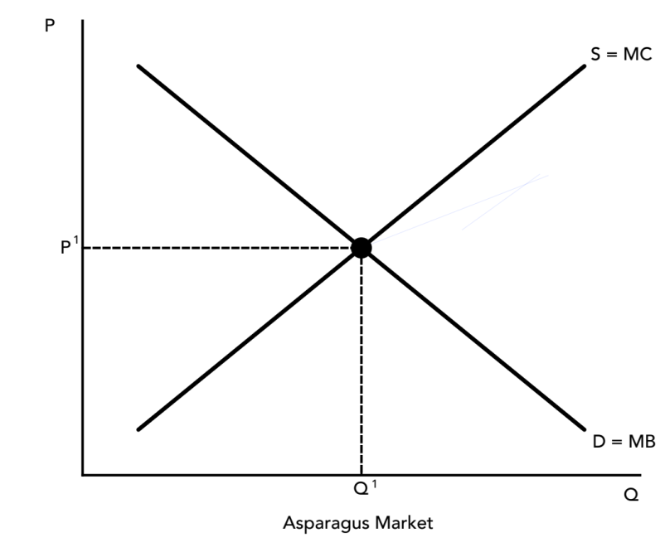


Section: Conventional Theory Tools, cont’d
Q. Why is equilibrium so important?
A. Because it shows us where we maximize our social welfare.
1st explanation:
At equilibrium, Marginal Benefit (MB) = Marginal Cost (MC)
MC = MB
↓
MC < MB
MC > MB
From The VOTE Textbook Second Edition Copyright © 2023

Slide 25
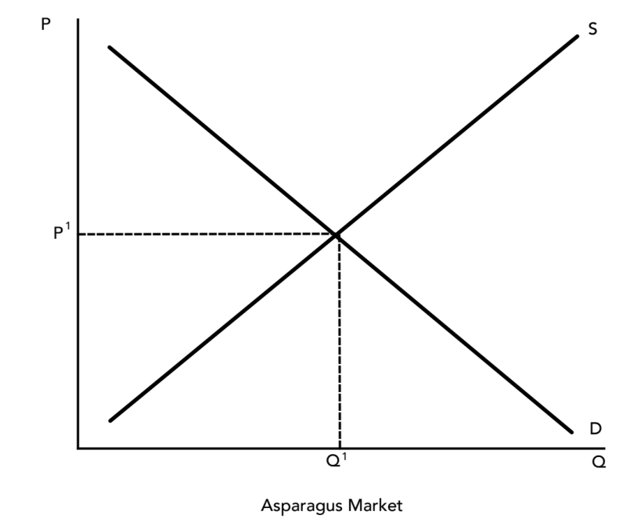
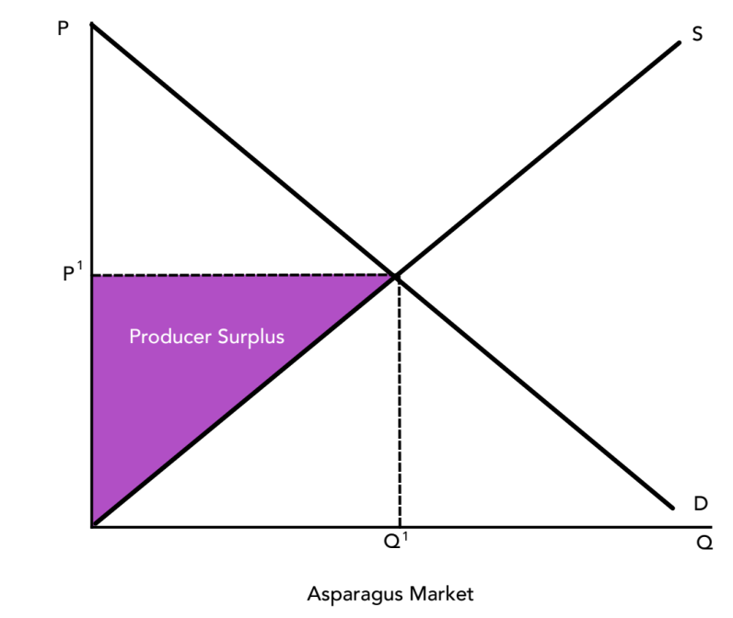
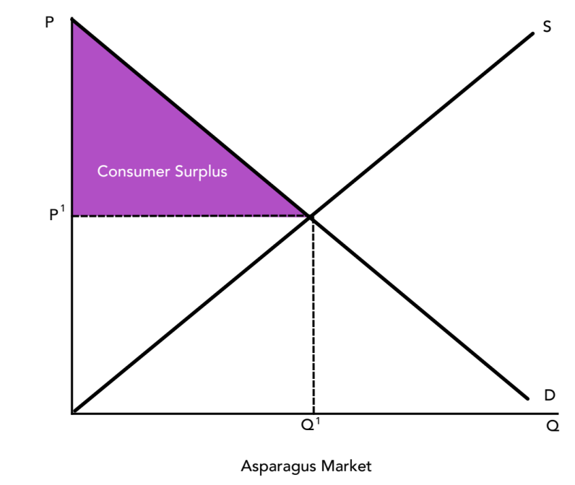
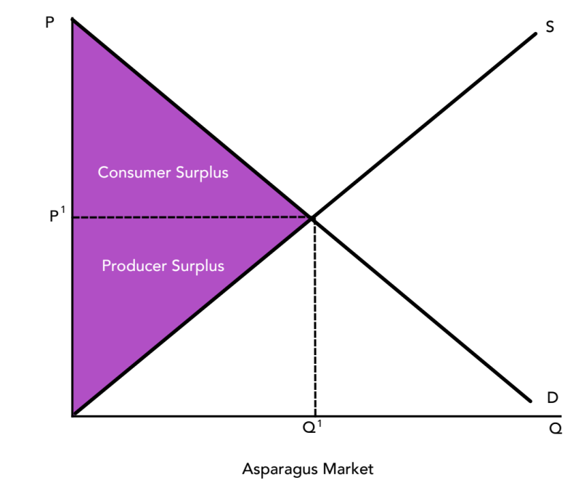
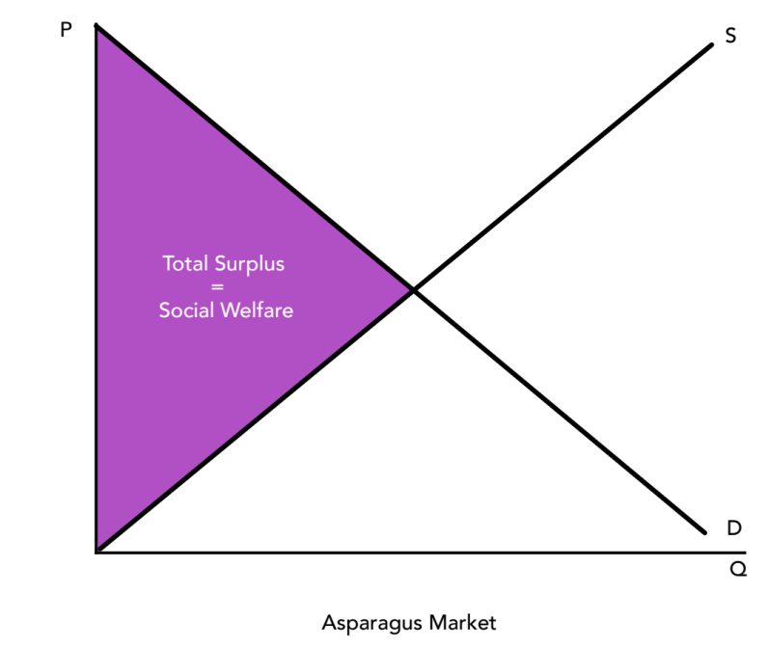
Section: Conventional Theory Tools, cont’d
Q. Why is equilibrium so important?
A. Because it shows us where we maximize our social welfare.
2nd explanation:
At equilibrium, Total Surplus is maximized
From The VOTE Textbook Second Edition Copyright © 2023

Slide 26
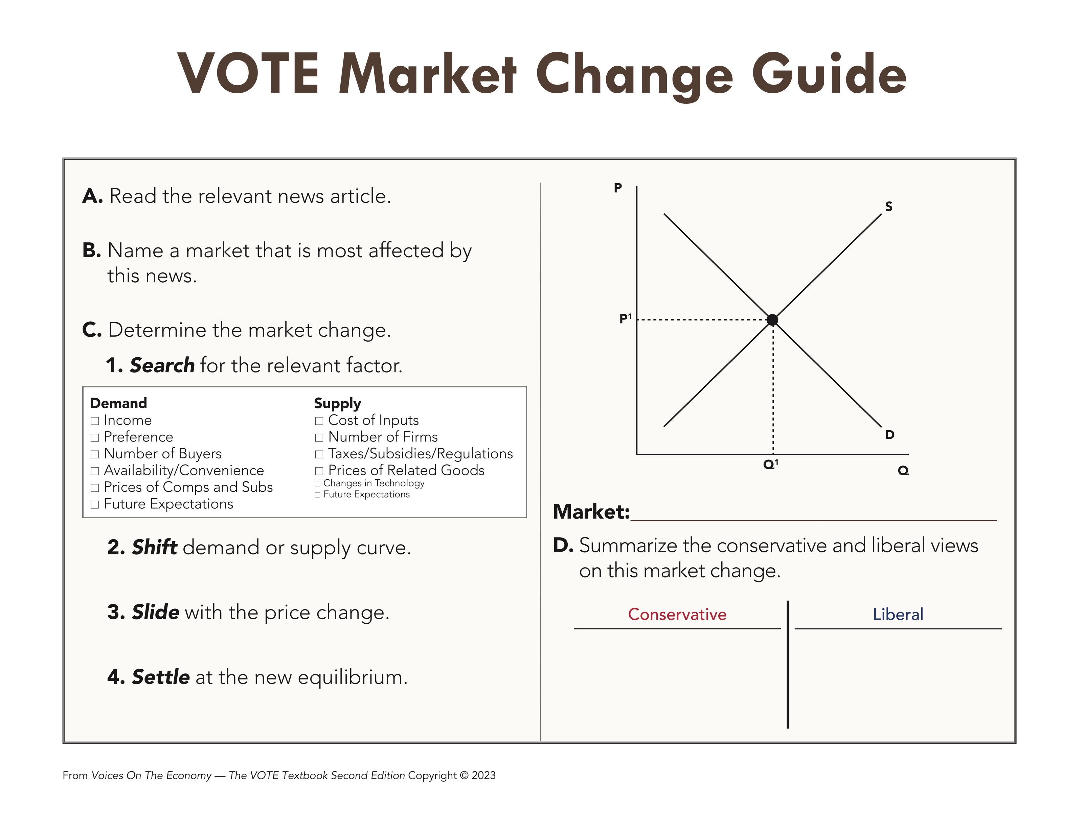
Section: Conventional Theory Tools, cont’d
New state law affects asparagus farmers
Practice!
The state passed new requirements for asparagus farmers yesterday. They must register the names of the pesticides they use on fields located near schools. In addition, those farmers must submit soil samples on a quarterly basis to certified independent labs to ensure that toxicity levels don't pose a threat to the community.
From The VOTE Textbook Second Edition Copyright © 2023

Slide 27
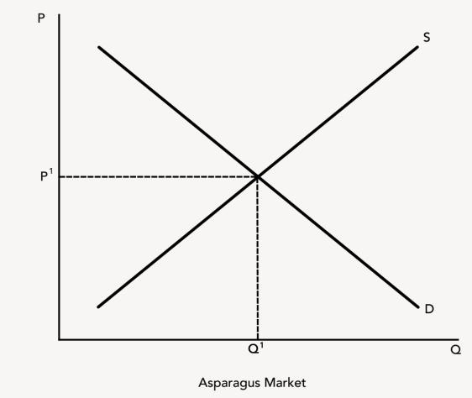
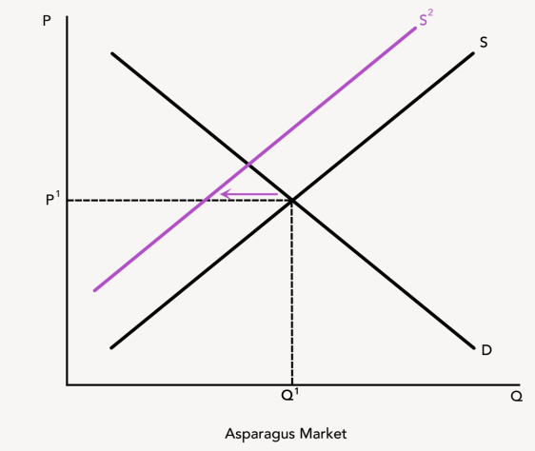
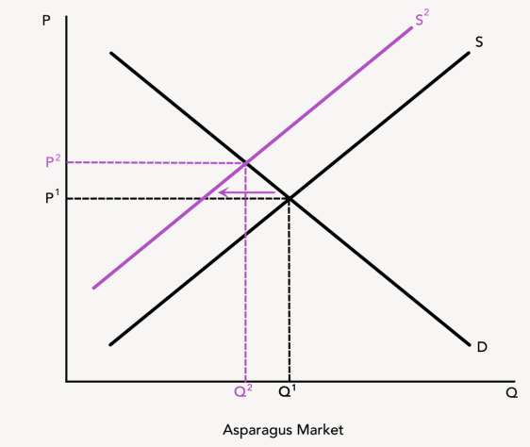
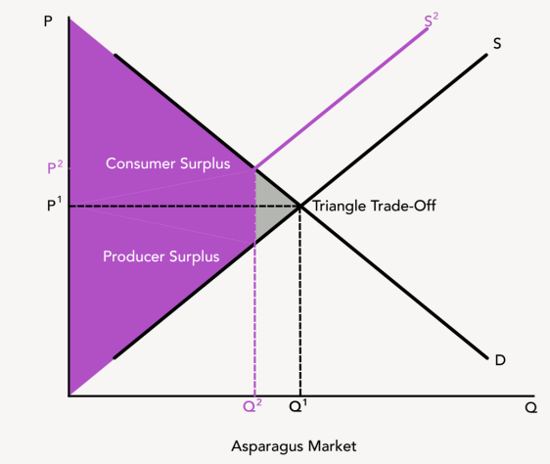
Section: Conventional Theory Tools, cont’d
X
  Asparagus Market
  Supply Shifts Left
  QD > QS, Shortage, P tends ↑
  Government interference hurts society.
  Government intervention helps society.
  New Eq. P ↑, New Eq. Q ↓
  Conservative Triangle Trade-Off:
  “Efficiency Loss” ( aka Deadweight Loss”)
  Liberal Triangle Trade-Off:
  “Equity Gain”
From The VOTE Textbook Second Edition Copyright © 2023

Slide 28
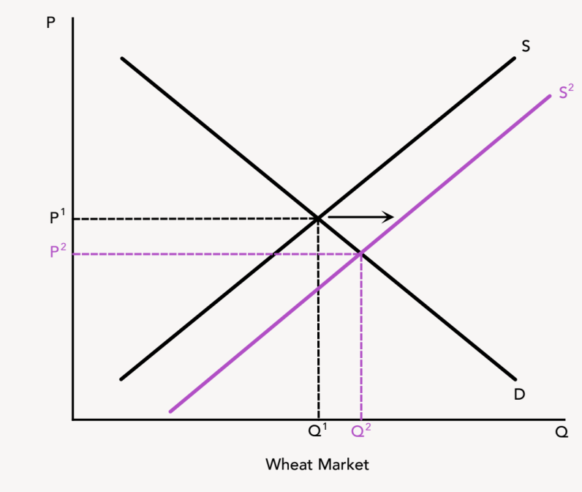
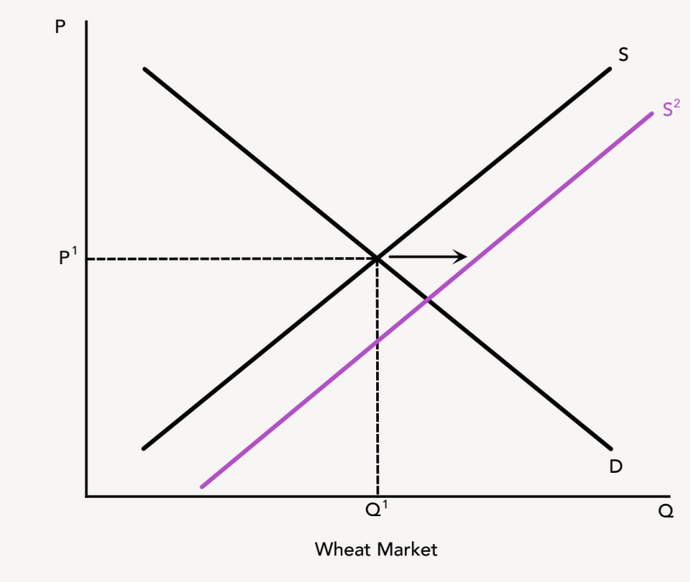
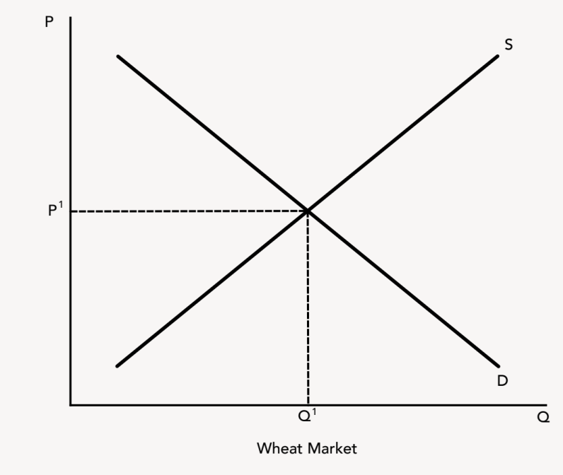
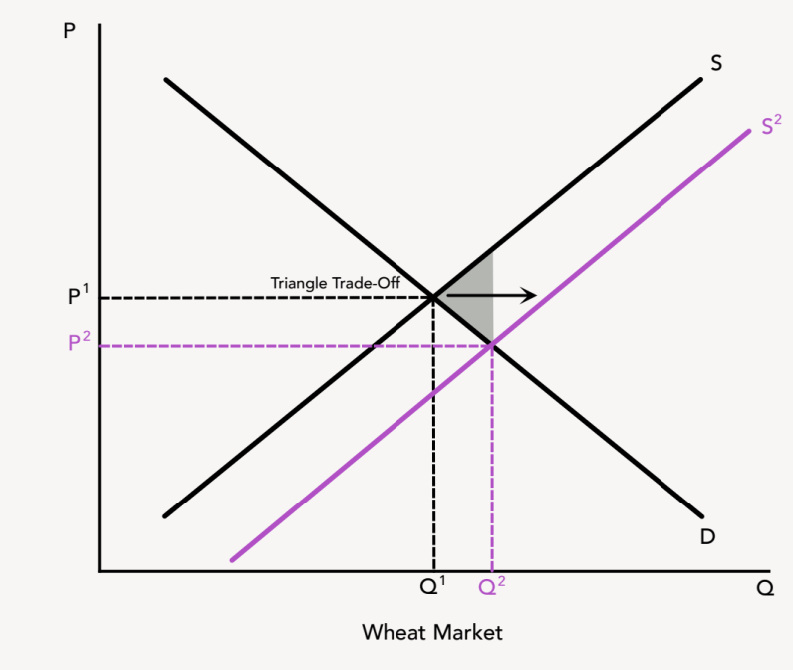
Section: Conventional Theory Tools, cont’d
Agricultural Subsidies
Financial support given by the government to producers of agricultural products.
Liberal
YES!
Government intervention helps society.
Triangle trade-off: equity gain
With subsidies, the problem of food insecurity will be fixed.
Conservative
NO!
Government interference hurts society.
Triangle trade-off: efficiency loss
(aka deadweight loss)
Left alone, the problem of food insecurity will self-correct.
From The VOTE Textbook Second Edition Copyright © 2023

Slide 29
Section: Conventional Theory Tools, cont’d
Agriculture Policies
Liberal
Conservative
Liberals want
agricultural subsidies.
Conservatives want unfettered price signals.
From The VOTE Textbook Second Edition Copyright © 2023

Slide 30
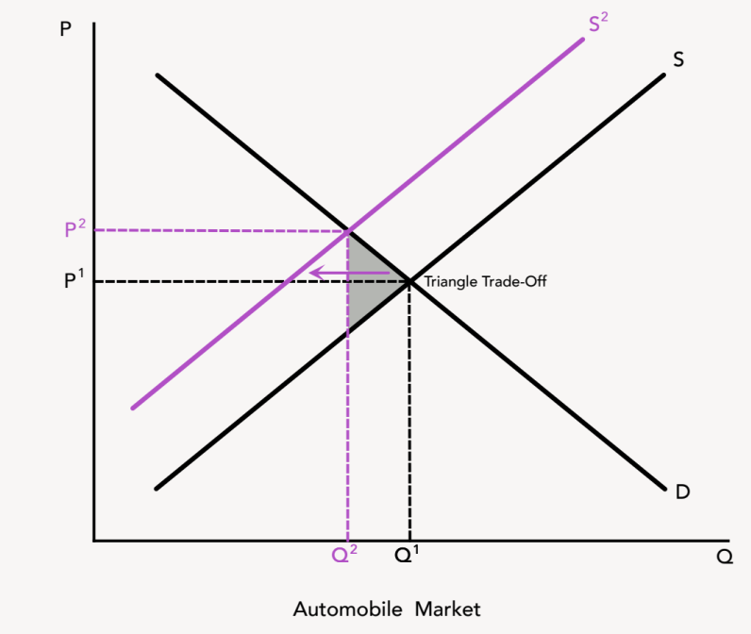
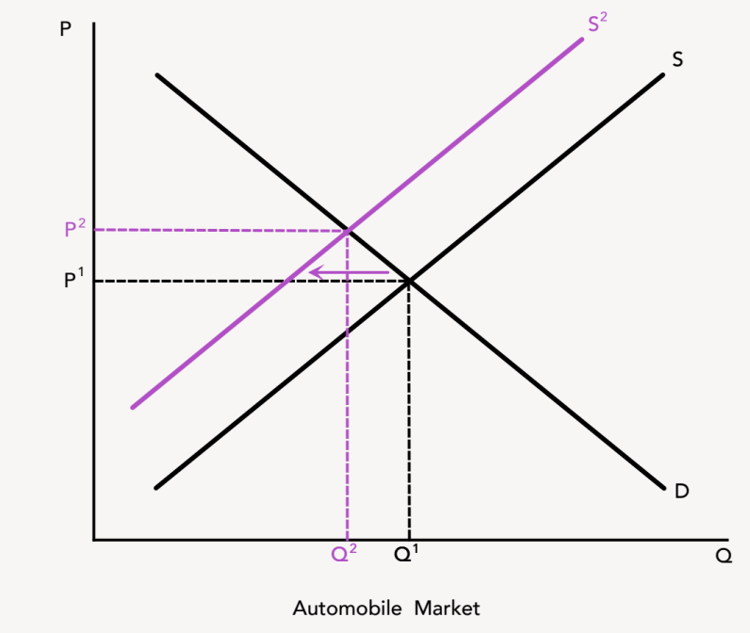
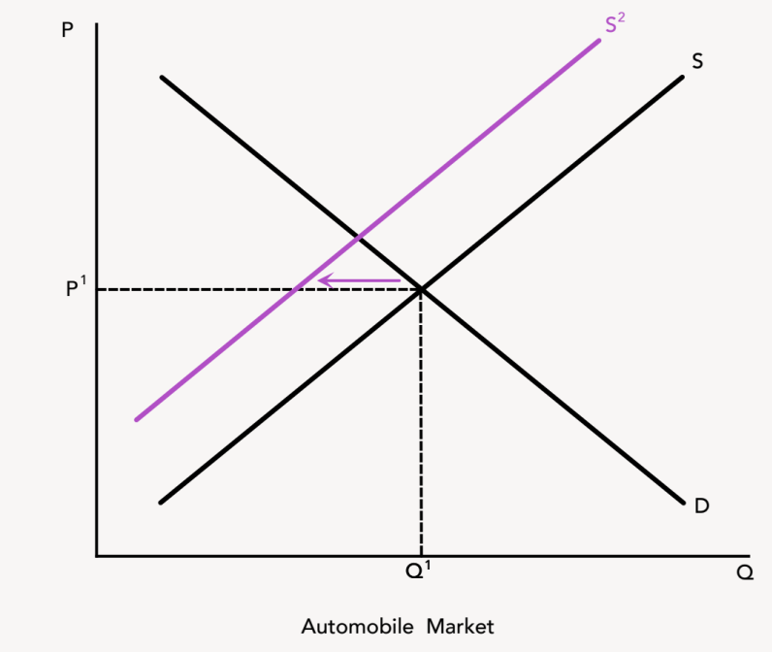
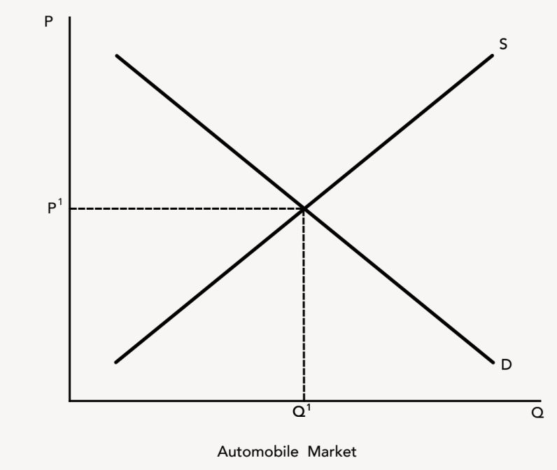
Section: Conventional Theory Tools, cont’d
Product Safety Regulations
Standards that lawmakers believe firms must follow to prevent risks to consumers at all levels of production and distribution.
Conservative
NO!
Government interference hurts society.
Triangle trade-off: efficiency loss
(aka deadweight loss)
Left alone, the problem of unsafe products will self-correct.
Liberal
YES!
Government intervention helps society.
Triangle trade-off: equity gain
With regulations, the problem of unsafe products will be fixed.
From The VOTE Textbook Second Edition Copyright © 2023

Slide 31
Section: Conventional Theory Tools, cont’d
Product Safety Policies
Conservative
Liberal
Conservatives want
unfettered price signals.
Liberals want
product safety regulations.
From The VOTE Textbook Second Edition Copyright © 2023

Slide 32
Section: Radical Theory Tools
Radical Theory Tools
Top-Down Governance and Participatory Governance
* These tools are built on the foundation presented in Chapter 6.
From The VOTE Textbook Second Edition Copyright © 2023

Slide 33
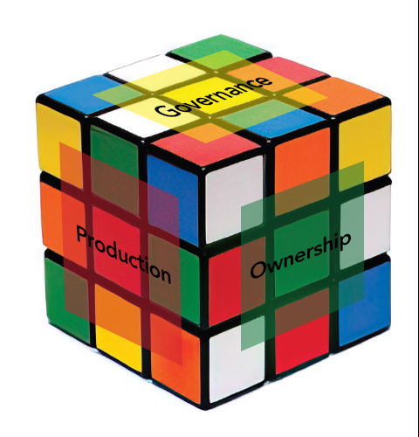
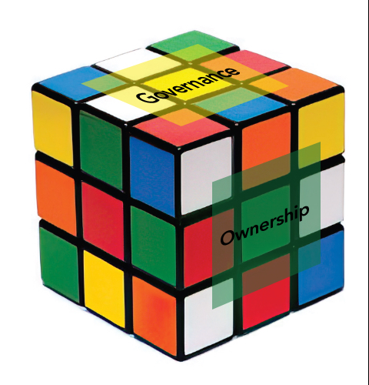
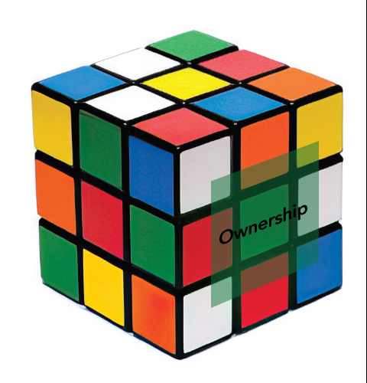

Section: Building Radical Theory in Two Parts, cont’d
Practice: Write the names of the six core points of economic
systems.
        Ownership
        Governance
        Meeting people’s
        material needs
        Production
        Sustainability
        Communities
(1)
(2)
(3)
(4)
(5)
(6)
The Six-Core Cube
of Every Economic System
From The VOTE Textbook Second Edition Copyright © 2023

Slide 34

Section: Radical Theory Tools, cont’d
Radicals use the six core points as tools to analyze economic issues. Each core point is like a portal that allows us to drill down into an aspect of the economic system and analyze the issue from that angle. Radicals select the core point that makes the most sense for a particular issue. But please remember that there is no "right" core point. They are all relevant.
For agriculture and product safety, we use the core point of governance.
        Ownership
        Governance
        Meeting people’s basic material needs
        Production
        Sustainability
        Communities
From The VOTE Textbook Second Edition Copyright © 2023

Slide 35
Section: Radical Theory Tools, cont’d
Agriculture and Product Safety
Radical Tools, Part 1:
Drill down into governance in capitalism
Radical Tools, Part 2:
Drill down into governance in democratic socialism
The Six-Core Cube
of Every Economic System
From The VOTE Textbook Second Edition Copyright © 2023

Slide 36
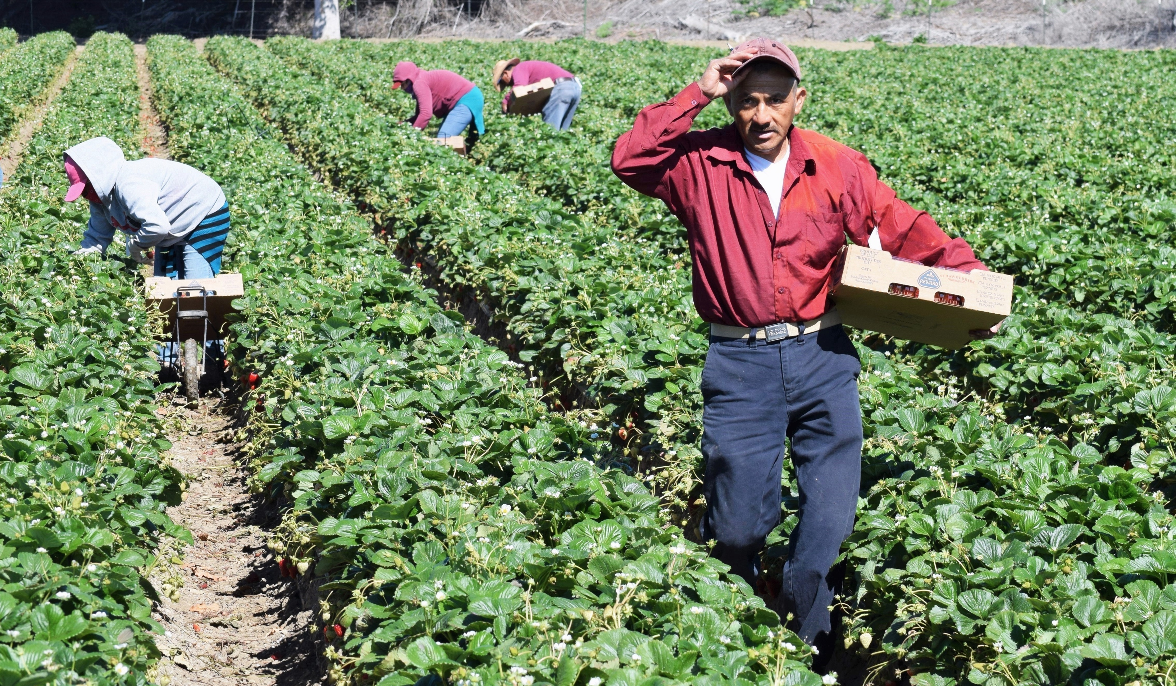
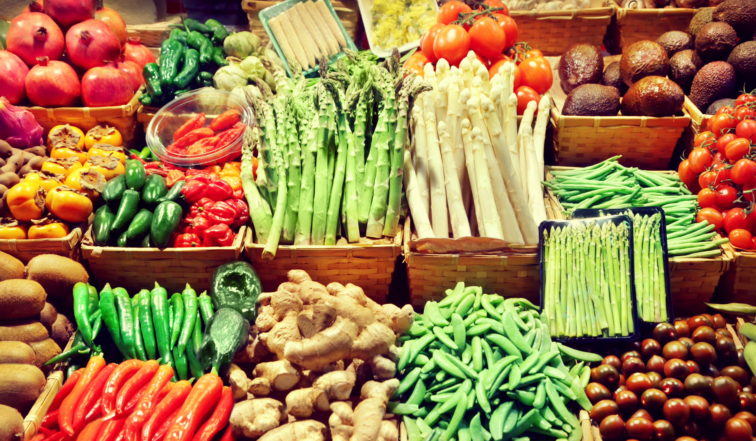
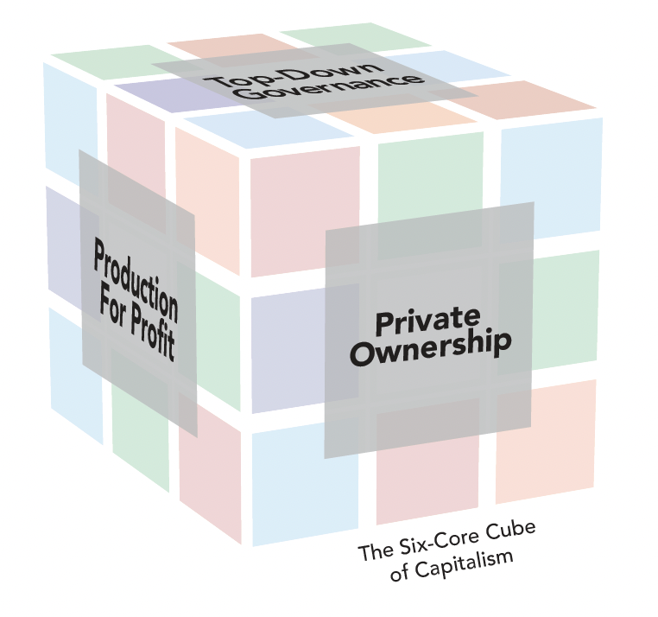
Section: Radical Theory Tools, cont’d
Workplace Exploitation
+
Capitalist Competition
The Pressure for Bad
leads to
The Visible Suffering
… and is represented by the Six-Core Cube of capitalism, which can never be solved.
From The VOTE Textbook Second Edition Copyright © 2023

Slide 37
Section: Radical Theory Tools, cont’d
The Unsolvable
Six-Core Cube of Capitalism
        Private Ownership
        Top-Down Governance
        Individuals at Risk
        Production for Profit
        Unsustainable Growth
        Unhealthy Communities
Why unsolvable?
It is built around six core points that are rotten to the core!
Top-Down Governance: decision-making is left in the hands of a few elected officials and bureaucrats, and people don’t have a real say.
From The VOTE Textbook Second Edition Copyright © 2023

Slide 38
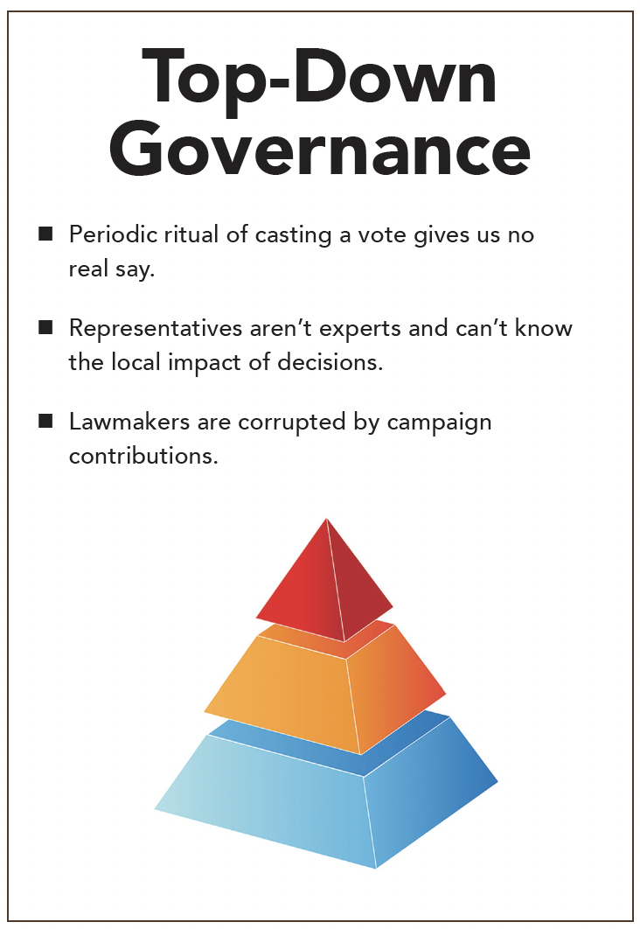

Section: Radical Theory Tools, cont’d
From The VOTE Textbook Second Edition Copyright © 2023

Slide 39
Section: Radical Theory Tools, cont’d
Top-Down Governance
Competitor #1:
“Citrus growers hired a lobbyist to go to D.C. and get government subsidies. We ought to hire a lobbyist and get ourselves subsidies, too.”
Owner:
Competitor:
Owner:
“I don’t want to be a part of…”
“So don’t do it.”
“But if I don’t do it and you do,
I won’t survive.”
“We’re spraying our fields with that new questionable
pesticide, but the government is threatening to regulate it. Let’s pay off politicians to get exemptions for our industry.”
Competitor #2:
"So don’t do it.”
Competitor #3:
“We’re taking the tax breaks government is offering to plow up our crops and switch to growing biofuels. Yes, the price of food will skyrocket, but our firm will make a bundle.”
“So don’t do it.”
PRESSURE FOR BAD
From The VOTE Textbook Second Edition Copyright © 2023

Slide 40
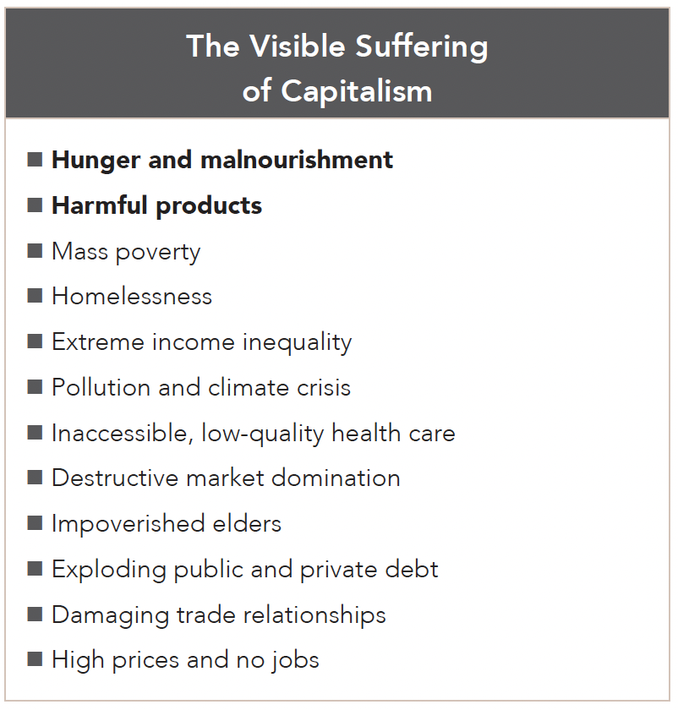
Section: Radical Theory Tools, cont’d
From The VOTE Textbook Second Edition Copyright © 2023

Slide 41
Section: Radical Theory Tools, cont’d
Agriculture and Product Safety
Radical Tools, Part 1:
Drill down into governance in capitalism
Radical Tools, Part 2:
Drill down into governance in democratic socialism
The Six-Core Cube
of Every Economic System
From The VOTE Textbook Second Edition Copyright © 2023

Slide 42

Section: Radical Theory Tools, cont’d
Workplace Justice
Coordination Among Competitors
The Pressure for Good leads to
The Invisible Synergy
+
…and is represented by the Six-Core Cube of democratic socialism, which can be solved.
From The VOTE Textbook Second Edition Copyright © 2023

Slide 43
Section: Radical Theory Tools, cont’d
The Solvable
Six-Core Cube of Democratic Socialism
        Cooperative Ownership
        Participatory Governance
        Social Safeguards
        Production for Use
        Sustainable Development
        Healthy Communities
Cooperative Ownership
Why solvable?
It is built around six core points that are beneficial to the core!
Participatory Governance: decisions are made by community councils of diverse stakeholders who represent our collective best interests.
From The VOTE Textbook Second Edition Copyright © 2023

Slide 44
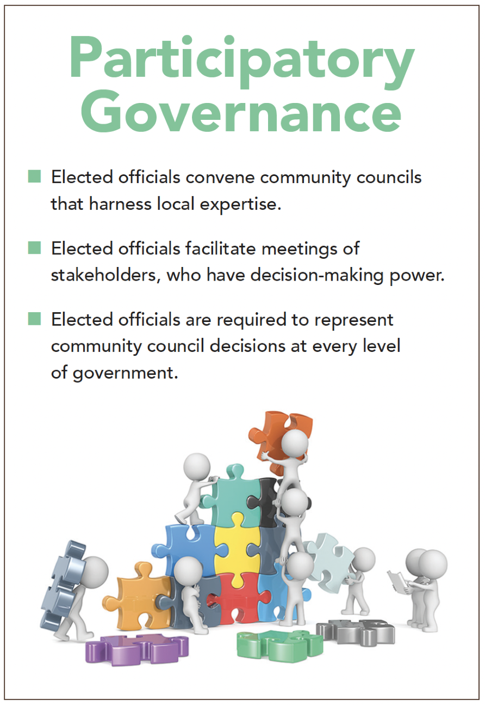
Section: Radical Theory Tools, cont’d
From The VOTE Textbook Second Edition Copyright © 2023

Slide 45
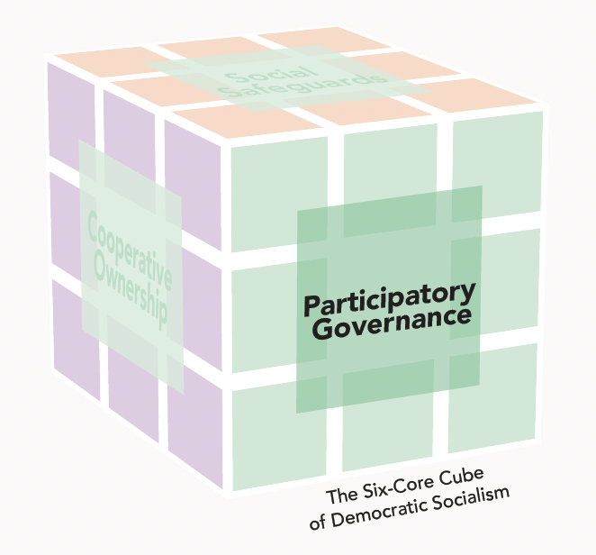
Section: Radical Theory Tools, cont’d
Agriculture and Product Safety Policies:
Radical
Agriculture
Food Security Councils
Policy example: Emergency and Innovation Funds
Government support to help farmers prepare for, respond to, and adapt to instability in agriculture.
Product Safety
Product Safety Councils
Policy example: Hazard Assessment Protocols
Government support to reduce the risks of dangerous flaws in product design, manufacture, and use.
From The VOTE Textbook Second Edition Copyright © 2023

Slide 46
Section: Radical Theory Tools, cont’d
Participatory Governance
Competitor #1:
“There is a proposal to use a portion of the Emergency and Innovation Fund to develop drought-resistant seeds and better irrigation methods.”
Owner:
Competitor:
Owner:
“That’s a great idea…“
“You should do it!“
“I’ll definitely propose
it to my co-owners.“
“Our pesticide is going through hazard assessment because it is a suspected carcinogen. Even though it will cost more, we won’t use it until we get the results.”
Competitor #2:
“You should do it.”
Competitor #3:
“Our local food security council is offering subsidies to all farms that set aside a portion of land for renewable energy. Our firm has signed up.”
“You should do it.”
PRESSURE FOR GOOD
From The VOTE Textbook Second Edition Copyright © 2023

Slide 47
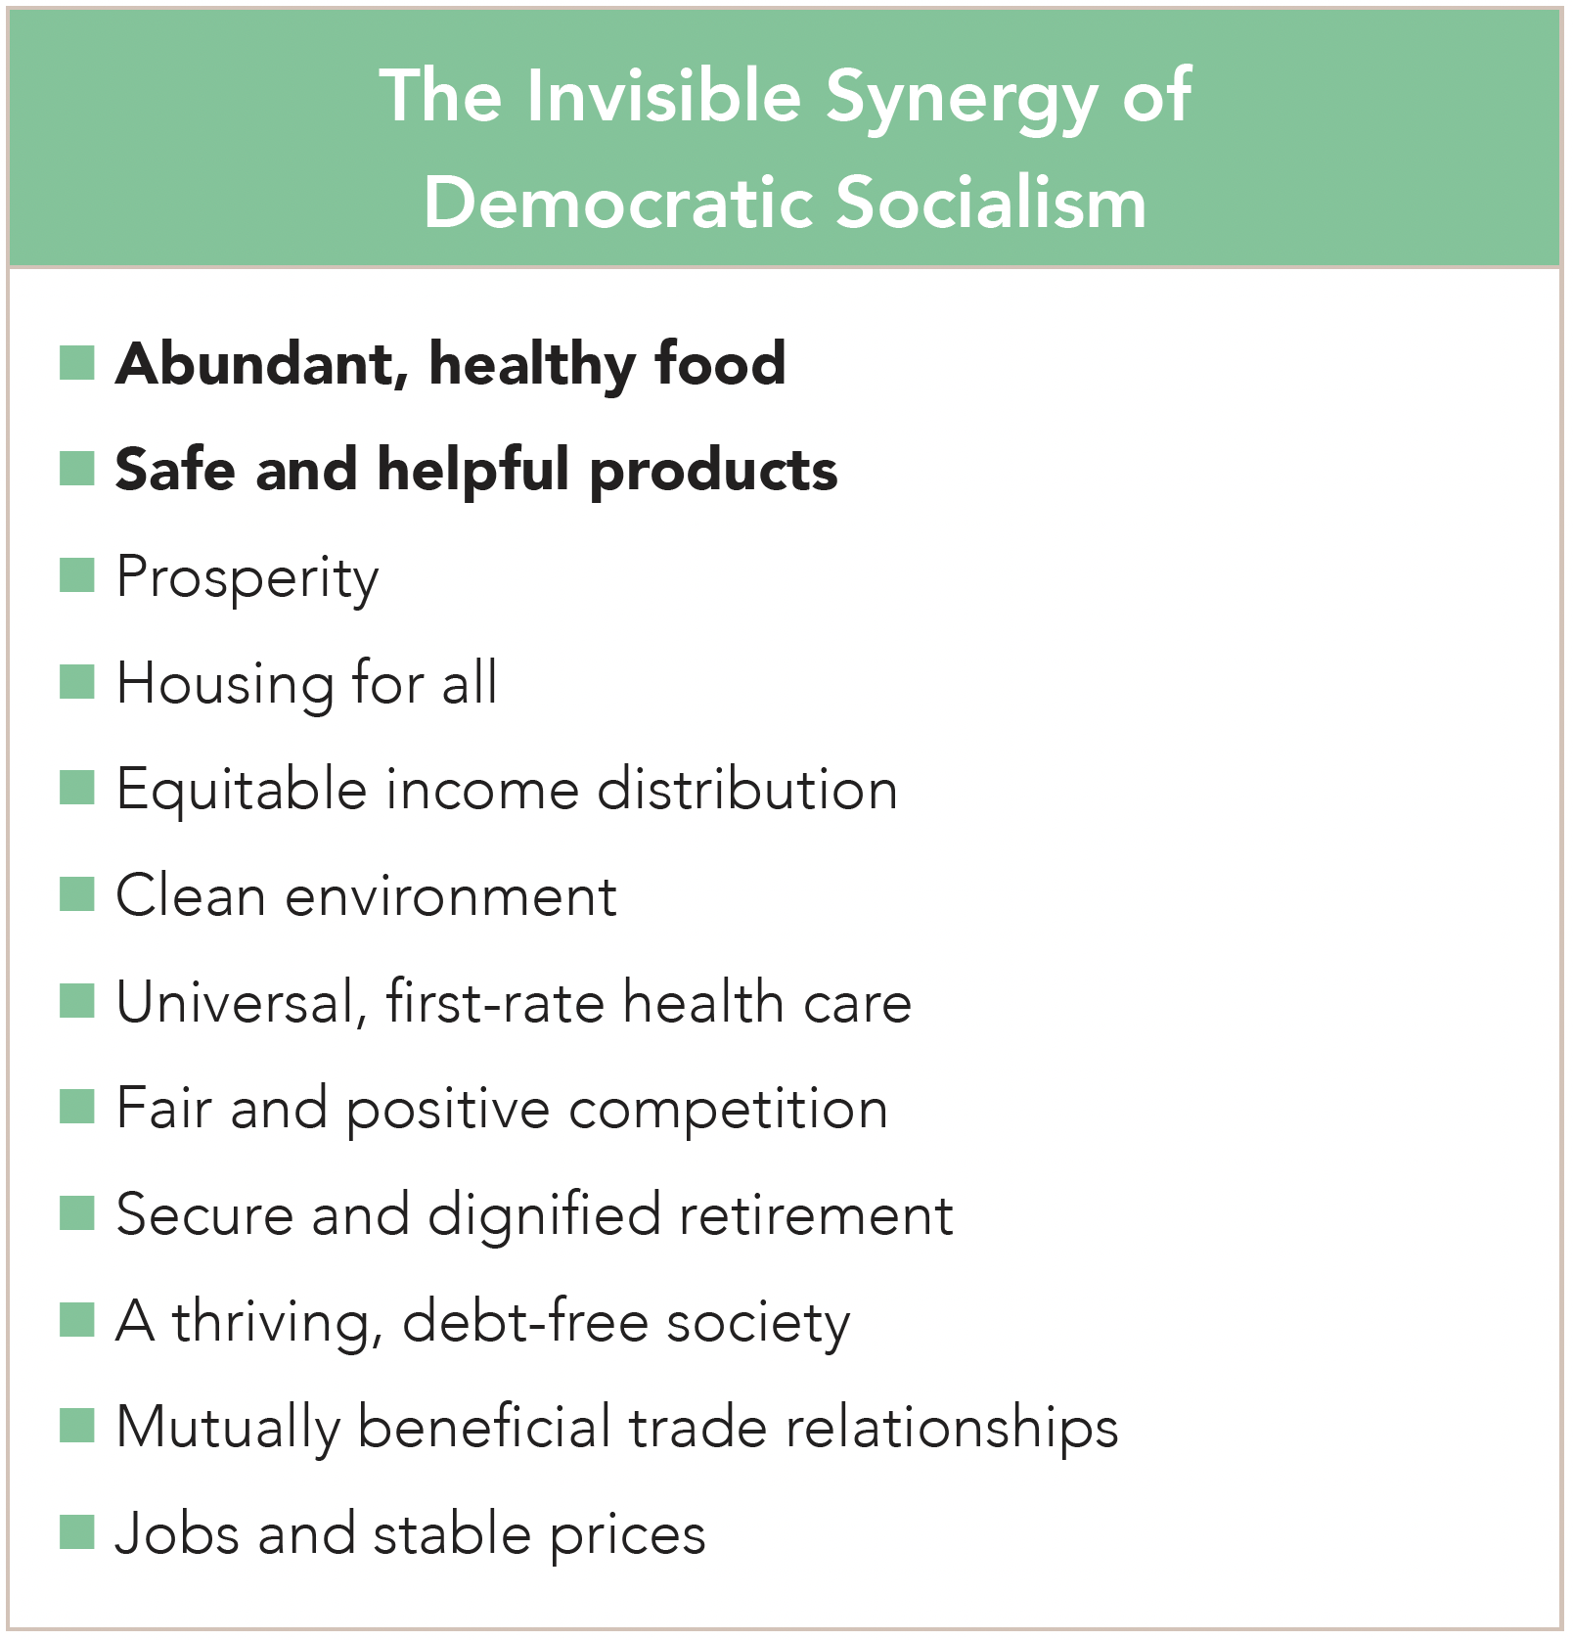
Section: Radical Theory Tools, cont’d
From The VOTE Textbook Second Edition Copyright © 2023

Slide 48
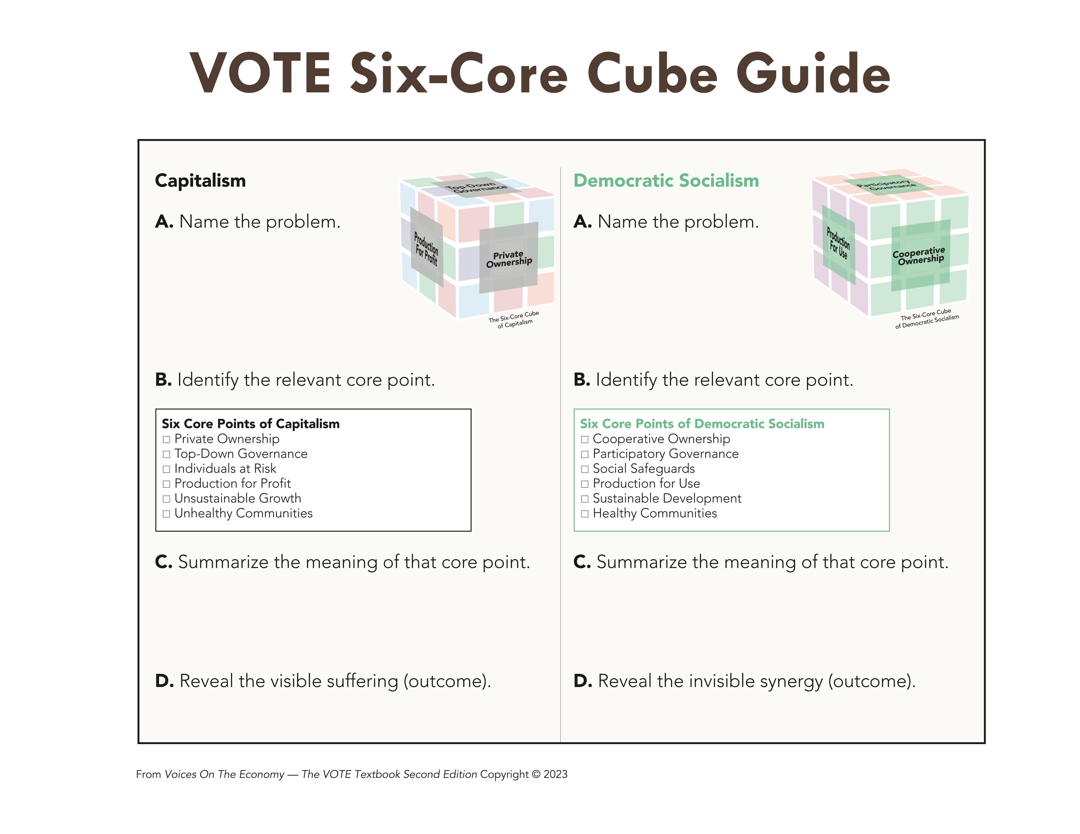
Section: Radical Theory Tools, cont’d
New state law affects asparagus farmers
The state passed new requirements for asparagus farmers yesterday. They must register the names of the pesticides they use on fields located near schools. In addition, those farmers must submit soil samples on a quarterly basis to certified independent labs to ensure that toxicity levels don't pose a threat to the community.
Practice!
From The VOTE Textbook Second Edition Copyright © 2023

Slide 49
Section: Radical Theory Tools, cont’d
  Pesticides could
  ham children
  Pesticides could
  harm children
X
X
  Decision-making is left in the hands of a few elected officials and bureaucrats, and people don’t have a real say.
  Decisions are made by community councils, of diverse stakeholders who represent our collective best interests.
  Hunger and malnourishment
  Harmful products
  Abundant, healthy food
  Safe and helpful products
From The VOTE Textbook Second Edition Copyright © 2023

Slide 50
THE BLAME GAME
What causes food insecurity and unsafe products?
Conservative
Liberal
Radical
From The VOTE Textbook Second Edition Copyright © 2023

Slide 51
Polling Question
The Blame Game
What causes food insecurity and unsafe products? Choose all that apply.
Conservatives: “Too much government interference in capitalism.”
Liberals: “Not enough government intervention in capitalism.”
Radicals: “The drive for profit in capitalism.”
From The VOTE Textbook Second Edition Copyright © 2023

Slide 52
THE BLAME GAME
What causes food insecurity and unsafe products?
Conservative
Liberal
Radical
Too much government interference
in capitalism
We need
free-market capitalism.
Not enough government intervention
in capitalism
We need
fair-market capitalism.
The drive for profit in capitalism
We need
democratic socialism.
From The VOTE Textbook Second Edition Copyright © 2023

Slide 53
The VOTE Jingle
Conservatives say,
“Government, NO! Free markets let prosperity flow.”
Liberals say,
“Government’s a GO! Fair markets make the economy grow.”
Radicals say,
“Capitalism, WHOA! Democratic socialism is the way to go.”
From The VOTE Textbook Second Edition Copyright © 2023

Slide 54

Chapter 7
Check out the book for more!
Test Yourself • Key Terms • Answer Key
From The VOTE Textbook Second Edition Copyright © 2023

