Slide 1

From The VOTE Textbook Second Edition Copyright © 2023

Slide 2


From The VOTE Textbook Second Edition Copyright © 2023
Notes:
2

Slide 3
From The VOTE Textbook Second Edition Copyright © 2023
Notes:
3

Slide 4
The VOTE Textbook Chapters
From The VOTE Textbook Second Edition Copyright © 2023
Notes:
4

Slide 5
1
2
3
4
5
6
7
8
9
10
11
12
13
14
15
16
17
18
19
20
21
From The VOTE Textbook Second Edition Copyright © 2023
Notes:
5

Slide 6

From The VOTE Textbook Second Edition Copyright © 2023

Slide 7
Opening story: Micah White and Occupy Wall Street
In 2011, in the wake of the Great Recession, the economy was in tatters. While millions of middle-class people lost their homes and businesses, the government bailed out some of those very firms that had caused the collapse. Activists camped out in public spaces across the nation to protest the economic system of capitalism. The motto of the Occupy movement was: “We are the 99%.”
From The VOTE Textbook Second Edition Copyright © 2023

Slide 8

Note: We present each perspective as if we wholeheartedly agree with it. We do this on purpose to present each point of view in its best light, but please imagine each time that we are wearing a mask—as if we are actors playing three different roles.
From The VOTE Textbook Second Edition Copyright © 2023

Slide 9
Section: Factories Without Bosses
The Occupy movement ended when police were ordered to break up the encampments. Many think that this was the spark that lit democratic socialist Bernie Sanders’ run for president in 2016 and 2020 and explained his popularity with young people.
A decade earlier, Argentina's economy had collapsed, but their recession had a very different outcome: wage laborers took over the shuttered factories and turned them into worker-owned co-ops. One of the leading companies, Zanon Ceramics, was renamed FaSinPat, which stands for “factories without bosses.”
From The VOTE Textbook Second Edition Copyright © 2023

Slide 10
Section: Cooperative Ownership in Democratic Socialism
Types of Ownership in Democratic Socialism
Public
Community
Nonprofit
Cooperative
From The VOTE Textbook Second Edition Copyright © 2023

Slide 11

Section: Cooperative Ownership in Democratic Socialism, cont’d
What is Cooperative Ownership?
Cooperatives (co-ops, for short) are jointly owned and democratically run enterprises.
From The VOTE Textbook Second Edition Copyright © 2023

Slide 12
Section: Cooperative Ownership in Democratic Socialism, cont’d
Four Types of Co-ops
Worker-Owned
Workers own the firm.
From The VOTE Textbook Second Edition Copyright © 2023

Slide 13



Section: Cooperative Ownership in Democratic Socialism, cont’d
Examples of
Worker-Owned Co-ops
Bakery
Multinational Cooperative: Finance, Retail, & More
Medical Emergency Transportation
W. W. Norton & Company
Books
Supermarket
From The VOTE Textbook Second Edition Copyright © 2023

Slide 14
Section: Cooperative Ownership in Democratic Socialism, cont’d
Four Types of Co-ops
Worker
Workers own the firm.
Consumer
Customers own the company.
From The VOTE Textbook Second Edition Copyright © 2023

Slide 15






Section: Cooperative Ownership in Democratic Socialism, cont’d
Examples of
Consumer Co-ops
Professional Football Team
Credit Union
Insurance
Recreational Equipment
Food
From The VOTE Textbook Second Edition Copyright © 2023

Slide 16
Section: Cooperative Ownership in Democratic Socialism, cont’d
Four Types of Co-ops
Worker
Workers own the firm.
Consumer
Consumer members own the company.
Producer/Marketing
Independent owners come together under one label to market their products.
From The VOTE Textbook Second Edition Copyright © 2023

Slide 17

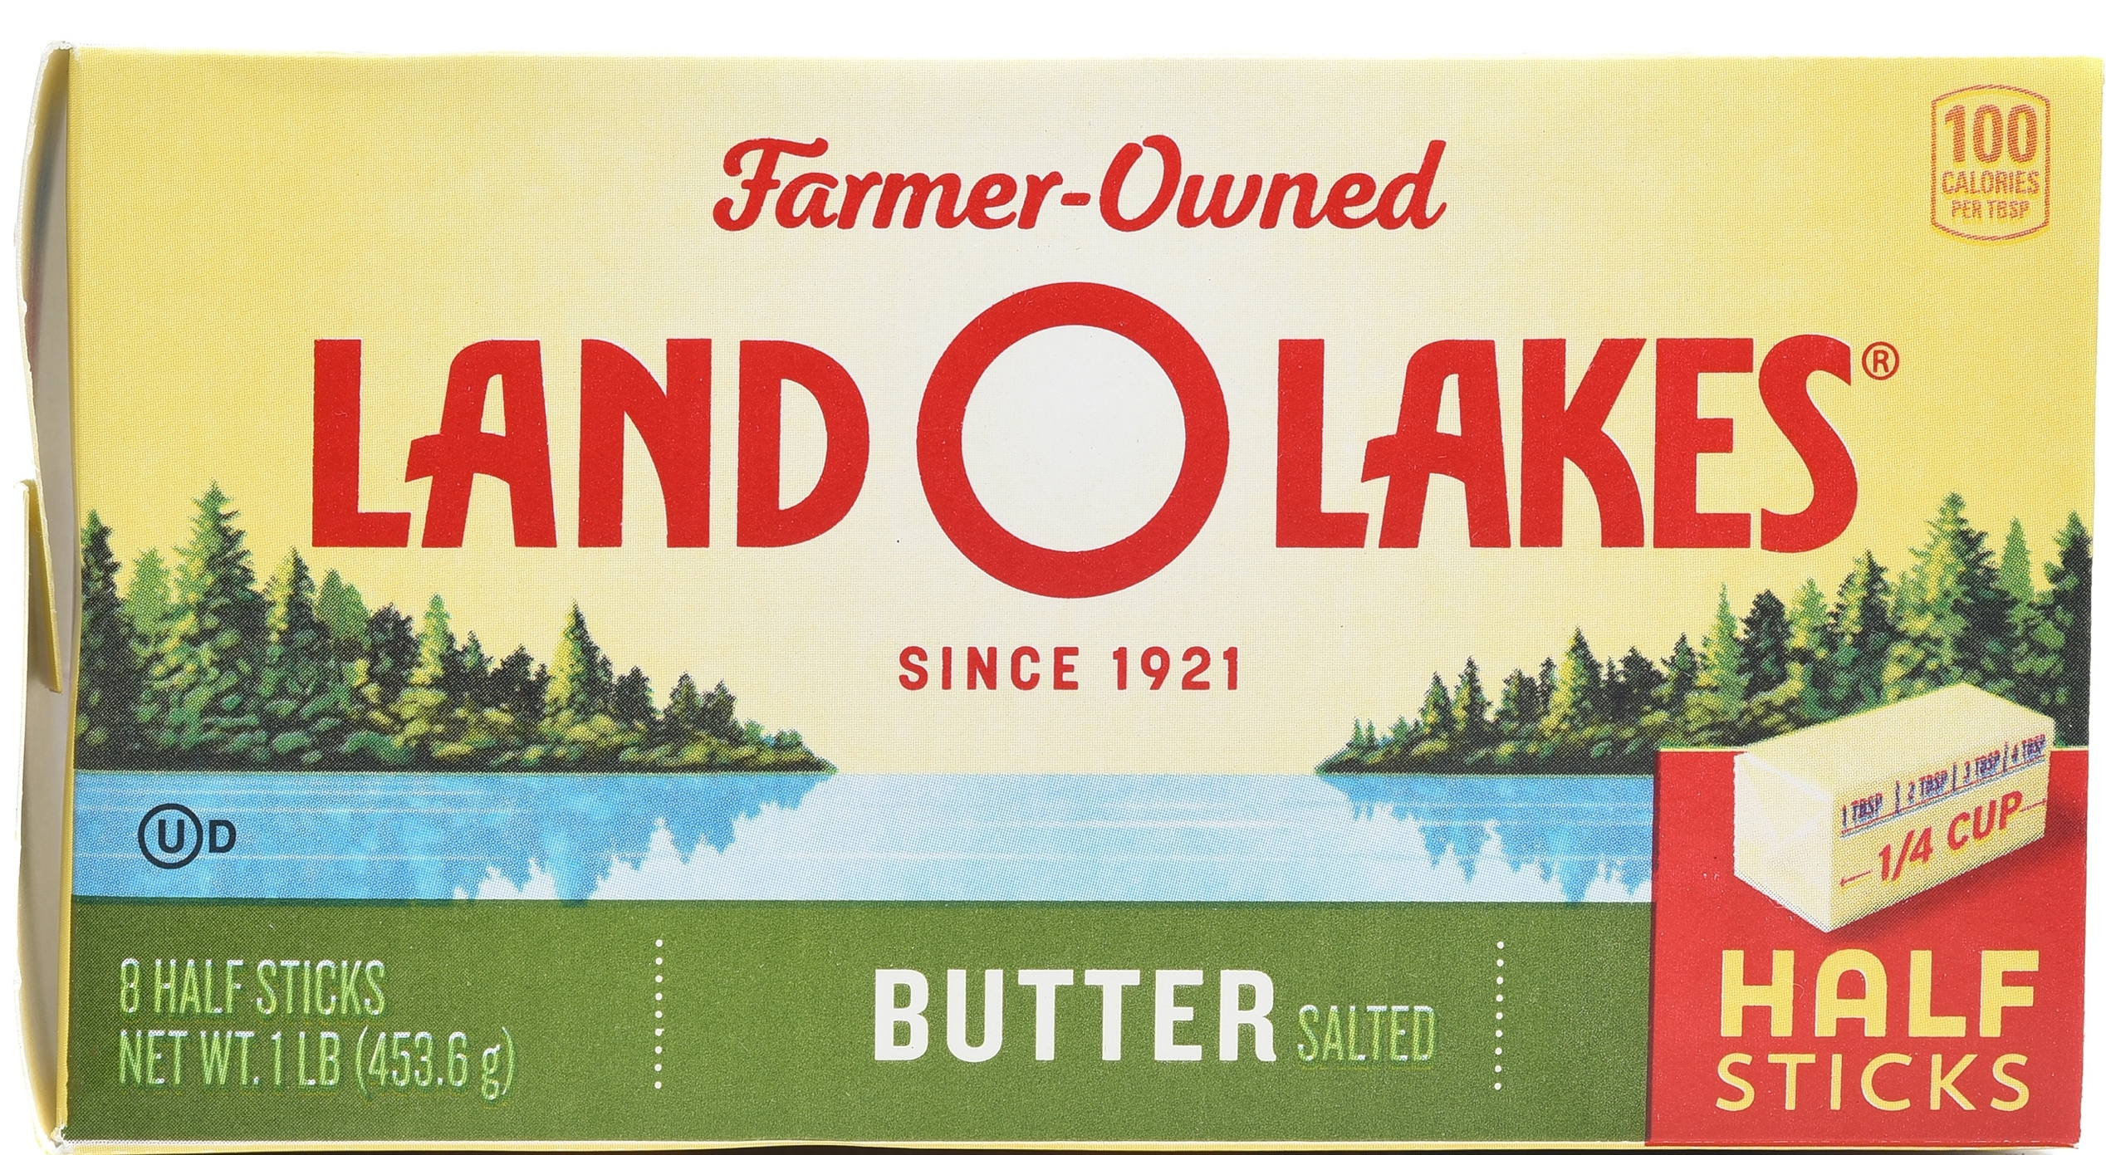
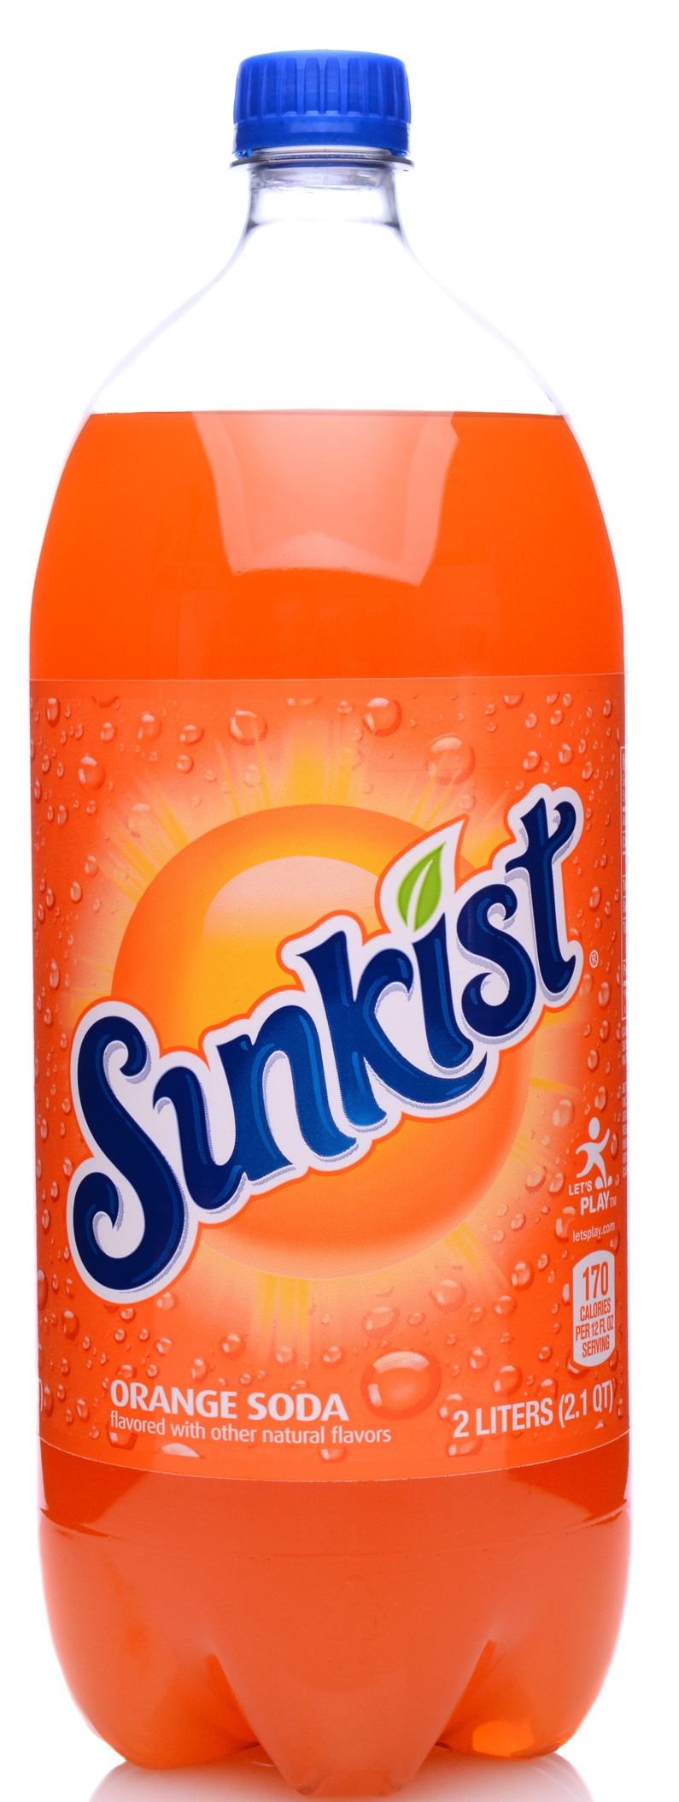
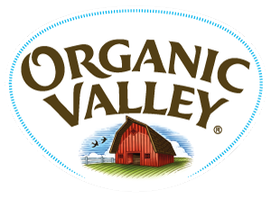

Section: Cooperative Ownership in Democratic Socialism, cont’d
Examples of
Producer/Marketing Co-ops
Dairy Products
Cranberry Products
Citrus Products
Grape Products
Organic Products
From The VOTE Textbook Second Edition Copyright © 2023

Slide 18
Section: Cooperative Ownership in Democratic Socialism, cont’d
Four Types of Co-ops
Worker
Workers own the firm.
Consumer
Consumer members own the company.
Producer/Marketing
Independent owners come together under one label to market their products.
Purchasing/Retail
Independent owners come together under one label to purchase inputs.
From The VOTE Textbook Second Edition Copyright © 2023

Slide 19
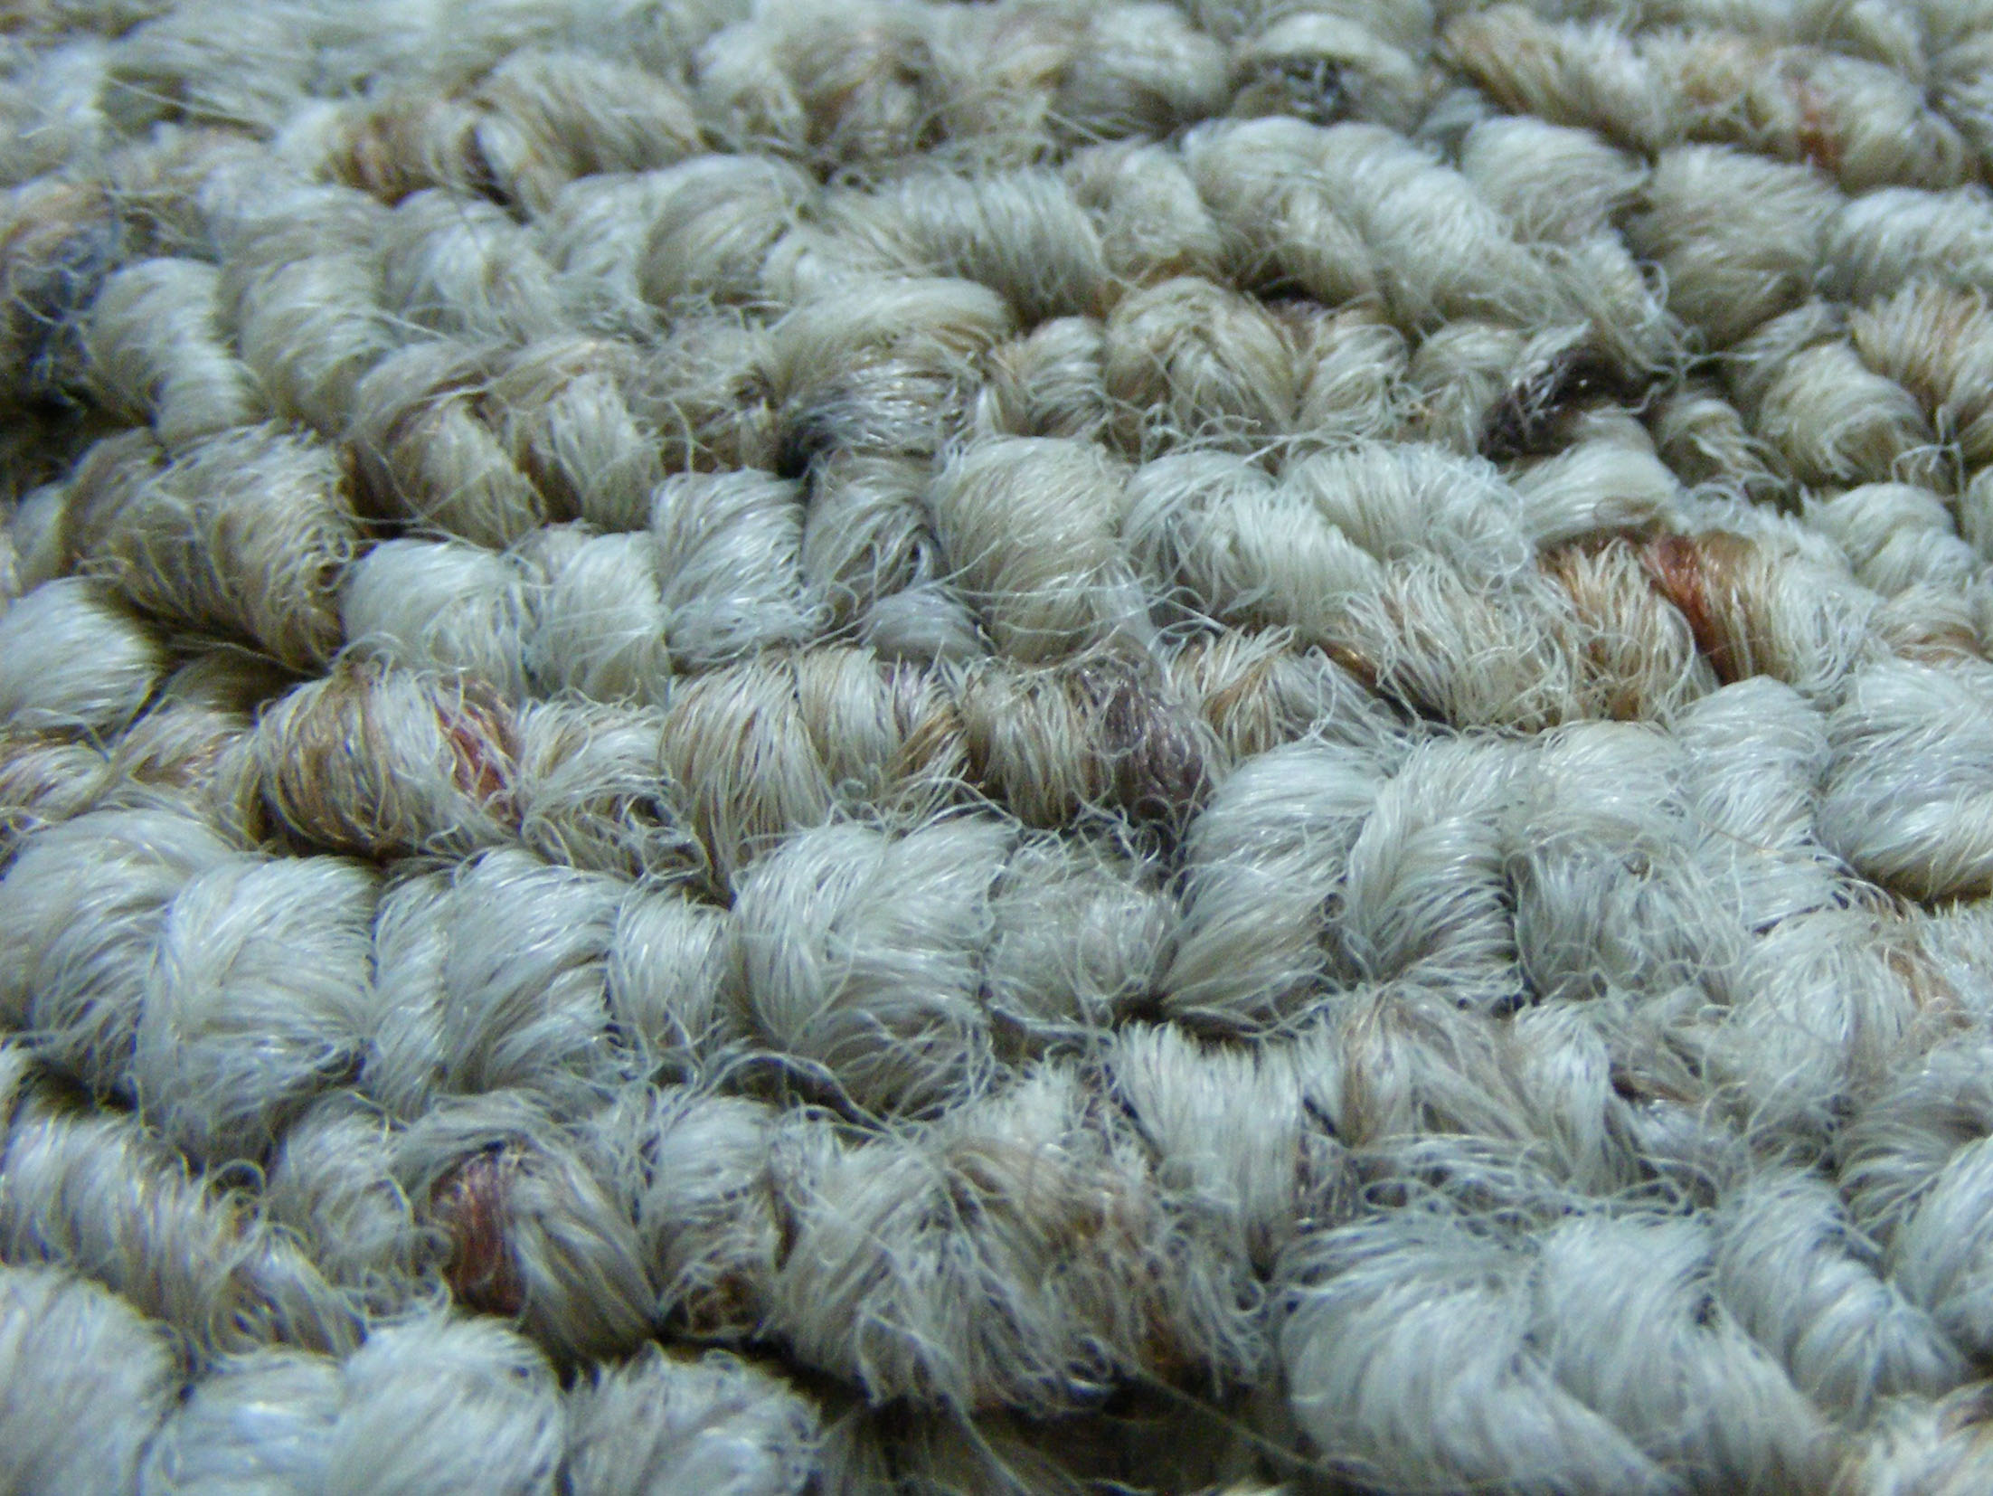





Section: Cooperative Ownership in Democratic Socialism, cont’d
Examples of
Purchasing/Retail Co-ops
Hardware
Flooring
Auto Parts
Groceries
Hotels
From The VOTE Textbook Second Edition Copyright © 2023

Slide 20
Section: Cooperative Ownership in Democratic Socialism, cont’d
Match the type of co-op with the correct description.
Type of Co-op
Description
Worker-Owned Co-op
Consumer Co-op
Producer/Marketing
Co-op
Retail/Purchasing Co-op
Customers who buy the product own the business.
Businesses come together to buy in bulk.
Those who work in the business own the business.
Businesses come together to sell their products under one label.
Notes:
20

Slide 21
Polling Question
Types of Co-ops
What is a worker-owned co-op?
Customers who buy the product own the business.
Businesses come together to buy in bulk.
Those who work in the business own the business.
Businesses come together to sell their products under one label.
From The VOTE Textbook Second Edition Copyright © 2023

Slide 22
Section: Cooperative Ownership in Democratic Socialism, cont’d
Match the type of co-op with the correct description.
Type of Co-op
Description
Worker-Owned Co-op
Consumer Co-op
Producer/Marketing
Co-op
Retail/Purchasing Co-op
Customers who buy the product own the business.
Businesses come together to buy in bulk.
Those who work in the business own the business.
Businesses come together to sell their products under one label.
DAILY
DOUBLE
From The VOTE Textbook Second Edition Copyright © 2023
Notes:
22

Slide 23

Section: Cooperative Ownership in Democratic Socialism, cont’d
From The VOTE Textbook Second Edition Copyright © 2023

Slide 24

Form: Radical Theory: Capitalism versus Democratic Socialism
Radical Theory: Capitalism versus Democratic Socialism
1.
1.
ASSUMPTIONS
ASSUMPTIONS
Capitalism
Democratic Socialism
2.
2.
MODEL
MODEL
3.
3.
Radical Policy
CONCLUSIONS
CONCLUSIONS
From The VOTE Textbook Second Edition Copyright © 2023

Slide 25
Section: Building Radical Theory in Two Parts
Radical Theory Assumptions
i. Surplus
For any society to survive, those who produce must produce a surplus.
ii. Class Process
Societies differ in the production, appropriation, and distribution of the surplus.
iii. Dynamic Interactions over Surplus
There is a constant struggle to control the surplus.
(who makes it)
(who takes it)
(who gets it)
From The VOTE Textbook Second Edition Copyright © 2023

Slide 26

Section: Building Radical Theory in Two Parts, cont’d
Because there is a constant struggle to control the surplus, with ever-changing, ever-shifting, complex, and dynamic forces at play at every moment, there can be no ceteris paribus.
Radicals need a way to represent this holistic view of the economy.
They use a three-dimensional model that looks like a Rubik’s Cube.
From The VOTE Textbook Second Edition Copyright © 2023

Slide 27
Section: Building Radical Theory in Two Parts, cont’d
In a standard 3 x 3 Rubik’s Cube, there are 43 quintillion possible arrangements.
Q: Given this huge number, how can it ever be solved?
A: Each of the six center pieces is a fixed point around which the others revolve. Once you realize this you can solve the puzzle.
From The VOTE Textbook Second Edition Copyright © 2023

Slide 28
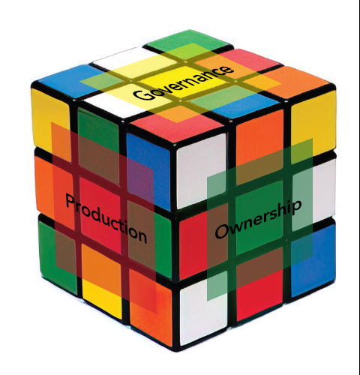
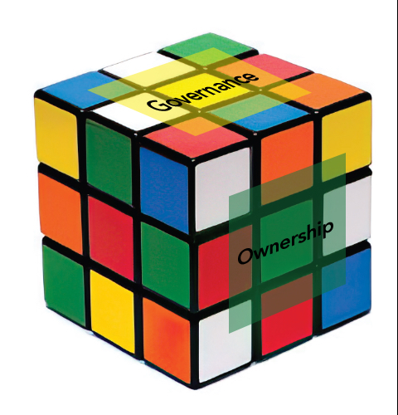


Section: Building Radical Theory in Two Parts, cont’d
Radicals use six-core cubes to model
capitalism and democratic socialism.
Both cubes revolve around six fixed
(“core”) points that are central to all
economic systems.
Ownership
Governance
Meeting people’s
material needs
Production
Sustainability
Communities
The Six-Core Cube
of Every Economic System
These are the six core points that every economic system addresses.
From The VOTE Textbook Second Edition Copyright © 2023

Slide 29
Section: Building Radical Theory in Two Parts, cont’d
Practice: Write the names of the six core points of economic
systems.
        Ownership
        Governance
        Meeting people’s
        material needs
        Production
        Sustainability
        Communities
(1)
(2)
(3)
(4)
(5)
(6)
The Six-Core Cube
of Every Economic System
From The VOTE Textbook Second Edition Copyright © 2023

Slide 30
Form: Radical Theory: Capitalism versus Democratic Socialism
Radical Theory: Capitalism versus Democratic Socialism
1.
1.
ASSUMPTIONS
ASSUMPTIONS
Surplus
The Class Process
Dynamic Interactions over Surplus
Surplus
The Class Process
Dynamic Interactions over Surplus
Self-Interest
Self-Interest
2.
2.
MODEL
Capitalism
Democratic Socialism
MODEL
3.
3.
Radical Policy
CONCLUSIONS
CONCLUSIONS
From The VOTE Textbook Second Edition Copyright © 2023

Slide 31

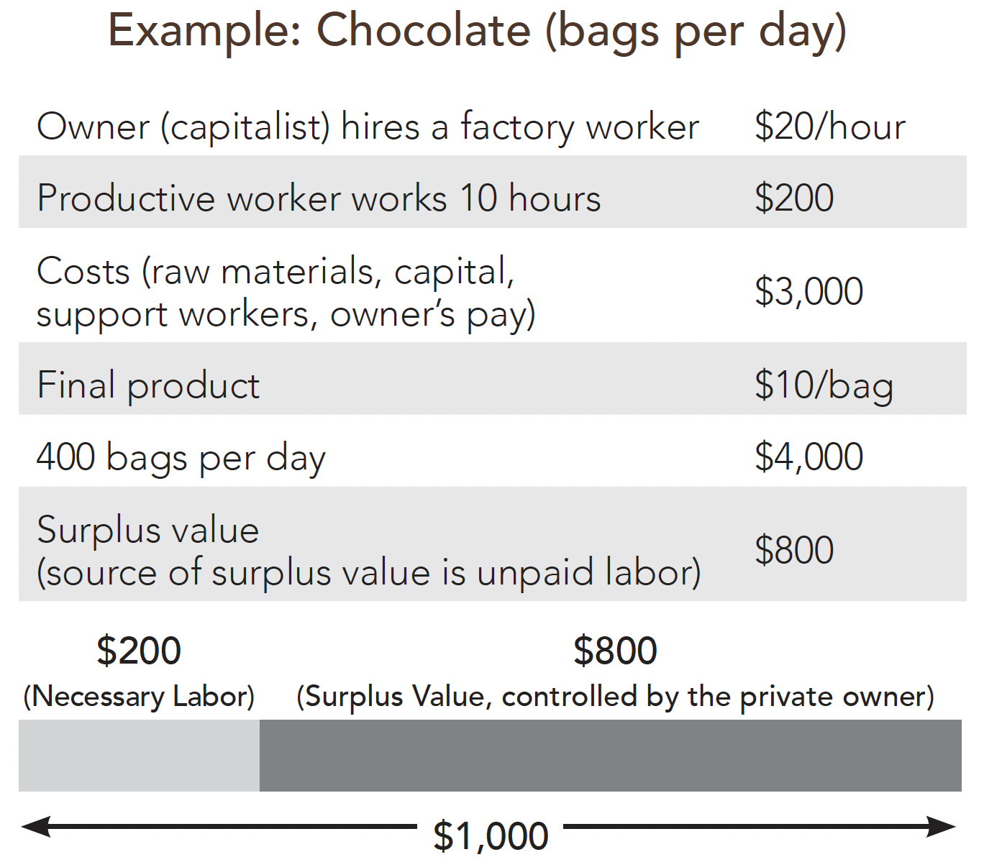
Section: Radical Theory Model: Capitalism
Radical Theory Model i: Surplus
Labor Theory of Value
The source of surplus value is the worker’s unpaid labor.
From The VOTE Textbook Second Edition Copyright © 2023

Slide 32
Section: Radical Theory Model: Capitalism, cont’d
Radical Theory Model ii: The Class Process
Production of surplus: Laborer-Worker-Proletariat
Appropriation of surplus: Capitalist-Owner-Bourgeoisie
Workplace Exploitation
Owners steal surplus from wage laborers.
}
“Exploitation”
Exploitation
The process by which the surplus is stolen by the owner from the laborer.
From The VOTE Textbook Second Edition Copyright © 2023

Slide 33
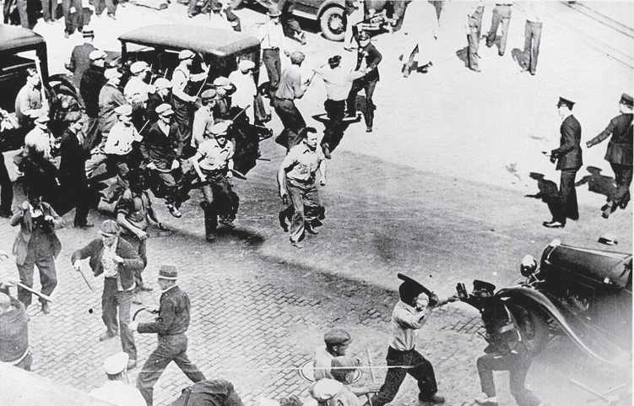
Radicals say the history of labor relations is one of violence and bloodshed, not harmony and equilibrium.
From The VOTE Textbook Second Edition Copyright © 2023

Slide 34
Section: Radical Theory Model: Capitalism, cont’d
Radical Theory Model ii: The Class Process
Production of surplus: Laborer-Worker-Proletariat
Appropriation of surplus: Capitalist-Owner-Bourgeoisie
Workplace Exploitation
Owners steal surplus from wage laborers.
}
“Exploitation”
Exploitation
The process by which the surplus is stolen by the owner from the laborer.
Distribution of Surplus: Direct Exploiter:
*Owners—bonuses and perks
Indirect Exploiters:
*Managers
*Lawyers
*Accountants
*Politicians
*Lobbyists
From The VOTE Textbook Second Edition Copyright © 2023

Slide 35

Section: Radical Theory Model: Capitalism, cont’d
Radical Theory Model iii: Dynamic Interactions over Surplus
Capitalist Competition
Owners must make harmful decisions to survive.
Owners compete with other owners to maximize profit.
To survive, owners do whatever is necessary to maximize profits.
Owners are not necessarily bad people; they are people stuck in a bad system.
From The VOTE Textbook Second Edition Copyright © 2023

Slide 36

Section: Radical Theory Tools, cont’d
Radical Theory Model Summary: Capitalism
Workplace Exploitation
+
Capitalist Competition
The Pressure for Bad
leads to
The Visible Suffering
… and is represented by the unsolved cube.
From The VOTE Textbook Second Edition Copyright © 2023

Slide 37
Form: Radical Theory: Capitalism versus Democratic Socialism
Radical Theory: Capitalism versus Democratic Socialism
1.
1.
ASSUMPTIONS
ASSUMPTIONS
Surplus
The Class Process
Dynamic Interactions over Surplus
Surplus
The Class Process
Dynamic Interactions over Surplus
Self-Interest
Self-Interest
2.
Capitalism
Democratic Socialism
2.
MODEL
MODEL
Labor Theory of Value
Workplace Exploitation
Capitalist Competition
Pressure for Bad Leads to The Visible Suffering
3.
3.
Radical Policy
CONCLUSIONS
CONCLUSIONS
From The VOTE Textbook Second Edition Copyright © 2023

Slide 38
Section: Radical Theory Model: Capitalism, cont’d
The Pressure for Bad in Capitalism
Scenario 1: The Rich Get Richer
“I just bought new packaging machines and now my factory doubled production. I don’t need as many workers, so I’ve laid off a third of my workforce and I’m saving a bundle of money.”
Owner:
Competitor:
Owner:
“That sounds awful. I don’t want to lay off my dedicated workers.”
“So don’t do it!”
“But if you do it and I don‘t, I won‘t survive. So I must do
it, too.“
Core Point of Capitalism #1: PRIVATE OWNERSHIP
From The VOTE Textbook Second Edition Copyright © 2023

Slide 39
Section: Radical Theory Model: Capitalism, cont’d
The Pressure for Bad in Capitalism
Scenario 2: Gaming the System
“We’re planning on using a new, less expensive sweetener that has controversial side-effects, but as soon as we convince the government to approve it, we’re going to make a bundle.”
Owner:
Competitor:
Owner:
“That idea will keep me up at night. I don’t want to harm
my customers.”
“So don’t do it!”
“But if you do it and I don‘t, I won‘t survive. So I must do
it, too.“
Core Point of Capitalism #2: TOP-DOWN GOVERNANCE
From The VOTE Textbook Second Edition Copyright © 2023

Slide 40
Section: Radical Theory Model: Capitalism, cont’d
The Pressure for Bad in Capitalism
Scenario 3: Kicked to the Curb
“Even though sales are down, our numbers look good because we cut our workers’ pension plan and health benefits. We’ve saved an enormous amount of money.”
Owner:
Competitor:
Owner:
“What a terrible idea! I don’t want to create hardship for
my employees.”
“So don’t do it!”
“But if you do it and I don‘t, I won‘t survive. So I must do
it, too.“
Core Point of Capitalism #3: INDIVIDUALS AT RISK
From The VOTE Textbook Second Edition Copyright © 2023

Slide 41
Section: Radical Theory Model: Capitalism, cont’d
The Pressure for Bad in Capitalism
Scenario 4: Go Big or Go Home
“Our firm is struggling so I’m going to hire a marketing firm and fund research to convince people that chocolate makes them sexier, sportier, happier, healthier, and smarter.”
Owner:
Competitor:
Owner:
“That’s just wrong! I don’t want to lie.”
“So don’t do it!”
“But if you do it and I don‘t, I won‘t survive. So I must do
it, too.“
Core Point of Capitalism #4: PRODUCTION FOR PROFIT
From The VOTE Textbook Second Edition Copyright © 2023

Slide 42
Section: Radical Theory Model: Capitalism, cont’d
The Pressure for Bad in Capitalism
Scenario 5: Planet in Peril
“We instituted a night shift to increase production and profit. Of course, we’ve had to find more suppliers because we need twice as much milk, sugar, and other ingredients.”
Owner:
Competitor:
Owner:
“That’s the type of idea that ruins the planet. I don’t want to destroy the environment.”
“So don’t do it!”
“But if you do it and I don‘t, I won‘t survive. So I must do
it, too.“
Core Point of Capitalism #5: UNSUSTAINABLE GROWTH
From The VOTE Textbook Second Edition Copyright © 2023

Slide 43
Section: Radical Theory Model: Capitalism, cont’d
The Pressure for Bad in Capitalism
Scenario 6: Race to the Bottom
“Our company is planning to move to a country with cheaper labor. We will only have to pay $1 per hour instead of $15. We’ll rake in the profits.”
Owner:
Competitor:
Owner:
“Count me out. I don’t want to do devastate
communities here and in the developing world.”
“So don’t do it!”
“But if you do it and I don‘t, I won‘t survive. So I must do
it, too.“
Core Point of Capitalism #6: UNHEALTHY COMMUNITIES
From The VOTE Textbook Second Edition Copyright © 2023

Slide 44
Section: Radical Theory Model: Capitalism, cont’d
The (Unsolvable)
Six-Core Cube of Capitalism
        Private Ownership
        Top-Down Governance
        Individuals at Risk
        Production for Profit
        Unsustainable Growth
        Unhealthy Communities
Why unsolvable?
It is built around six core points that are rotten to the core!
From The VOTE Textbook Second Edition Copyright © 2023

Slide 45
Form: Radical Theory: Capitalism versus Democratic Socialism
Radical Theory: Capitalism versus Democratic Socialism
1.
1.
ASSUMPTIONS
ASSUMPTIONS
Surplus
The Class Process
Dynamic Interactions over Surplus
Surplus
The Class Process
Dynamic Interactions over Surplus
Self-Interest
Self-Interest
2.
Capitalism
Democratic Socialism
2.
MODEL
MODEL
Labor Theory of Value
Workplace Exploitation
Capitalist Competition
Pressure for Bad Leads to The Visible Suffering
Six Core Cube: Capitalism
Private Ownership
Top-Down Governance
Individuals at Risk
Production for Profit
Unsustainable Growth
Unhealthy Communities
3.
3.
Radical Policy
CONCLUSIONS
CONCLUSIONS
From The VOTE Textbook Second Edition Copyright © 2023

Slide 46
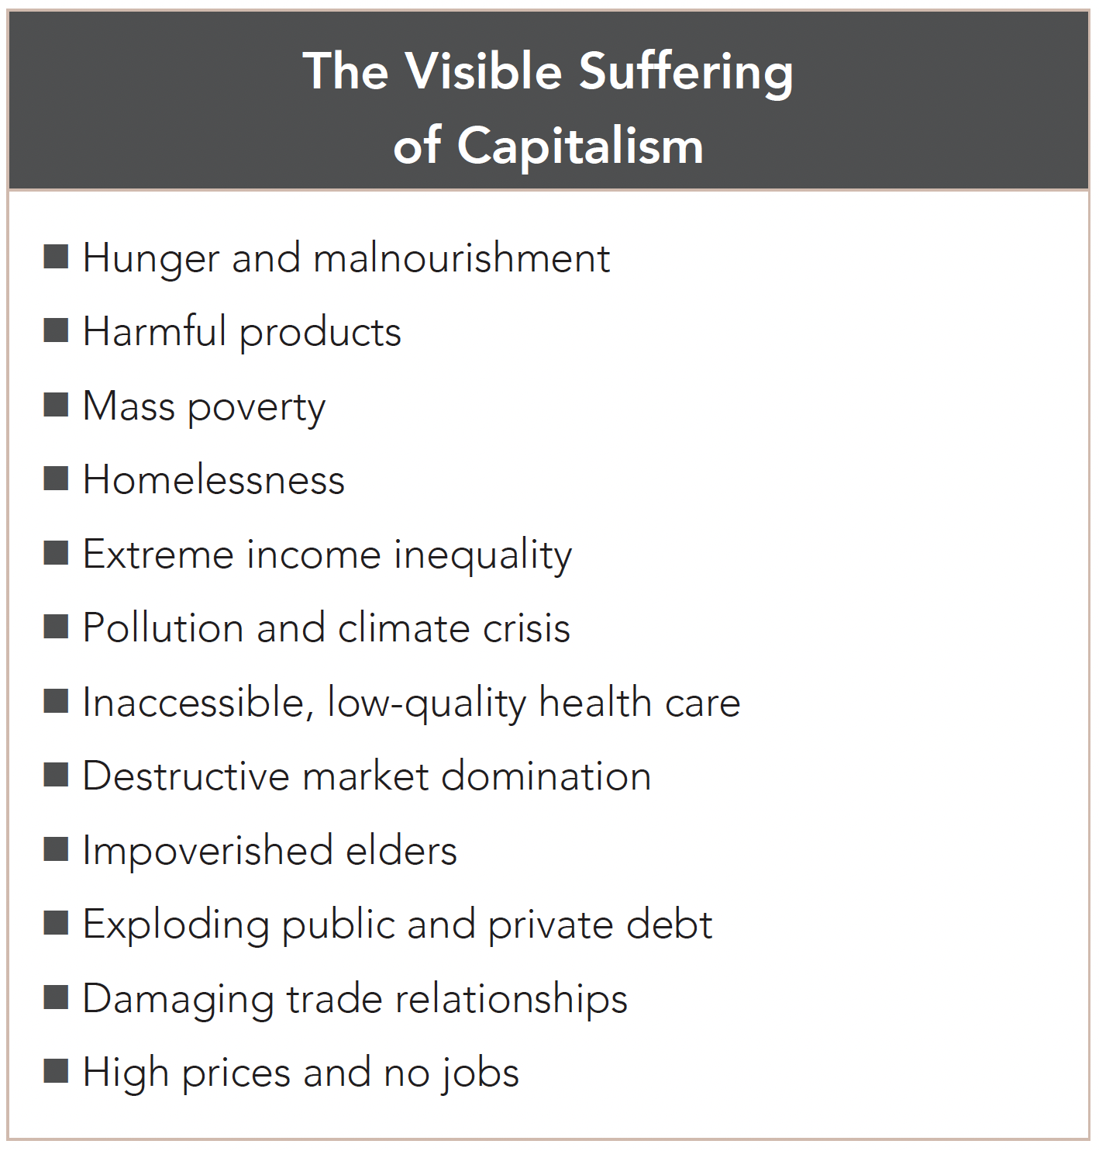
Section: Radical Theory Model: Capitalism, cont’d
From The VOTE Textbook Second Edition Copyright © 2023

Slide 47
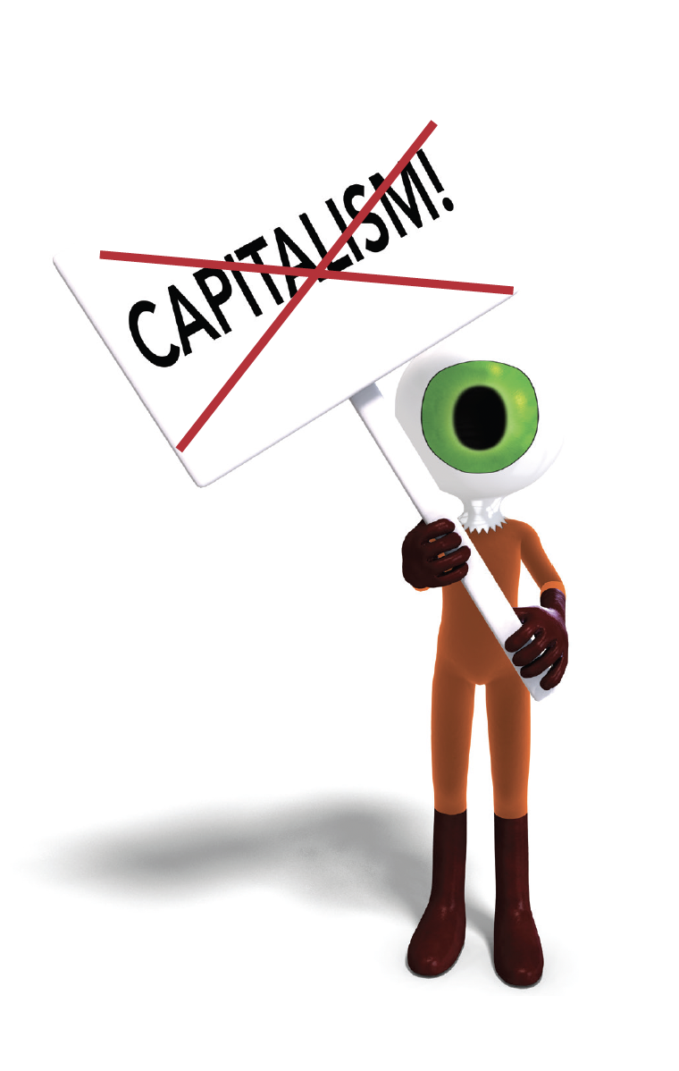
Section: Radical Theory Model: Capitalism, cont’d
Radical theorists say that even aliens visiting from outer space would see all the harm that comes from capitalism.
They say that it is impossible to understand why the visible suffering exists when clearly our lovely blue-green planet has everything necessary to provide for everyone’s basic human needs.
From The VOTE Textbook Second Edition Copyright © 2023

Slide 48
Section: Radical Theory Conclusions: Capitalism
Radical Theory Conclusions: Capitalism
What to Produce?
Firms make what serves their profit interests.
How to Produce?
Firms maximize output, but at an unacceptable cost to society.
For Whom to Produce?
Firms’ products go to those who directly or indirectly
exploit others.
From The VOTE Textbook Second Edition Copyright © 2023

Slide 49
Form: Radical Theory: Capitalism versus Democratic Socialism
Radical Theory: Capitalism versus Democratic Socialism
1.
1.
ASSUMPTIONS
ASSUMPTIONS
Surplus
The Class Process
Dynamic Interactions over Surplus
Surplus
The Class Process
Dynamic Interactions over Surplus
Self-Interest
Self-Interest
2.
Capitalism
Democratic Socialism
2.
MODEL
MODEL
Labor Theory of Value
Workplace Exploitation
Capitalist Competition
Pressure for Bad Leads to The Visible Suffering
Six Core Cube: Capitalism
Private Ownership
Top-Down Governance
Individuals at Risk
Production for Profit
Unsustainable Growth
Unhealthy Communities
3.
3.
Radical Policy
CONCLUSIONS
CONCLUSIONS
What to Produce?
Firms make what serves their profit interest.
How to Produce?
Firms maximize output, but at an
unacceptable cost to society.
For Whom to Produce?
Firms’ products go to those who directly or indirectly exploit others.
Destructive Self-Interest and Alienation
From The VOTE Textbook Second Edition Copyright © 2023

Slide 50

Section: Radical Theory Conclusions: Capitalism, cont’d
Alienation
In capitalism, workers are…
alienated from the fruits of their labor.
alienated from one another.
alienated from the decisions the firms make about production.
alienated from their ability to contribute meaning, beauty, and usefulness to the world.
From The VOTE Textbook Second Edition Copyright © 2023

Slide 51
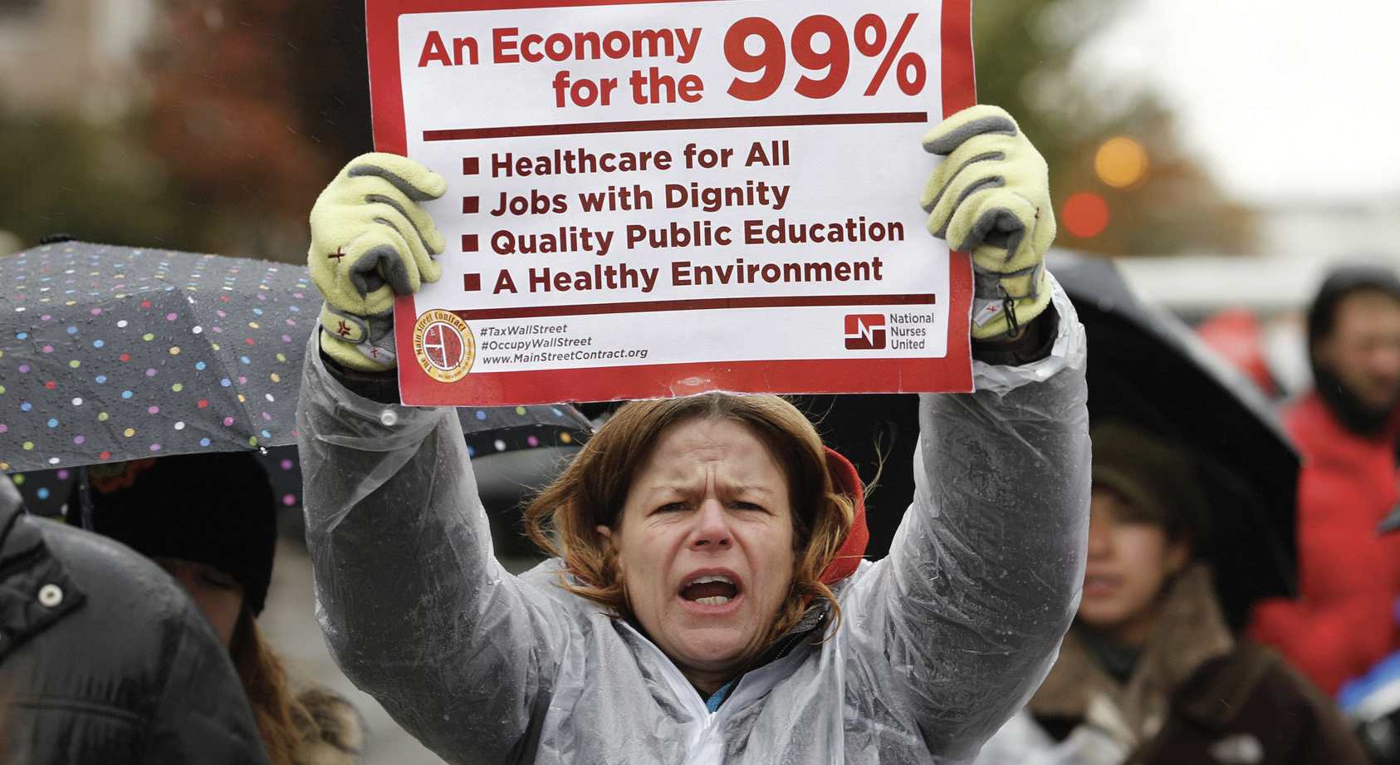
Section: Radical Theory Policy: Capitalism
Radical Theory Policy
a. Reject Capitalism
From The VOTE Textbook Second Edition Copyright © 2023

Slide 52
Form: Radical Theory: Capitalism versus Democratic Socialism
Radical Theory: Capitalism versus Democratic Socialism
1.
1.
ASSUMPTIONS
ASSUMPTIONS
Surplus
The Class Process
Dynamic Interactions over Surplus
Surplus
The Class Process
Dynamic Interactions over Surplus
Self-Interest
Self-Interest
2.
Capitalism
Democratic Socialism
2.
MODEL
Labor Theory of Value
Workplace Exploitation
Capitalist Competition
Pressure for Bad Leads to The Visible Suffering
Six Core Cube: Capitalism
Private Ownership
Top-Down Governance
Individuals at Risk
Production for Profit
Unsustainable Growth
Unhealthy Communities
3.
3.
Radical Policy
Reject Capitalism
CONCLUSIONS
CONCLUSIONS
What to Produce?
Firms make what serves their profit interest.
How to Produce?
Firms maximize output, but at an
unacceptable cost to society.
For Whom to Produce?
Firms’ products go to those who directly or indirectly exploit others.
Destructive Self-Interest and Alienation
From The VOTE Textbook Second Edition Copyright © 2023

Slide 53
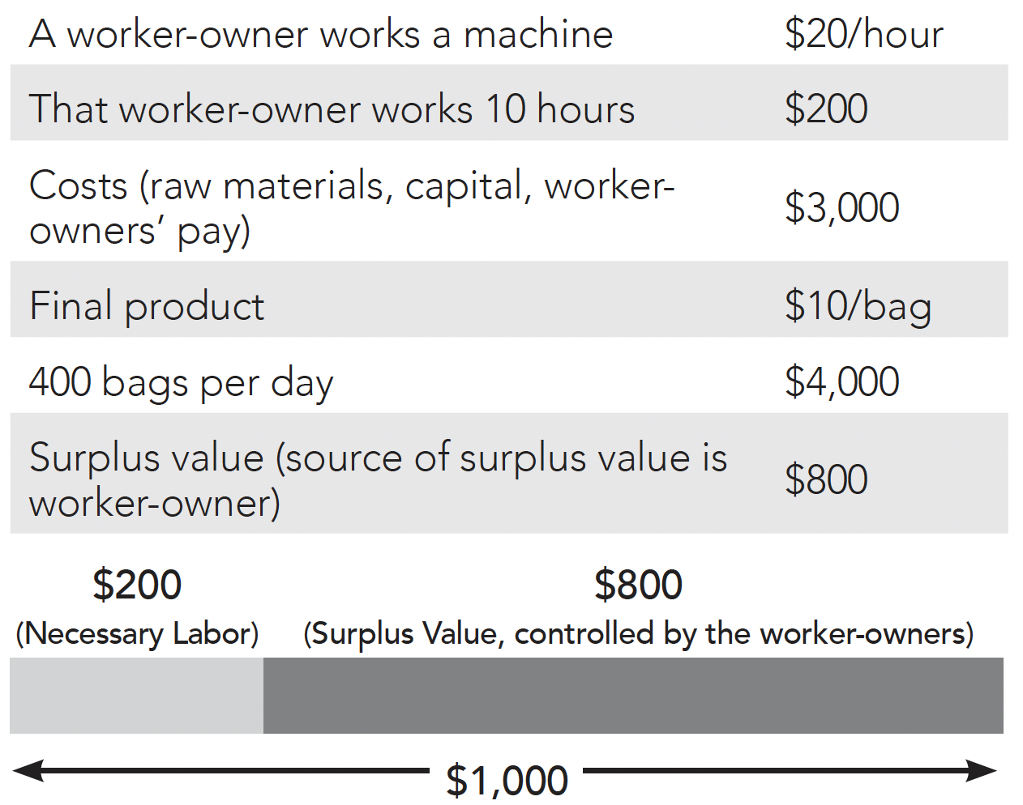
Section: Radical Theory Model: Democratic Socialism
Radical Theory Model i: Surplus
Collective Creation of Value
The source of surplus value is the worker-owner.
.
From The VOTE Textbook Second Edition Copyright © 2023

Slide 54
Section: Radical Theory Model: Democratic Socialism, cont’d
Radical Theory Model ii: The Class Process
Production of surplus: Worker-Owners
Appropriation of surplus: Worker-Owners
Workplace Justice
Workers make, take, and distribute the surplus using a democratic process.
}
Same people
(No exploitation)
Distribution of surplus:
Worker-Owners
*Wages
*Benefits, bonuses, and perks
Firms
*Reinvestment
*Lawyers, accountants, consultants
Community
*Provision of basic needs (health care, education, elder care)
*Infrastructure (roads, bridges, water, sewage, telecommunications)
From The VOTE Textbook Second Edition Copyright © 2023

Slide 55

Section: Radical Theory Model: Democratic Socialism, cont’d
Radical Theory Model iii: Dynamic Interactions over Surplus
Coordination Among Competitors
Everyone is interconnected, so well-being depends on everybody’s success.
Worker-owners live in the communities where they work and aspire to make profit, but profit is not the most important consideration.
Worker-owned firms compete in markets while recognizing their mutual interests, which leads them also to coordinate with competitors, to everyone’s benefit.
Owners are not necessarily good people; they are people stuck in a good system.
From The VOTE Textbook Second Edition Copyright © 2023

Slide 56

Section: Radical Theory Model: Democratic Socialism, cont’d
Radical Theory Model Summary: Democratic Socialism
Workplace Justice
Coordination Among Competitors
The Pressure for Good leads to
The Invisible Synergy
+
… and is represented by the solved cube.
From The VOTE Textbook Second Edition Copyright © 2023

Slide 57
Section: Radical Theory Model: Democratic Socialism, cont’d
The Pressure for Good in Democratic Socialism
Scenario 1: More than a Paycheck
“Our firm just bought those new packaging machines and they’re so efficient that our production is up. We just voted to give everyone in the company raises next quarter and create more positions in our firm.”
Worker-Owner:
Competitor:
Worker-Owner
“That sounds great for the whole economy.”
“Your firm should do it, too!”
“I‘ll definitely propose it to my co-owners for a discussion and a decision.“
Core Point of Democratic Socialism #1: COOPERATIVE OWNERSHIP
From The VOTE Textbook Second Edition Copyright © 2023

Slide 58
Section: Radical Theory Model: Democratic Socialism, cont’d
The Pressure for Good in Democratic Socialism
Scenario 2: Of the People, By the People, For the People
“The new sweeteners our competitors are using are making people sick. A community council made up of stakeholders was convened and they've asked us to work with them to find alternatives.”
Worker-Owner:
Competitor:
Worker-Owner
“That’s good news. I don’t want to make our customers sick.”
“Your firm should do it, too!”
“I‘ll definitely propose it to my co-owners for a discussion and a decision.“
Core Point of Democratic Socialism #2: PARTICIPATORY GOVERNANCE
From The VOTE Textbook Second Edition Copyright © 2023

Slide 59
Section: Radical Theory Model: Democratic Socialism, cont’d
The Pressure for Good in Democratic Socialism
Scenario 3: We Have Each Other’s Backs
“Of course we pay taxes that fund the universal basic pension and health care for all, but on top of that we’re setting up an elder-care program for our retirees.”
Worker-Owner:
Competitor:
Worker-Owner
“I love that idea! When you retire, it will give you extra peace of mind.”
“Your firm should do it, too!”
“I‘ll definitely propose it to my co-owners for a discussion and a decision.“
Core Point of Democratic Socialism #3: SOCIAL SAFEGUARDS
From The VOTE Textbook Second Edition Copyright © 2023

Slide 60
Section: Radical Theory Model: Democratic Socialism, cont’d
The Pressure for Good in Democratic Socialism
Scenario 4: The Right Stuff
“My firm is struggling. We’re hoping business turns around with our marketing campaign for our new protein bars. We’re also promoting the health benefits of chocolate when eaten in moderation.”
Worker-Owner:
Competitor:
Worker-Owner
“Offering a healthier option to customers makes sense.”
“Your firm should do it, too!”
“I‘ll definitely propose it to my co-owners for a discussion and a decision.“
Core Point of Democratic Socialism #4: PRODUCTION FOR USE
From The VOTE Textbook Second Edition Copyright © 2023

Slide 61
Section: Radical Theory Model: Democratic Socialism, cont’d
The Pressure for Good in Democratic Socialism
Scenario 5: Save the Earth
“We instituted a night shift and increased production. But instead of overproducing, we voted to take one day off every week. Now we benefit from the efficiency gain without harming the planet.”
Worker-Owner:
Competitor:
Worker-Owner
“What an inspired idea! It gives you more time to spend doing what you love.”
“Your firm should do it, too!”
“I‘ll definitely propose it to my co-owners for a discussion and a decision.“
Core Point of Democratic Socialism #5: SUSTAINABLE DEVELOPMENT
From The VOTE Textbook Second Edition Copyright © 2023

Slide 62
Section: Radical Theory Model: Democratic Socialism, cont’d
The Pressure for Good in Democratic Socialism
Scenario 6: Think Globally, Act Locally
“We found out that our cacao bean growers are using child labor, so we’ve decided to source from a cooperative of Indigenous cacao bean growers instead. It will be more expensive, but we believe it’s worth it.”
Worker-Owner:
Competitor:
Worker-Owner
“That is the right thing to do! I’d rather spend more on production costs and sleep well at night.”
“Your firm should do it, too!”
“I‘ll definitely propose it to my co-owners for a discussion and a decision.“
Core Point of Democratic Socialism #6: HEALTHY COMMUNITIES
From The VOTE Textbook Second Edition Copyright © 2023

Slide 63
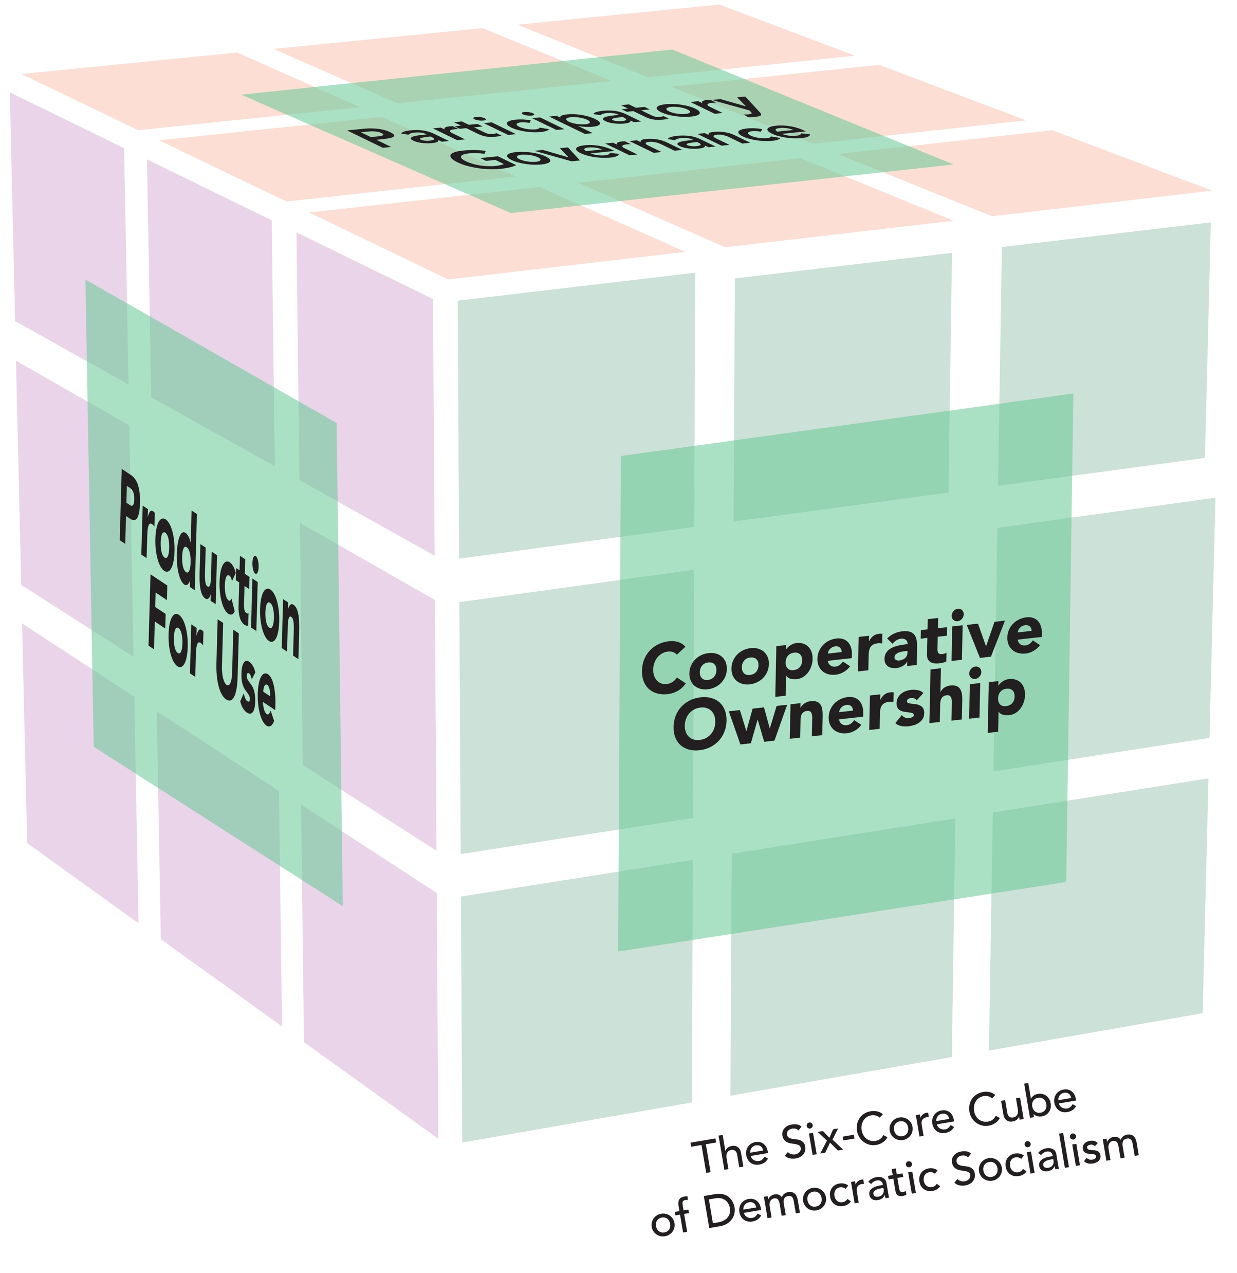
Section: Radical Theory Model: Democratic Socialism, cont’d
The (Solvable)
Six-Core Cube of Democratic Socialism
        Cooperative Ownership
        Participatory Governance
        Social Safeguards
        Production for Use
        Sustainable Development
        Healthy Communities
Cooperative Ownership
Why solvable?
It is built around six core points that are beneficial to the core!
From The VOTE Textbook Second Edition Copyright © 2023

Slide 64
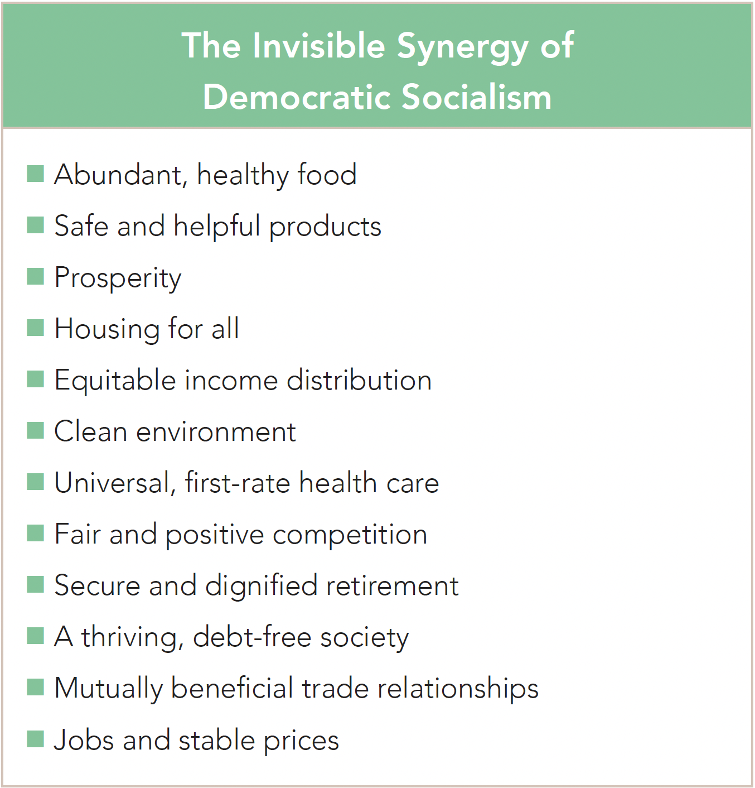
Section: Radical Theory Model: Democratic Socialism, cont’d
From The VOTE Textbook Second Edition Copyright © 2023

Slide 65

Section: Radical Theory Model: Democratic Socialism, cont’d
Radical theorists say that aliens visiting from outer space would see all the good that comes from democratic socialism.
They say our lovely blue-green planet has everything necessary to provide for everyone’s wants and needs, and with democratic socialism humans have found a way to share in the bounty, to the benefit of all.
From The VOTE Textbook Second Edition Copyright © 2023

Slide 66
Form: Radical Theory: Capitalism versus Democratic Socialism
Radical Theory: Capitalism versus Democratic Socialism
1.
1.
ASSUMPTIONS
ASSUMPTIONS
Surplus
The Class Process
Dynamic Interactions over Surplus
Surplus
The Class Process
Dynamic Interactions over Surplus
Self-Interest
Self-Interest
2.
Capitalism
Democratic Socialism
2.
MODEL
Labor Theory of Value
Workplace Exploitation
Capitalist Competition
Collective Creation of Value
Workplace Justice
Coordination among Competitors
Pressure for Bad Leads to The Visible Suffering
Pressure for Good Leads to the Invisible Synergy
Six Core Cube: Capitalism
Private Ownership
Top-Down Governance
Individuals at Risk
Six Core Cube: Democratic Socialism
Cooperative Ownership
Participatory Governance
Social Safeguards
Production for Profit
Unsustainable Growth
Unhealthy Communities
Production for Use
Sustainable Growth
Healthy Communities
3.
3.
Radical Policy
Reject Capitalism
CONCLUSIONS
CONCLUSIONS
What to Produce?
Firms make what serves their profit interest.
How to Produce?
Firms maximize output, but at an
unacceptable cost to society.
For Whom to Produce?
Firms’ products go to those who directly or indirectly exploit others.
Destructive Self-Interest and Alienation
From The VOTE Textbook Second Edition Copyright © 2023

Slide 67
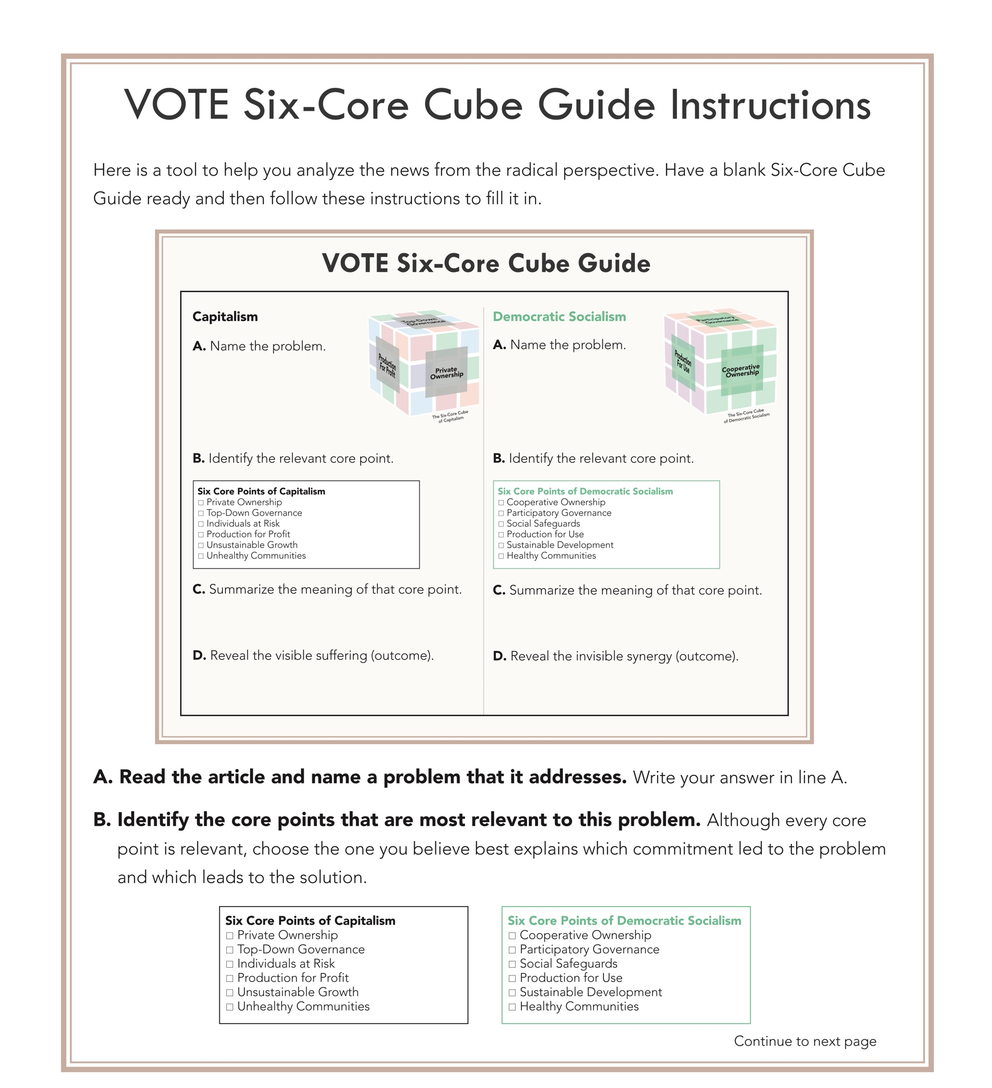

Form: VOTE Six-Core Cube Guide Instructions
VOTE Six-Core Cube Guide Instructions
From The VOTE Textbook Second Edition Copyright © 2023

Slide 68
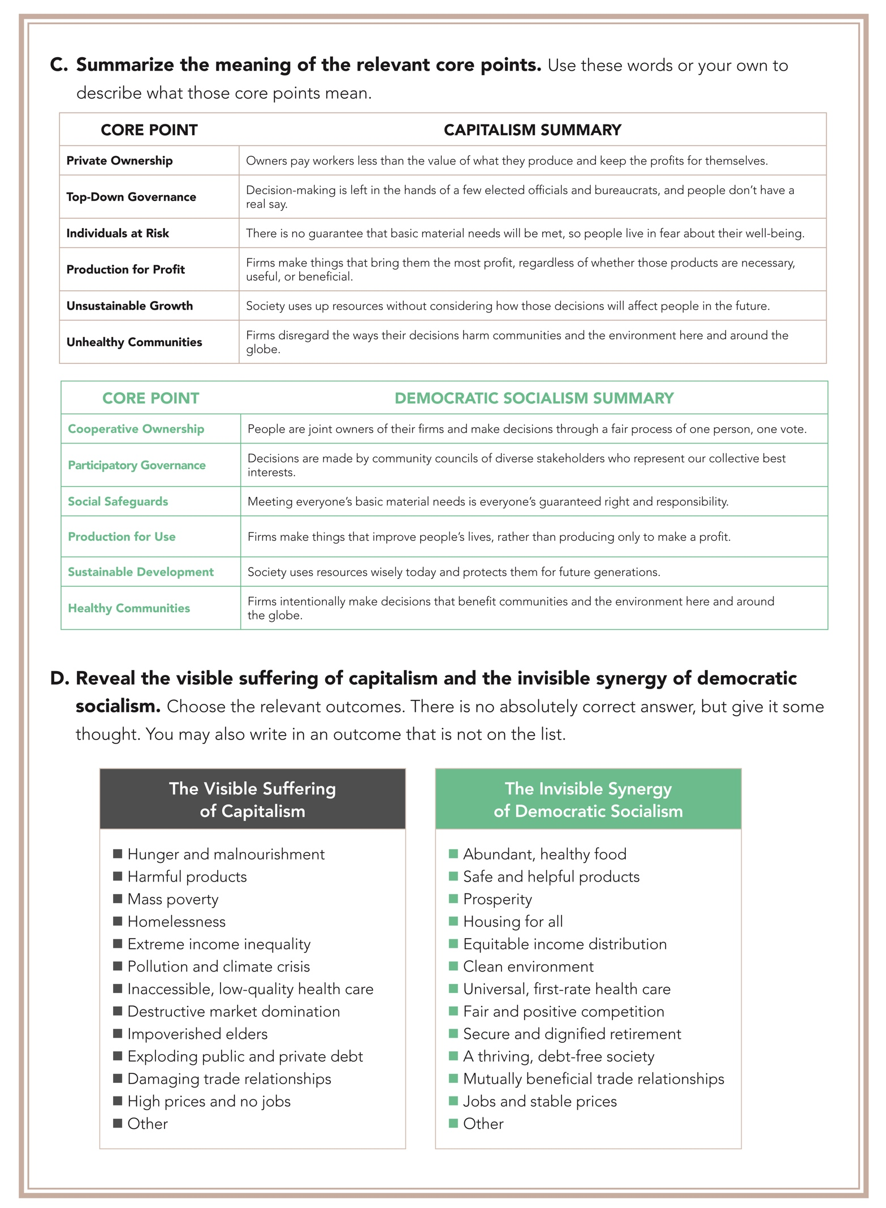
Form: VOTE Six-Core Cube Guide Instructions, cont’d
From The VOTE Textbook Second Edition Copyright © 2023

Slide 69
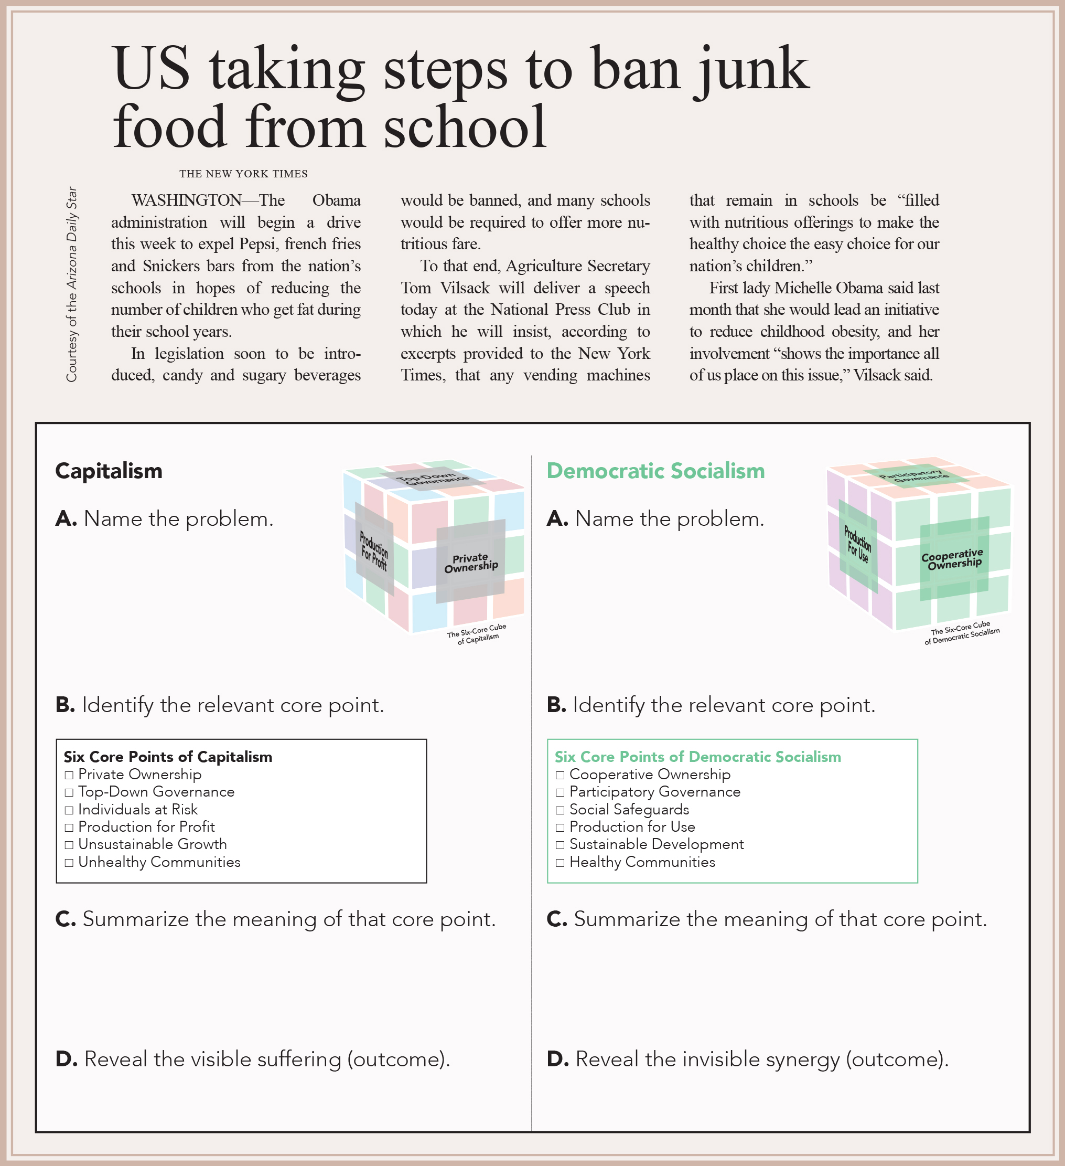
Exercise 6.1: VOTE Six-Core Cube Guide
Exercise 1: VOTE Six-Core Cube Guide
  Childhood Obesity
  Childhood Obesity
From The VOTE Textbook Second Edition Copyright © 2023

Slide 70
Polling Question
Core Points
Although all core points can help to explain any news article, which best explain and solve the problem of childhood obesity? (Make sure to look at the short descriptions on the back of the instructions.)
Private Ownership / Cooperative Ownership
Top-Down Governance / Participatory Governance
Individuals at Risk / Social Safeguards
Production for Profit / Production for Use
Unsustainable Growth / Sustainable Development
Unhealthy Communities / Healthy Communities
From The VOTE Textbook Second Edition Copyright © 2023

Slide 71
Exercise 6.1: VOTE Six-Core Cube Guide, cont’d
Exercise 1: VOTE Six-Core Cube Guide, cont’d
  Childhood Obesity
  Childhood Obesity
X
X
  Firms make things that bring them the most profit, regardless of whether those products are necessary, useful, or beneficial.
  Firms make things that improve people’s lives, rather than producing only to make a profit.
  Destructive Market Domination
  Fair and Positive Competition
From The VOTE Textbook Second Edition Copyright © 2023

Slide 72
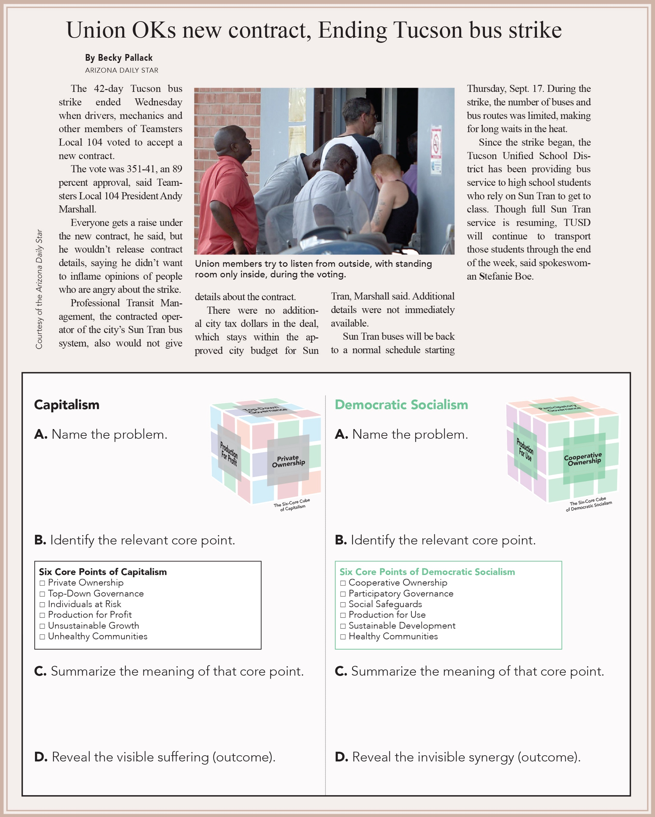
Exercise 6.2: VOTE Six-Core Cube Guide
Exercise 2: VOTE Six-Core Cube Guide
Try this on your own. Answer key is in the book.
From The VOTE Textbook Second Edition Copyright © 2023

Slide 73
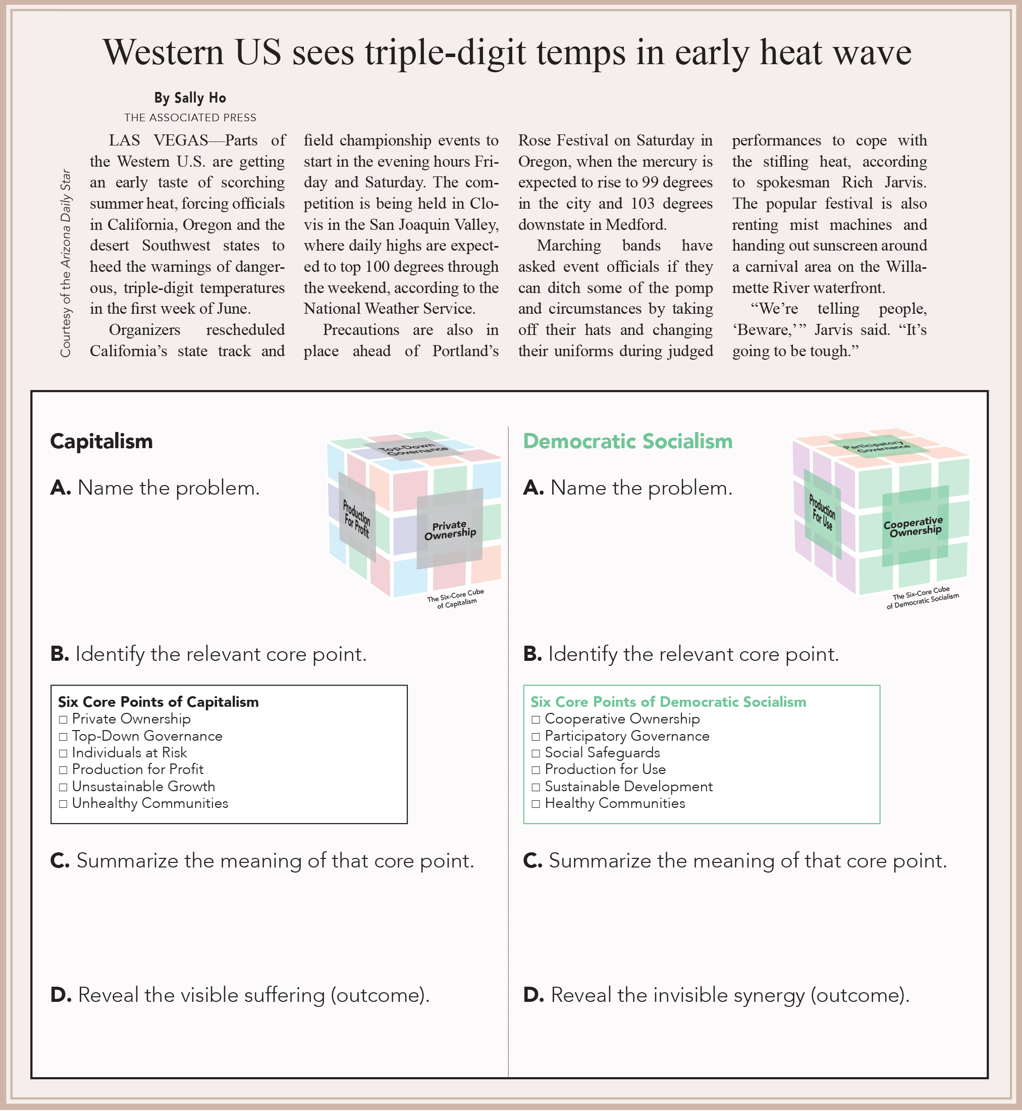
Exercise 6.3: VOTE Six-Core Cube Guide
Exercise 3: VOTE Six-Core Cube Guide
Try this on your own. Answer key is in the book.
From The VOTE Textbook Second Edition Copyright © 2023

Slide 74

Section: Radical Theory Conclusions: Democratic Socialism
Radical Theory Conclusions: Democratic Socialism
What to Produce?
Firms make what people want and need.
How to Produce?
Firms anchor communities and produce sustainably.
For Whom to Produce?
Firms’ products go to worker-owners, firms, and the community.
From The VOTE Textbook Second Edition Copyright © 2023

Slide 75
Form: Radical Theory: Capitalism versus Democratic Socialism
Radical Theory: Capitalism versus Democratic Socialism
1.
1.
ASSUMPTIONS
ASSUMPTIONS
Surplus
The Class Process
Dynamic Interactions over Surplus
Surplus
The Class Process
Dynamic Interactions over Surplus
Self-Interest
Self-Interest
2.
Capitalism
Democratic Socialism
2.
MODEL
MODEL
Labor Theory of Value
Workplace Exploitation
Capitalist Competition
Collective Creation of Value
Workplace Justice
Coordination among Competitors
Pressure for Bad Leads to The Visible Suffering
Pressure for Good Leads to the Invisible Synergy
Six Core Cube: Capitalism
Private Ownership
Top-Down Governance
Individuals at Risk
Six Core Cube: Democratic Socialism
Cooperative Ownership
Participatory Governance
Social Safeguards
Production for Profit
Unsustainable Growth
Unhealthy Communities
Production for Use
Sustainable Growth
Healthy Communities
3.
3.
Radical Policy
Radical Policy
Reject Capitalism
CONCLUSIONS
CONCLUSIONS
What to Produce?
Firms make what serves their profit interest.
How to Produce?
Firms maximize output, but at an
unacceptable cost to society.
For Whom to Produce?
Firms’ products go to those who directly or indirectly exploit others.
What to Produce?
Firms make what people want and need.
How to Produce?
Firms anchor communities and produce sustainably.
For Whom to Produce?
Firms’ products go worker-owners, firms,
and the community.
Destructive Self-Interest and Alienation
Mutual Interest and Connection
From The VOTE Textbook Second Edition Copyright © 2023

Slide 76

Section: Radical Theory Conclusions: Democratic Socialism, cont’d
Connection
In democratic socialism, workers are…
connected to the fruits of their labor.
connected to one another.
connected to the decisions their firms make about production.
connected to their ability to contribute meaning, beauty, and usefulness to the world.
From The VOTE Textbook Second Edition Copyright © 2023

Slide 77
Section: Radical Theory Policy: Democratic Socialism
Radical Theory Policy
a. Reject capitalism.
b. Embrace democratic socialism.
The common good
From The VOTE Textbook Second Edition Copyright © 2023

Slide 78
Form: Radical Theory: Capitalism versus Democratic Socialism
Radical Theory: Capitalism versus Democratic Socialism
1.
1.
ASSUMPTIONS
ASSUMPTIONS
Surplus
The Class Process
Dynamic Interactions over Surplus
Surplus
The Class Process
Dynamic Interactions over Surplus
Self-Interest
Self-Interest
2.
Capitalism
Democratic Socialism
2.
MODEL
MODEL
Labor Theory of Value
Workplace Exploitation
Capitalist Competition
Collective Creation of Value
Workplace Justice
Coordination among Competitors
Pressure for Bad Leads to The Visible Suffering
Pressure for Good Leads to the Invisible Synergy
Six Core Cube: Capitalism
Private Ownership
Top-Down Governance
Individuals at Risk
Six Core Cube: Democratic Socialism
Cooperative Ownership
Participatory Governance
Social Safeguards
Production for Profit
Unsustainable Growth
Unhealthy Communities
Production for Use
Sustainable Growth
Healthy Communities
3.
3.
Radical Policy
Radical Policy
Reject capitalism.
Embrace democratic socialism.
• The common good
CONCLUSIONS
CONCLUSIONS
What to Produce?
Firms make what serves their profit interest.
How to Produce?
Firms maximize output, but at an
unacceptable cost to society.
For Whom to Produce?
Firms’ products go to those who directly or indirectly exploit others.
What to Produce?
Firms make what people want and need.
How to Produce?
Firms anchor communities and produce sustainability.
For Whom to Produce?
Firms’ products go worker-owners, firms,
and the community.
Destructive Self-Interest and Alienation
Mutual Interest and Connection
From The VOTE Textbook Second Edition Copyright © 2023

Slide 79
Section: Economic Well-Being from Different Perspectives
From The VOTE Textbook Second Edition Copyright © 2023

Slide 80

Chapter 6
Check out the book for more!
Test Yourself • Key Terms • Answer Key
From The VOTE Textbook Second Edition Copyright © 2023

