Slide 1

From The VOTE Textbook Second Edition Copyright © 2023

Slide 2


From The VOTE Textbook Second Edition Copyright © 2023
Notes:
2

Slide 3
From The VOTE Textbook Second Edition Copyright © 2023
Notes:
3

Slide 4
The VOTE Textbook Chapters
From The VOTE Textbook Second Edition Copyright © 2023
Notes:
4

Slide 5
1
2
3
4
5
6
7
8
9
10
11
12
13
14
15
16
17
18
19
20
21
From The VOTE Textbook Second Edition Copyright © 2023
Notes:
5

Slide 6


From The VOTE Textbook Second Edition Copyright © 2023

Slide 7
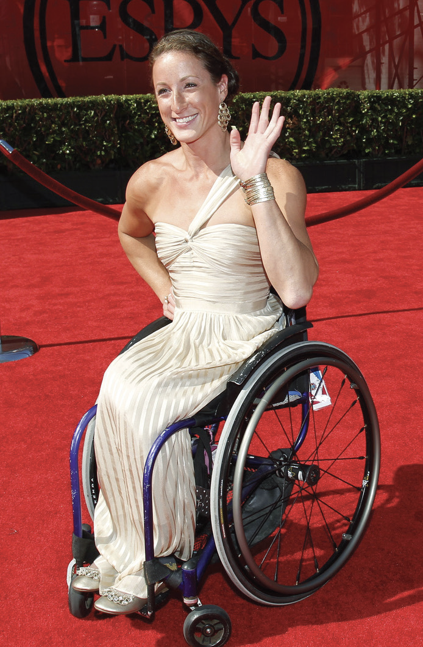
Opening story: Champion wheelchair racer Tatyana McFadden
Tatyana McFadden was born with spina bifida in the Soviet Union and left in an orphanage, where it was expected that she would die.
Adopted and moved to the U.S. at age 6.
As of 2023, she had:
20 Paralympic medals (8 gold medals)
24 major marathon wins (4 grand slams)
5 world records in track and field.
From The VOTE Textbook Second Edition Copyright © 2023

Slide 8

Note: We present each perspective as if we wholeheartedly agree with it. We do this on purpose to present each point of view in its best light, but please imagine each time that we are wearing a mask—as if we are actors playing three different roles.
From The VOTE Textbook Second Edition Copyright © 2023

Slide 9

Opening story: Champion wheelchair racer Tatyana McFadden, cont’d
Capitalism creates the levels of prosperity that make it possible for all of us to realize our potential.
From The VOTE Textbook Second Edition Copyright © 2023

Slide 10
Section: Building Conventional Theory
Conventional theory is an umbrella term that includes both liberal and conservative theories. “Conventional” means mainstream or dominant.
What are the four components of theory-plus?
Psst… Hint:
A
Milk
Chocolate
Piece
Assumptions
Model
Conclusions
Policy
Conservatives and Liberals agree about the assumptions, model, and conclusions, but disagree about policy.
To get started, who remembers the three questions of economics?
• What to produce? • How to produce? • For whom to produce?
From The VOTE Textbook Second Edition Copyright © 2023

Slide 11

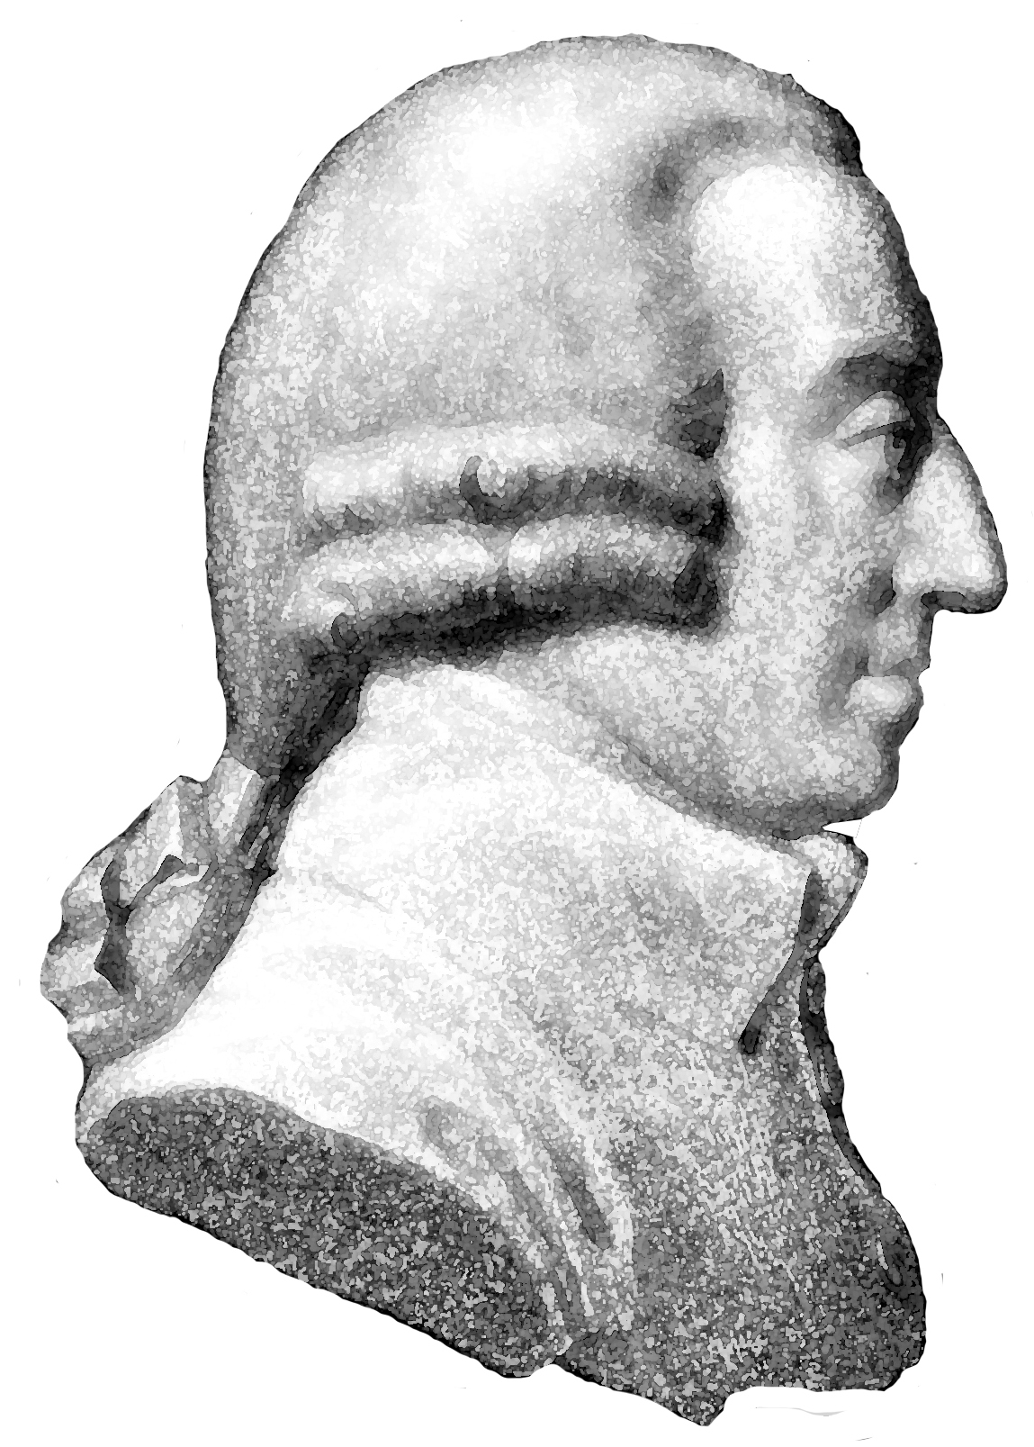
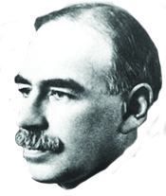
Form: Conventional Theory: Capitalism
Conventional Theory: Capitalism
1.
2.
ASSUMPTIONS
MODEL
3.
CONCLUSIONS
Conservative Policy
Liberal Policy
From The VOTE Textbook Second Edition Copyright © 2023

Slide 12

Section: Building Conventional Theory, cont’d
Conventional Theory Assumptions
i. Scarcity
Since all inputs (resources) are limited, output is also limited.
ii. Individuals Maximize Happiness
Individuals act in self-interested ways to maximize happiness by making rational choices to acquire more goods and services.
iii. Firms Maximize Profits
Firms act in self-interested ways to maximize profits by transforming resources into products that people want, using technology to do so.
From The VOTE Textbook Second Edition Copyright © 2023

Slide 13
Form: Conventional Theory: Capitalism
Conventional Theory: Capitalism
1.
2.
ASSUMPTIONS
MODEL
Scarcity
Individuals Maximize Happiness
Firms Maximize Profits
Production Possibilities Curve
(Chapter 17)
Self-Interest
3.
CONCLUSIONS
Conservative Policy
Liberal Policy
From The VOTE Textbook Second Edition Copyright © 2023

Slide 14
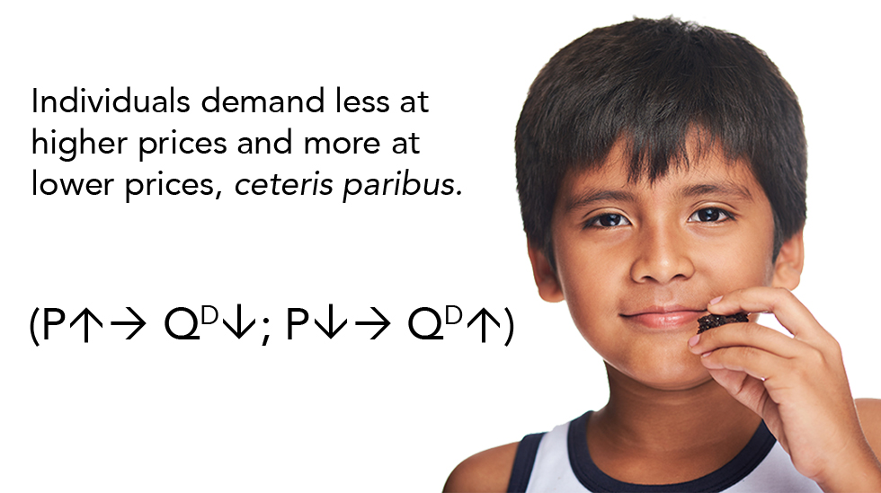
Section: Building Conventional Theory, cont’d
Conventional Model ii: Individuals Maximize Happiness
Law of Demand
From The VOTE Textbook Second Edition Copyright © 2023

Slide 15
Form: Conventional Theory: Capitalism
Conventional Theory: Capitalism
1.
2.
ASSUMPTIONS
MODEL
Scarcity
Individuals Maximize Happiness
Firms Maximize Profits
Production Possibilities Curve
Law of Demand
Self-Interest
3.
CONCLUSIONS
Conservative Policy
Liberal Policy
From The VOTE Textbook Second Edition Copyright © 2023

Slide 16

Section: Building Conventional Theory, cont’d
Conventional Model ii: Firms Maximize Profits
Law of Supply
From The VOTE Textbook Second Edition Copyright © 2023

Slide 17
Form: Conventional Theory: Capitalism
Conventional Theory: Capitalism
1.
2.
ASSUMPTIONS
MODEL
Scarcity
Individuals Maximize Happiness
Firms Maximize Profits
Production Possibilities Curve
Law of Demand
Law of Supply
Self-Interest
Market: Price signals (the invisible hand)
3.
CONCLUSIONS
Conservative Policy
Liberal Policy
From The VOTE Textbook Second Edition Copyright © 2023

Slide 18

Section: Building Conventional Theory, cont’d
Market: A real or virtual place where demanders meet
suppliers, and prices and quantities are determined.
Two sets of actors in a market for goods and services:
1. Demanders
Consumers • Households • Individuals • Buyers
2. Suppliers
Producers • Vendors • Firms • Sellers
From The VOTE Textbook Second Edition Copyright © 2023

Slide 19
Section: Building Conventional Theory, cont’d
When demanders meet suppliers in markets, prices
emerge (price signals) which serve as incentives to act
(the invisible hand).
Ceteris paribus, price is the most important factor in your decision either to buy something or sell something!
From The VOTE Textbook Second Edition Copyright © 2023

Slide 20
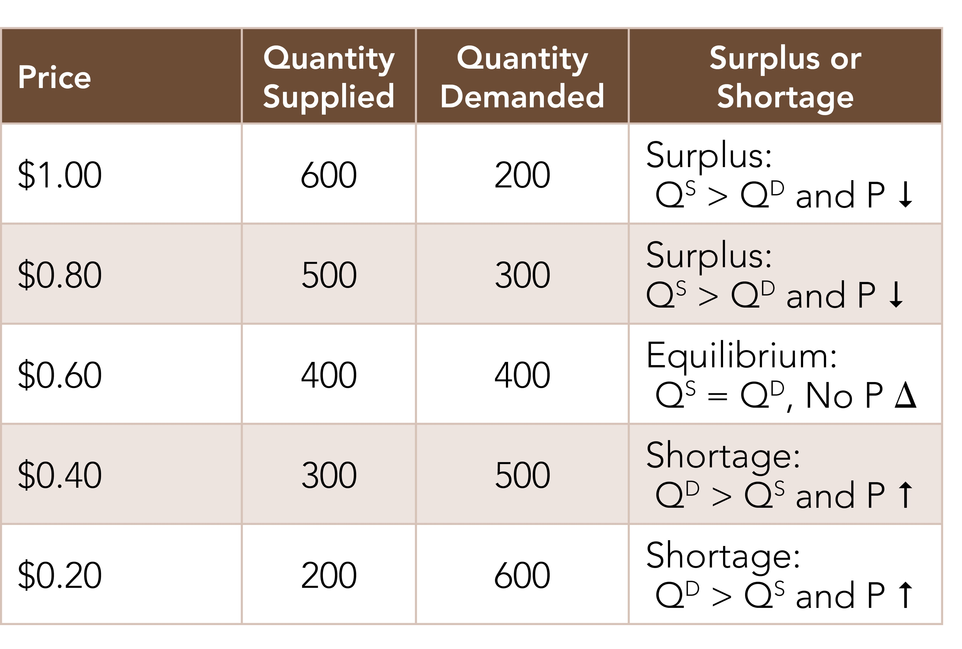
Section: Building Conventional Theory, cont’d
Demand and Supply Schedule
Okay, let’s graph it, but only because you asked ☺!
From The VOTE Textbook Second Edition Copyright © 2023

Slide 21

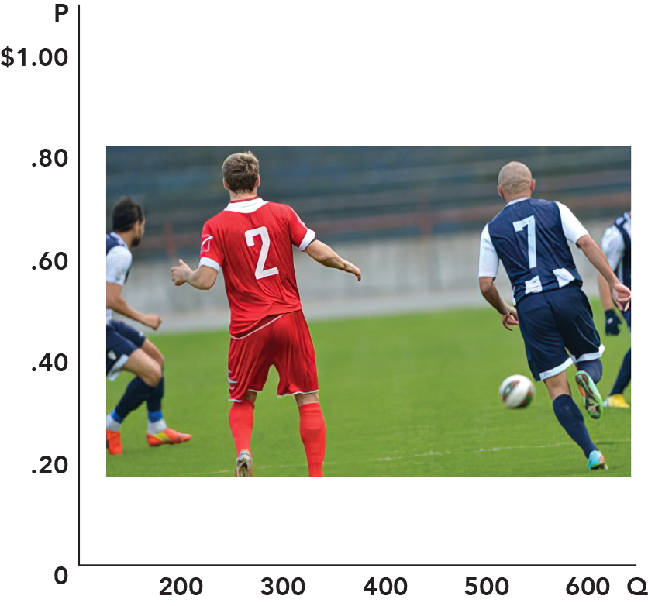
Section: Building Conventional Theory, cont’d
The Joy of Graphing
From The VOTE Textbook Second Edition Copyright © 2023

Slide 22
Section: Building Conventional Theory, cont’d
Y
II
I
2
1
-2
-1
-1
1
2
X
-2
(if X then Y: this means X is independent)
III
IV
This is quick introduction for people uncomfortable with graphing.
From The VOTE Textbook Second Edition Copyright © 2023

Slide 23
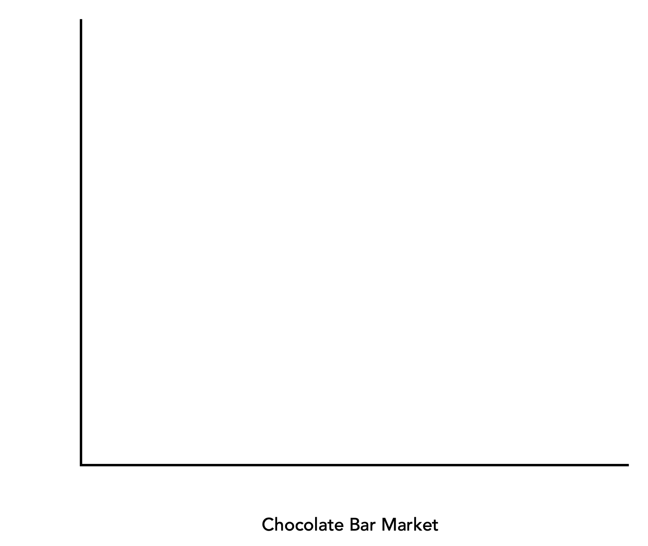
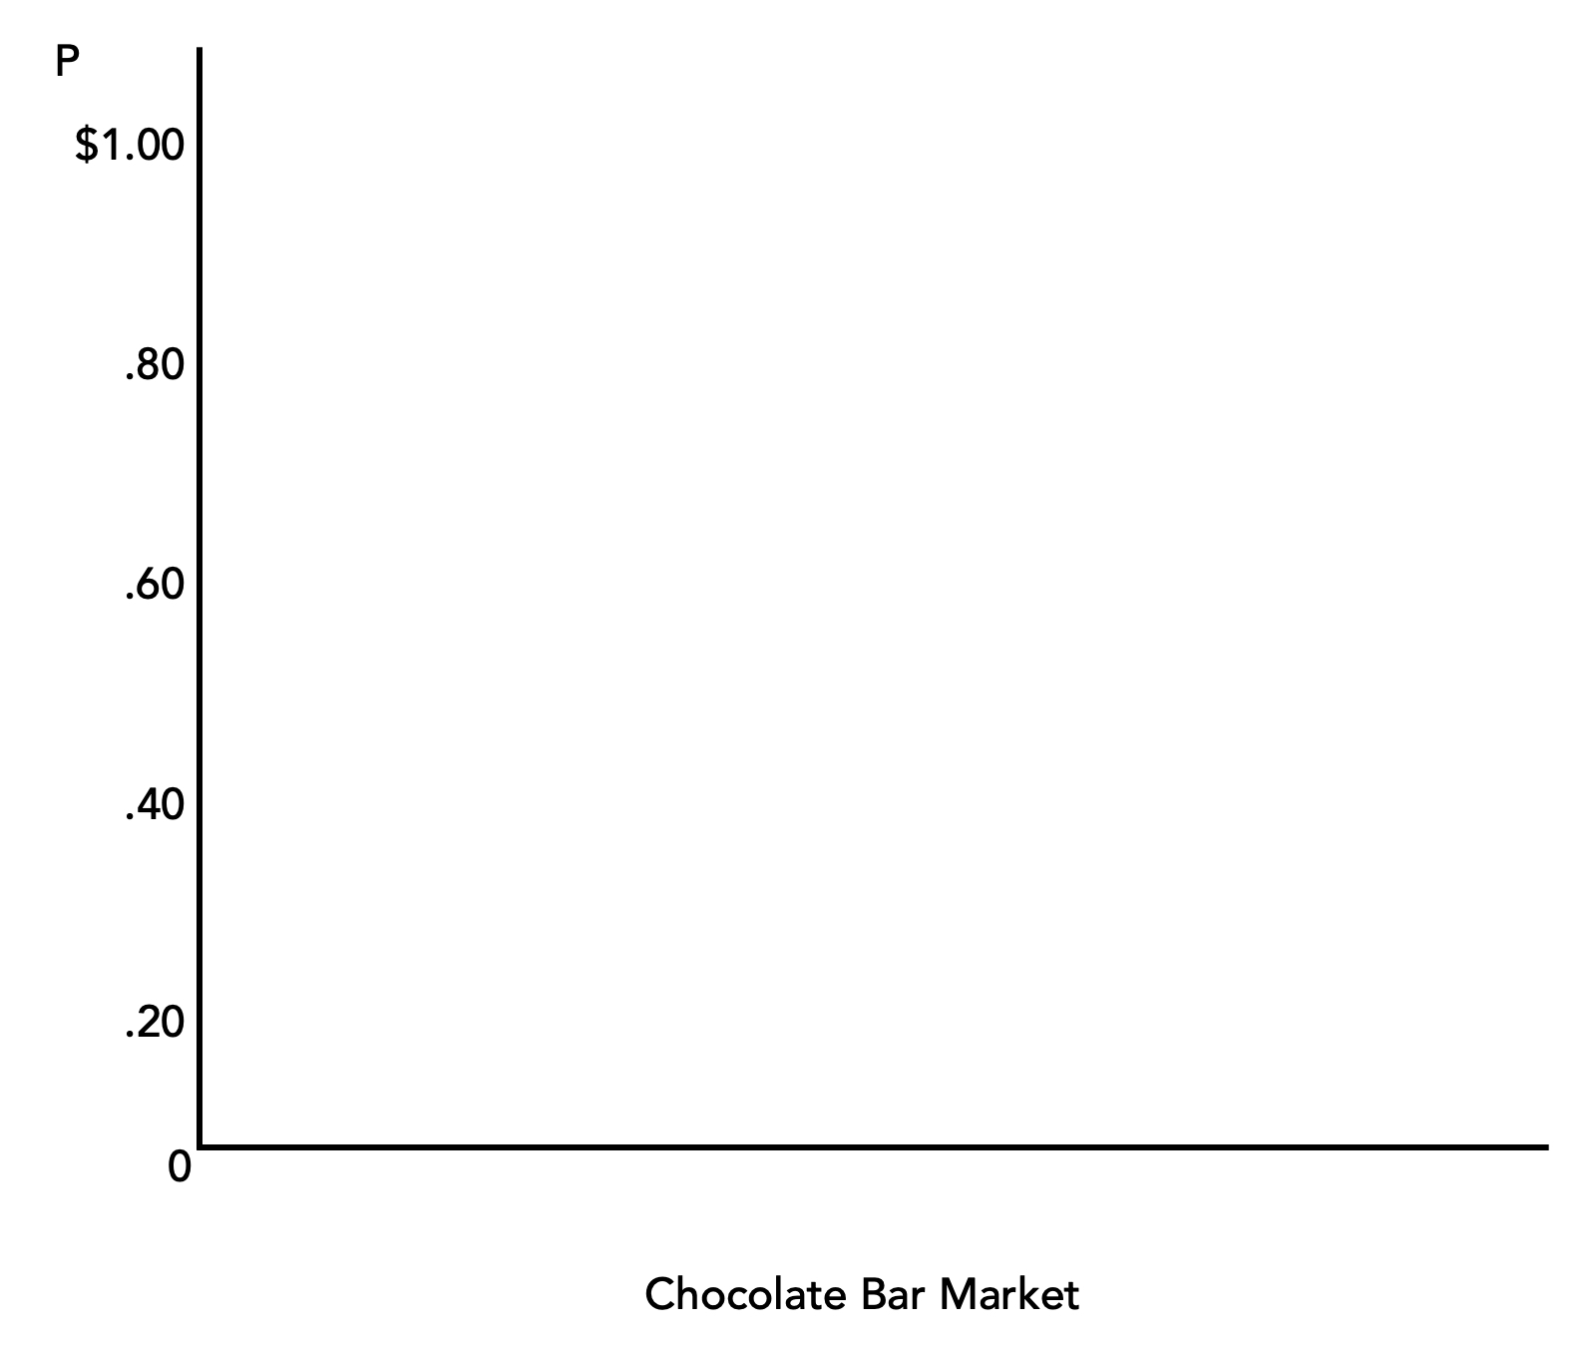
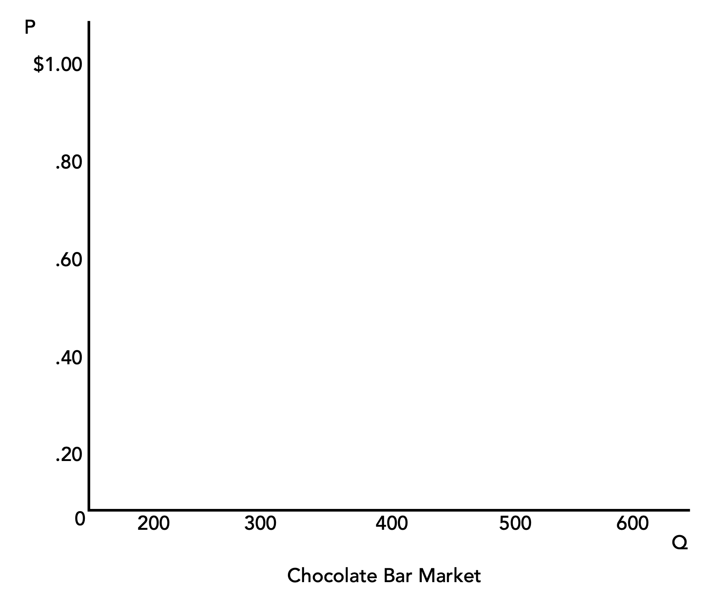
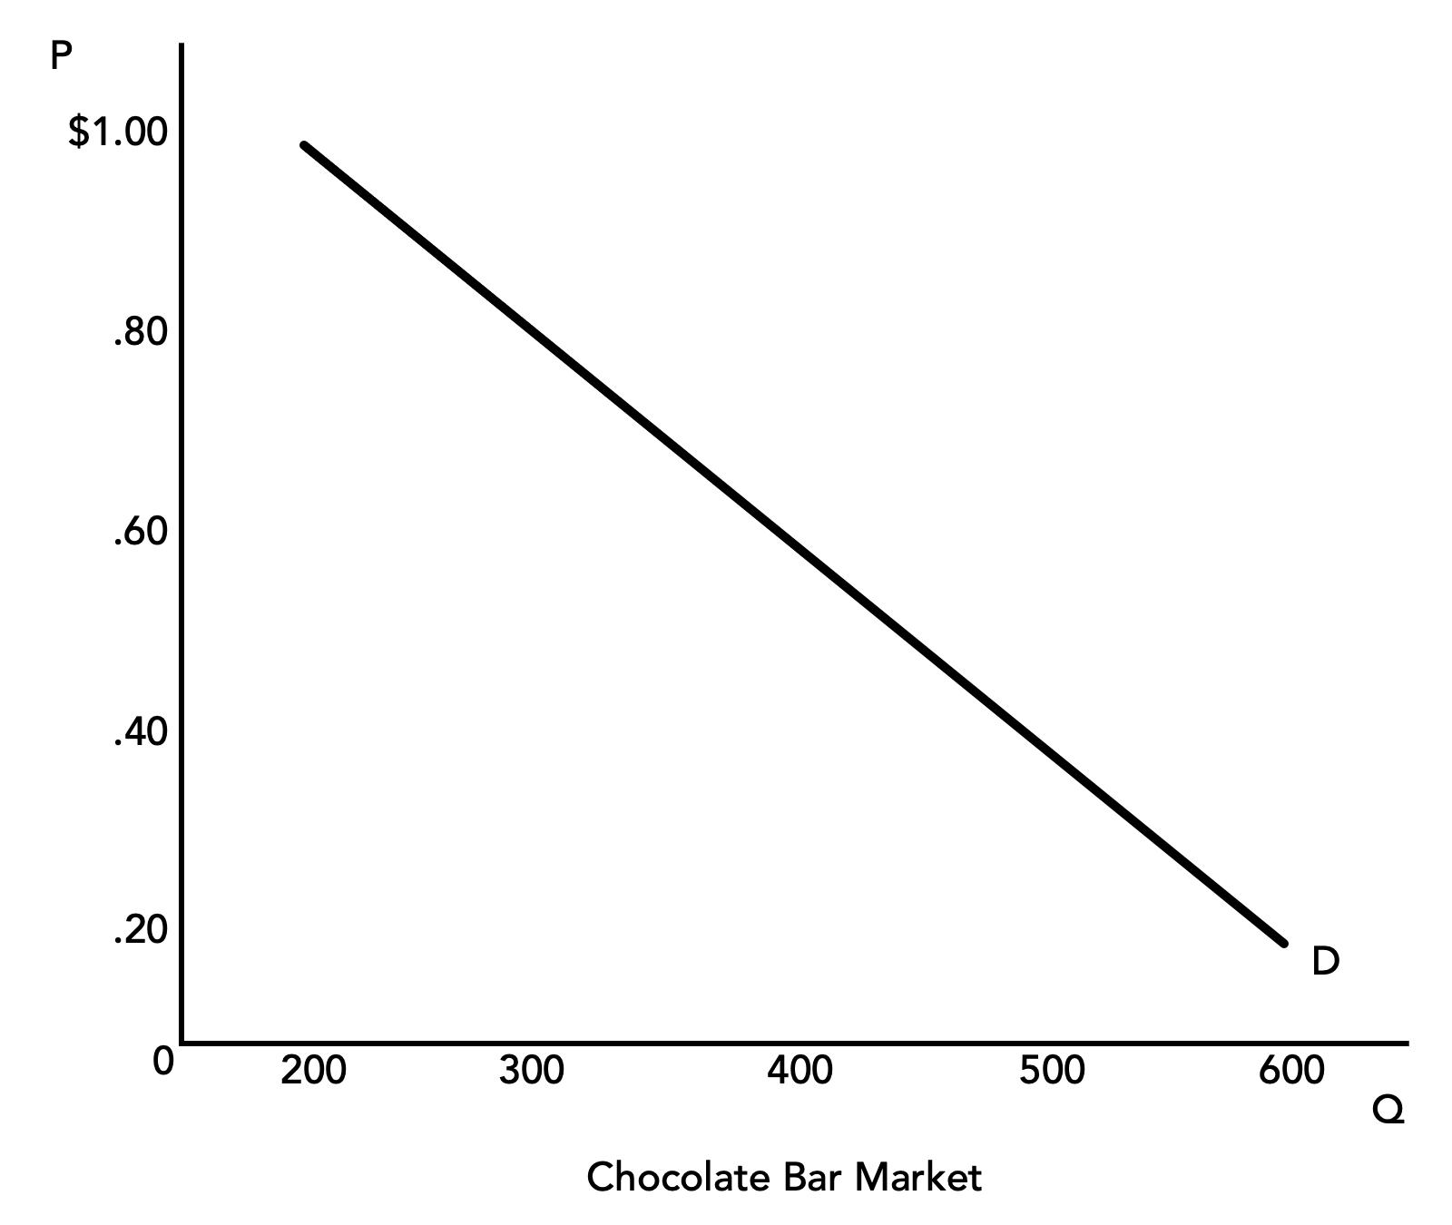
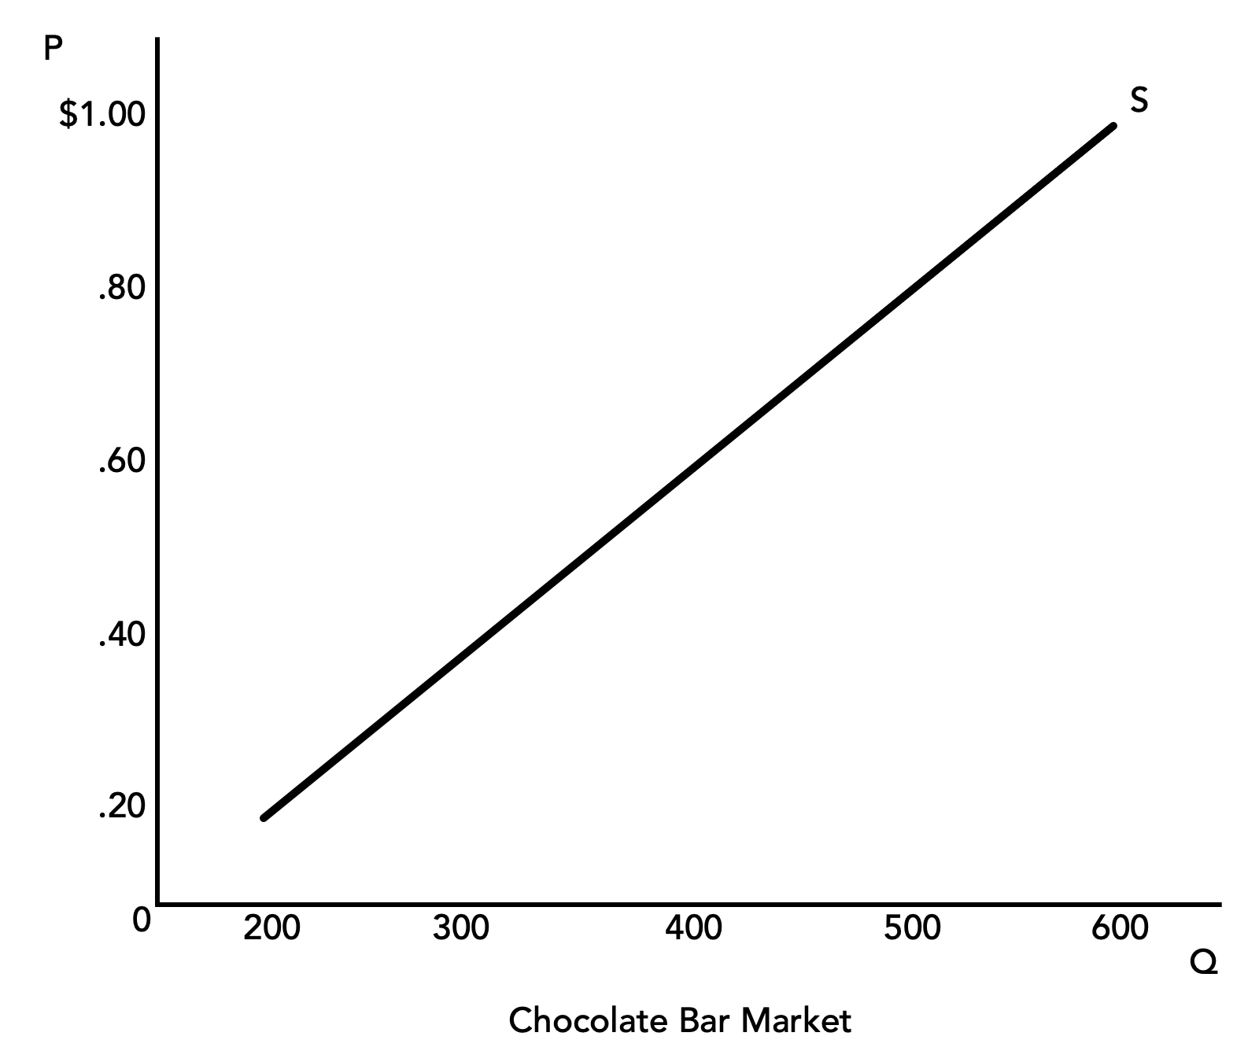
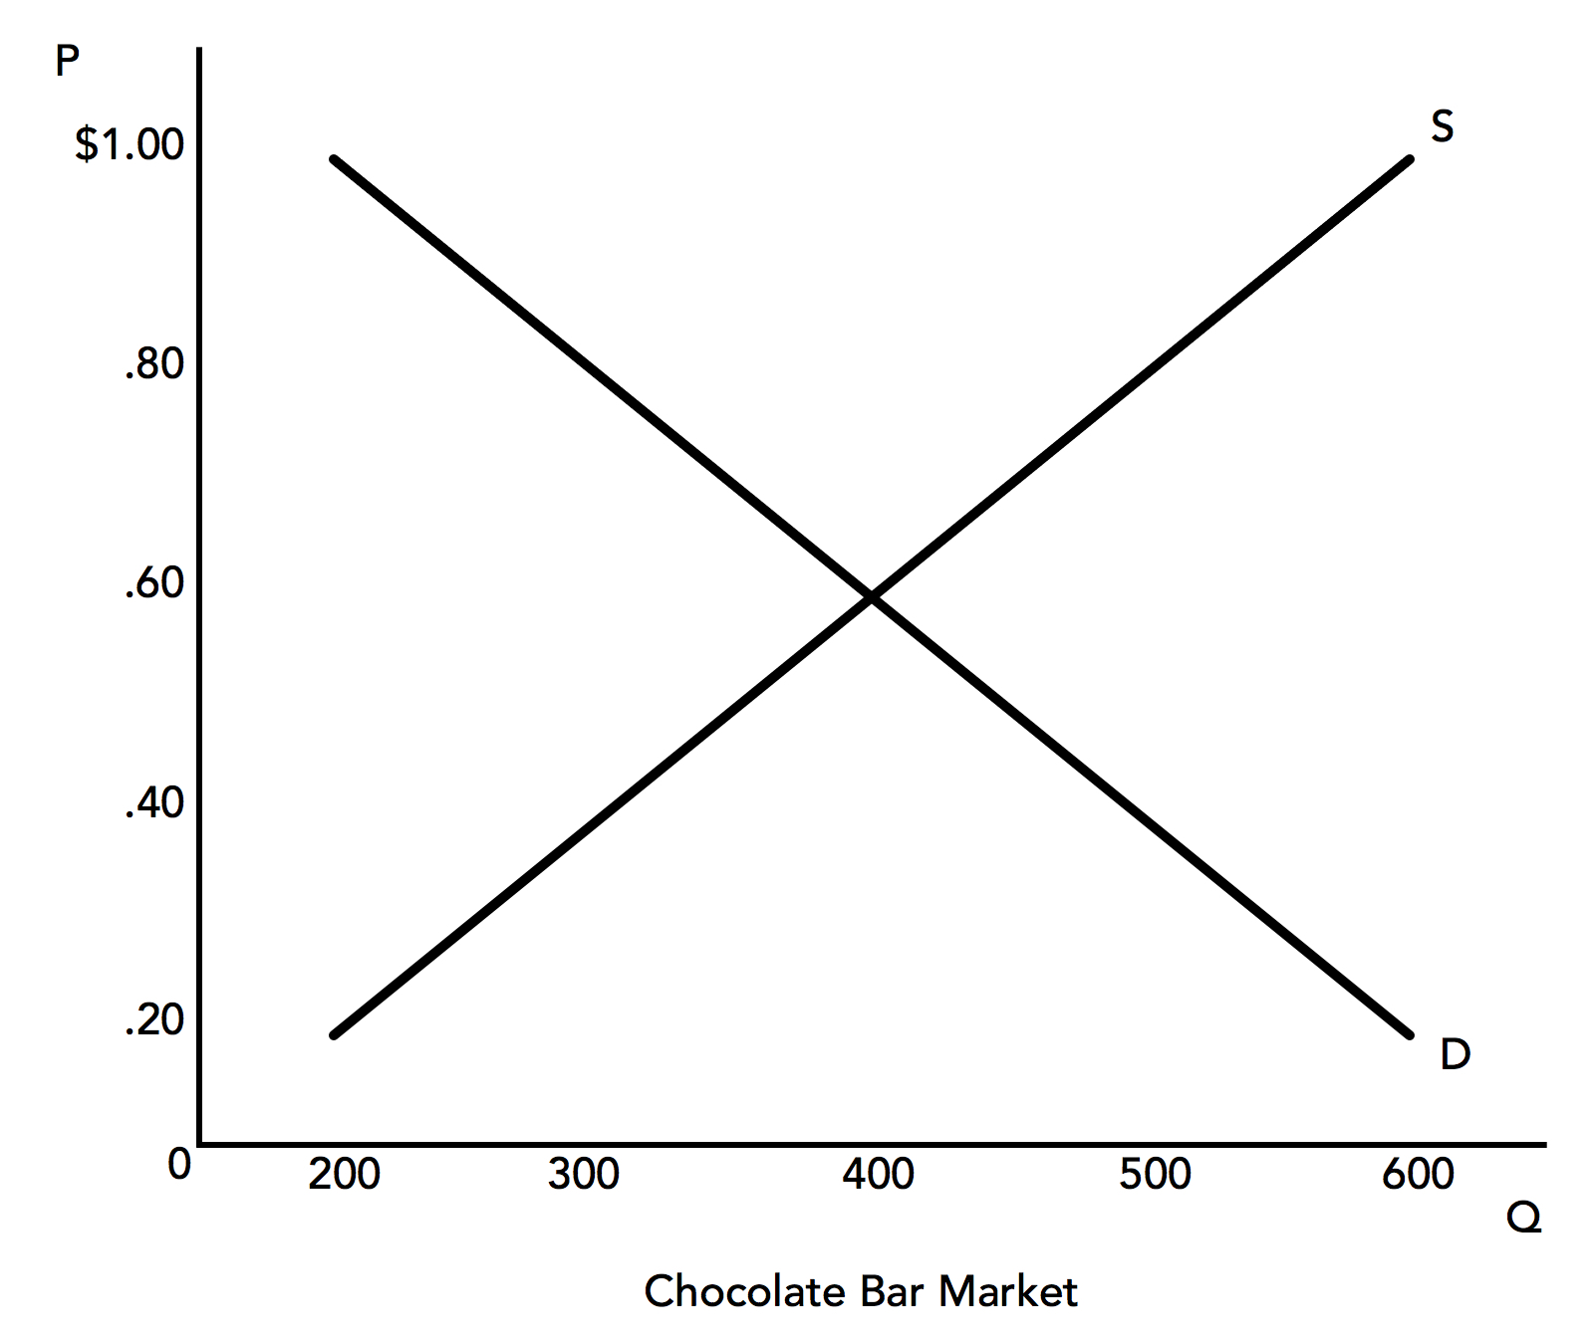
Section: Building Conventional Theory, cont’d
Please note well: Unlike in regular mathematics, the independent variable P is on the y-axis. This will be challenging for some of you... be careful!
From The VOTE Textbook Second Edition Copyright © 2023

Slide 24
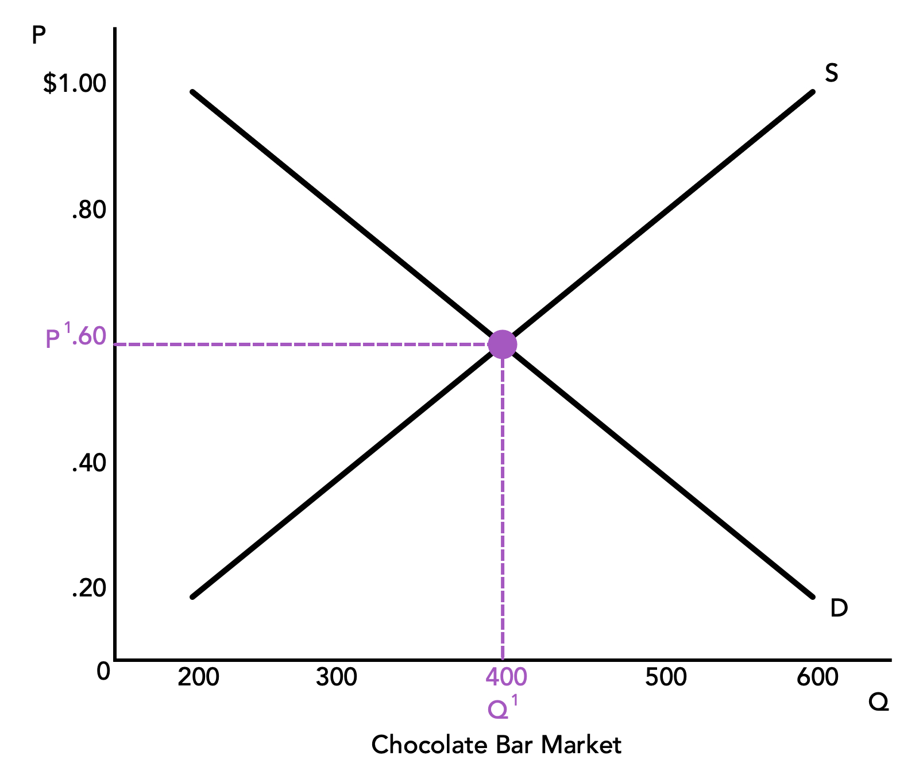
Section: Building Conventional Theory, cont’d
From The VOTE Textbook Second Edition Copyright © 2023

Slide 25
Section: Building Conventional Theory, cont’d
To draw a graph of a market, you need to include six components:
(1) P for Price on the y-axis
(2) Q for Quantity on the x-axis
(3) D for the Demand Curve (negative slope)
(4) S for the Supply Curve (positive slope)
(5) P¹ for Equilibrium Price
(6) Q² for Equilibrium Quantity
From The VOTE Textbook Second Edition Copyright © 2023

Slide 26
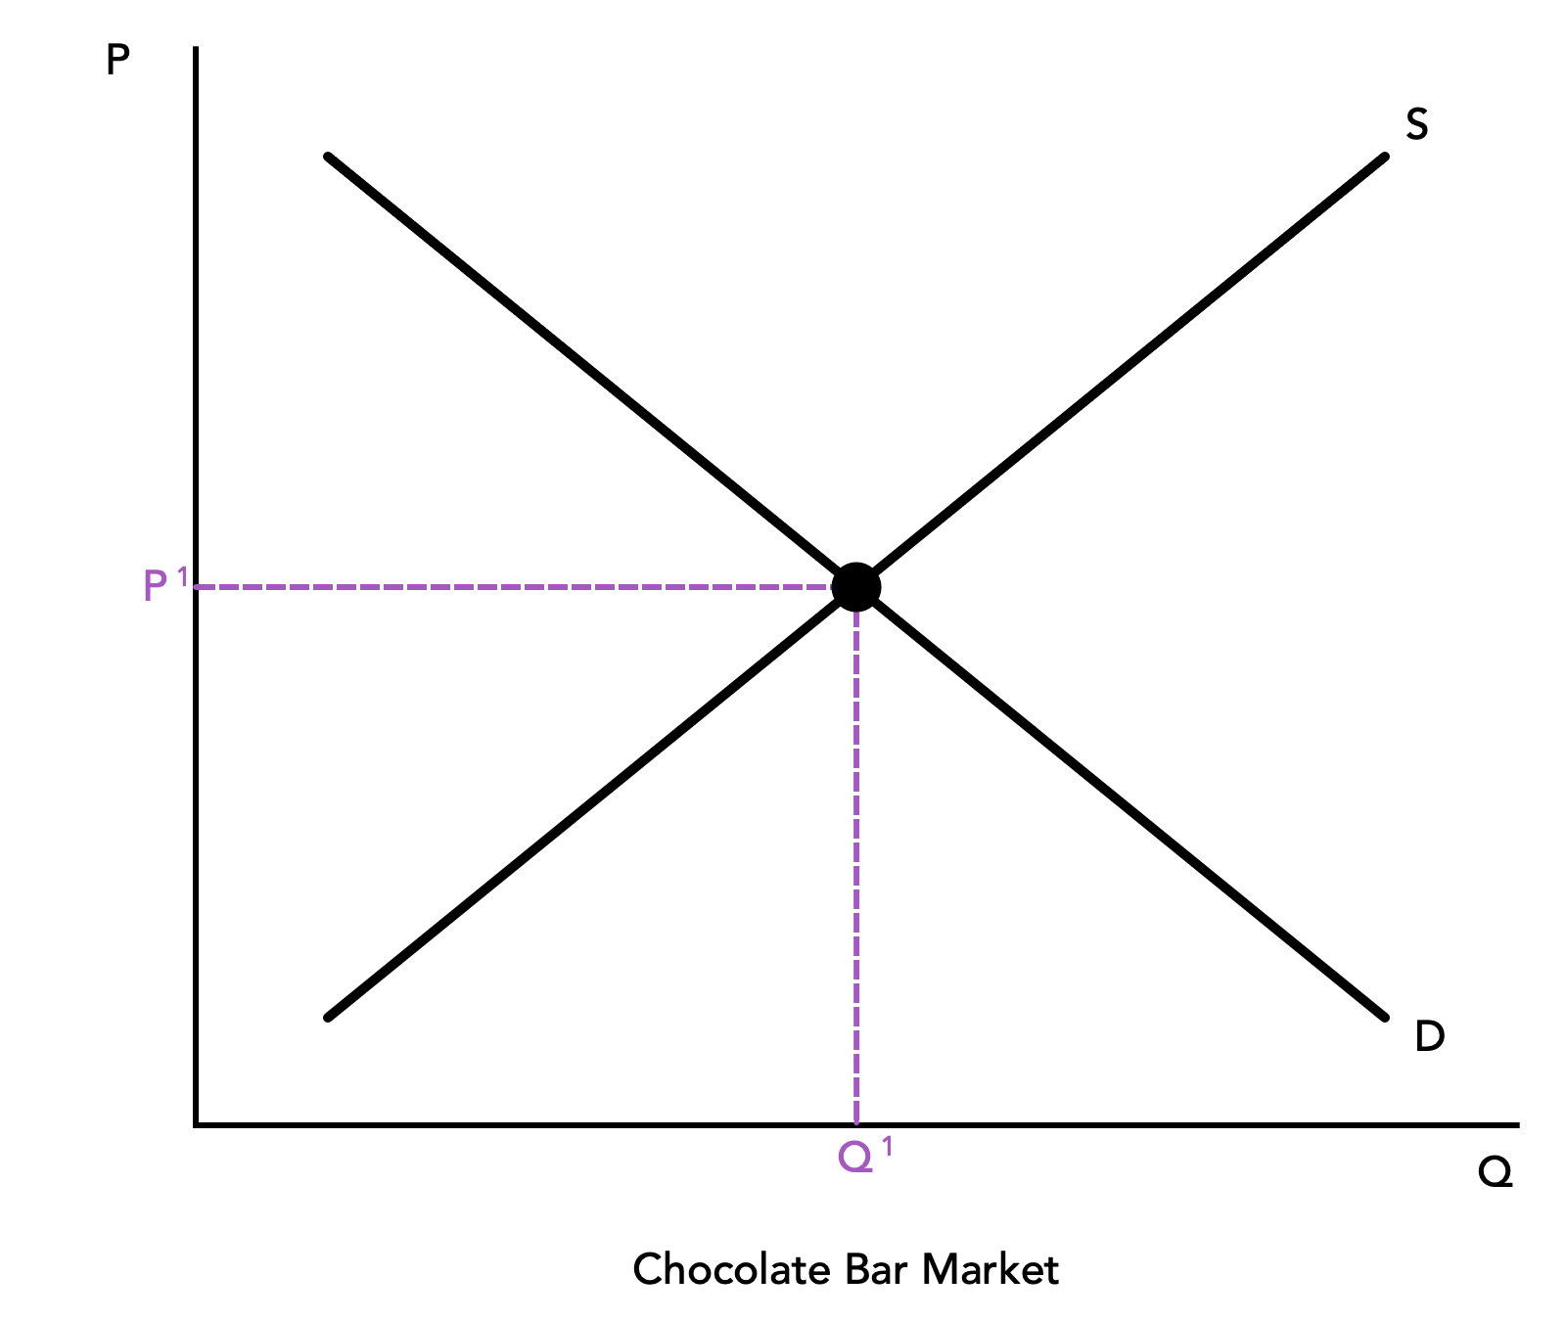
Section: Building Conventional Theory, cont’d
Practice: Draw a graph of a market—let’s say it’s the bicycle market.
(There is no need for numbers along the axes because we know the slopes.)
(1)
(4)
(5)
(3)
(6)
(2)
Bicycle Market
From The VOTE Textbook Second Edition Copyright © 2023

Slide 27
Section: Building Conventional Theory, cont’d
Surpluses and Shortages?
NEVER!
Price signals will automatically bring the market back to equilibrium, ceteris paribus.
From The VOTE Textbook Second Edition Copyright © 2023

Slide 28
Section: Building Conventional Theory, cont’d
Q^{S} > Q^{D}
Surplus
V
Price tends ↓
V
Q^{D}
Q^{S}
From The VOTE Textbook Second Edition Copyright © 2023

Slide 29
Section: Building Conventional Theory, cont’d
V
V
Q^{D} > Q^{S}
Shortage
Price tends ↑
Q^{S}
Q^{D}
From The VOTE Textbook Second Edition Copyright © 2023

Slide 30

Section: Building Conventional Theory, cont’d
If price signals always lead the market back to equilibrium, prices would never change, right? But we know they do—all the time!
Remember, we had to assume ceteris paribus to draw market graphs. So now, let’s release the condition that all other things besides price remain constant, and consider the six factors that shift the demand curve and the six factors that shift the supply curve.
These shifts bring about the price changes you see every day.
From The VOTE Textbook Second Edition Copyright © 2023

Slide 31
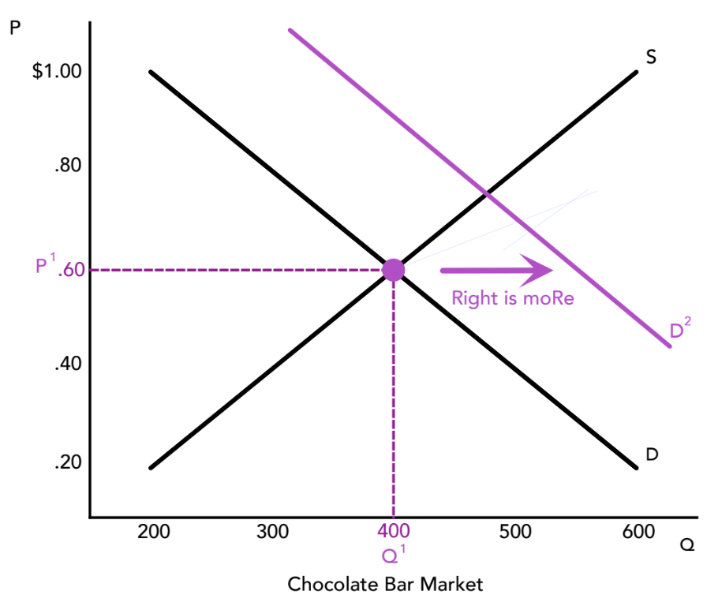
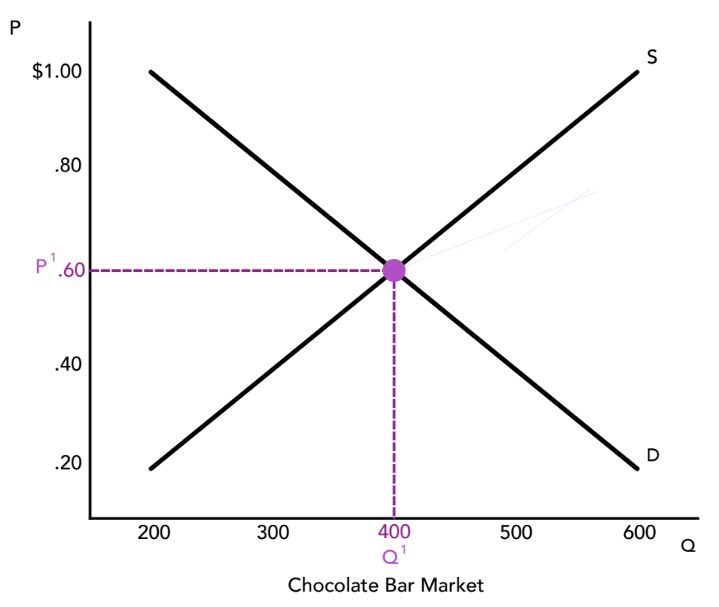
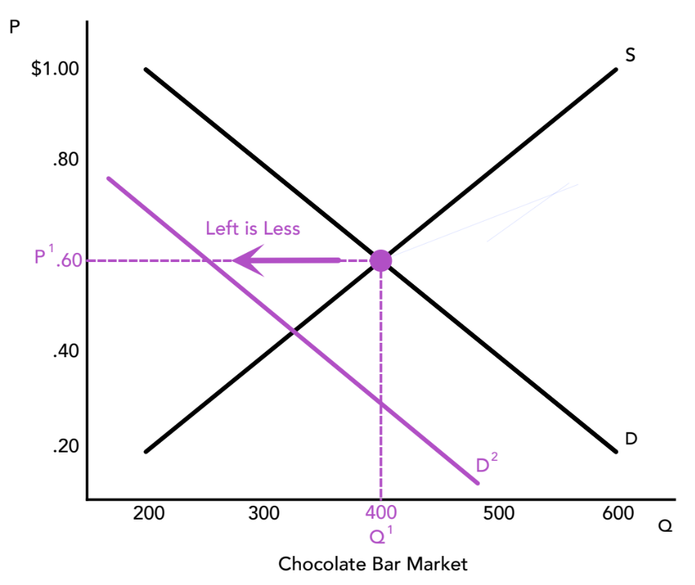
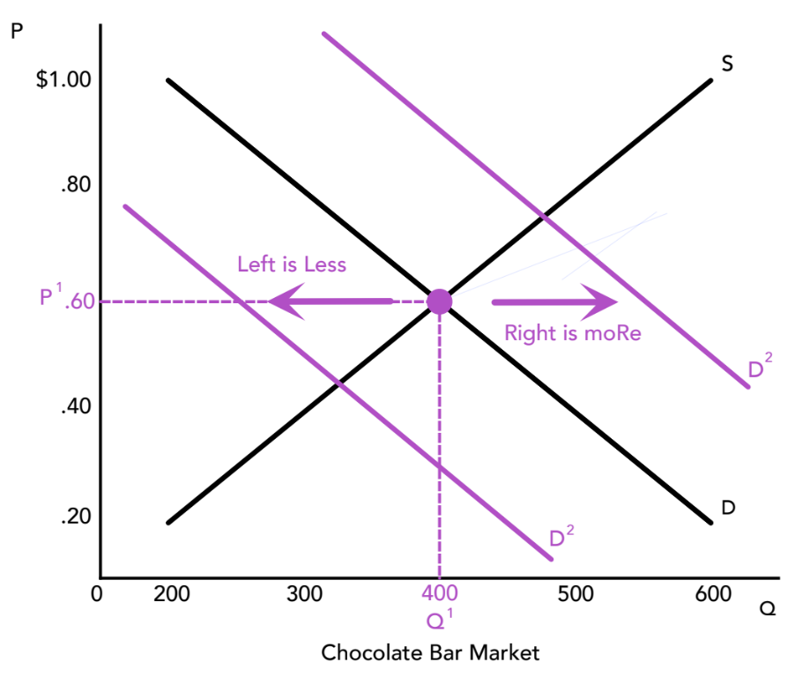
Section: Building Conventional Theory, cont’d
Six Factors that Shift the Demand Curve
Income
Preference
Prices of Complements
and Substitutes
Availability/Convenience
Future Expectations
of Price, Income,
and Preference
Number of Buyers
From The VOTE Textbook Second Edition Copyright © 2023

Slide 32

The Demand Curve for Chocolate Bars
Section: Building Conventional Theory, cont’d
What happens to demand for chocolate bars
when there is a change in…
Income — Average wages fall $2/hour.
From The VOTE Textbook Second Edition Copyright © 2023

Slide 33
Polling Question
Demand and Supply Shifts
Choose the correct change in demand in the market for chocolate bars if average wages fall by $2 per hour.
Demand shifts left
Demand shifts right
Demand doesn’t shift
From The VOTE Textbook Second Edition Copyright © 2023

Slide 34
The Demand Curve for Chocolate Bars
Section: Building Conventional Theory, cont’d
What happens to demand for chocolate bars
when there is a change in…
Income — Average wages fall $2/hour.
Demand shifts left
Preference — Chocolate is found to be
an anti-carcinogen.
Demand shifts right
Number of Buyers — Immigration reform
opens the borders to immigrants.
Demand shifts right
From The VOTE Textbook Second Edition Copyright © 2023

Slide 35
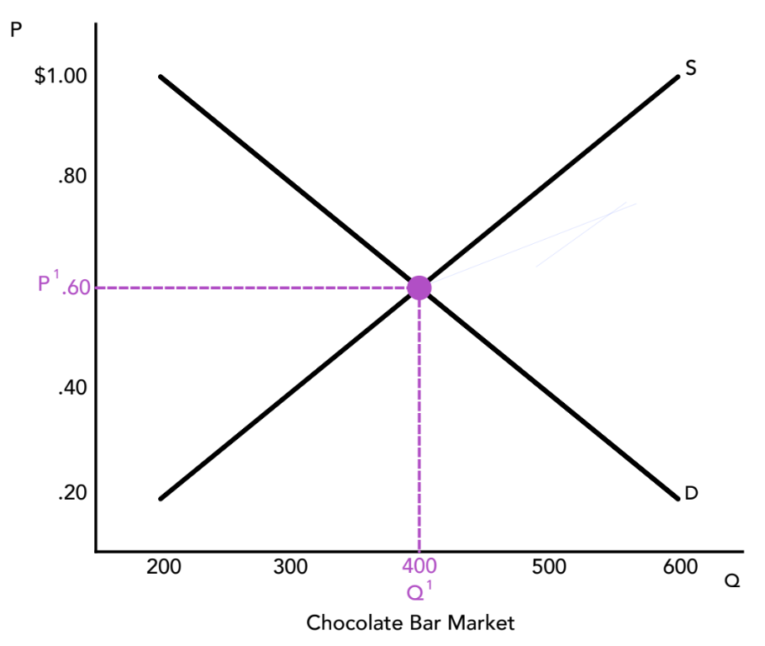
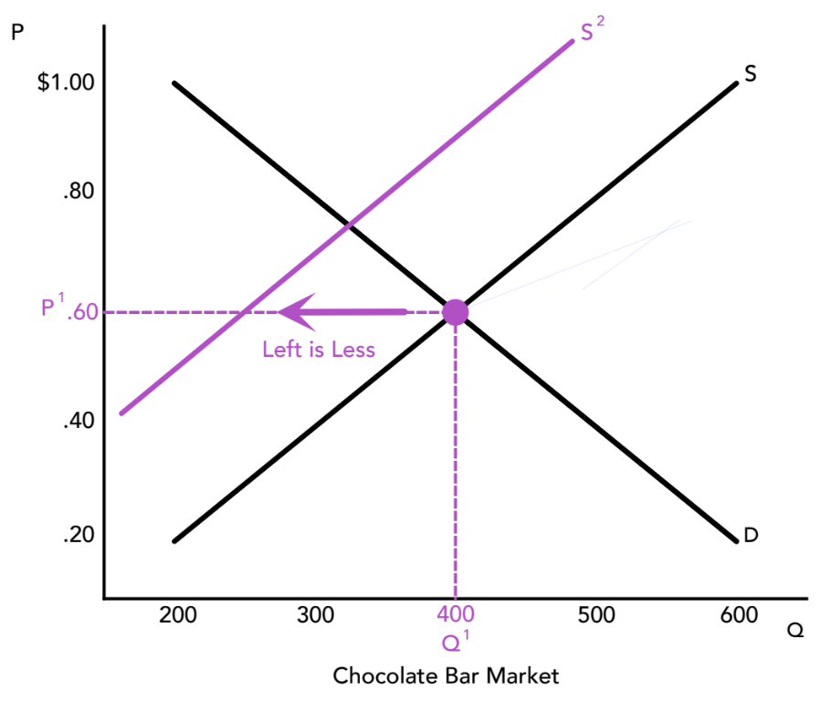
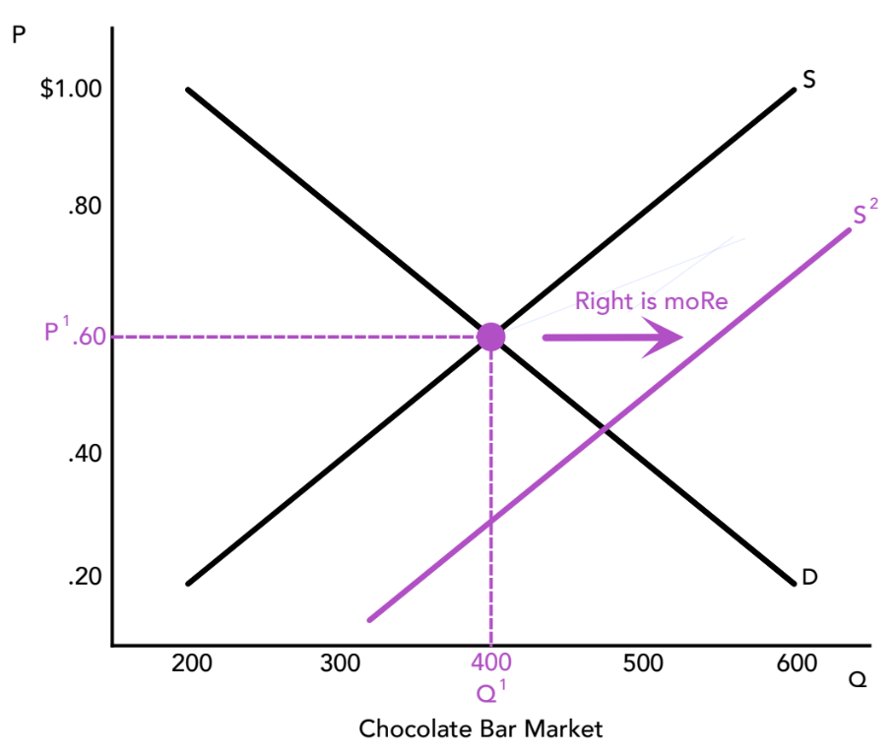
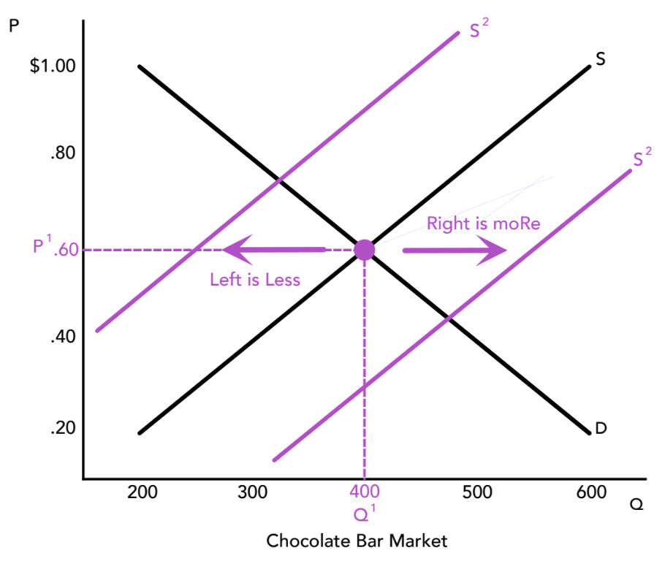
Section: Building Conventional Theory, cont’d
Six Factors that Shift the Supply Curve
Cost of Inputs
Number of Firms
Taxes, Subsidies,
and Regulations
Prices of Related Goods
Changes in Technology
Future Expectations
From The VOTE Textbook Second Edition Copyright © 2023

Slide 36
The Supply Curve for Chocolate Bars
Section: Building Conventional Theory, cont’d
What happens to supply of chocolate bars
when there is a change in…
Cost of Inputs — A hurricane in the Caribbean
increases the price of sugar.
Supply shifts left
Taxes, Subsidies, and Regulations — A tax break
is given to chocolate bar producers.
Supply shifts right
Changes in Technology — A faster
procedure is used to mix milk, cocoa, and sugar.
Supply shifts right
DAILY
DOUBLE
From The VOTE Textbook Second Edition Copyright © 2023

Slide 37
Form: Conventional Theory: Capitalism
Conventional Theory: Capitalism
1.
2.
ASSUMPTIONS
MODEL
Scarcity
Individuals Maximize Happiness
Firms Maximize Profits
Production Possibilities Curve
Law of Demand
Law of Supply
Self-Interest
Market: Price signals (the invisible hand)
3.
Determinants of Demand
Income
Preference
Number of Buyers
Availability/Convenience
Prices of Substitutes and Complements
Future Expectations
Determinants of Supply
Cost of Inputs
Number of Firms
Taxes, Subsidies, and
Regulations
Prices of Related Goods
Changes in Technology
Future Expectations
CONCLUSIONS
Conservative Policy
Liberal Policy
From The VOTE Textbook Second Edition Copyright © 2023

Slide 38
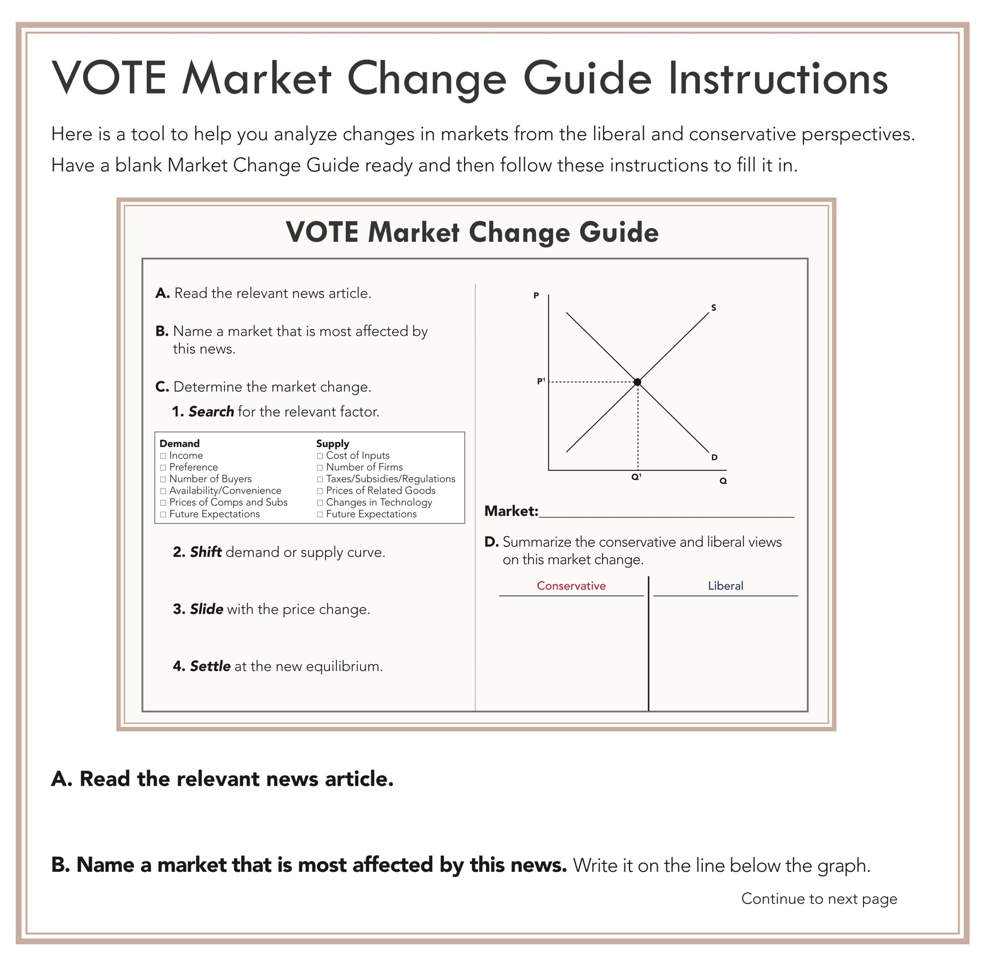

Form: VOTE Market Change Guide Instructions
VOTE Market Change Guide Instructions
From The VOTE Textbook Second Edition Copyright © 2023

Slide 39
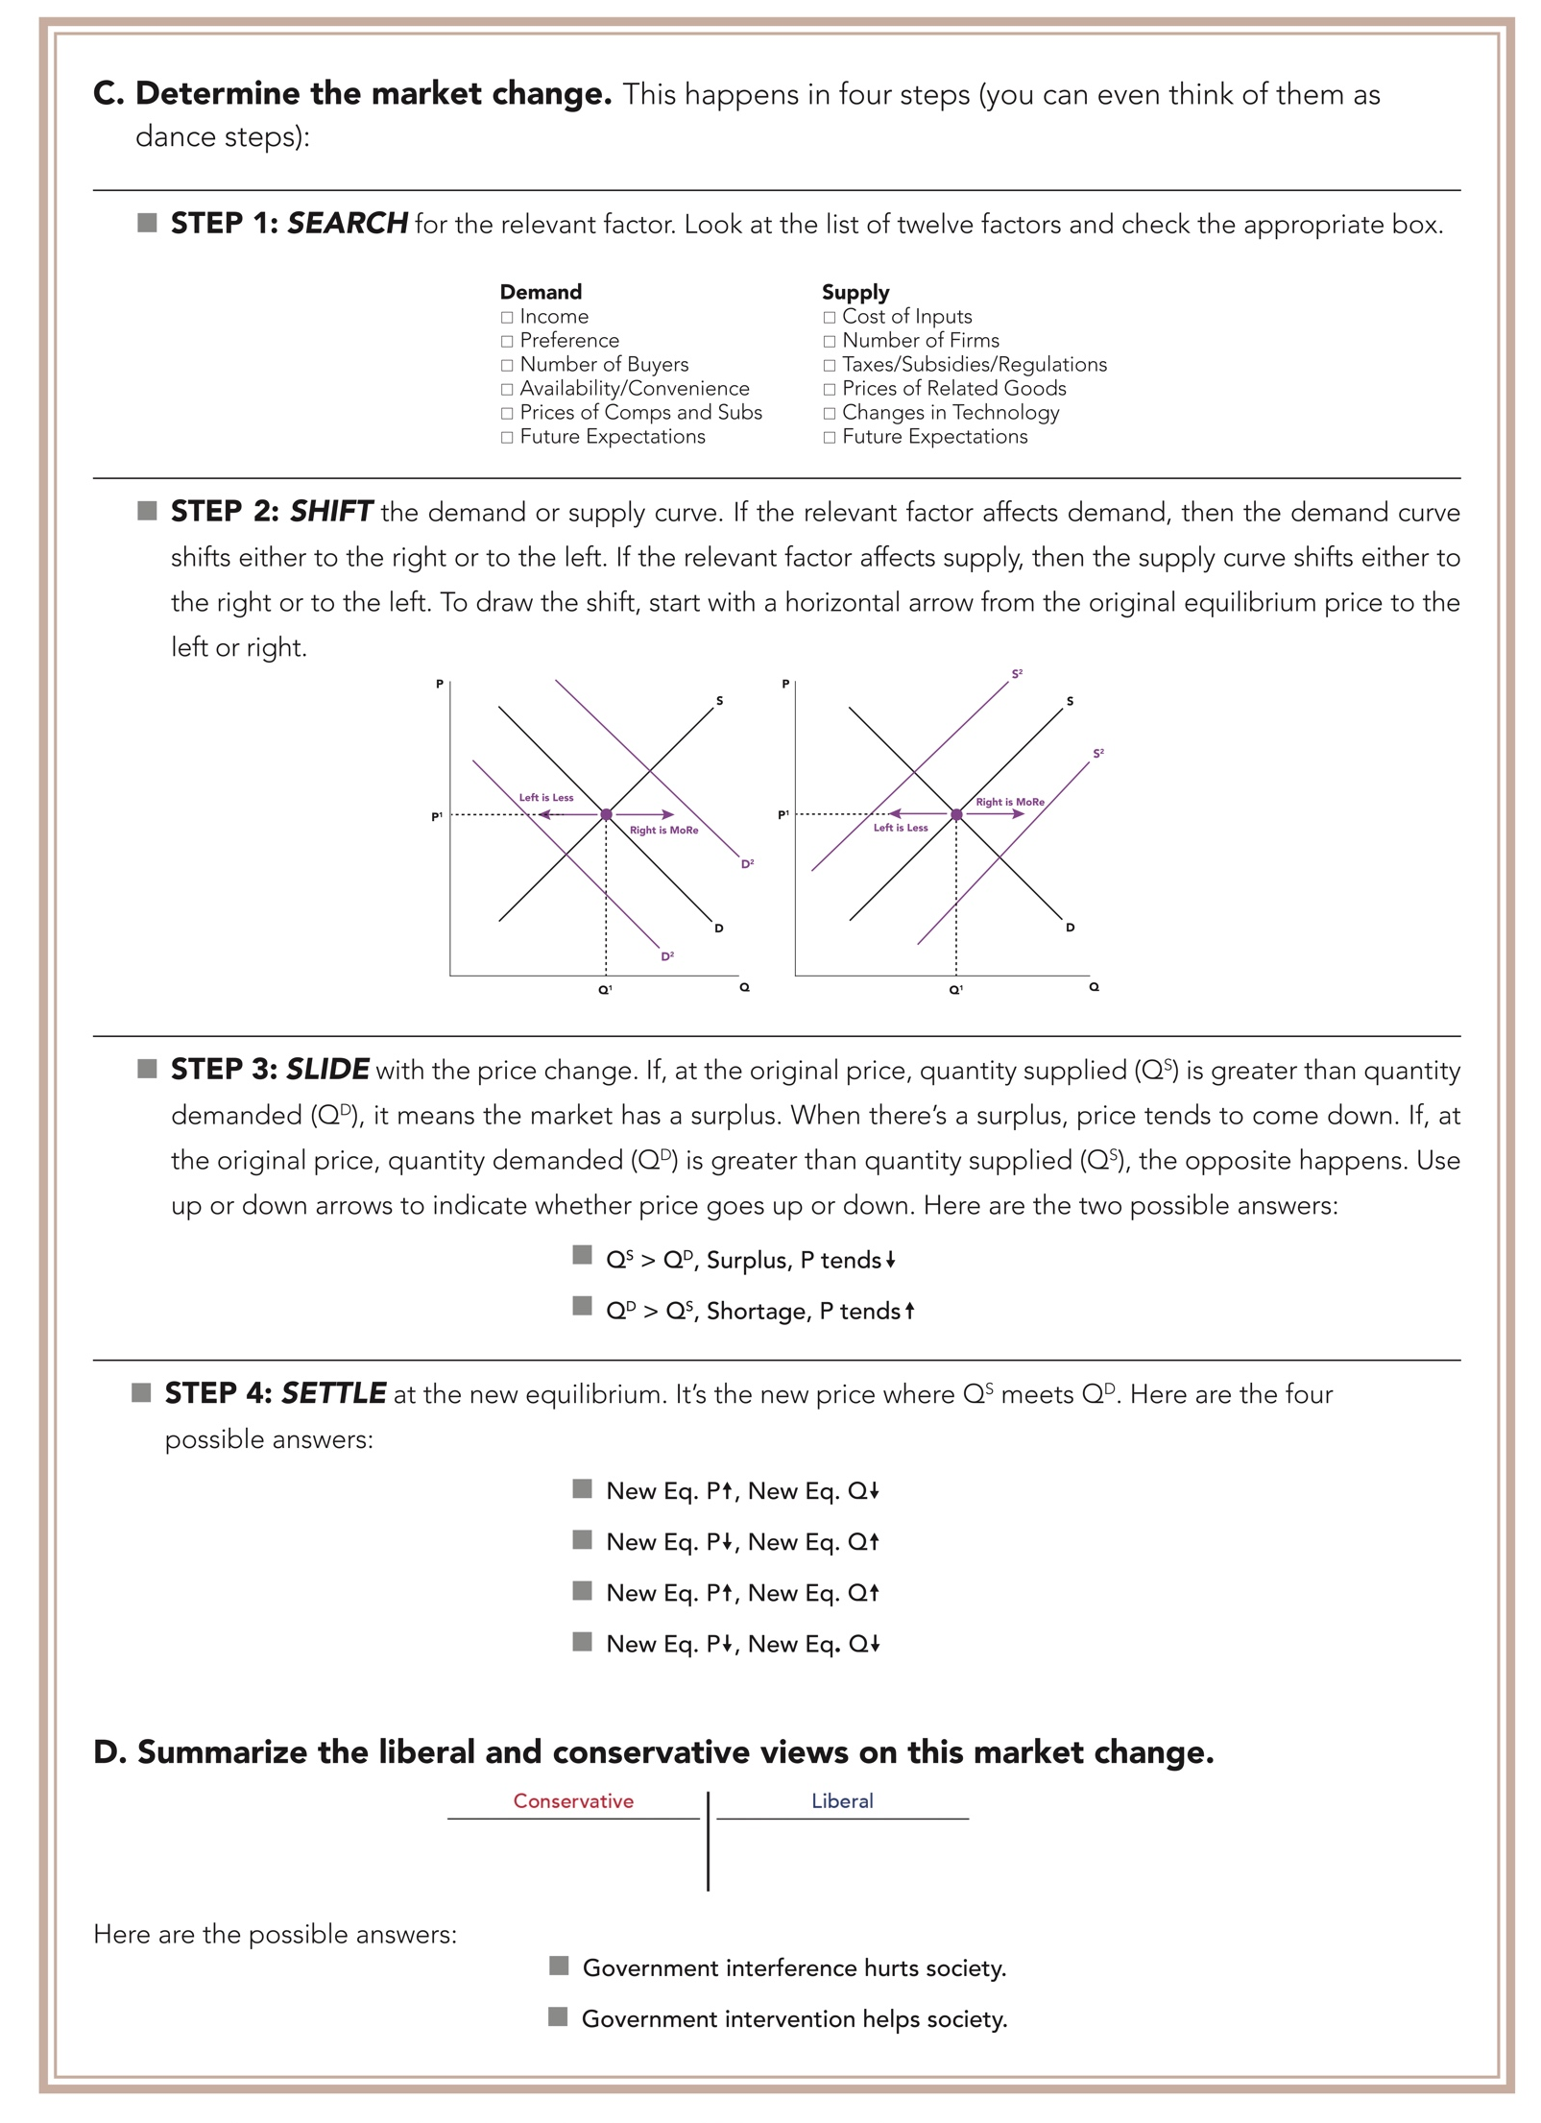
Form: VOTE Market Change Guide Instructions, cont’d
From The VOTE Textbook Second Edition Copyright © 2023

Slide 40
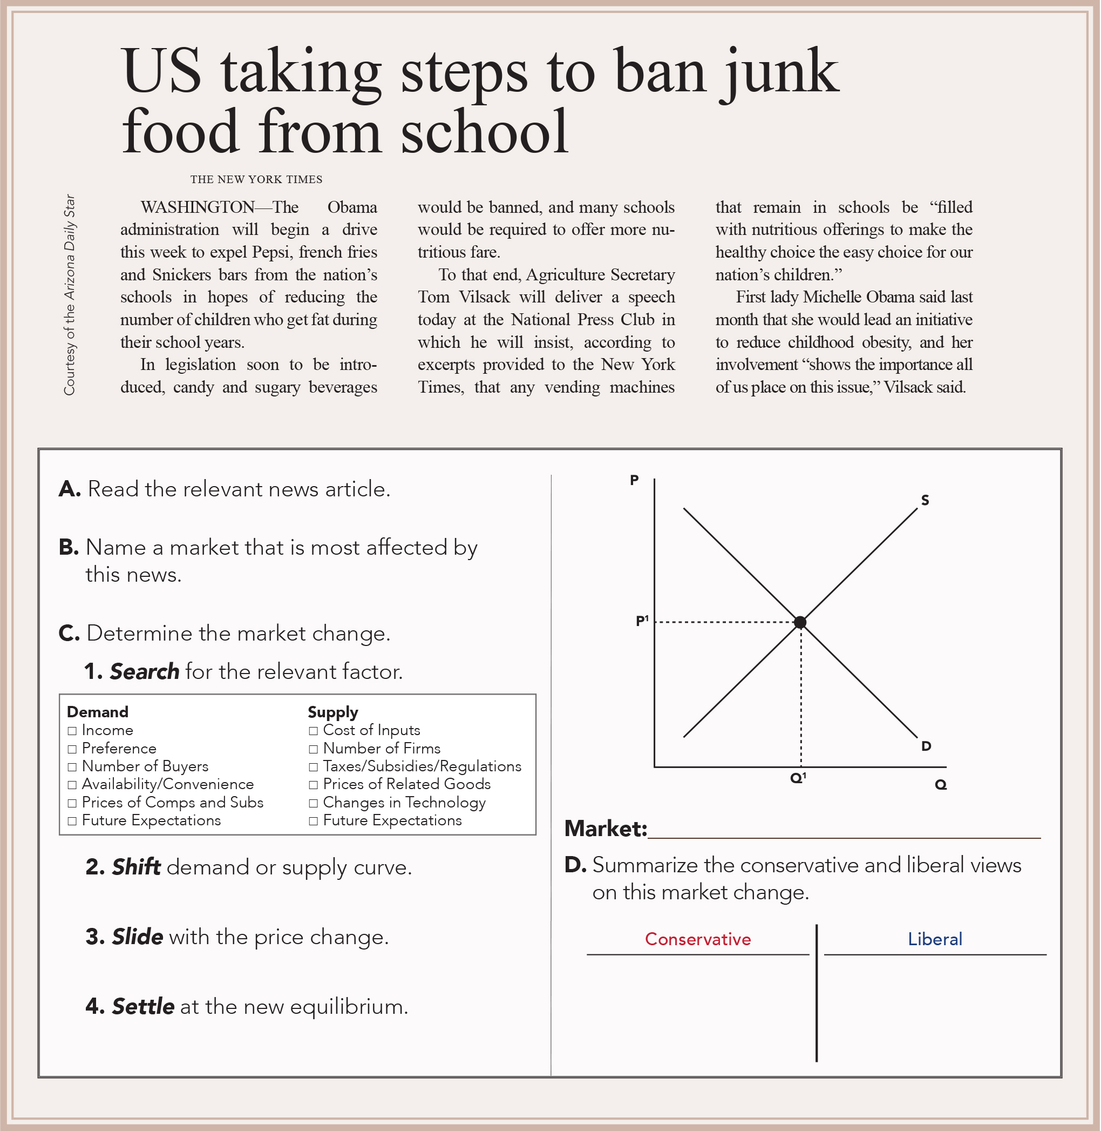
Exercise 5.1: VOTE Market Change Guide
Exercise 1: VOTE Market Change Guide
  Soda Market
From The VOTE Textbook Second Edition Copyright © 2023

Slide 41
Polling Question
Search for the Relevant Factor
Which factor causes a shift of supply or demand for soda when sodas are no longer allowed to be sold in schools?
Income
Preference
Number of Buyers
Availability/Convenience
Cost of Inputs
Number of Firms
Taxes, Subsidies, and Regulations
Changes in Technology
From The VOTE Textbook Second Edition Copyright © 2023

Slide 42
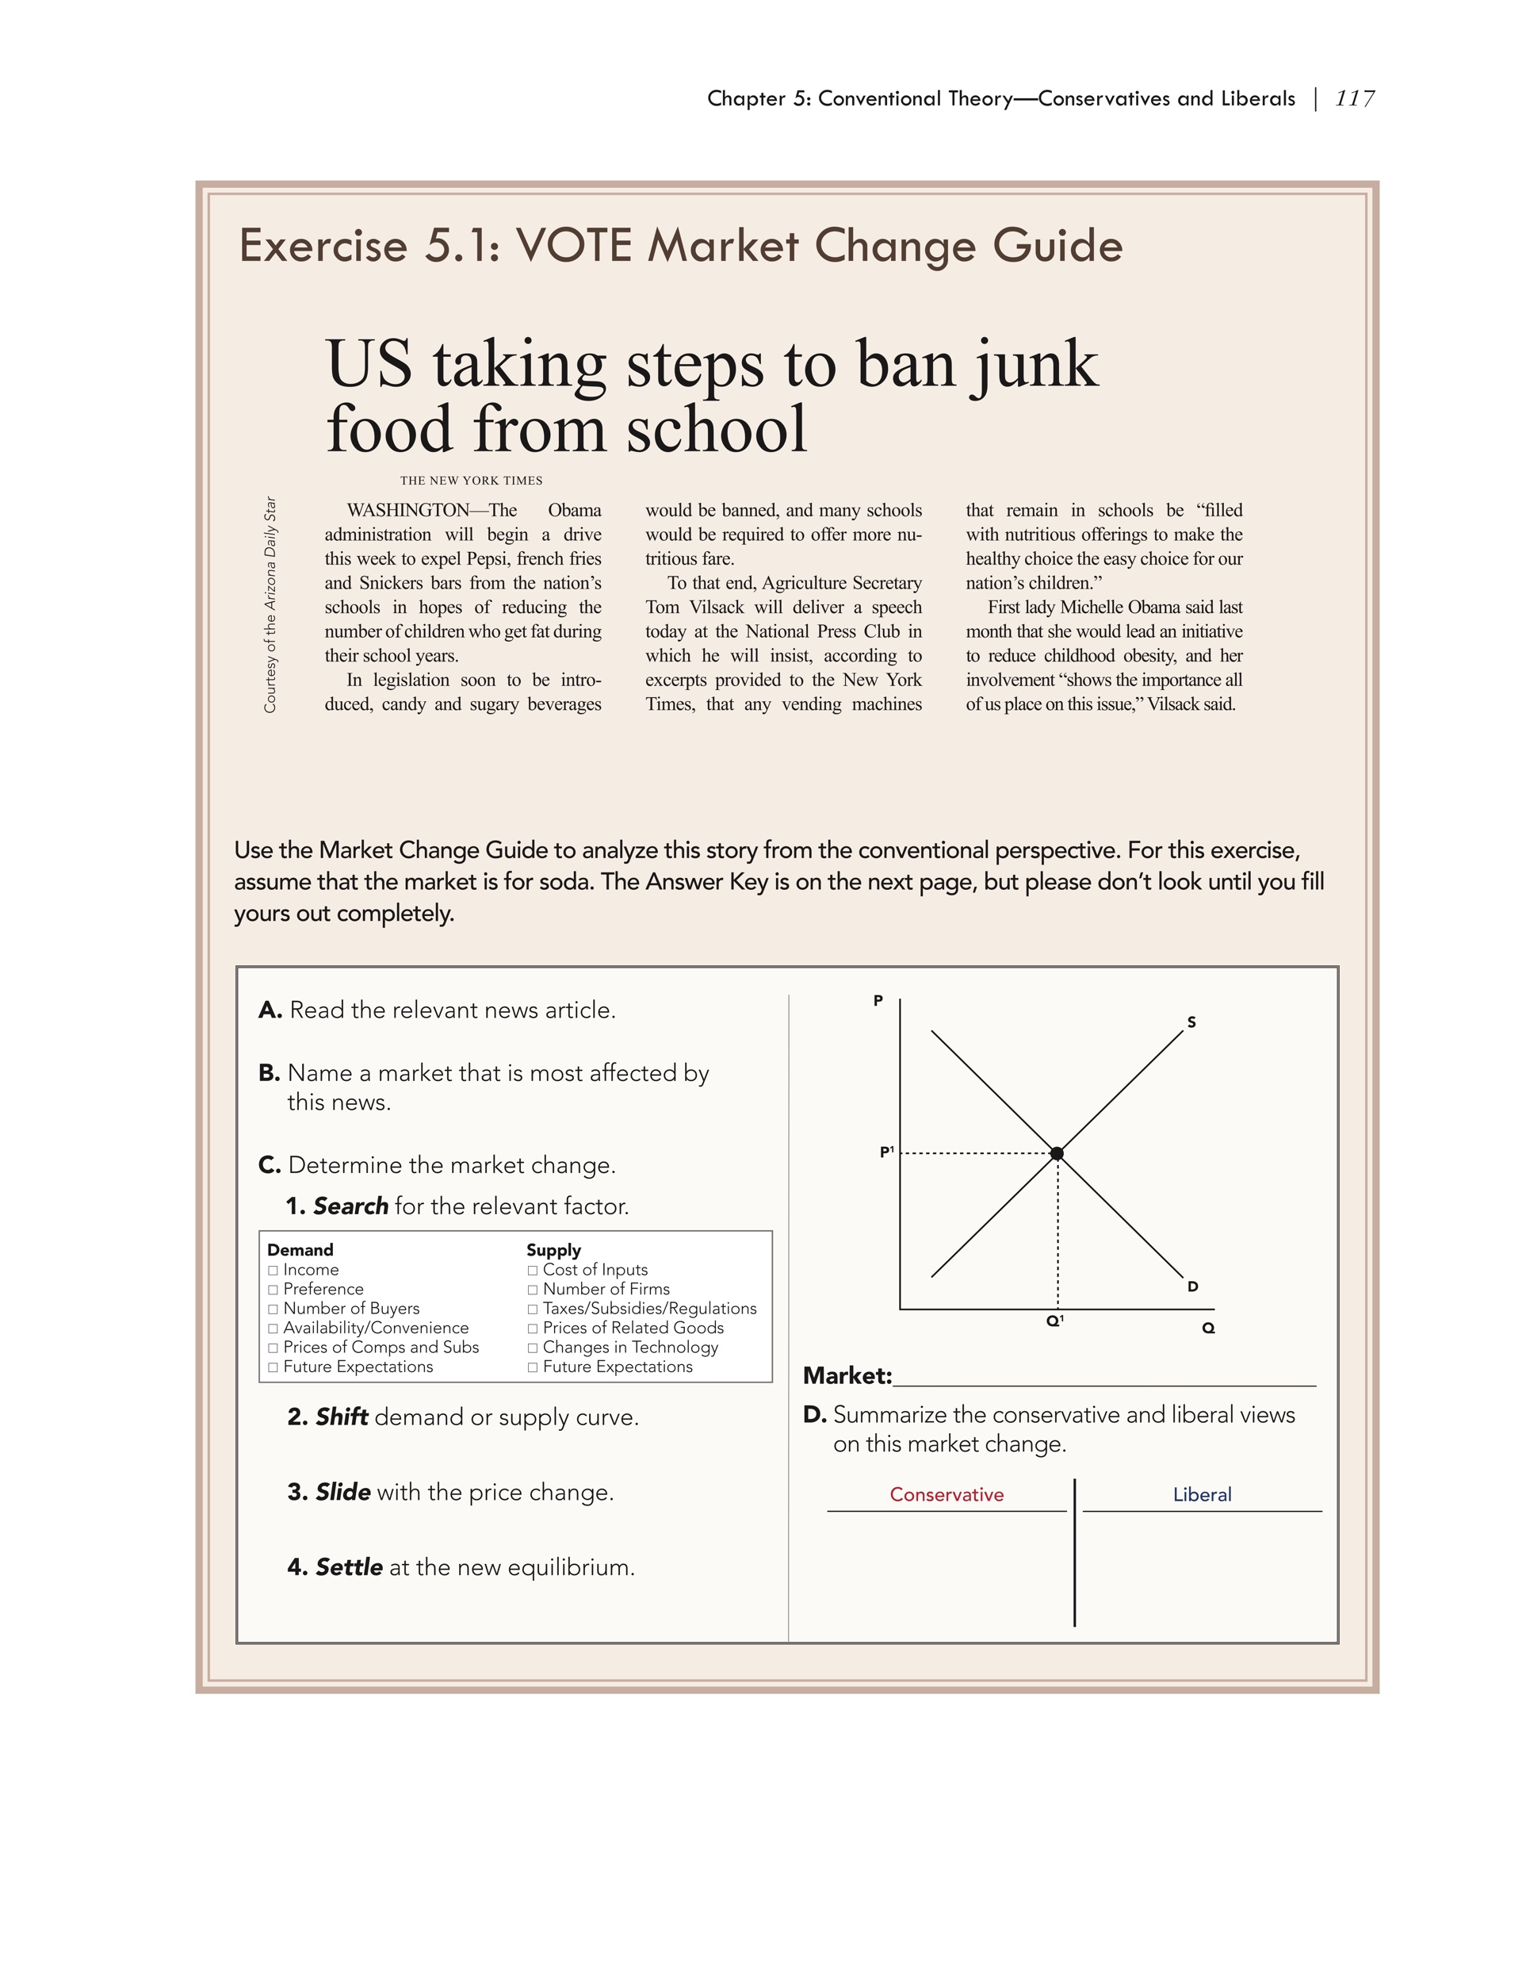
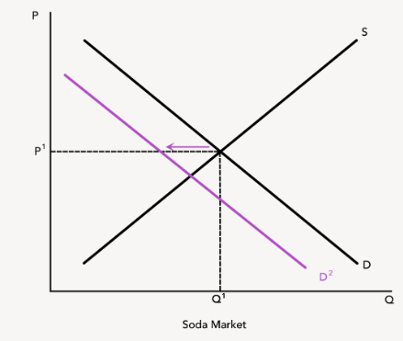
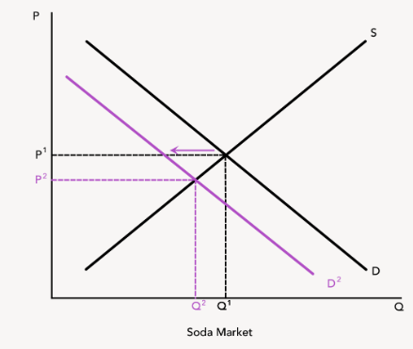
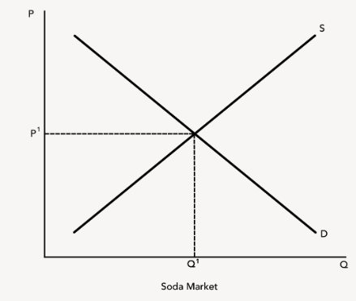

Exercise 5.1: VOTE Market Change Guide, cont’d
Exercise 1: VOTE Market Change Guide, cont’d
  Soda Market
  Demand shifts left
  Q^{S} > Q^{D}, Surplus, P tends ↓
  New Eq. P ↓, New Eq. Q ↓
From The VOTE Textbook Second Edition Copyright © 2023

Slide 43
Form: Conventional Theory: Capitalism
Conventional Theory: Capitalism
1.
2.
ASSUMPTIONS
MODEL
Scarcity
Individuals Maximize Happiness
Firms Maximize Profits
Production Possibilities Curve
Law of Demand
Law of Supply
Self-Interest
Market: Price signals (the invisible hand)
3.
Determinants of Demand
Income
Preference
Number of Buyers
Availability/Convenience
Prices of Substitutes and Complements
Future Expectations
Determinants of Supply
Cost of Inputs
Number of Firms
Taxes, Subsidies, and Regulations
Prices of Related Goods
Changes in Technology
Future Expectations
CONCLUSIONS
Conservative Policy
Liberal Policy
From The VOTE Textbook Second Edition Copyright © 2023

Slide 44

Section: Building Conventional Theory, cont’d
Conventional theorists say that even aliens visiting from outer space would see all the good that comes from capitalism.
They say that we can’t see the invisible hand, but we can see the effects of this marvelous economic system on our lovely blue-green planet. Where there is capitalism, profit brings prosperity to societies and gives humans what they want and need.
From The VOTE Textbook Second Edition Copyright © 2023

Slide 45
Section: Conventional Theory Conclusions
Conventional Theory Conclusions
The invisible hand of price signals brings about maximum economic well-being.
i. What to Produce?
Firms make what people want.
(“Allocative Efficiency”)
ii. How to Produce?
Firms make the profit-maximizing amount of products using the fewest resources.
(“Productive Efficiency”)
iii. For Whom to Produce?
Firms’ products go to those who want it most.
(“Distributive Efficiency”)
From The VOTE Textbook Second Edition Copyright © 2023

Slide 46
Form: Conventional Theory: Capitalism
Conventional Theory: Capitalism
1.
2.
ASSUMPTIONS
MODEL
Scarcity
Individuals Maximize Happiness
Firms Maximize Profits
Production Possibilities Curve
Law of Demand
Law of Supply
Self-Interest
Market: Price signals (the invisible hand)
3.
Determinants of Demand
Income
Preference
Number of Buyers
Availability/Convenience
Prices of Substitutes and Complements
Future Expectations
Determinants of Supply
Cost of Inputs
Number of Firms
Taxes, Subsidies, and Regulations
Prices of Related Goods
Changes in Technology
Future Expectations
CONCLUSIONS
What to Produce?
Firms make what people want.
How to Produce?
Firms make the profit-maximizing amount using the fewest resources.
For Whom to Produce?
Firms’ products go to those who want them most.
Conservative Policy
Liberal Policy
Enlightened Self-Interest
From The VOTE Textbook Second Edition Copyright © 2023

Slide 47

Section: Radical Theory Conclusions: Capitalism, cont’d
Enlightened Self-Interest
When individuals and firms act out of self-interest, those actions enhance well-being for everyone.
If you start a business because you want to make a good living, you supply products that benefit others and you create jobs, which enable others to make a good living. Bottom line: put your own mask on first and you will be in a position to help others.
From The VOTE Textbook Second Edition Copyright © 2023

Slide 48

Section: Conventional Theory Conclusions, cont’d
From The VOTE Textbook Second Edition Copyright © 2023

Slide 49

Section: Conventional Theory Policy
Liberals and conservatives disagree on what form of capitalism results in economic well-being—free-market or fair-market.
They argue that only their way will deliver the American Dream.
From The VOTE Textbook Second Edition Copyright © 2023

Slide 50
Section: Conventional Theory Policy, cont’d
Conservative and Liberal Policies
Conservative
Liberal
a. Embrace free-market capitalism.
b. Reject government interference.
Self-correction
a. Embrace fair-market capitalism.
b. Support government intervention.
Equal opportunity
From The VOTE Textbook Second Edition Copyright © 2023

Slide 51
Exercise 5.1: VOTE Market Change Guide, cont’d
Exercise 1: Market Change Guide, cont’d
  Soda Market
  Demand shifts left
  Q^{S} > Q^{D}, Surplus, P tends ↓
  Government interference hurts society.
  Government intervention helps society.
  New Eq. P ↓, New Eq. Q ↓
From The VOTE Textbook Second Edition Copyright © 2023

Slide 52
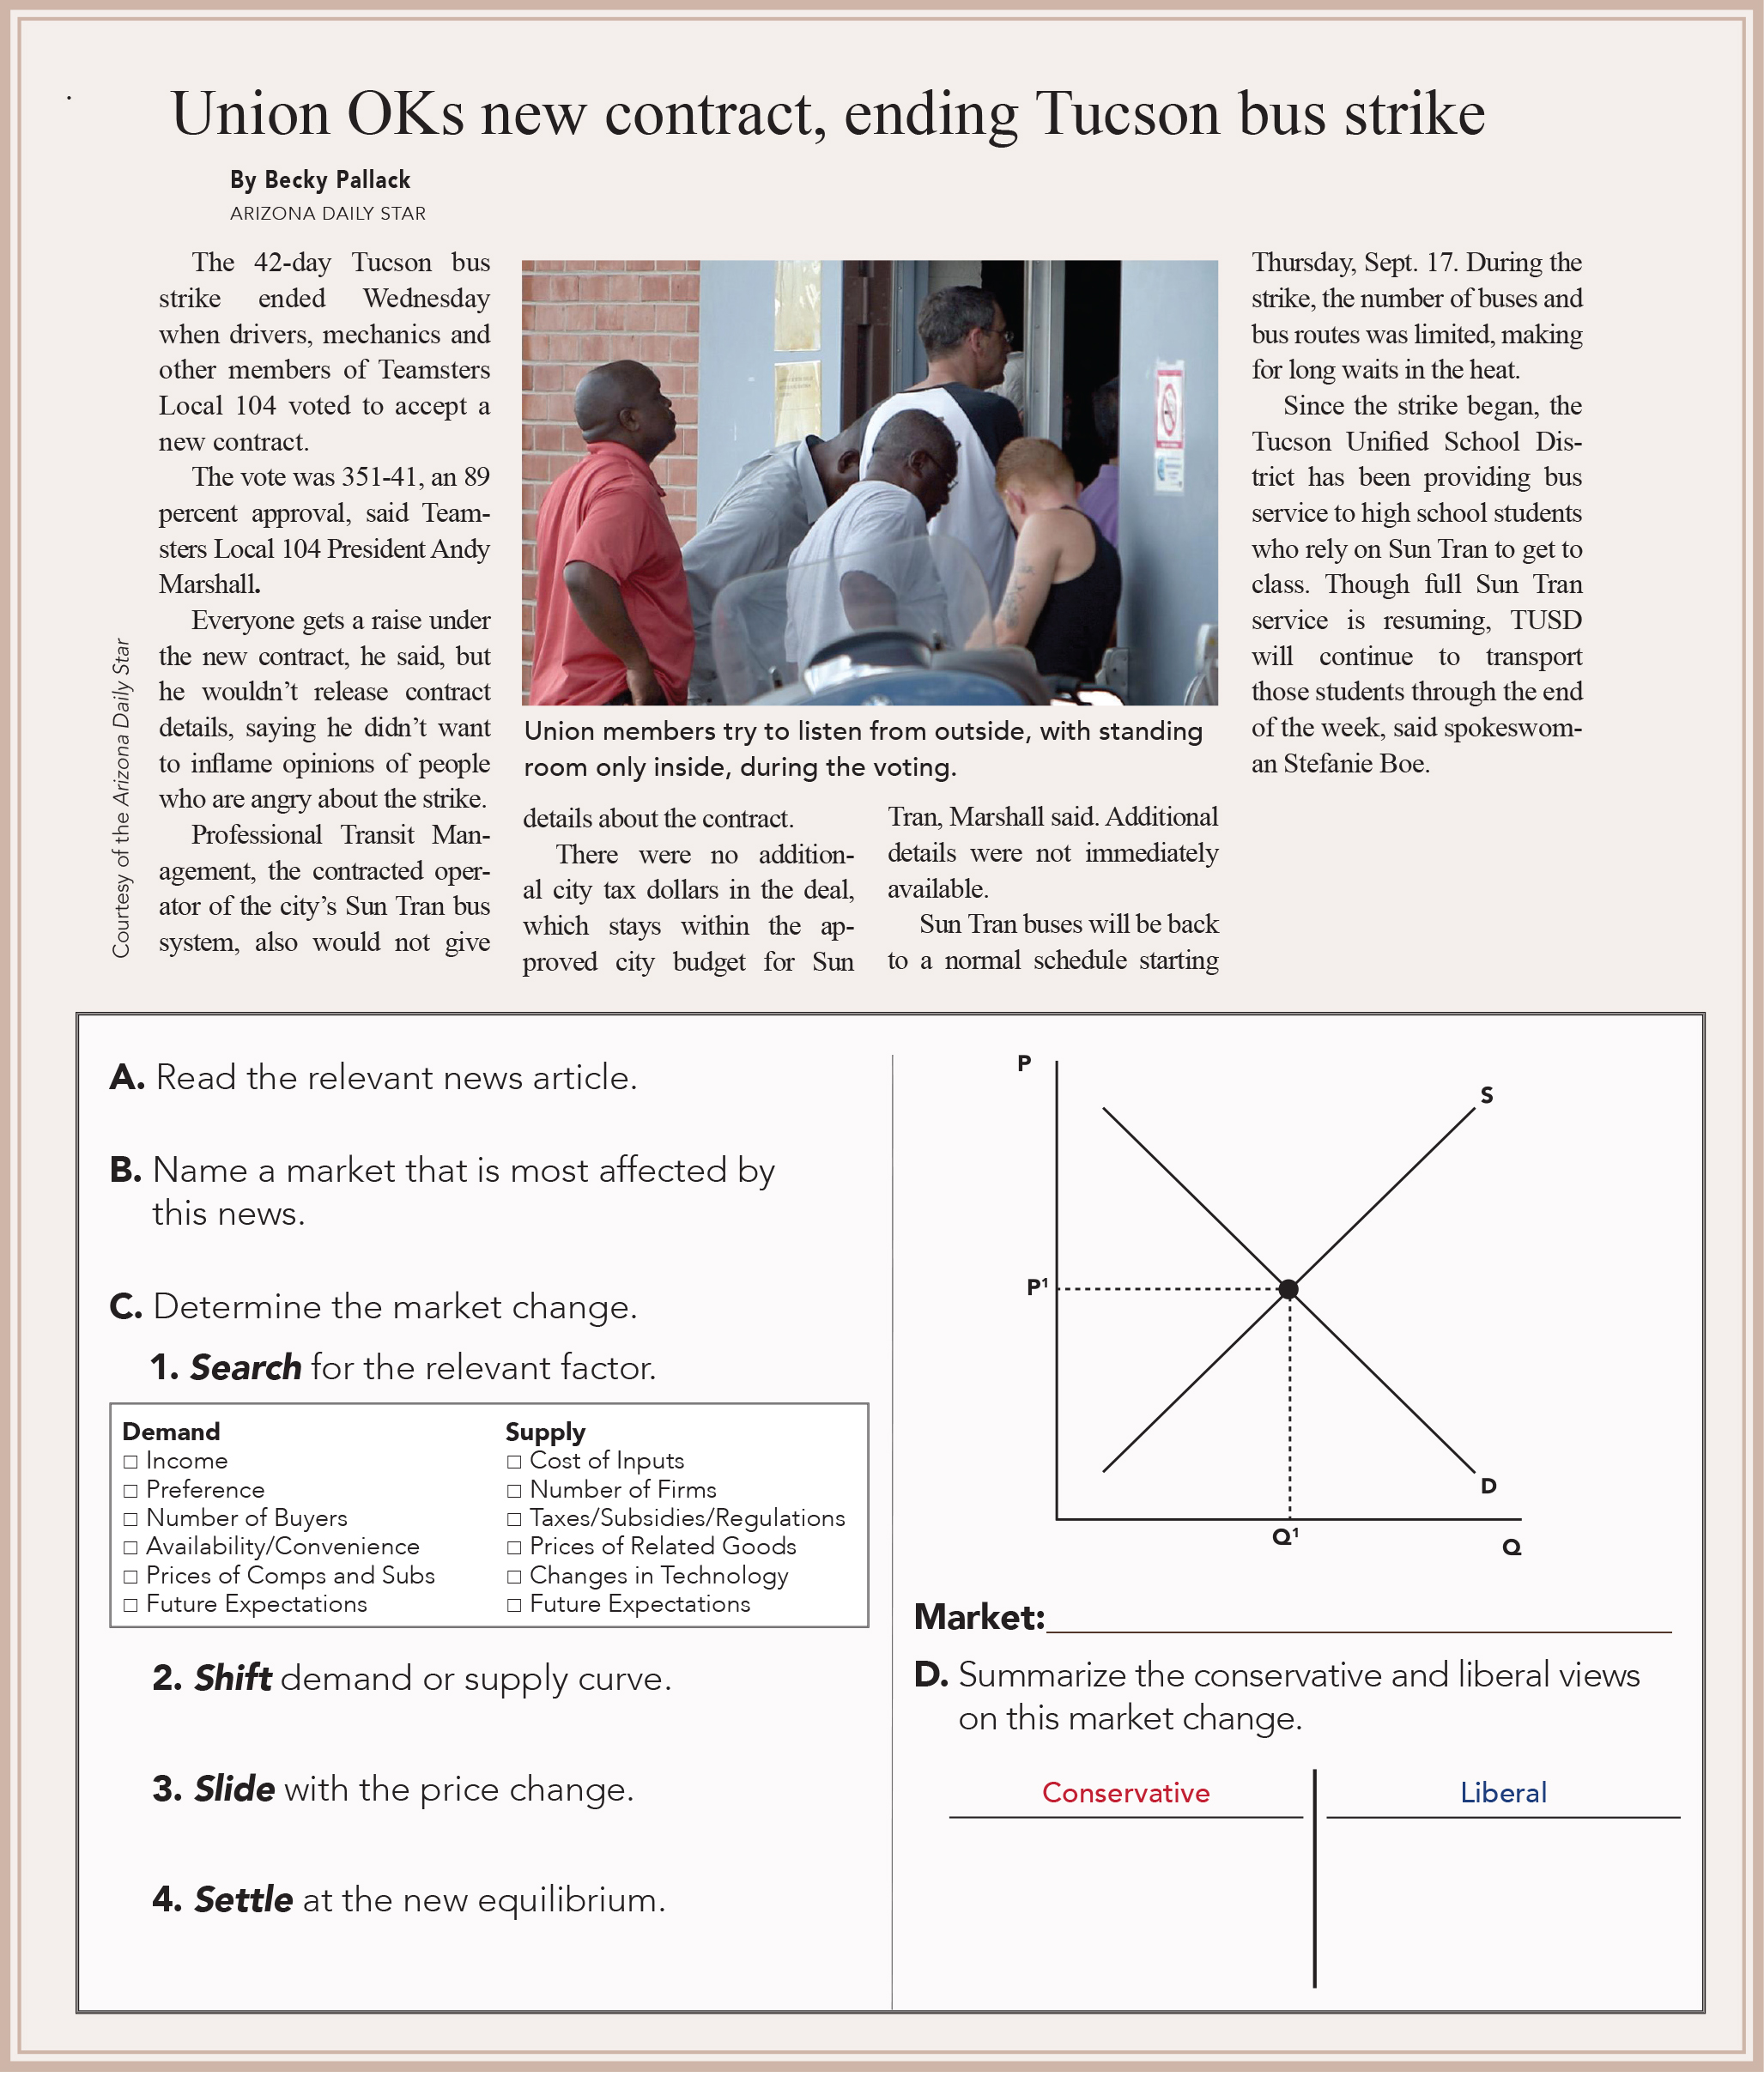
Exercise 5.2: VOTE Market Change Guide
Exercise 2: VOTE Market Change Guide
Try this on your own. Answer key is in the book.
From The VOTE Textbook Second Edition Copyright © 2023

Slide 53
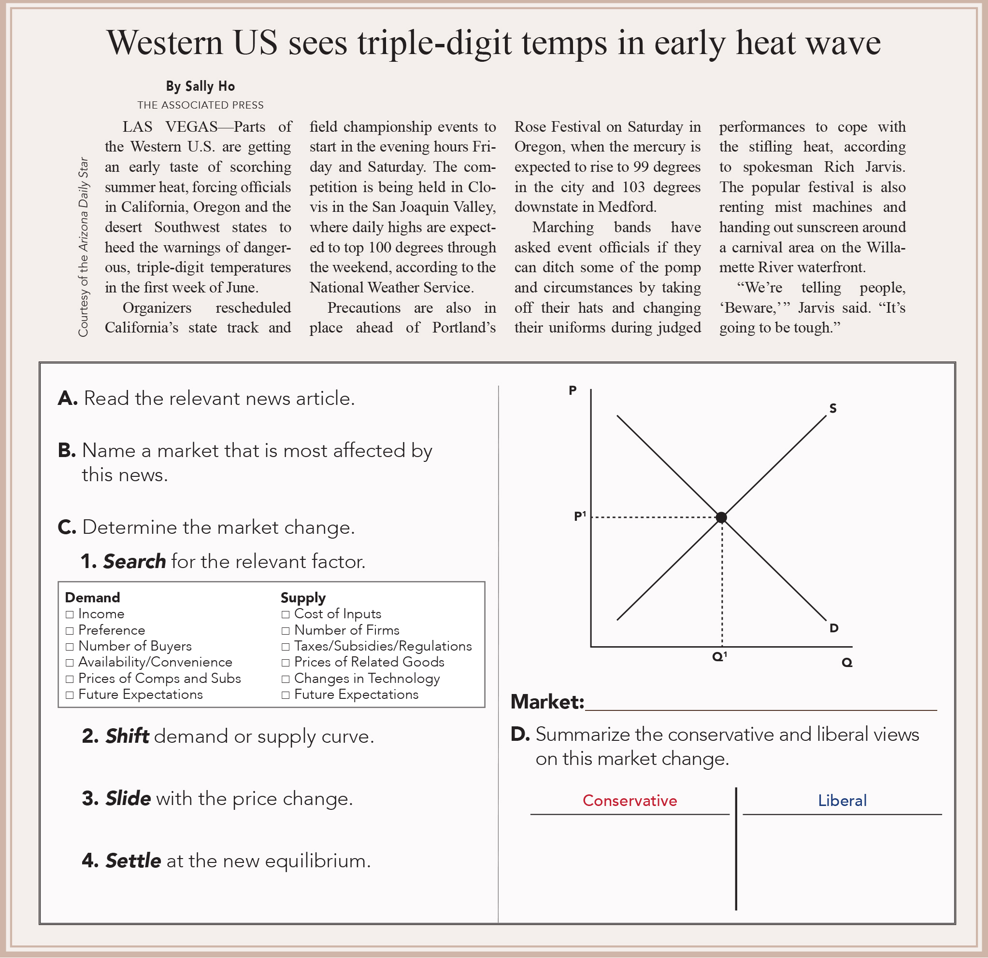
Exercise 5.3: VOTE Market Change Guide
Exercise 3: VOTE Market Change Guide
Try this on your own. Answer key is in the book.
From The VOTE Textbook Second Edition Copyright © 2023

Slide 54
Form: Conventional Theory: Capitalism
Conventional Theory: Capitalism
1.
2.
ASSUMPTIONS
MODEL
Scarcity
Individuals Maximize Happiness
Firms Maximize Profits
Production Possibilities Curve
Law of Demand
Law of Supply
Self-Interest
Market: Price signals (the invisible hand)
3.
Determinants of Demand
Income
Preference
Number of Buyers
Availability/Convenience
Prices of Substitutes and Complements
Future Expectations
Determinants of Supply
Cost of Inputs
Number of Firms
Taxes, Subsidies, and Regulations
Prices of Related Goods
Changes in Technology
Future Expectations
CONCLUSIONS
What to Produce?
Firms make what people want.
How to Produce?
Firms make the profit-maximizing amount using the fewest resources.
For Whom to Produce?
Firms’ products go to those who want them most.
Conservative Policy
Embrace free-market capitalism.
Reject government interference.
• Self-correction
Liberal Policy
Embrace fair-market capitalism.
Support government intervention.
• Equal opportunity
Enlightened Self-Interest
From The VOTE Textbook Second Edition Copyright © 2023

Slide 55
The VOTE Jingle
Conservatives say,
“Government, NO! Free markets let prosperity flow.”
Liberals say,
“Government’s a GO! Fair markets make the economy grow.”
Radicals say,
“Capitalism, WHOA! Democratic socialism is the way to go.”
From The VOTE Program Copyright © 2023

Slide 56
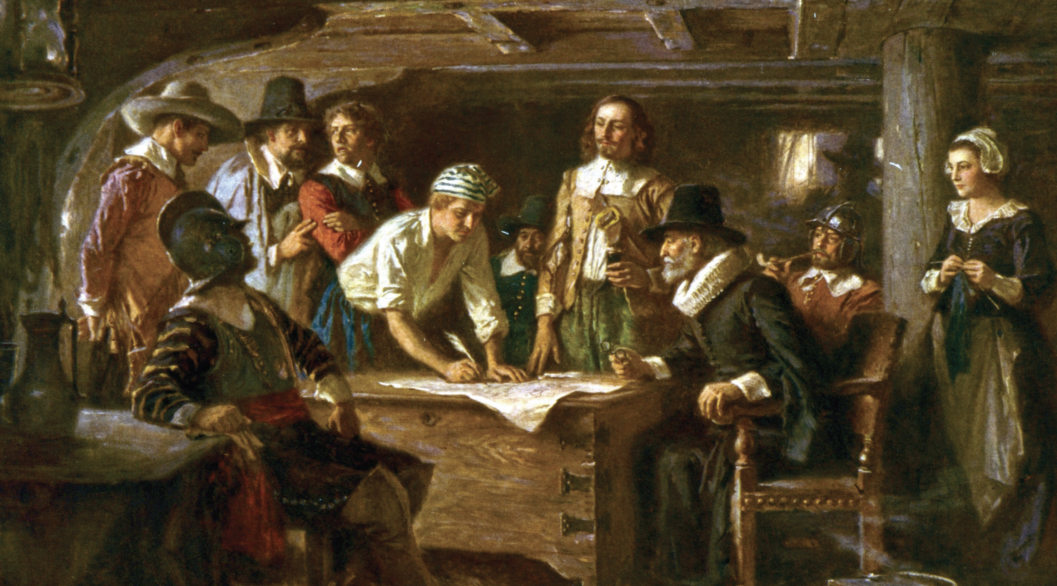
Section: Conventional Critique of Socialism
Conventional Critique of Socialism
The cautionary tale of the Mayflower Compact. Its socialist ban on private property is said to have led to poverty for all the Pilgrims.
From The VOTE Textbook Second Edition Copyright © 2023

Slide 57
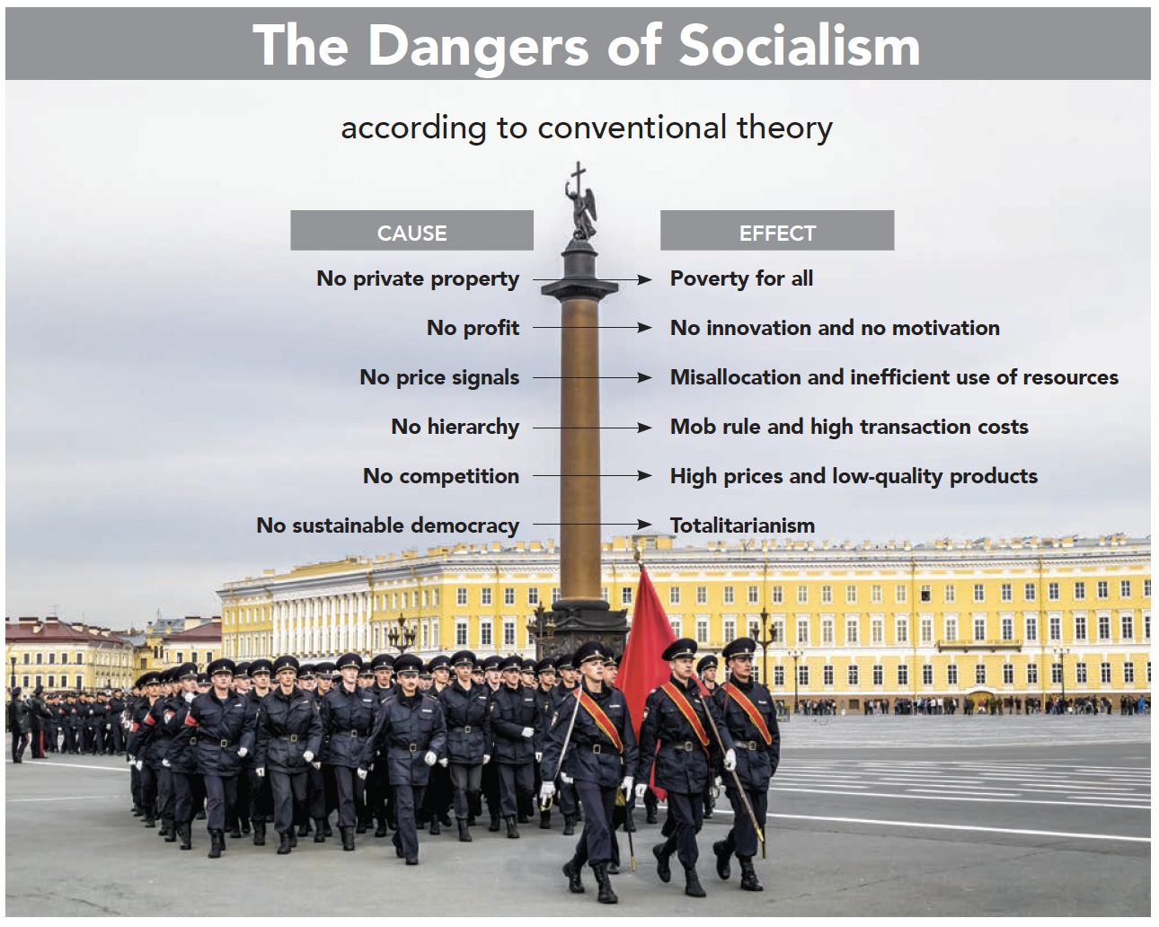

Form: The Dangers of Socialism
From The VOTE Textbook Second Edition Copyright © 2023

Slide 58
Form: Conventional Theory: Capitalism
Conventional Theory: Capitalism
1.
2.
ASSUMPTIONS
MODEL
Scarcity
Individuals Maximize Happiness
Firms Maximize Profits
Production Possibilities Curve
Law of Demand
Law of Supply
Self-Interest
Market: Price signals (the invisible hand)
Determinants of Demand
Income
Preference
Number of Buyers
Availability/Convenience
Prices of Substitutes and Complements
Future Expectations
Determinants of Supply
Cost of Inputs
Number of Firms
Taxes, Subsidies, and
Regulations
Prices of Related Goods
Changes in Technology
Future Expectations
3.
CONCLUSIONS
What to Produce?
Firms make what people want.
How to Produce?
Firms make the profit-maximizing amount using the fewest resources.
For Whom to Produce?
Firms’ products go to those who want them most.
Conservative Policy
Embrace free-market capitalism.
Reject government interference.
• Self-correction
Liberal Policy
Embrace fair-market capitalism.
Support government intervention.
• Equal opportunity
Enlightened Self-Interest
From The VOTE Textbook Second Edition Copyright © 2023

Slide 59


Section: Economic Well-Being from Different Perspectives
From The VOTE Textbook Second Edition Copyright © 2023

Slide 60

Chapter 5
Check out the book for more!
Test Yourself • Key Terms • Answer Key
From The VOTE Textbook Second Edition Copyright © 2023

