Slide 1
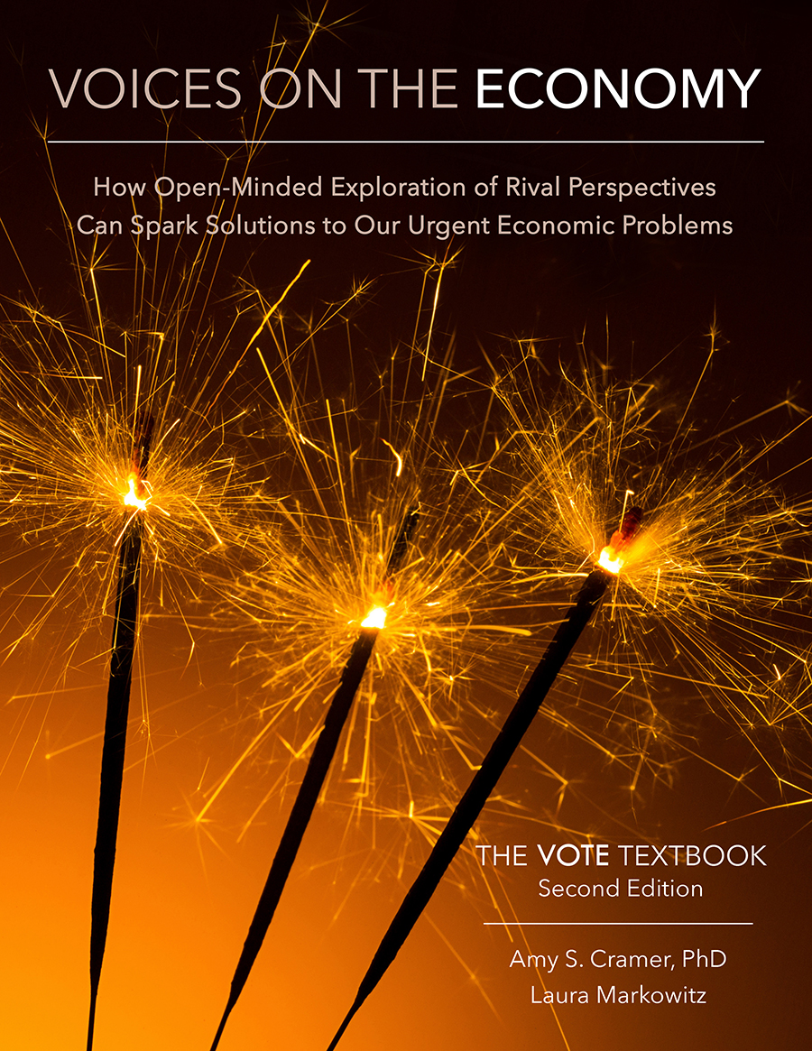
From The VOTE Textbook Second Edition Copyright © 2023

Slide 2


From The VOTE Textbook Second Edition Copyright © 2023
Notes:
2

Slide 3
From The VOTE Textbook Second Edition Copyright © 2023
Notes:
3

Slide 4
The VOTE Textbook Chapters
From The VOTE Textbook Second Edition Copyright © 2023
Notes:
4

Slide 5
1
2
3
4
5
6
7
8
9
10
11
12
13
14
15
16
17
18
19
20
21
From The VOTE Textbook Second Edition Copyright © 2023
Notes:
5

Slide 6
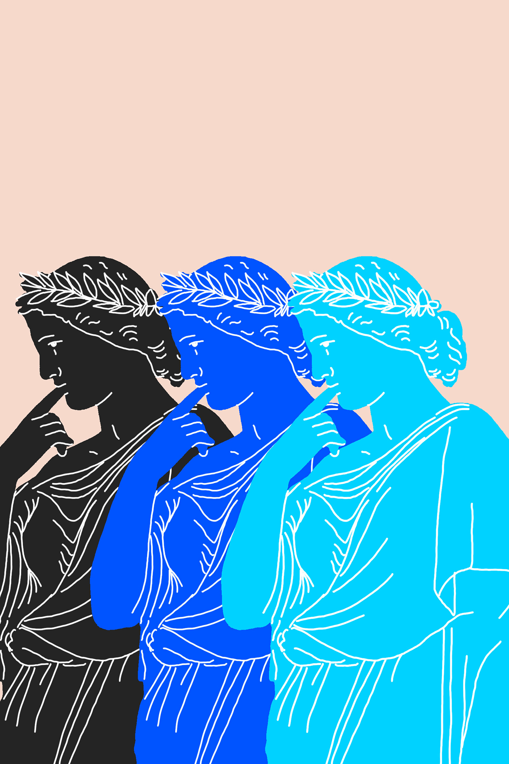
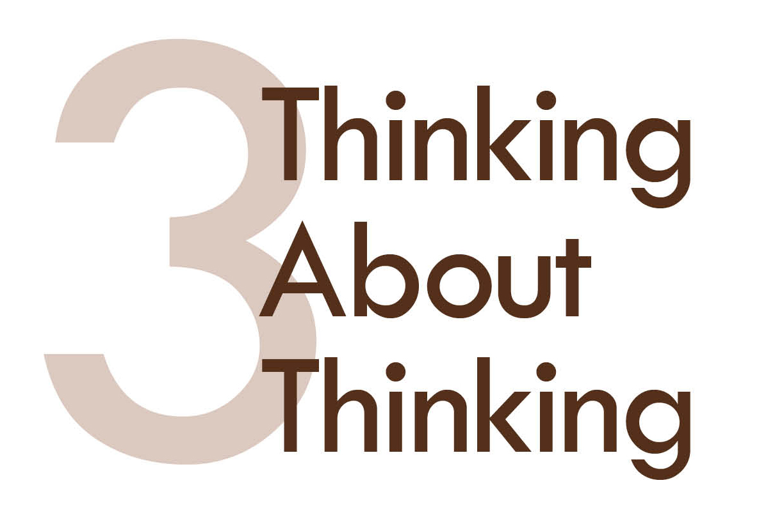
From The VOTE Textbook Second Edition Copyright © 2023

Slide 7
Opening story: Sherlock Holmes on a camping trip
From The VOTE Textbook Second Edition Copyright © 2023

Slide 8

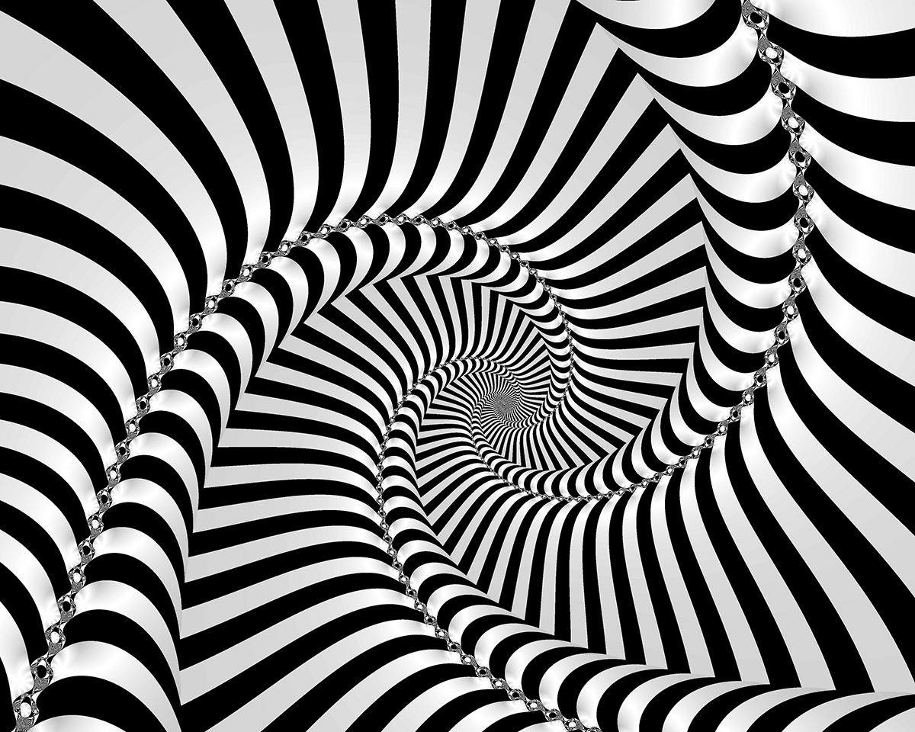
Opening story: Sherlock Holmes on a camping trip, cont’d
What do you see in these photos?
From The VOTE Textbook Second Edition Copyright © 2023

Slide 9
Opening story: Sherlock Holmes on a camping trip, cont’d
Conclusion: Sometimes the fact that see things from different perspectives isn’t that important, such as when one person sees two faces and the other person sees a vase.
Other times it is quite dangerous to express one’s perspective and it takes profound courage to question the beliefs of everyone around you.
Galileo Galilei took that leap and ended up paying a heavy price of lifetime imprisonment, destruction of his work, and being banned from publishing any new work.
From The VOTE Textbook Second Edition Copyright © 2023

Slide 10
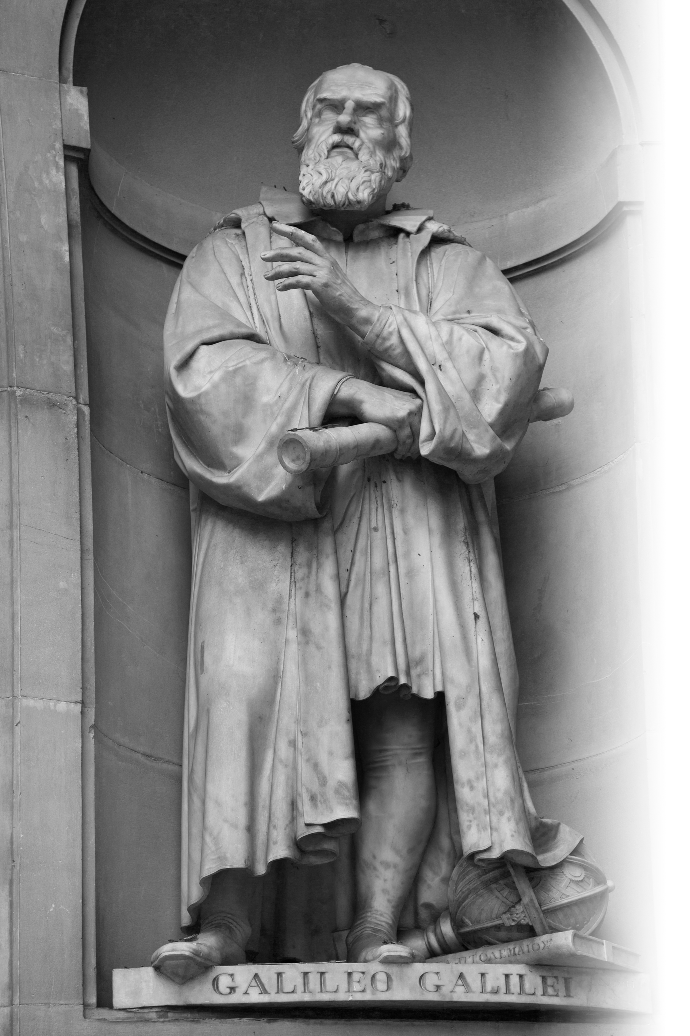
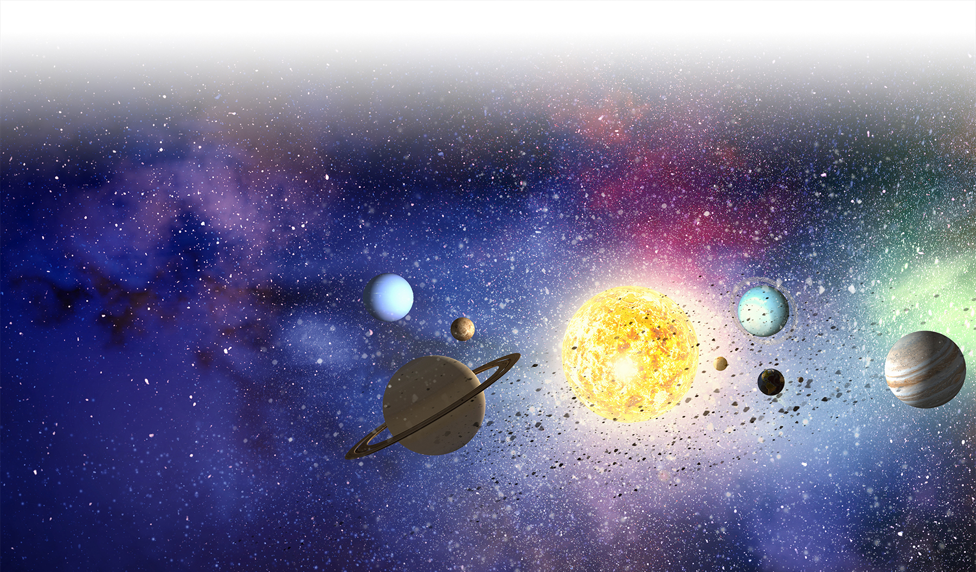
Opening story: Sherlock Holmes on a camping trip, cont’d
Galileo Galilei
1564–1642
Galileo’s claim: The earth revolves around the sun, not the other way around.
Today, the vast majority of people agree with Galileo, but we don’t all believe it in the same way.
From The VOTE Textbook Second Edition Copyright © 2023

Slide 11
Section: Essentialism, Non-Essentialism, Relativism, and Absolutism
Epistemology
A branch of philosophy that explores how we think about thinking.
Four ways people think about thinking:
Essentialism
Non-Essentialism
Relativism
Absolutism
From The VOTE Textbook Second Edition Copyright © 2023

Slide 12

Section: Essentialism, Non-Essentialism, Relativism, and Absolutism, cont’d
Essentialism
The essential truth (the essence) can be known through our senses and our rational minds.
A fact can be proven because it’s objectively true.
An open mind means new information brings us closer to understanding the essence of things.
The
Essence
From The VOTE Textbook Second Edition Copyright © 2023

Slide 13

Section: Essentialism, Non-Essentialism, Relativism, and Absolutism, cont’d
Non-Essentialism
What we know to be true changes with context.
A “fact” is subjective and depends on how you think about it.
An open mind means being open to alternative theories and
their consequences.
Desirable
Outcomes
From The VOTE Textbook Second Edition Copyright © 2023

Slide 14





Section: Essentialism, Non-Essentialism, Relativism, and Absolutism, cont’d
The Essence of Truth
Desirable Outcomes
Essentialist Thinker
Non-Essentialist Thinker
Both are open-minded.
From The VOTE Textbook Second Edition Copyright © 2023

Slide 15

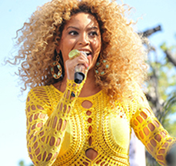
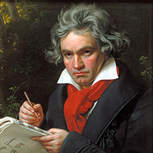
Section: Essentialism, Non-Essentialism, Relativism, and Absolutism, cont’d
Relativism
Since we can’t actually know what the truth is, it doesn’t matter what we decide to believe.
(sometimes confused with Non-Essentialism)
DANGER
There are consequences to ideas, so what you believe definitely matters.
Relativism makes sense in some contexts
(but not for VOTE issues)
Example of when it makes sense:
Which is the right kind of music?
Both!
From The VOTE Textbook Second Edition Copyright © 2023

Slide 16

Section: Essentialism, Non-Essentialism, Relativism, and Absolutism, cont’d
Absolutism
Believing that there is one
Absolute Truth, and any new
idea about what is true is
automatically rejected.
(sometimes confused with Essentialism)
DANGER
Close-minded thinking rejects new ideas and blocks opportunities to expand our understanding.
Absolutism makes sense in some contexts
(but not for VOTE issues)
Example of when it makes sense:
Is human trafficking wrong? Yes!
From The VOTE Textbook Second Edition Copyright © 2023

Slide 17

Exercise 3.1: Name the Type of Thinker
Exercise: Name the Type of Thinker
Essentialist? Non-Essentialist? Relativist? Absolutist?
“As a child I was taught that the atom
was the smallest particle. When scientists
discovered even smaller ones, I changed
my belief. New information brings us
closer to the essential truth.”
From The VOTE Textbook Second Edition Copyright © 2023

Slide 18
Polling Question
Name the Type of Thinker
Which type of epistemology does the following quote represent?
“As a child I was taught that the atom was the smallest particle. When scientists discovered even smaller ones, I changed my belief. New information brings us closer to the essential truth.”
Essentialist
Non-Essentialist
Relativist
Absolutist
From The VOTE Textbook Second Edition Copyright © 2023

Slide 19

Exercise 3.1: Name the Type of Thinker
Exercise: Name the Type of Thinker
Essentialist? Non-Essentialist? Relativist? Absolutist?
“As a child I was taught that the atom
was the smallest particle. When scientists
discovered even smaller ones, I changed
my belief. New information brings us
closer to the essential truth.”
Essentialist
“If I drop a shoe from a second-story window, I am completely certain it falls to the ground because of gravity. This is an obvious fact that will never change, so it’s a waste of time to consider other theories
or explanations.”
Absolutist
From The VOTE Textbook Second Edition Copyright © 2023

Slide 20



Exercise 3.1: Name the Type of Thinker, cont’d
Exercise: Name the Type of Thinker
Essentialist? Non-Essentialist? Relativist? Absolutist?
DAILY
DOUBLE
“Juan thinks the forest should be cut down so the city can build a new shopping mall. Ashley is passionate about saving the forest. I say neither one is right or wrong; it’s just a
matter of preference.”
Relativist
“My doctor told me to lift weights to prevent
high blood pressure. Then a study came out showing that running was more effective for
my age group. New knowledge and changing contexts continually add to what we know so that we keep improving and making decisions that
have better outcomes for us.”
Non-Essentialist
From The VOTE Textbook Second Edition Copyright © 2023

Slide 21
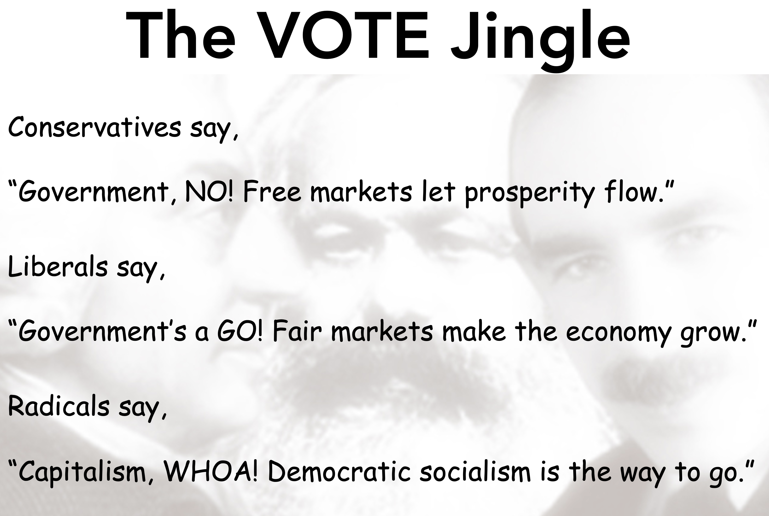
Section: Economics and Pluralism
How do these philosophical questions relate to economics?
Economists are famous for fervently disagreeing with one another about which perspective is the “right” one (liberal, radical, conservative).
Economists from every perspective are often certain that the others are dead wrong. This absolutist way of thinking limits our potential to see solutions, and relativism is just as harmful because it ignores the real-world consequences that arise from our beliefs.
From The VOTE Textbook Second Edition Copyright © 2023

Slide 22
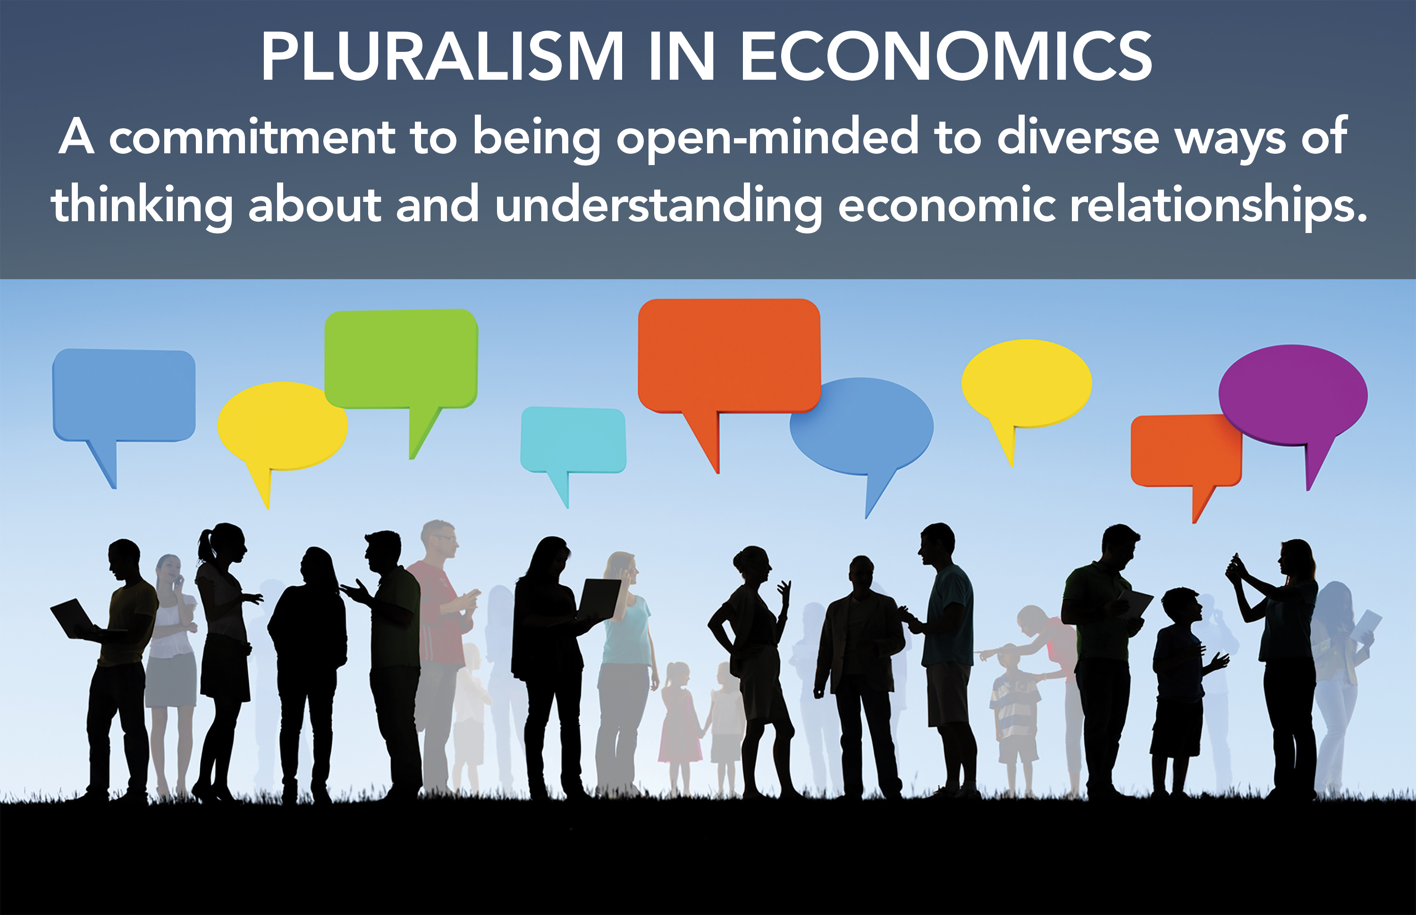
Form: Pluralism in Economics
The VOTE Program is committed to a pluralistic
approach to economics education.
From The VOTE Textbook Second Edition Copyright © 2023

Slide 23

Section: The Case for Pluralism in Economics
Sometimes pluralism in the classroom is not allowed.
• In Texas in 2010, social studies teachers were required by law to teach that unregulated capitalism is superior to all other economic systems.
Sometimes students demand to be taught multiple perspectives.
• The International Student Initiative for Pluralism in Economics at one point
had 82 associations in 31 countries.
Sometimes what’s called “pluralism”… isn’t.
• In an early 2000s high school economics textbook, there was a chart giving a “choice” between economic systems, but it was a false choice because two of the three systems were extremely outdated and there was no call in society to reinstate them.
From The VOTE Textbook Second Edition Copyright © 2023

Slide 24

Section: Ethics and Economics
Ethics and Economics
Some people become self-righteous and want to claim the moral high ground, viewing other perspectives as the enemy.
This is wrong thinking!
The radical, conservative, and liberal perspectives each hold ethics, integrity, and morality as core values (although certain individuals who identify with those perspectives may not).
All three perspectives want wealth and prosperity for all. They just have very different ideas about how to make that happen.
From The VOTE Textbook Second Edition Copyright © 2023

Slide 25
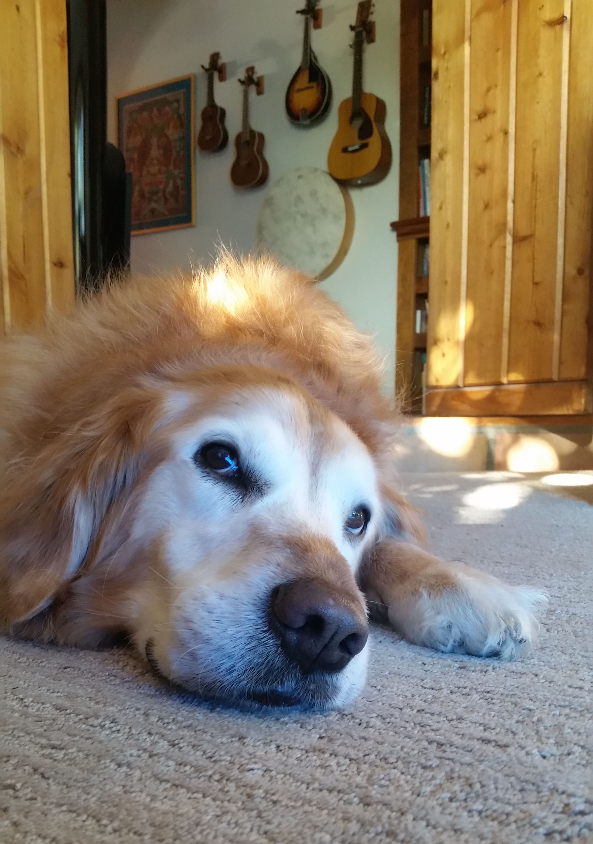
Section: How to Build “Theory-Plus”
A theory is a system of ideas intended
to explain something.
We build theories to answer our questions
(and all theories start with questions).
Do dogs have the same range of emotions as humans?
Why is my brother so annoying?
Is nature more important than nurture?
The three questions of economics:
What should we produce?
How should we produce it?
For whom should we produce it?
From The VOTE Textbook Second Edition Copyright © 2023

Slide 26
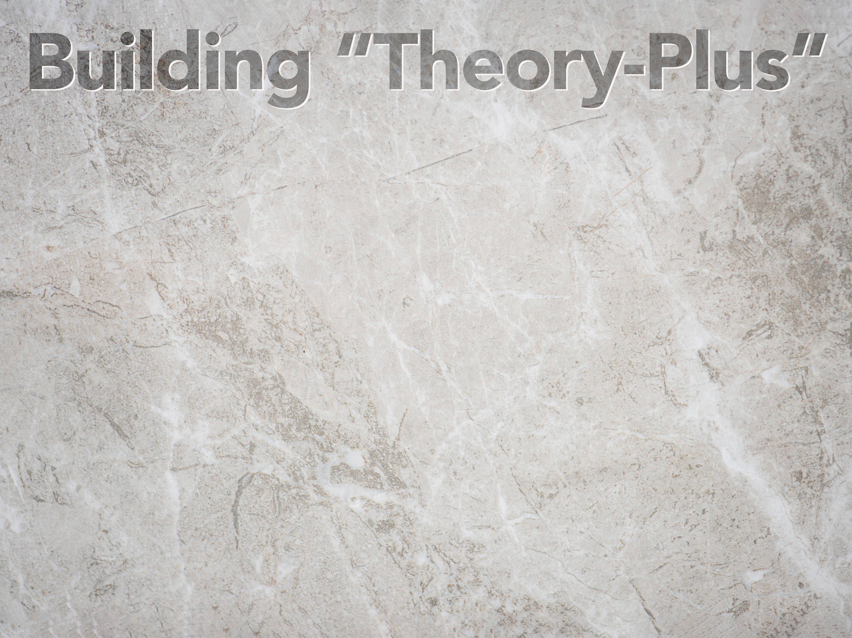
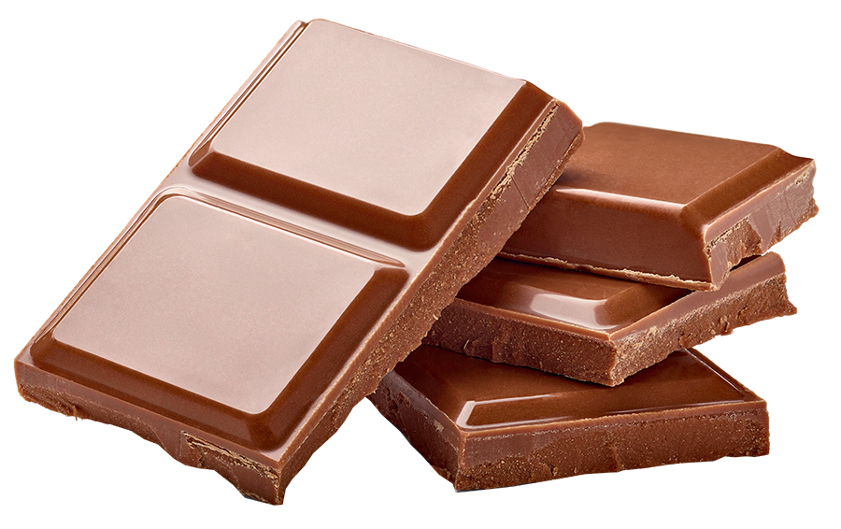
Section: How to Build “Theory-Plus”, cont’d
Assumptions
Model
Conclusions
+ Policy
A
Milk
Chocolate
Piece
From The VOTE Textbook Second Edition Copyright © 2023

Slide 27
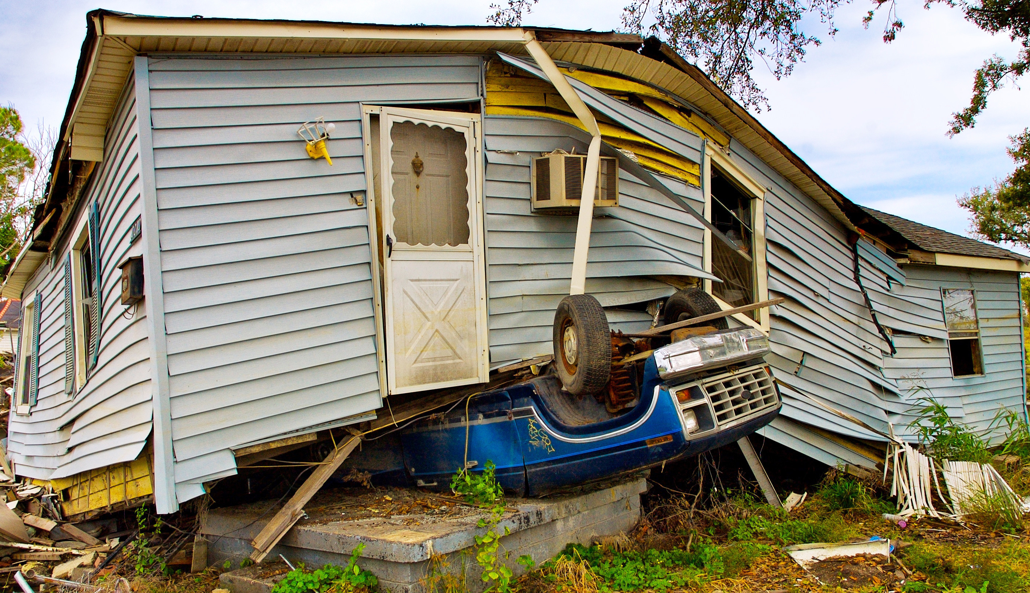
Section: How to Build “Theory-Plus”, cont’d
Architectural Theory Example
Question:
What type of house design offers the best protection from wind and rain?
From The VOTE Textbook Second Edition Copyright © 2023

Slide 28
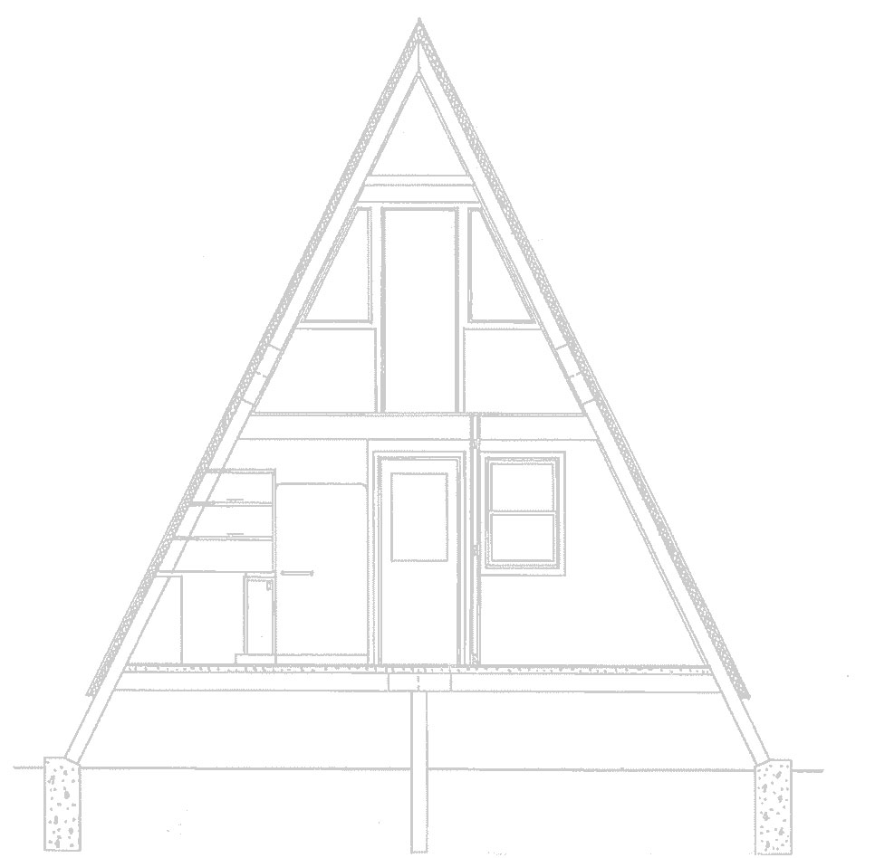
Section: How to Build “Theory-Plus”, cont’d
ASSUMPTIONS
Assumptions are ideas that the person building the
theory believes are “givens” and are most relevant
to the question.
Establish assumptions: For the question of
house design, three assumptions might be…
Steep roofs keep rain from getting in houses.
Shingles are the optimal roofing material.
Stone is the sturdiest material for walls.
*Even if you don’t agree with the assumptions, it is important to learn the dominant theories so that you can engage in intelligent debates.
From The VOTE Textbook Second Edition Copyright © 2023

Slide 29

Section: How to Build “Theory-Plus”, cont’d
MODEL
A model represents the
assumptions. It can be physical, narrative (words), mathematical, or graphical.
Construct a model: Build a physical model of a house.
Test the model and gather data: Simulate wind and rain and record the results.
From The VOTE Textbook Second Edition Copyright © 2023

Slide 30
Section: How to Build “Theory-Plus”, cont’d
CONCLUSIONS
A conclusion uses the data to answer the initial question.
Draw conclusions: A stone house with a steep, shingled roof offers the best protection from wind and rain.
From The VOTE Textbook Second Edition Copyright © 2023

Slide 31
Section: How to Build “Theory-Plus”, cont’d
+ POLICY
Policy is the practical result of a theory. It directs individuals, groups, or governments to follow a certain course of action.
Create policy: If you had a million dollars in cash and could only spend it on a house, would you build a house with stone walls and a steep, shingled roof?
From The VOTE Textbook Second Edition Copyright © 2023

Slide 32
Polling Question
Policy (Part I)
If you had a million dollars in cash and could only spend it on a house, would you build a house with stone walls and a steep, shingled roof?
Yes
No
From The VOTE Textbook Second Edition Copyright © 2023

Slide 33
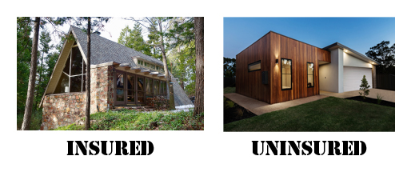

Section: How to Build “Theory-Plus”, cont’d
+ POLICY, cont’d
Suppose insurance companies are convinced that they should only insure houses built with stone walls and steep, shingled roofs. (And your land is in a high fire-danger area.)
From The VOTE Textbook Second Edition Copyright © 2023

Slide 34
Polling Question
Policy (Part II)
If you had a million dollars in cash and could only spend it on a house, would you build a house with stone walls and a steep, shingled roof if that was the only way to qualify for home insurance?
Yes
No
From The VOTE Textbook Second Edition Copyright © 2023

Slide 35
Section: How to Build “Theory-Plus”, cont’d
+ POLICY, cont’d
Consider the impact that policy has on your life.
Even in this silly example your choices were uncomfortably constrained.
Economic theories lead to economic policies (tax reform, health care, international trade, and more) that directly impact your day-to-day life.
The takeaway: Policies arise from theories. We need to learn about the assumptions, models, and conclusions that drive them. This is the key to being able to effectively argue for and against the policies on the table, which inevitably impact your life.
From The VOTE Textbook Second Edition Copyright © 2023

Slide 36
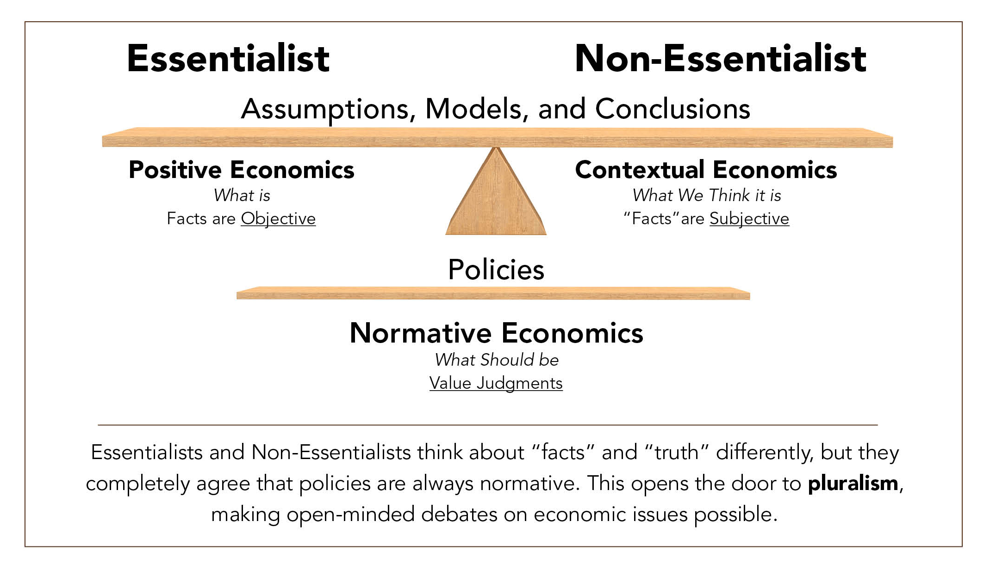

Form: Positive, Contextual, and Normative Economics
Bringing together theory-plus and epistemology
as they relate to the study of economics
From The VOTE Textbook Second Edition Copyright © 2023

Slide 37
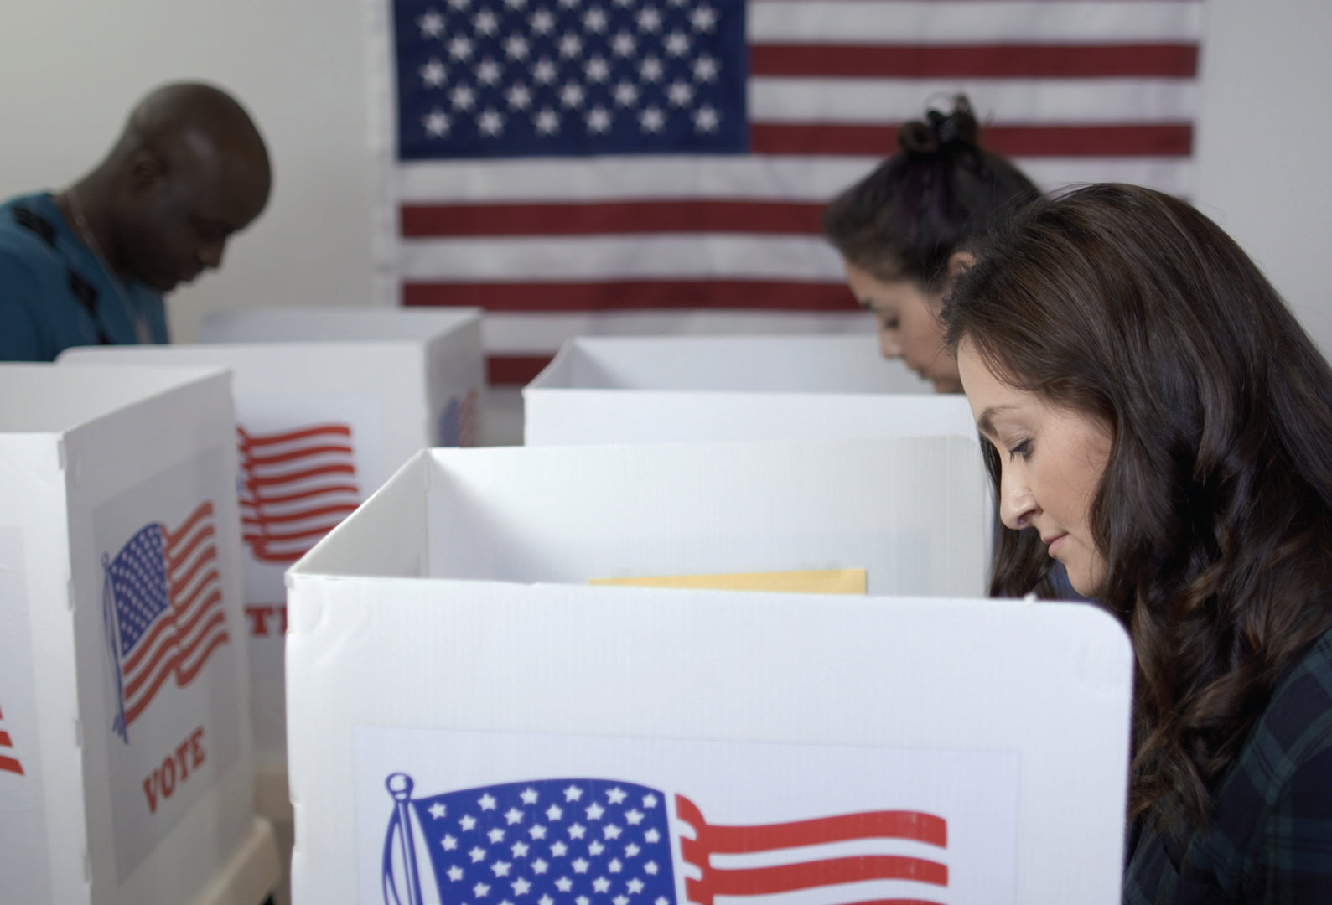
Section: But What Is True?!
Final thought: You will be better off—and the world will be richer for it—if you develop your own opinions and learn how to convey them to others who may not agree with you.
From The VOTE Textbook Second Edition Copyright © 2023

Slide 38

Chapter 3
Check out the book for more!
Test Yourself • Key Terms • Answer Key
From The VOTE Textbook Second Edition Copyright © 2023

