Slide 1
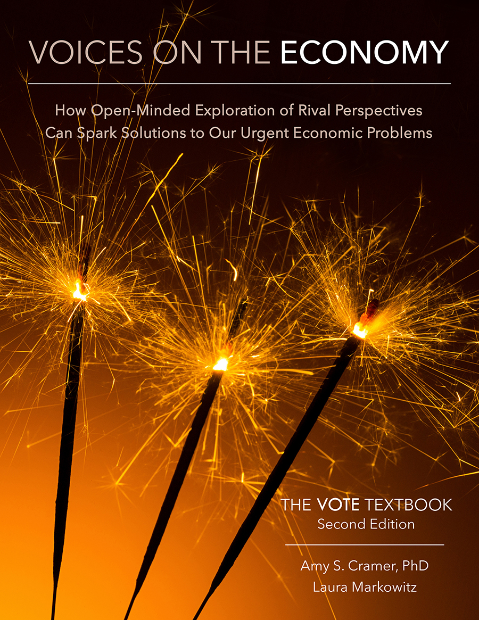
From The VOTE Textbook Second Edition Copyright © 2023

Slide 2


From The VOTE Textbook Second Edition Copyright © 2023
Notes:
2

Slide 3
From The VOTE Textbook Second Edition Copyright © 2023
Notes:
3

Slide 4
The VOTE Textbook Chapters
From The VOTE Textbook Second Edition Copyright © 2023
Notes:
4

Slide 5
1
2
3
4
5
6
7
8
9
10
11
12
13
14
15
16
17
18
19
20
21
From The VOTE Textbook Second Edition Copyright © 2023
Notes:
5

Slide 6


From The VOTE Textbook Second Edition Copyright © 2023

Slide 7

Opening story: The royal siblings and three empty rooms
The royal siblings and three empty rooms
Like the three royal siblings in this story, people from all three economic perspectives want to create prosperity so that everyone can achieve their goals and realize their dreams…
From The VOTE Textbook Second Edition Copyright © 2023
Notes:
7

Slide 8

Opening story: The royal siblings and three empty rooms
… but without the light of knowledge and open-mindedness to new ideas from multiple perspectives, our country will continue to struggle to provide material well-being for all.
By letting in light, we set the foundation for innovative thinking to emerge. We find the solutions that free us from material worry so we can each contribute our unique gifts and society can reach its highest potential.
From The VOTE Textbook Second Edition Copyright © 2023
Notes:
8

Slide 9
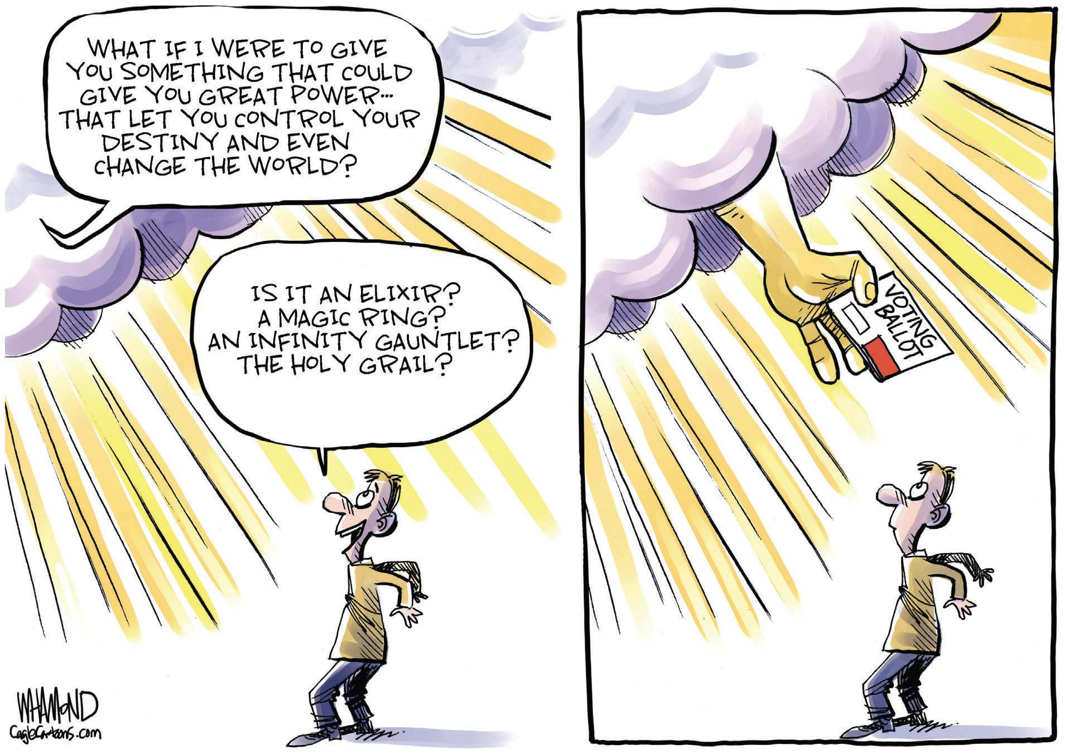
Section: Democracy and Voting
Even if you can’t vote at the ballot box, you can “vote” by joining the conversations around you about our nation’s urgent economic problems. You can use your voice to share your views on how we should use our precious resources to improve life for everyone.
From The VOTE Textbook Second Edition Copyright © 2023
Notes:
9

Slide 10
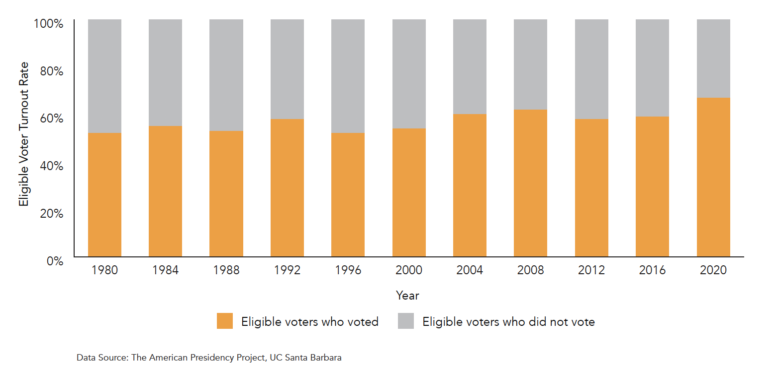
Section: Democracy and Voting, cont’d
Generations of people fought to secure the right to vote. They would probably be deeply disappointed that barely half of eligible U.S. voters cast their ballots in recent elections. Millions more didn’t register and therefore couldn’t vote.
U.S. Eligible Voter Turnout in Presidential Elections, 1980–2020
From The VOTE Textbook Second Edition Copyright © 2023
Notes:
10

Slide 11
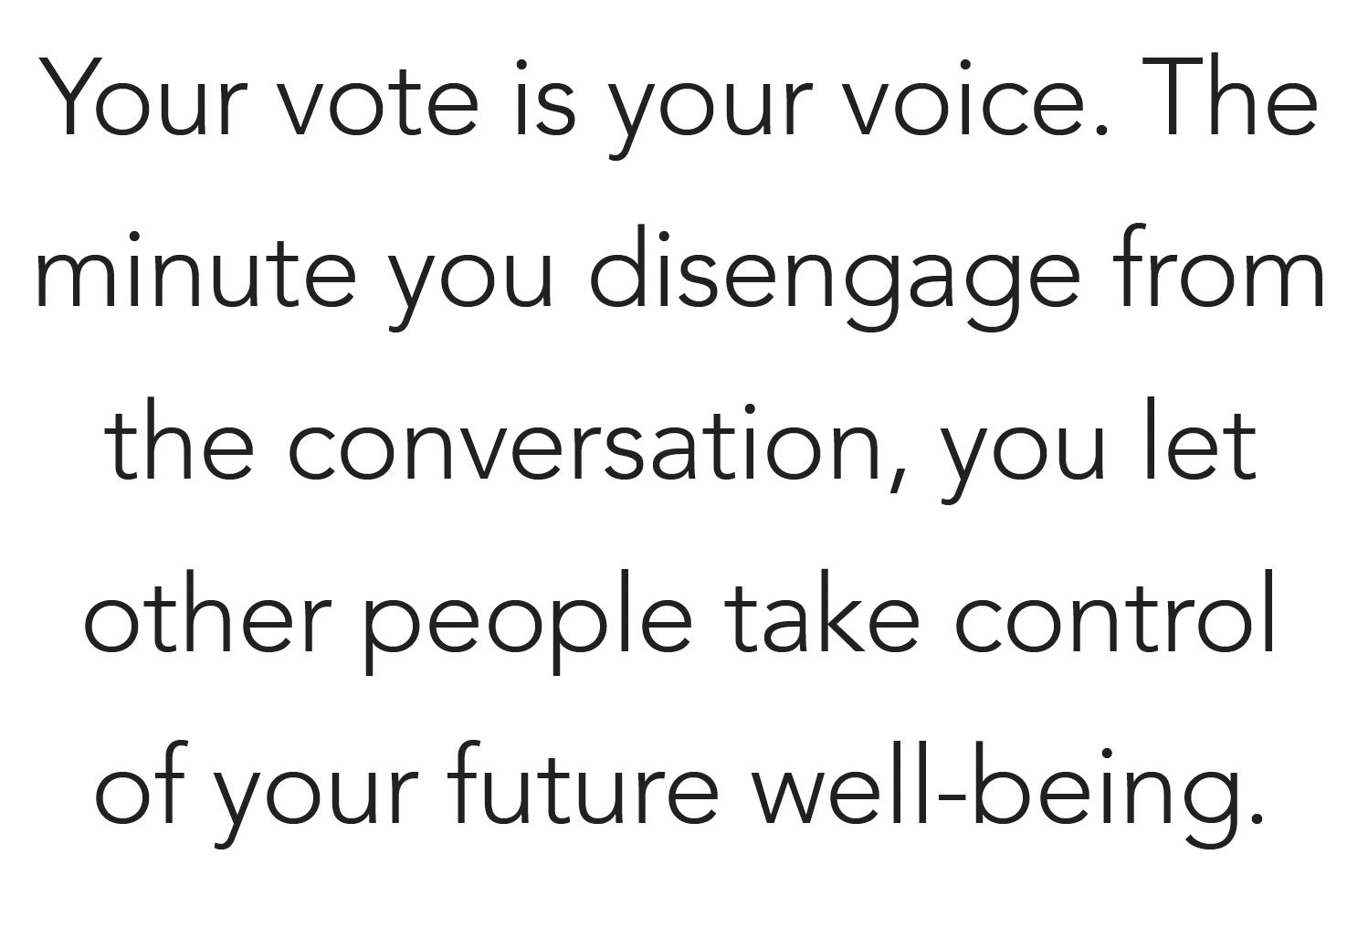
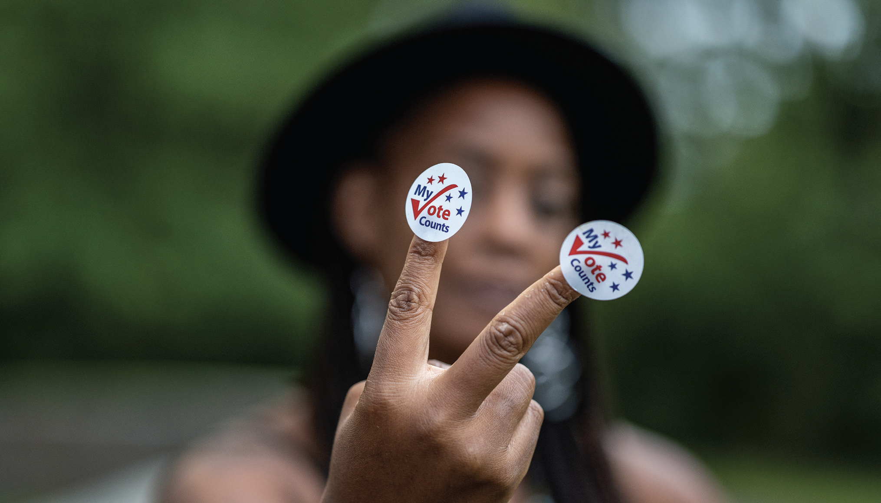
Section: Democracy and Voting, cont’d
If you ever hear a person say that voting doesn’t matter, explain to them how fragile and important our democracy is, and then let them know there are many examples of a single vote making all the difference.
From The VOTE Textbook Second Edition Copyright © 2023
Notes:
11

Slide 12
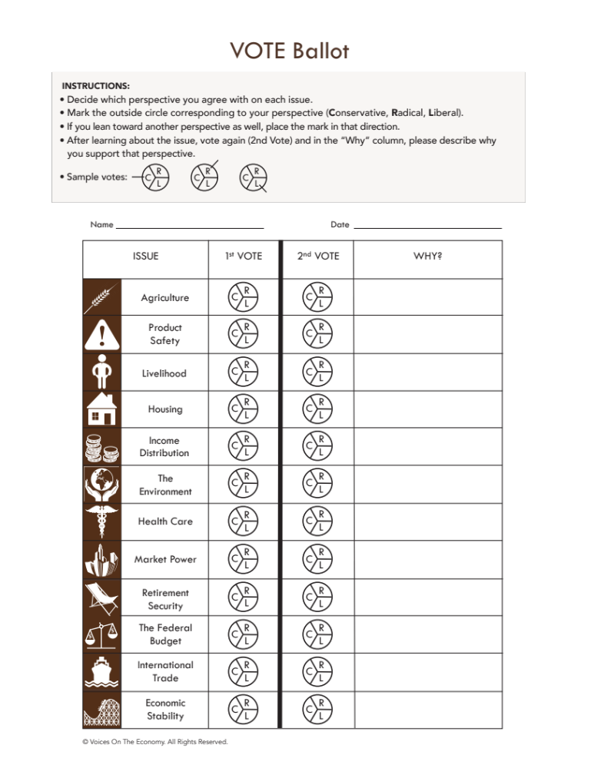
Section: Democracy and Voting, cont’d
When you started this book, you voted on your perspective on 12 urgent economic issues. At the end of each Issues chapter, you were asked to revisit your VOTE Ballot and vote again. If possible, take a look at your completed ballot now.
From The VOTE Textbook Second Edition Copyright © 2023
Notes:
12

Slide 13
Polling Question
Final Vote
Compare your first vote to your second vote on each issue.
Did you completely change your perspective on at least one issue?
Did you keep the same perspective but shift a bit toward another perspective on at least one issue?
Were both votes identical on at least one issue, but you became more articulate and confident about your position?
From The VOTE Textbook Second Edition Copyright © 2023

Slide 14
Section: Democracy and Voting, cont’d
Compare your first vote to your second vote on each issue.
Did you completely change your perspective on at least one issue?
Did you keep the same perspective but shift a bit toward another perspective on at least one issue?
Were both votes identical on at least one issue, but you became more articulate and confident about your position?
The point of spending your precious and limited time in any educational endeavor is to be transformed. If you answered “yes” to any of the above questions, then your ability to consider the ideas of others is potentially world-changing.
From The VOTE Textbook Second Edition Copyright © 2023
Notes:
14

Slide 15

Section: The VOTE Mission
Imagine you’re in an elevator after the final VOTE class and someone asks, “What was that course about?”
A thousand possible answers go through your head, but then you remember the golden moment.
You answer, “Even though liberals, radicals, and conservatives strongly disagree on economic policies, they share the same goals. They all want to create prosperity and well-being. They just have very different ways to do it.”
From The VOTE Textbook Second Edition Copyright © 2023
Notes:
15

Slide 16
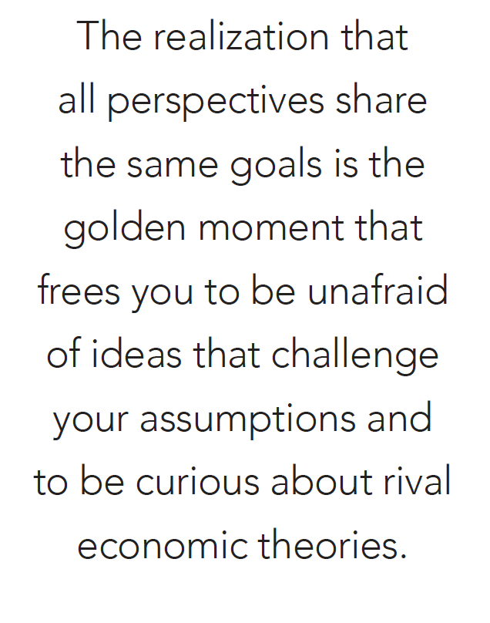
Section: The VOTE Mission, cont’d
The Golden Moment
From The VOTE Textbook Second Edition Copyright © 2023
Notes:
16

Slide 17

Section: The VOTE Mission, cont’d
The mission of the VOTE Program is to inspire new solutions to our country’s urgent economic problems by building a culture of respectful listening, passionate advocacy, and intelligent debate.
From The VOTE Textbook Second Edition Copyright © 2023
Notes:
17

Slide 18
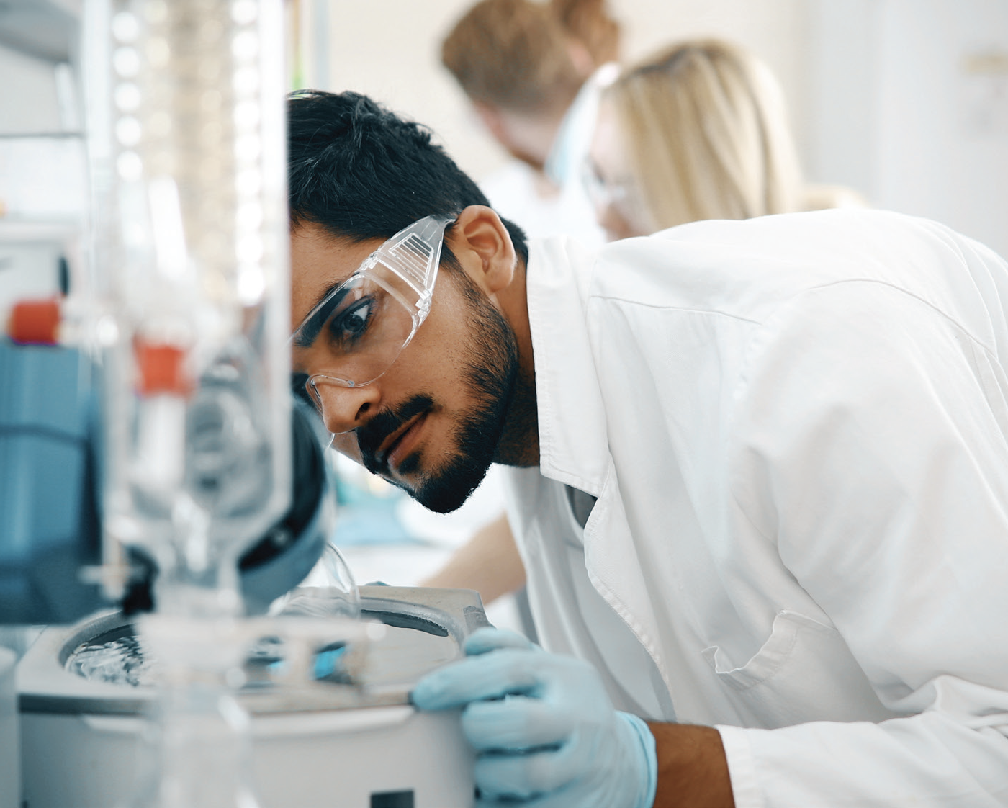
Section: Inspire New Solutions
It is definitely possible to inspire new solutions to our urgent economic problems.
When we’re open-minded to diverse ideas—including ideas from rival perspectives—they become springboards to new ways of thinking that can lead to breakthroughs.
Open-mindedness is the pathway to prosperity!
From The VOTE Textbook Second Edition Copyright © 2023
Notes:
18

Slide 19
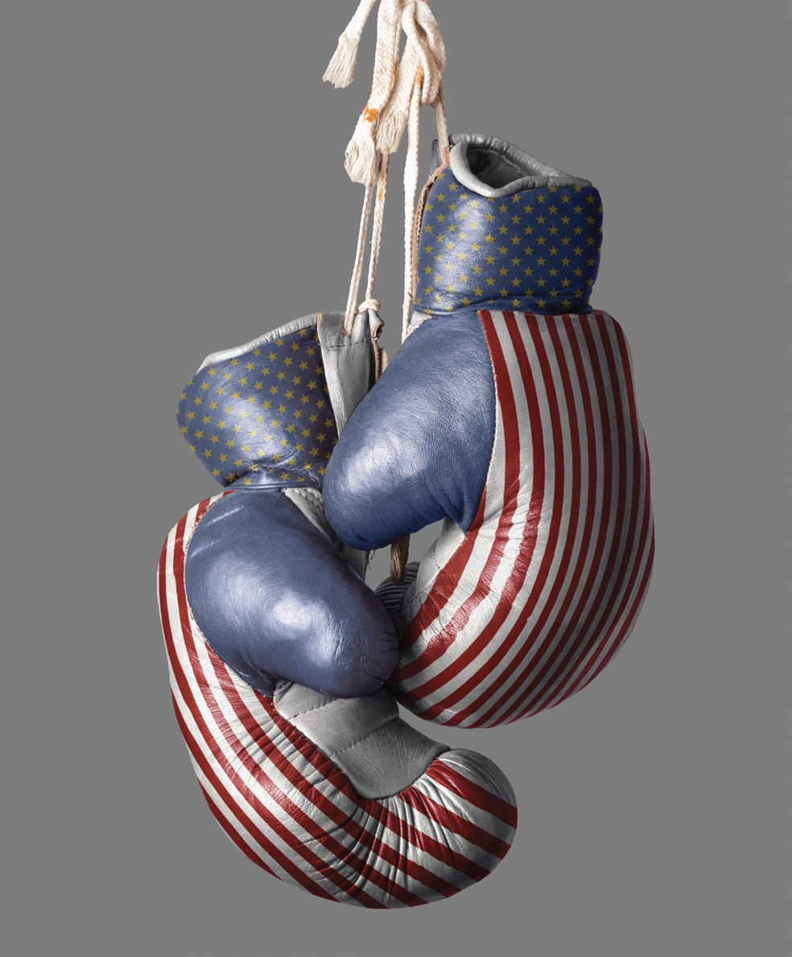
Section: Building a Culture
It is definitely possible to build a culture that overcomes partisan hostility and siloed thinking.
We can deeply disagree with a person’s ideas while simultaneously trusting that they want the same outcomes that we want.
From The VOTE Textbook Second Edition Copyright © 2023
Notes:
19

Slide 20

Section: Respectful Listening, Passionate Advocacy, and Intelligent Debate
Question:
What is the main ingredient of respectful listening?
Answer:
It’s honest curiosity. Be genuinely interested in others’ ideas because you can learn something, and it is a powerful gesture of respect.
From The VOTE Textbook Second Edition Copyright © 2023
Notes:
20

Slide 21

Section: Respectful Listening, Passionate Advocacy, and Intelligent Debate
Question:
What is the main ingredient of passionate advocacy?
Answer:
It’s enthusiasm. But make sure you are a passionate advocate for constructive ideas, not ones that give oxygen to hatred and dehumanization.
From The VOTE Textbook Second Edition Copyright © 2023
Notes:
21

Slide 22

Section: Respectful Listening, Passionate Advocacy, and Intelligent Debate
Question:
What is the main ingredient for intelligent debate?
Answer:
It’s nuanced understanding. Don’t make things up or repeat soundbites. Be thoughtful and well-informed.
From The VOTE Textbook Second Edition Copyright © 2023
Notes:
22

Slide 23
Section: Your Note in the Song
Above all, please don’t let fear or insecurity silence you. Remember that your unique point of view contains the seeds that could sprout the next great economic idea. Without your voice, our song is incomplete because it’s missing the key part that only you can contribute.
Practice hitting the right note at the dinner table.
Polish your persuasive skills in conversations with coworkers, classmates, neighbors, and strangers.
Hone your arguments so you can discuss ideas with strength and clarity.
From The VOTE Textbook Second Edition Copyright © 2023
Notes:
23

Slide 24

Section: Your Note in the Song
Whether you are a student, plumber, comedian, baker, veterinarian, personal trainer, economist, or anything else, you have unique ideas and insights. Don’t count yourself out. This is your time to use the light of knowledge and open-mindedness to change the conversation.
From The VOTE Textbook Second Edition Copyright © 2023
Notes:
24

Slide 25

Chapter 21
Check out the book for more!
Thank you for a great journey.
From The VOTE Textbook Second Edition Copyright © 2023

