Slide 1

From The VOTE Textbook Second Edition Copyright © 2023

Slide 2


From The VOTE Textbook Second Edition Copyright © 2023
Notes:
2

Slide 3
From The VOTE Textbook Second Edition Copyright © 2023
Notes:
3

Slide 4
The VOTE Textbook Chapters
From The VOTE Textbook Second Edition Copyright © 2023
Notes:
4

Slide 5
1
2
3
4
5
6
7
8
9
10
11
12
13
14
15
16
17
18
19
20
21
From The VOTE Textbook Second Edition Copyright © 2023
Notes:
5

Slide 6

From The VOTE Textbook Second Edition Copyright © 2023

Slide 7
Opening story: Reading the newspaper
Highway rest areas closed due to state budget shortfall
The news is brimming with information
relevant to your life.
Salmonella found in romaine lettuce
Biotech firm develops cure for common cold
National parks less crowded this year
Salmonella found in romaine lettuce
Downtown rental prices fall
Downtown rental prices fall
National parks less crowded this year
Highway rest areas closed due to state budget shortfall
Biotech firm develops cure for common cold
From The VOTE Textbook Second Edition Copyright © 2023

Slide 8
Opening story: Reading the newspaper, cont’d
Everyone wants material well-being (a decent standard
of living). That’s why the news focuses on:
Are we making enough products that people want and need?
“Gross Domestic Product”
Are there enough jobs for the people who want them?
“Unemployment”
Are prices stable enough so people can afford what they need?
“Inflation”
From The VOTE Textbook Second Edition Copyright © 2023

Slide 9
Section: We Make It Up
Human beings have made up every single definition that exists. Whether we’re defining endangered species, wetlands, life, unemployment, GDP, inflation, or anything else, we invented it. Those definitions weren’t handed down from on high.
When assessing economic data, we need to know the definitions to know what was counted and what was left out.
From The VOTE Textbook Second Edition Copyright © 2023

Slide 10
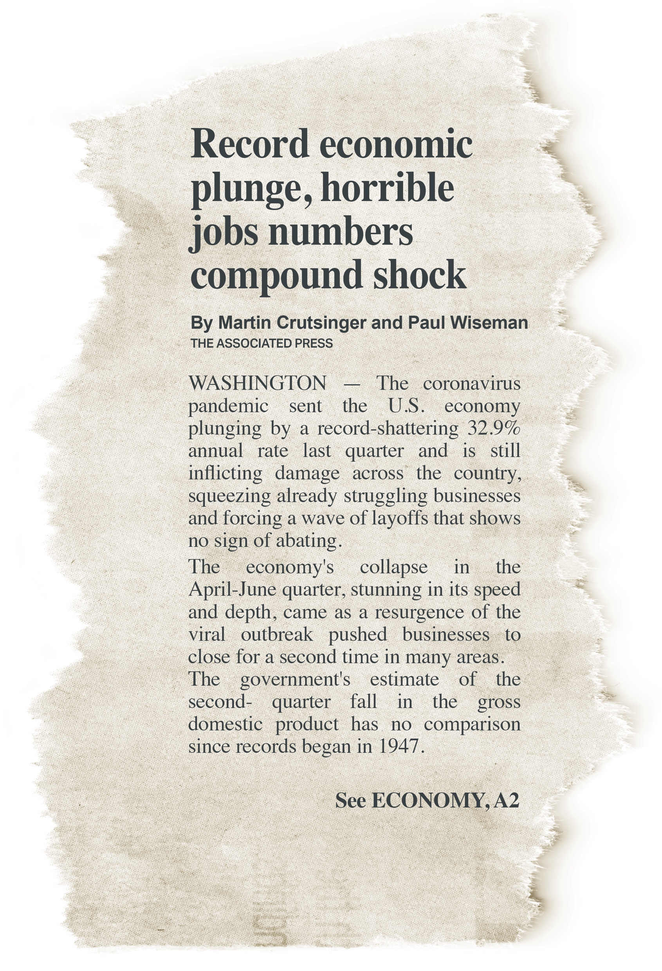
Section: We Make It Up, cont’d
For example, the terms ”economic plunge” and ”jobs numbers” have specific meanings.
Once you know the definitions, you can join the conversations about what should be done.
In other words, we need to understand the definitions before we can intelligently discuss possible solutions.
From The VOTE Textbook Second Edition Copyright © 2023

Slide 11
Definition #1
GROSS DOMESTIC PRODUCT (GDP)
Section: Gross Domestic Product (GDP)
From The VOTE Textbook Second Edition Copyright © 2023

Slide 12
Section: The Official Definition of GDP
GROSS DOMESTIC PRODUCT (GDP)
The total market value of all
final goods and services
newly produced within a nation’s borders during a given
period of time.
From The VOTE Textbook Second Edition Copyright © 2023

Slide 13

Section: The Official Definition of GDP, cont’d
“Market Value”
-No do-it-yourself projects
-No illegal activities or unreported activities
-No financial transactions or income transfers
“Final Goods and Services”
-No intermediate products
“Newly Produced”
-No used products
“Given Period of Time”
-Calculated quarterly
-No products produced at other times
From The VOTE Textbook Second Edition Copyright © 2023

Slide 14
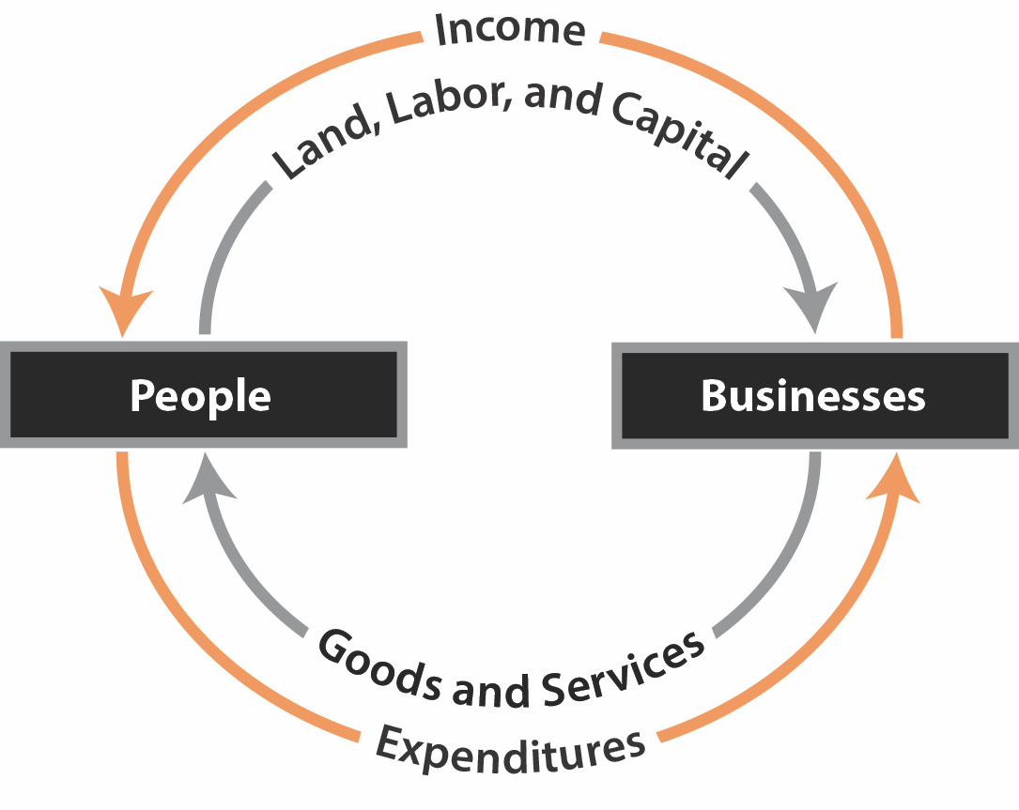
Section: Measuring GDP
Circular Flow: Oversimplified Version
From The VOTE Textbook Second Edition Copyright © 2023

Slide 15
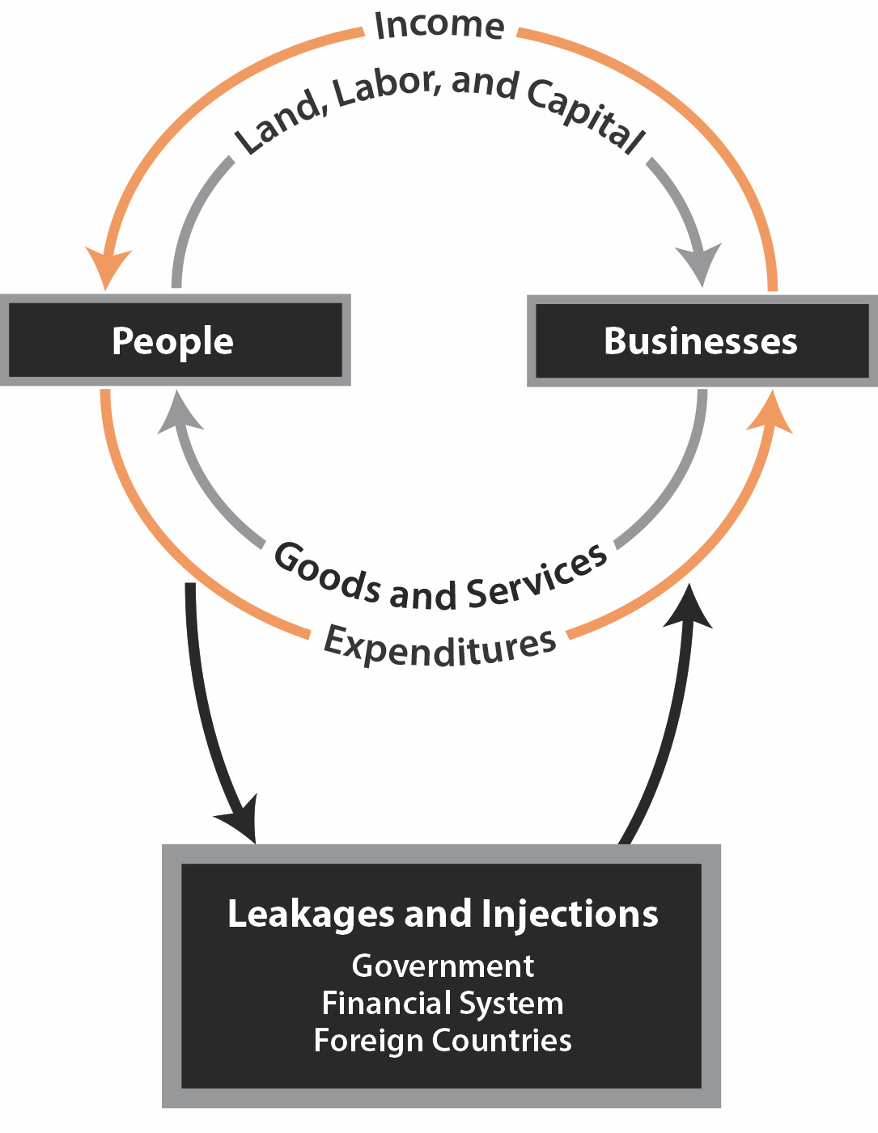
Section: Measuring GDP, cont’d
Circular Flow: Expanded Version
From The VOTE Textbook Second Edition Copyright © 2023

Slide 16
Section: Measuring GDP, cont’d
GDP counts four types of final goods and services:
C Consumer spending
Final goods and services (biggest)
I Investment spending
New homes and business capital, factory space, and inventory (most unstable)
G Government spending
Federal, state, regional, local goods and services
X-M Net Export spending
Exports (X) minus imports (M)
GDP = C + I + G + (X-M)
From The VOTE Textbook Second Edition Copyright © 2023

Slide 17
Exercise 2.1: What is Measured in GDP?
1. Tires produced for car makers?
Exercise: What Is Measured in GDP?
Does GDP include…?
-Tire production for automobile companies?
-Tire production for replacement tires?
From The VOTE Textbook Second Edition Copyright © 2023

Slide 18
Polling Question
What is Measured in GDP?
Does GDP include tires produced for car makers?
Yes
No
From The VOTE Textbook Second Edition Copyright © 2023

Slide 19
Exercise 2.1: What is Measured in GDP?, cont’d
Exercise: What Is Measured in GDP?
1. Tires produced for car makers?
NO! Intermediate good
2. Babysitting your cousins for $50?
    NO! Unreported income
3. Olive oil from Italy?
    YES! Import good
Does GDP include…?
-Tire production for automobile companies?
-Tire production for replacement tires?
From The VOTE Textbook Second Edition Copyright © 2023

Slide 20
Exercise 2.1: What is Measured in GDP?, cont’d
Exercise: What Is Measured in GDP?, cont’d
4. Replacement phone batteries?
    YES! Final good
5. Customs officials who work at the airport?
    YES! Government service
6. Selling your old video game console?
    NO! Used good
7. Cupcake pans for bakeries?
    YES! Investment good
Does GDP include…?
-Tire production for automobile companies?
-Tire production for replacement tires?
From The VOTE Textbook Second Edition Copyright © 2023

Slide 21

Section: Reading GDP on a Graph
2019 GDP ≅ $21.74 Trillion
  Consumption ≅ $ 14.76 T
  Investment ≅ $ 3.72 T
  Government ≅ $ 3.80 T
  Net Exports ≅ - $549.00 B
From The VOTE Textbook Second Edition Copyright © 2023

Slide 22
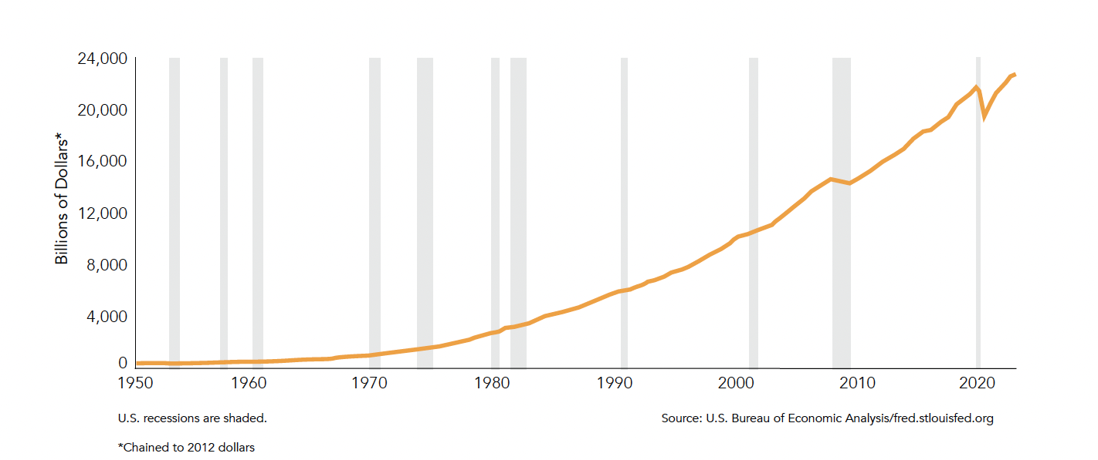
Section: Reading GDP on a Graph
Real GDP over a Seventy-Year Period
From The VOTE Textbook Second Edition Copyright © 2023

Slide 23

Section: Measuring Happiness
GDP is not a measure of HAPPINESS because it ignores:
  The amount of leisure time
  Pollution caused by production
  The “bads” versus the “goods”
  Distribution of output
  Non-market production
From The VOTE Textbook Second Edition Copyright © 2023

Slide 24

Section: Measuring Happiness, cont’d
In the 1970s, Bhutan developed the Gross National Happiness (GNH) measurement. It doesn’t replace GDP, but it can be used alongside GDP to measure happiness.
GDP
GNH
The market value of all final goods and services newly produced by the economy during a specified period of time.
Psychological well-being
Health
Education
Time use
Cultural diversity and resilience
Good governance
Community vitality
Environment
Living standards
From The VOTE Textbook Second Edition Copyright © 2023

Slide 25
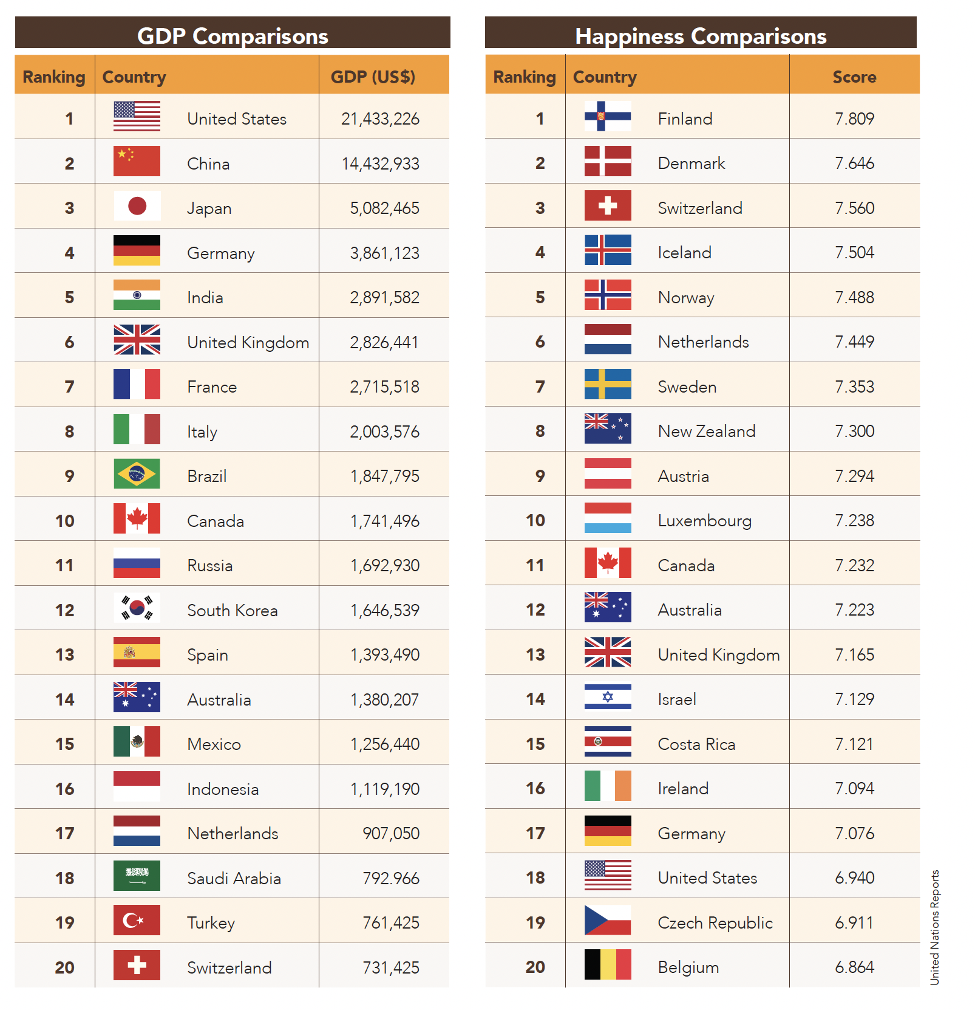
Section: Measuring Happiness, cont’d
GDP and Happiness Measures, 2019
From The VOTE Textbook Second Edition Copyright © 2023

Slide 26
Definition #2
UNEMPLOYMENT
Section: Unemployment
From The VOTE Textbook Second Edition Copyright © 2023

Slide 27
Section: Unemployment, cont’d
As we discuss the numbers of people not working who want or need to work, please remember that we are talking about human beings. The cold, faceless unemployment numbers don’t capture the devastation people experience when they are out of work.
From The VOTE Textbook Second Edition Copyright © 2023

Slide 28
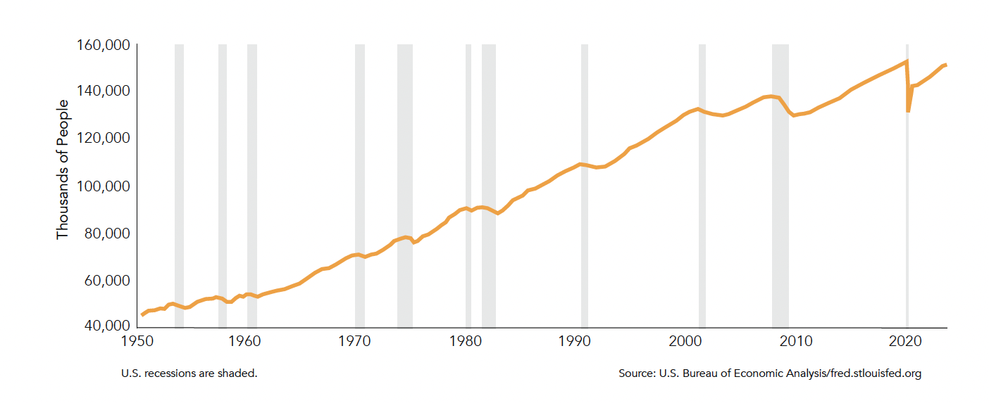
Section: Unemployment, cont’d
Employment over a Seventy-Year Period
From The VOTE Textbook Second Edition Copyright © 2023

Slide 29
Section: Official Definition of Unemployment and Employment
Unemployment
When people don’t have jobs and want them, actively seek them, and are eligible and available to take a job.
Employment
When people work for pay
(not as a volunteer),
either part time or full time.
From The VOTE Textbook Second Edition Copyright © 2023

Slide 30

Section: Official Definition of Unemployment and Employment, cont’d
In the Labor Force
All employed and unemployed people
Not in the Labor Force
-Stay-at-home parents
-Undocumented workers
-People in long-term care
facilities
-Military personnel
-Jail and prison inmates
-Others
From The VOTE Textbook Second Edition Copyright © 2023

Slide 31
Section: Measuring Unemployment
Two Ways Unemployment Is Measured
1. Establishment Survey
- Uses payroll data from the largest U.S. corporations
2. Household Survey
- Uses data collected from 60,000 random households
Unemployment Rate = Unemployed ÷ Labor Force
Example
Number Unemployed: 5 Million
Labor Force: 120 Million
5 ÷ 120 = 4.2%
From The VOTE Textbook Second Edition Copyright © 2023

Slide 32
Section: Measuring Unemployment, cont’d
Two Limitations of the Official Unemployment Rate
Ignores discouraged workers
(called ”marginally attached” workers)
Ignores underemployed workers
  Part-time workers who want full-time work
  (called “involuntary part-time workers”)
  Skilled workers who work at lower-skilled jobs
July 2020 Unemployment Numbers
Official unemployment rate: 10.2%
With marginally attached and involuntary part-time workers: 16.5%
From The VOTE Textbook Second Edition Copyright © 2023

Slide 33
Section: Three Types of Unemployment
Three Types of Unemployment
Frictional unemployment
Normal turnover rate in the labor market (natural)
Examples: moving, changing occupations, bad fit
Structural unemployment
Changes in the structure of the economy (natural)
Examples: change in demand, automation, outsourcing
Cyclical unemployment
Decline in the economy’s total production (not natural)
Examples: pandemic, stock market crash, weather event
From The VOTE Textbook Second Edition Copyright © 2023

Slide 34
Exercise 2.2: What Type of Unemployment Is It?
Exercise: What Type of Unemployment Is It?
Types of Unemployment
Description
Frictional
Structural
Cyclical
Not unemployed
Not in the labor force
Discouraged worker
Juan lost his in-store sales job when
consumers switched to online shopping.
Keisha lost her full-time job at a bank
and moved to part-time status.
Alex left their job to move to a beach
town and work as a pro surfer.
Abdul lost his job at a tech firm when
the economy tanked.
Erika lost her job and after three months
stopped looking for a new one.
Randy is a full-time student and
volunteer mentor.
From The VOTE Textbook Second Edition Copyright © 2023

Slide 35
Polling Question
What Type of Unemployment Is It?
Who is frictionally unemployed?
Juan lost his in-store sales job when consumers switched to online shopping.
Keisha lost her full-time job at a bank and moved to part-time status.
Alex left their job to move to a beach town and work as a pro surfer.
Abdul lost his job at a tech firm when the economy tanked.
Erika lost her job and after three months stopped looking for a new one.
Randy is a full-time student and volunteer mentor.
From The VOTE Textbook Second Edition Copyright © 2023

Slide 36
Exercise 2.2: What Type of Unemployment Is It?, cont’d
Exercise: What Type of Unemployment Is It?
Types of Unemployment
Description
Frictional
Structural
Cyclical
Not unemployed
Not in the labor force
Discouraged worker
Juan lost his in-store sales job when
consumers switched to online shopping.
Keisha lost her full-time job at a bank
and moved to part-time status.
Alex left their job to move to a beach
town and work as a pro surfer.
Abdul lost his job at a tech firm when
the economy tanked.
Erika lost her job and after three months
stopped looking for a new one.
Randy is a full-time student and
volunteer mentor.
From The VOTE Textbook Second Edition Copyright © 2023

Slide 37
Definition #3
INFLATION
Section: Inflation
From The VOTE Textbook Second Edition Copyright © 2023

Slide 38
Section: Official Definition of Inflation
Inflation
It’s when prices on average
go up.
Deflation
It’s when prices on average
go down.
Note: Disinflation isn’t deflation.
Disinflation means there’s still inflation, but the rate at which prices are rising is starting to come down.
From The VOTE Textbook Second Edition Copyright © 2023

Slide 39
Section: Measuring Inflation
Three Ways to Measure Average Price Changes
  1. Consumer Price Index (CPI) tracks
changes in consumer prices.
2. Producer Price Index (PPI) tracks
changes in producer prices.
3. GDP Deflator tracks changes
in all prices.
From The VOTE Textbook Second Edition Copyright © 2023

Slide 40
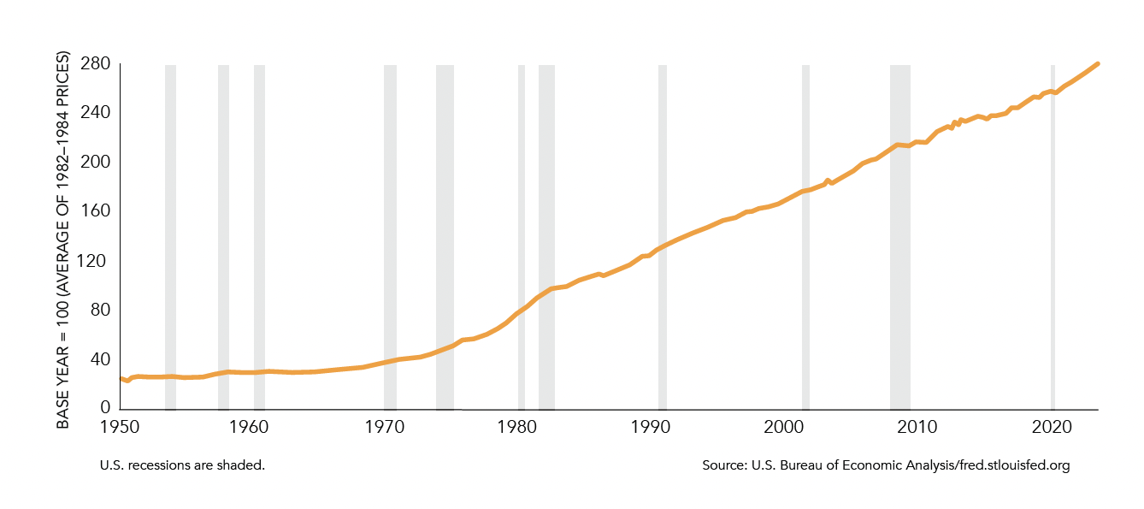
Section: Measuring Inflation, cont’d
CPI (Inflation) over a Seventy-Year Period
From The VOTE Textbook Second Edition Copyright © 2023

Slide 41

Section: Measuring Inflation, cont’d
Calculating CPI (Consumer Price Index)
The CPI is calculated by dividing the price of a basket of goods in a given year by the price of the same basket of goods in a base year, and multiplying the result by 100.
$
in 2015 (the given year)
X 100
$
in 2005 (the base year)
From The VOTE Textbook Second Edition Copyright © 2023

Slide 42
Section: Measuring Inflation, cont’d
The “base year” is the year against which we compare prices to see how they have changed. The CPI for the base year always equals 100.
Example:
Price of the basket in 2015 = $5,000
Price of the basket in base year 2005 = $4,000
CPI in 2005 = 100 (the base year is always 100)
In this example, what was the CPI in 2015?
125
Interpretation: Prices were 25% higher in 2015 than 2005
DAILY
DOUBLE
From The VOTE Textbook Second Edition Copyright © 2023

Slide 43
Exercise 2.3: Calculate the CPI
Exercise: Calculate the CPI
Assume in the base year of 2011, a basket of goods cost $6,000 (all of the numbers for this exercise are made up). Calculate the CPI and then state the percentage change in prices for the following years:
Year | Basket Price | CPI | Percentage Change
2008 | $5,700
2013 | $6,300
2018 | $7,800
Does GDP include…?
-Tire production for automobile companies?
-Tire production for replacement tires?
95
Prices were 5% lower
105
Prices were 5% higher
130
Prices were 30% higher
From The VOTE Textbook Second Edition Copyright © 2023

Slide 44
Section: Measuring Inflation, cont’d
Controversies with the CPI
CPI is used to calculate Cost of Living Adjustments (COLAs)
These affect the minimum wage, pensions, Social Security, public benefits, and more.
  CPI used for COLAs is based on a basket of goods relevant to Urban Wage Earners and Clerical Workers. But that is not appropriate for people in rural areas, retirees, and others.
  The basket used for the CORE CPI—which is used to determine COLAs—does not include food or energy.
  Using a chained CPI, substitutions are taken into account; however, consumers might continue to buy the original product instead.
  It can take years to integrate new items into the basket, so the CPI is often outdated.
  Changes in the quality of products from one period of time to another are not factored into the CPI.
From The VOTE Textbook Second Edition Copyright © 2023

Slide 45
Section: Money Illusion
There are two ways to think about things measured in money terms such as GDP, interest payments, and income.
NOMINAL value is the face value of money.
REAL value is adjusted for inflation.
From The VOTE Textbook Second Edition Copyright © 2023

Slide 46

Section: Money Illusion, cont’d
Beware of Money Illusion!
If you mistakenly believe that what’s important about
money is the face (nominal) value instead of the
inflation-adjusted (real) value, you could run into problems.
Income and salary: In negotiations with your employer, focus on “real” income because inflation will decrease your real income (purchasing power) and deflation will increase your real income (purchasing power).
Interest payments: In negotiations with your lender, focus on “real” interest rates because inflation will decrease the real interest rate you pay, and deflation will increase the real interest rate you pay.
BEWARE!
From The VOTE Textbook Second Edition Copyright © 2023
Notes:
Buy photo

Slide 47

Chapter 2
Check out the book for more!
Test Yourself • Key Terms • Answer Key
From The VOTE Textbook Second Edition Copyright © 2023

