Slide 1

From The VOTE Textbook Second Edition Copyright © 2023

Slide 2


From The VOTE Textbook Second Edition Copyright © 2023
Notes:
2

Slide 3
From The VOTE Textbook Second Edition Copyright © 2023
Notes:
3

Slide 4
The VOTE Textbook Chapters
From The VOTE Textbook Second Edition Copyright © 2023
Notes:
4

Slide 5
1
2
3
4
5
6
7
8
9
10
11
12
13
14
15
16
17
18
19
20
21
From The VOTE Textbook Second Edition Copyright © 2023
Notes:
5

Slide 6

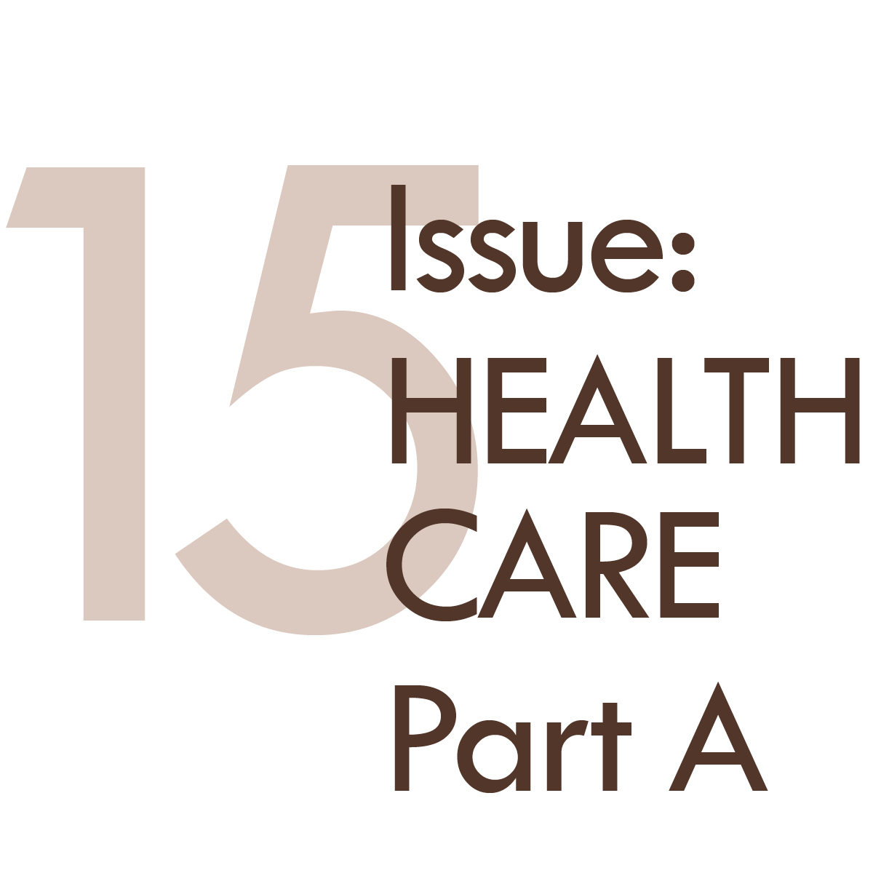
From The VOTE Textbook Second Edition Copyright © 2023

Slide 7
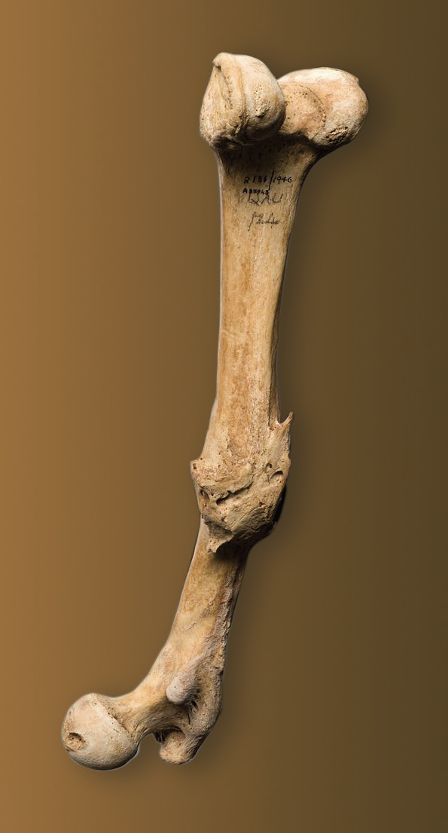
Opening Story: Margaret Mead and the femur bone
Margaret Mead and the femur bone
She said it was none of those. Then she held up a 15,000-year-old femur and showed where the bone had been broken and healed. Without modern medicine, she said, it would have taken the person six weeks of rest to heal.
So, this femur is evidence that humans had reached a higher level of development. We were able to be compassionate. And that, she said, is what makes it the earliest sign of civilization.
Famous cultural anthropologist Margaret Mead once asked, what is the first sign of civilization? Is it clay pots, tools for hunting, grinding stones, or religious artifacts?
From The VOTE Textbook Second Edition Copyright © 2023
Notes:
7

Slide 8

Opening Story: Margaret Mead and the femur bone, cont’d
Health Care System
It is the organized way in which society provides medical care to people. (In other words, how people, institutions, and resources are used to provide and fund medical care.)
From The VOTE Textbook Second Edition Copyright © 2023

Slide 9
Opening Story: Margaret Mead and the femur bone, cont’d
The Golden Moment
Shared Problem:
Shared Goal:
Lack of access to high-quality health care
Health and well-being for all
From The VOTE Textbook Second Edition Copyright © 2023
Notes:
9

Slide 10

Section: Your Physical Well-Being
Your current health is a combination of your nature and how you were nurtured. It changes as you age. Some say that we are all just temporarily able bodied.
From The VOTE Textbook Second Edition Copyright © 2023

Slide 11

Section: Your Physical Well-Being, cont’d
Hazel’s 9Oth birthday party
Heart
Attack
Broken
Elbow
Colon
Cancer
Acne
Alcoholism
Asthma
ADHD
Blood
Cancer
Flu
Cold
Diabetes
Anxiety
Disorder
If you feel comfortable, here is a way to think about your personal relationship to health care. Fill in the health histories of yourself and your loved ones. (Examples are given.)
From The VOTE Textbook Second Edition Copyright © 2023

Slide 12
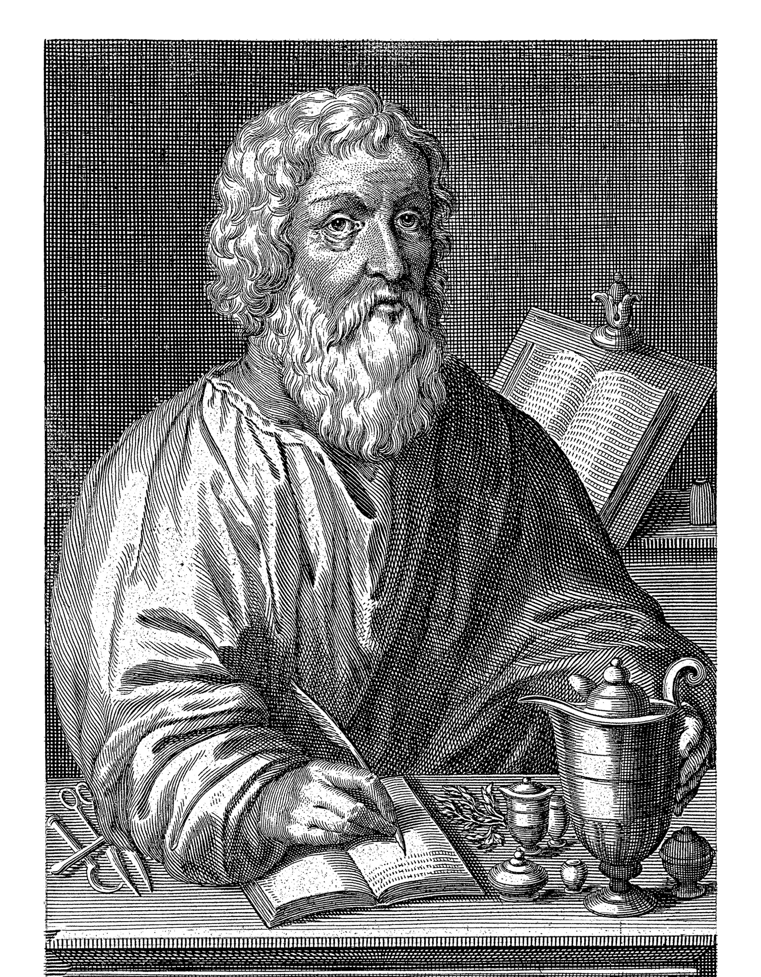
Section: A Brief History of Health Care
The Hippocratic Oath is named for Hippocrates, a Greek physician who lived around 2,400 years ago. The modern version is paraphrased as “First, do no harm.” He is credited with being the first to practice Western medicine, which used the scientific method.
Integrative medicine is the combination of traditional healing practices and Western medicine.
From The VOTE Textbook Second Edition Copyright © 2023

Slide 13
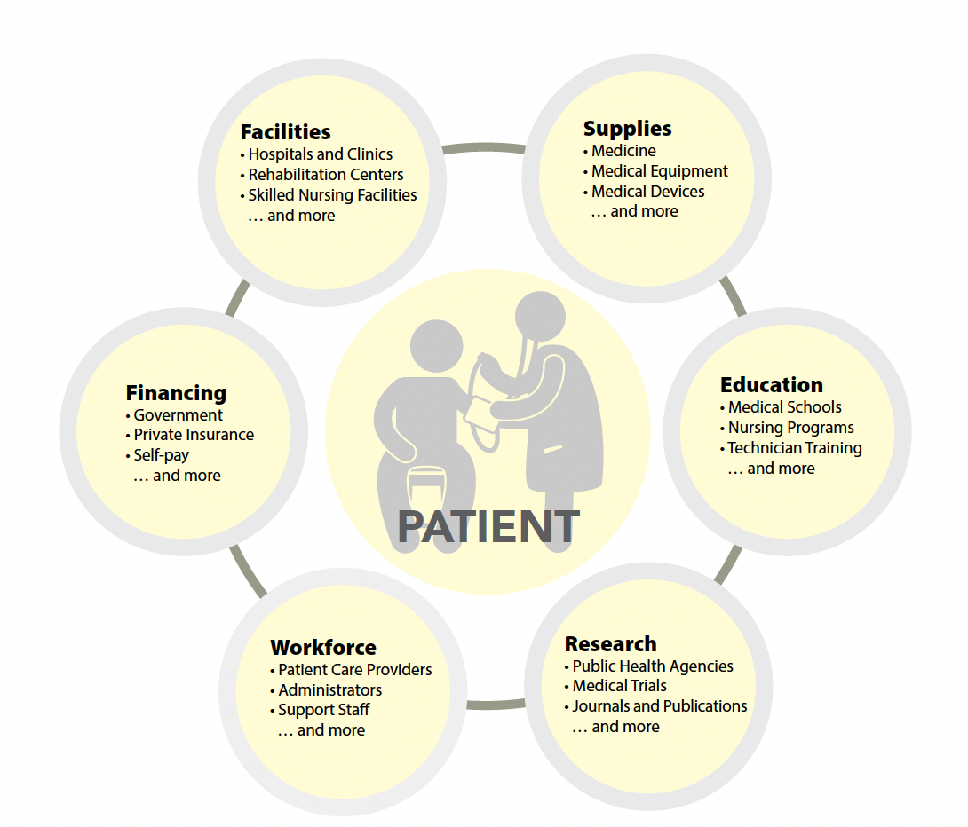
Section: The Health-Care System
There are many interconnected parts of the U.S. health-care system.
From The VOTE Textbook Second Edition Copyright © 2023

Slide 14
Section: The Health-Care System, cont’d
This is how it can feel to be caught in the labyrinth of the health-care system!
Doctor visits
Prescriptions
Medical bills
Tests and treatments
Health insurance
Benefits and claims
From The VOTE Textbook Second Edition Copyright © 2023

Slide 15
Section: Funding Health Care
There are three main debates in health care:
Who gets it?
The U.S. is still fighting about this, but our peer nations have already settled this debate. They all guarantee health care to people as a right.
2. How do we fund it?
This question is the center of debate in the U.S., but our peer nations have already settled this question, using a variety of funding methods.
3. How do we provide it?
Until the U.S. settles the funding question, we won’t have the bandwidth for this debate… but we will, someday.
From The VOTE Textbook Second Edition Copyright © 2023

Slide 16
Section: The Sky-High Costs of Health Care
What are the top five financial fears in the U.S.?
Paying for a medical emergency
Having adequate retirement savings
Paying for annual health care expenses
Not having affordable housing
Becoming unemployed
Two out of five are about health care!
We don’t just dread getting sick because
of physical and mental pain and suffering.
We dread being financially wiped out by medical bills.
25% of people in the U.S. had medical debt in 2014.
66% of bankruptcy filings in 2018 were due to medical debt.
From The VOTE Textbook Second Edition Copyright © 2023
Notes:
16

Slide 17
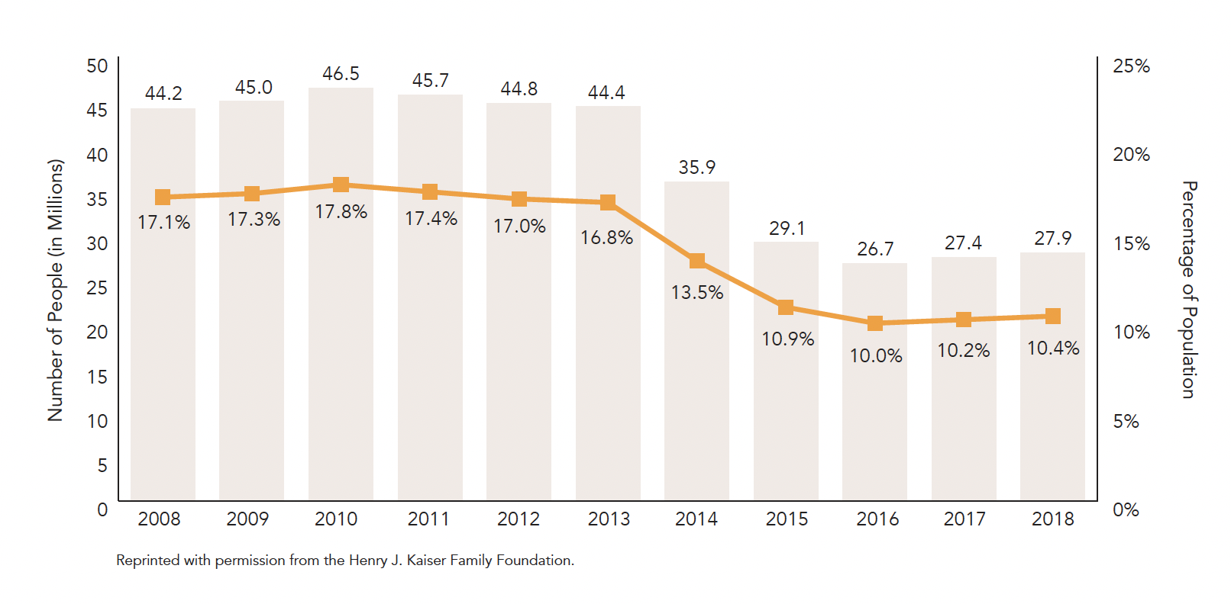
Section: The Sky-High Costs of Health Care, cont’d
While the U.S. fights about how to fund health care …
… there were 27.9 million uninsured people in the U.S. in 2018, which was 10.4% of the non-elderly population.
From The VOTE Textbook Second Edition Copyright © 2023
Notes:
17

Slide 18
Polling Question
Number of Uninsured
How many people were uninsured in 2008?
35.9
26.7
44.2
46.5
27.9
From The VOTE Textbook Second Edition Copyright © 2023

Slide 19
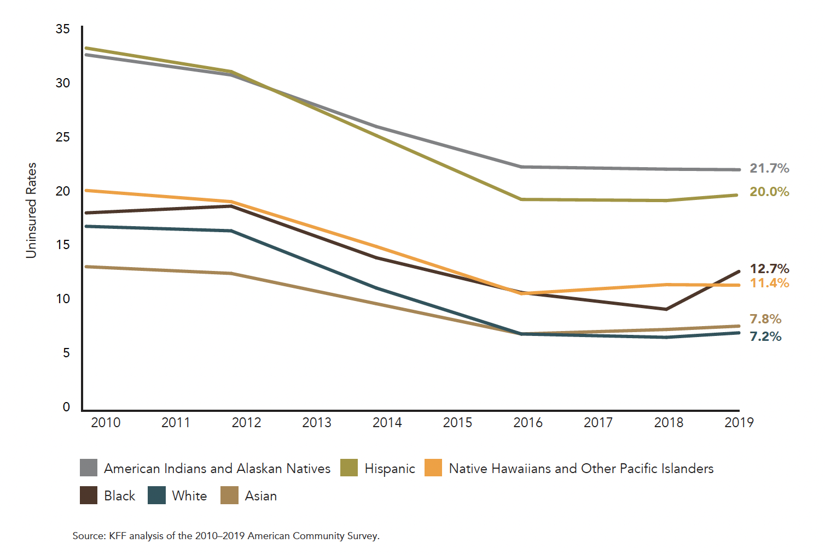
Section: The Sky-High Costs of Health Care, cont’d
And, some groups are disproportionately affected.
Disparities in Health Insurance Coverage
by Race and Ethnicity
From The VOTE Textbook Second Edition Copyright © 2023
Notes:
19

Slide 20


Section: Shared Tools
Shared Tools
Experimental Economics
for all three perspectives
From The VOTE Textbook Second Edition Copyright © 2023

Slide 21
Section: Shared Tools, cont’d
Markets and Third Parties, Part A*
Trading in a Pit Market
Consider the willingness to buy and sell wellness checkups, which is a health-care service. Patients are the demanders; providers are the suppliers.
For a Daily Double, 10 people volunteer to be demanders and 10 people volunteer to be suppliers of wellness checkups. Each is secretly assigned a number (given in Table 15.1 on page 571 of the textbook).
DAILY
DOUBLE
*A variation of an experiment created by Charles Holt
From The VOTE Textbook Second Edition Copyright © 2023

Slide 22
Section: Shared Tools, cont’d
Markets and Third Parties, Part A
Trading in a Pit Market
Willingness to Demand
a wellness checkup
(maximum amount)
Willingness to Supply
a wellness checkup
(minimum amount)
Objective:
Maximize the benefit.
A demander can’t buy a wellness checkup for more than their assigned number.
Objective:
Maximize the profit.
A supplier can’t sell a
wellness checkup for
less than their assigned number.
From The VOTE Textbook Second Edition Copyright © 2023

Slide 23

Section: Shared Tools, cont’d
FOUR ROUNDS
Rules:
No one knows anyone else’s number.
Numbers change each round.
Demanders may not pay more than their number.
Suppliers may not sell for less than their number.
All participants can hear others negotiating.
Players may not compare notes between rounds.
From The VOTE Textbook Second Edition Copyright © 2023

Slide 24
Section: Shared Tools, cont’d
Buyer | Willingness to Demand (maximum amount) | Seller | Willingness to Supply (minimum amount)
Josue |  | Jay
Sandra |  | Nina
Joseph |  | Francisco
Malik |  | Kai | $65
Katie |  | Penny
Elizabeth | $115 | Keisha
Laila |  | RaShawn
Ashley |  | Paula
Craig |  | Kanchu
Ram |  | Henry
EXAMPLE: ROUND 1
From The VOTE Textbook Second Edition Copyright © 2023

Slide 25
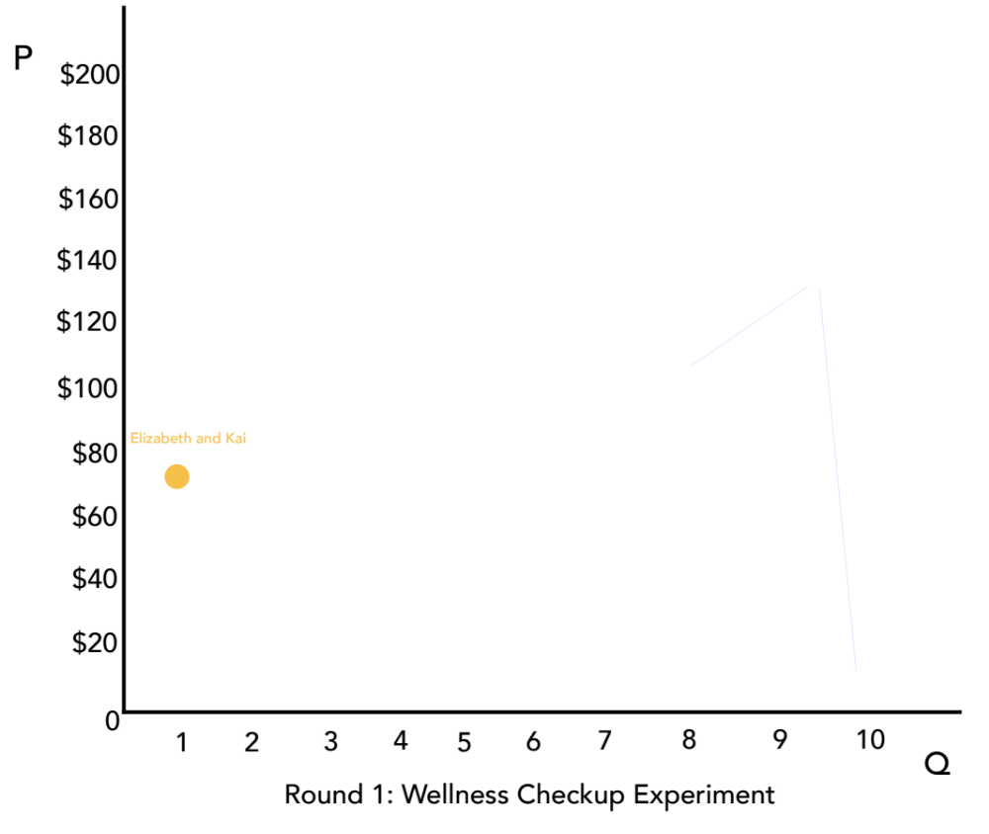
Section: Shared Tools, cont’d
ROUND 1
From The VOTE Textbook Second Edition Copyright © 2023

Slide 26
Section: Shared Tools, cont’d
Buyer | Willingness to Demand (maximum amount) | Seller | Willingness to Supply (minimum amount)
Josue |  | Jay
Sandra |  | Nina
Joseph |  | Francisco
Malik |  | Kai | $65
Katie |  | Penny
Elizabeth | $115 | Keisha | $125
Laila |  | RaShawn
Ashley |  | Paula
Craig |  | Kanchu
Ram | $190 | Henry
EXAMPLE: ROUND 1
From The VOTE Textbook Second Edition Copyright © 2023

Slide 27
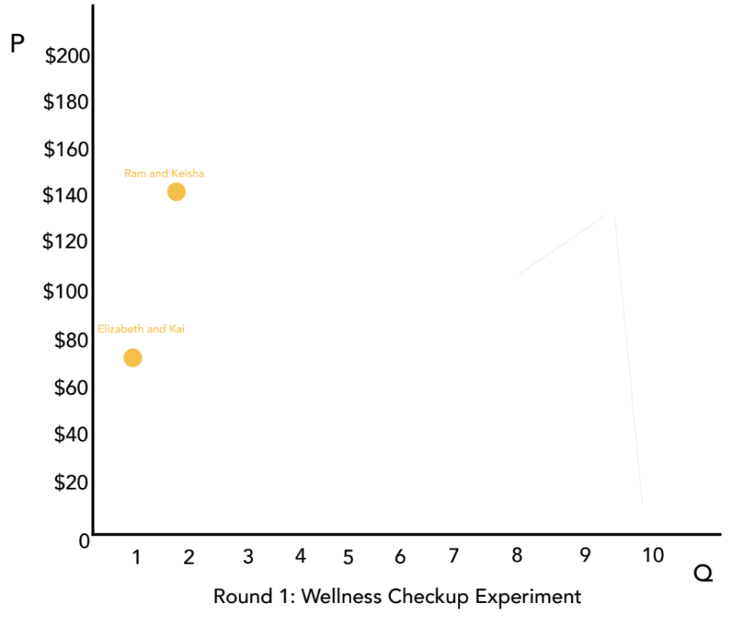
Section: Shared Tools, cont’d
ROUND 1
From The VOTE Textbook Second Edition Copyright © 2023

Slide 28
Section: Shared Tools, cont’d
Buyer | Willingness to Demand (maximum amount) | Seller | Willingness to Supply (minimum amount)
Josue | $25 | Jay
Sandra |  | Nina
Joseph |  | Francisco
Malik |  | Kai | $65
Katie |  | Penny | $100
Elizabeth | $115 | Keisha | $125
Laila |  | RaShawn
Ashley |  | Paula
Craig |  | Kanchu
Ram | $190 | Henry
EXAMPLE: ROUND 1
From The VOTE Textbook Second Edition Copyright © 2023

Slide 29
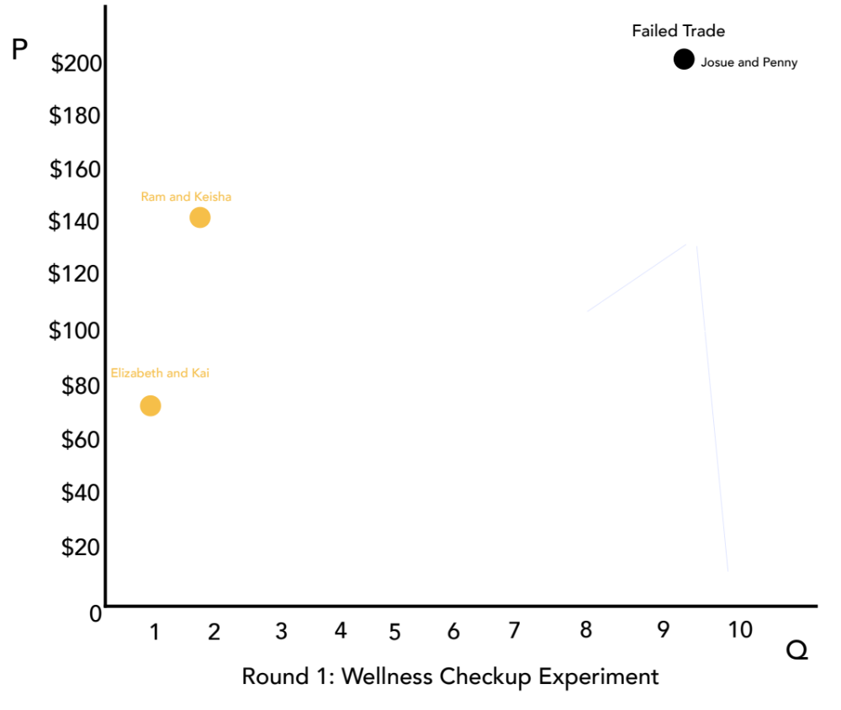
Section: Shared Tools, cont’d
ROUND 1
From The VOTE Textbook Second Edition Copyright © 2023

Slide 30
Section: Shared Tools, cont’d
Buyer | Willingness to Demand (maximum amount) | Seller | Willingness to Supply (minimum amount)
Josue | $25 | Jay | $15
Sandra | $40 | Nina | $30
Joseph | $50 | Francisco | $45
Malik | $75 | Kai | $65
Katie | $95 | Penny | $100
Elizabeth | $115 | Keisha | $125
Laila | $130 | RaShawn | $130
Ashley | $150 | Paula | $145
Craig | $180 | Kanchu | $175
Ram | $190 | Henry | $195
EXAMPLE: ROUND 1
From The VOTE Textbook Second Edition Copyright © 2023

Slide 31
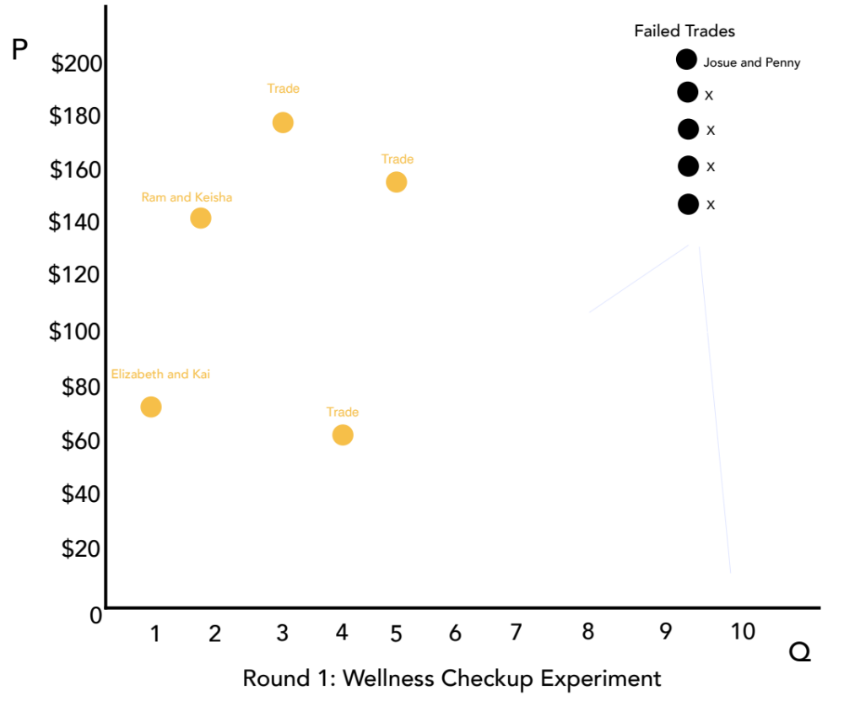
Section: Shared Tools, cont’d
ROUND 1
From The VOTE Textbook Second Edition Copyright © 2023

Slide 32

Section: Shared Tools, cont’d
EXAMPLE: ROUNDS 2 and 3
In Round 2 and then in Round 3, everyone is assigned a new number.
Once again, buyers and sellers mingle and start negotiating.
This time, however, they have additional information because they overheard the negotiations from previous rounds.
Successful trades converge around the same amount.
From The VOTE Textbook Second Edition Copyright © 2023

Slide 33
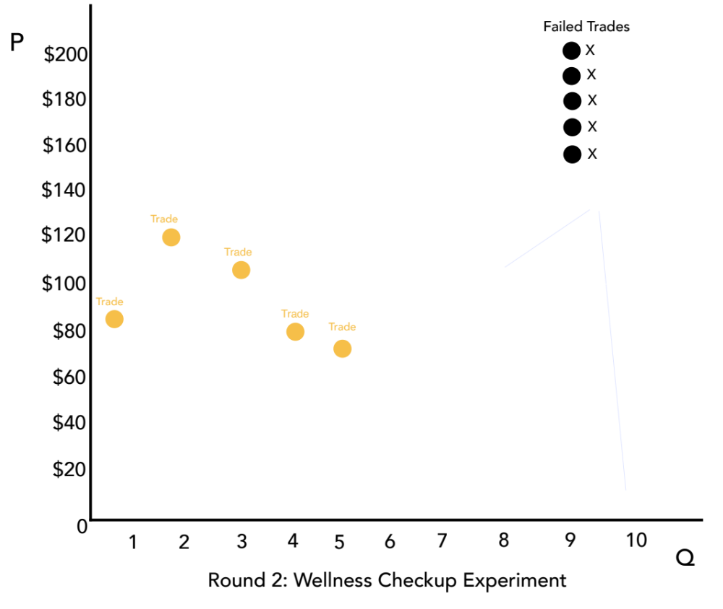
Section: Shared Tools, cont’d
ROUND 2
From The VOTE Textbook Second Edition Copyright © 2023

Slide 34
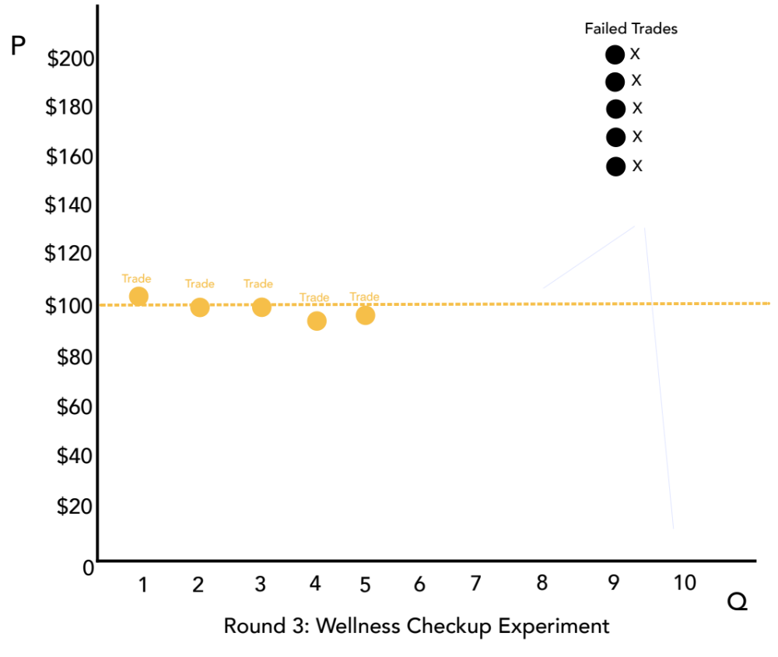
Section: Shared Tools, cont’d
ROUND 3
From The VOTE Textbook Second Edition Copyright © 2023

Slide 35
Section: Shared Tools, cont’d
ROUND 4: A third party enters the market
Buyers
Sellers
NEW: A third party pays half the price for wellness checkups. Buyers now double the maximum amount they are willing to pay.
No changes
What happens?
From The VOTE Textbook Second Edition Copyright © 2023

Slide 36
Section: Shared Tools, cont’d
Buyer | Willingness to Demand (maximum amount) | Seller | Willingness to Supply (minimum amount)
Elizabeth | $ 25 $50 | Keisha | $15
Laila | $40 $80 | RaShawn | $30
Ashley | $50 $100 | Paula | $45
Craig | $75 $150 | Seller 4 | $65
Ram | $95 $190 | Henry | $100
Buyer 4 | $115 $230 | Jay | $125
Sandra | $130 $260 | Nina | $130
Joseph | $150 $300 | Francisco | $145
Malik | $180 $360 | Kai | $175
Katie | $195 $390 | Penny | $190
EXAMPLE: ROUND 4
From The VOTE Textbook Second Edition Copyright © 2023

Slide 37
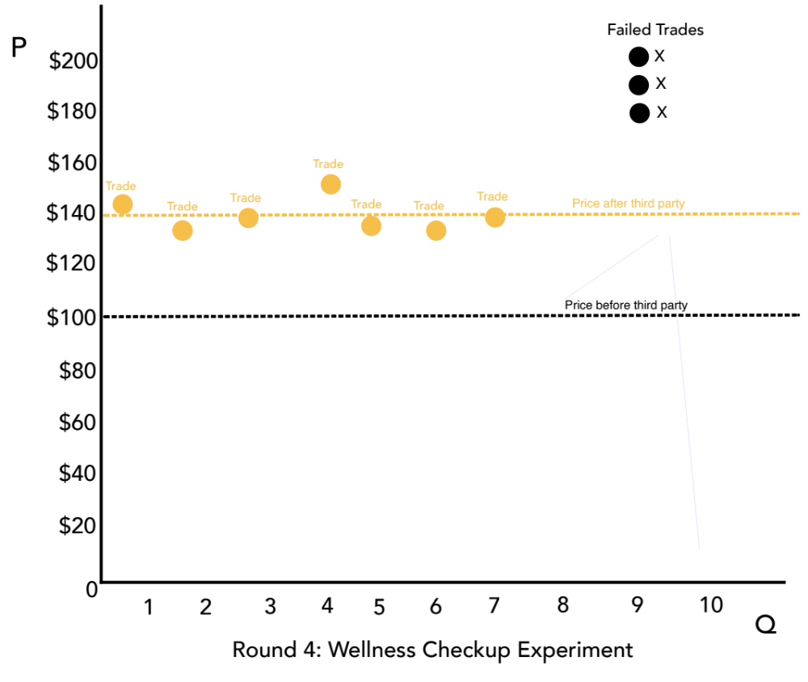
Section: Shared Tools, cont’d
ROUND 4
From The VOTE Textbook Second Edition Copyright © 2023

Slide 38
Polling Question
Experiment Conclusions
Based on this experiment, on which conclusion(s) do all three perspectives agree?
Insurance enables more people to get wellness checkups.
Insurance increases prices of wellness checkups.
Some people will not be able to get wellness checkups.
All of the above are correct.
There is no agreement among the perspectives.
From The VOTE Textbook Second Edition Copyright © 2023

Slide 39
Section: Shared Tools, cont’d
  Radical Perspective:
  This experiment demonstrates how health insurance in the system of capitalism doesn’t fix the problem of inaccessible health care because it puts profit first—before people.
  Conventional Perspective:
  This experiment demonstrates how health insurance in the for-profit system of capitalism is a vital part of fixing the problem of inaccessible health care because people are motivated to act in ways that put them in the best possible financial position.
From The VOTE Textbook Second Edition Copyright © 2023

Slide 40
Section: Conventional Theory Tools
Conventional Theory Tools
(Conservative and Liberal)
Third Parties in Markets and Demand-Curve Rotation
* These tools are built on the foundation presented in Chapter 5.
From The VOTE Textbook Second Edition Copyright © 2023

Slide 41
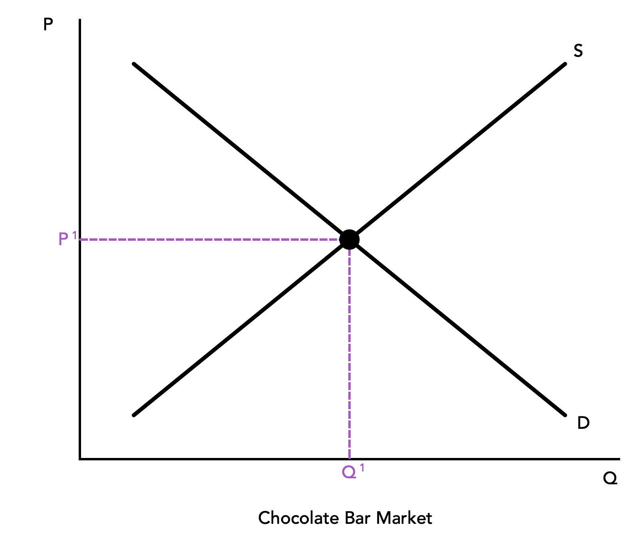
Section: Conventional Theory Tools, cont’d
  Practice: Draw the six components of the Wellness Checkup Market graph.
(1)
(4)
(5)
(3)
(2)
(6)
Wellness Checkup Market
From The VOTE Textbook Second Edition Copyright © 2023

Slide 42
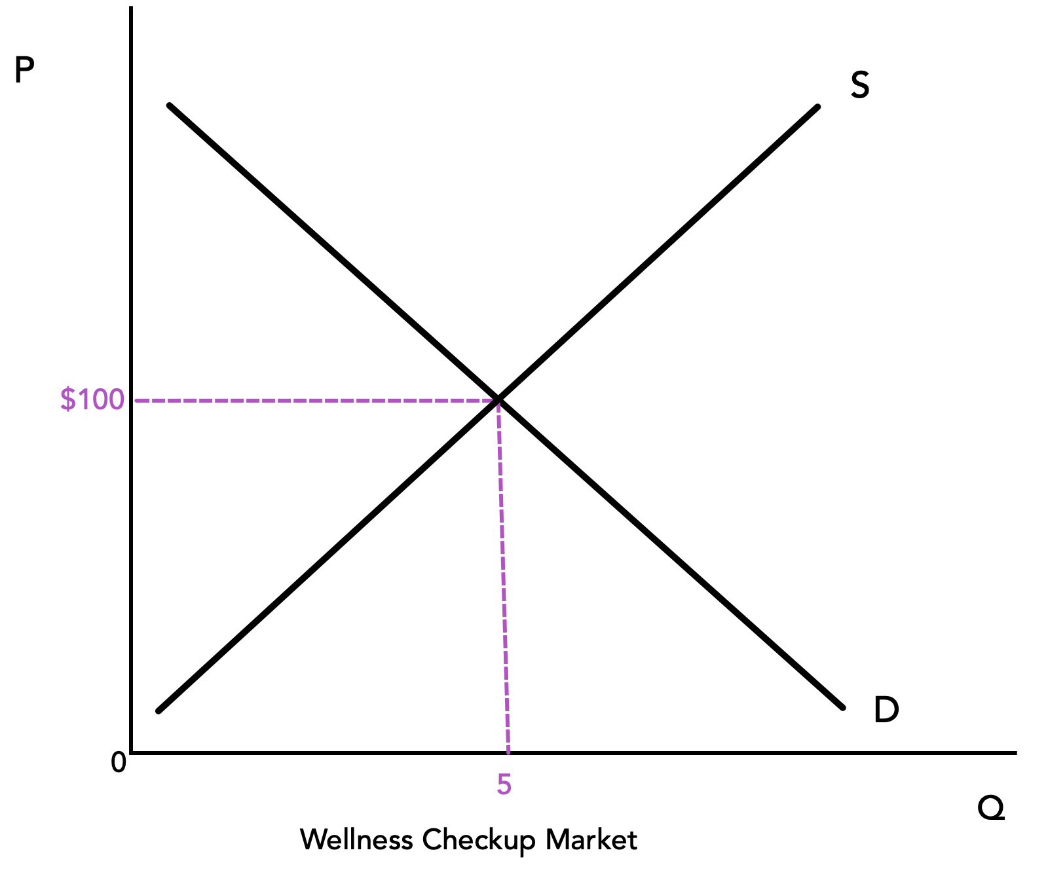
Section: Conventional Theory Tools, cont’d
The equilibrium price of a wellness checkup is $100
From The VOTE Textbook Second Edition Copyright © 2023

Slide 43
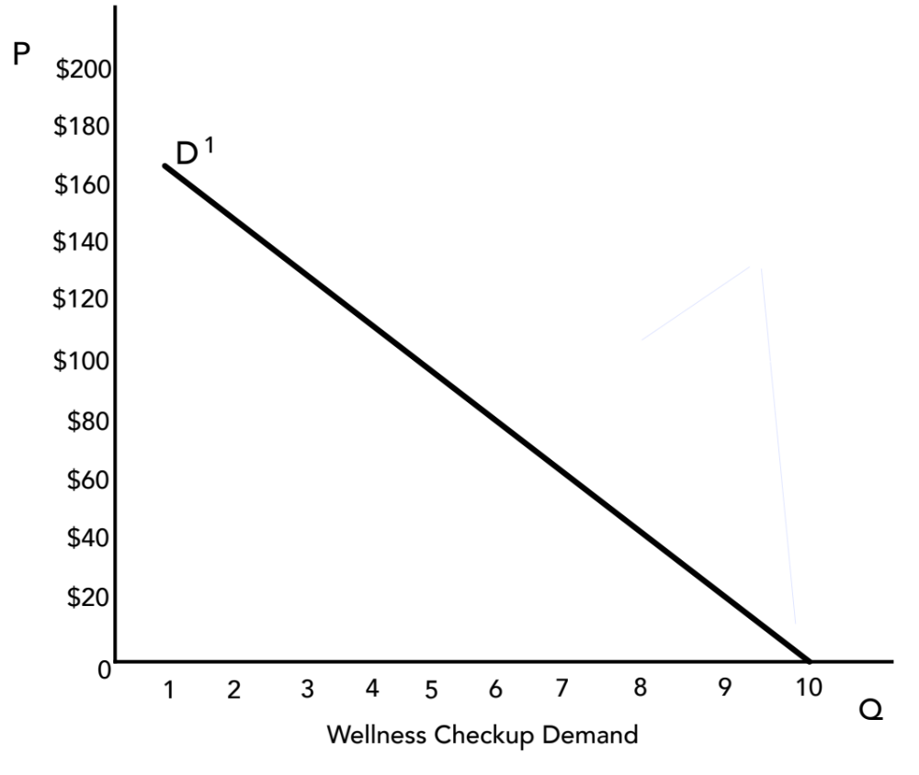
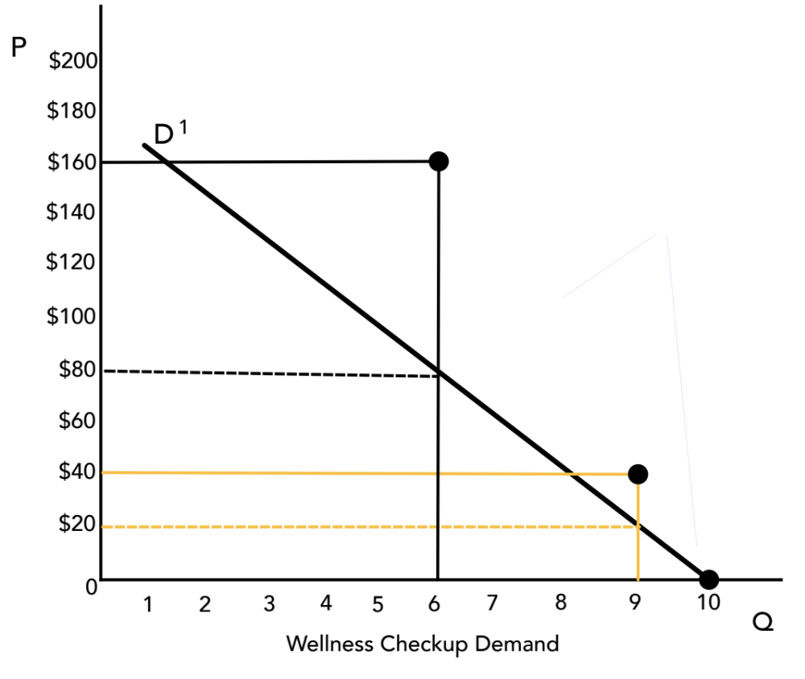
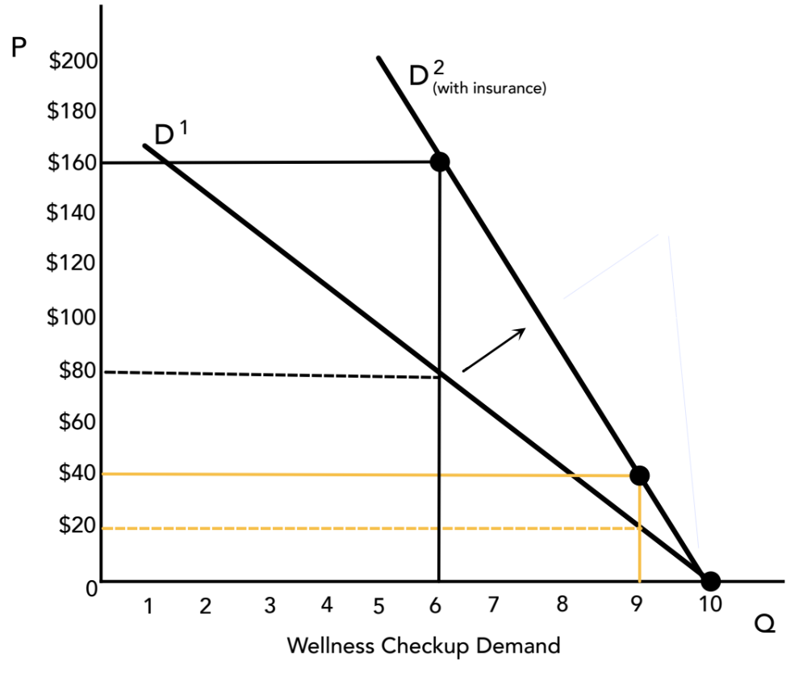
Section: Conventional Theory Tools, cont’d
When a third party pays half the price, buyers become willing to pay twice as much for wellness checkups.
As a result, the demand curve rotates to the right.
From The VOTE Textbook Second Edition Copyright © 2023

Slide 44
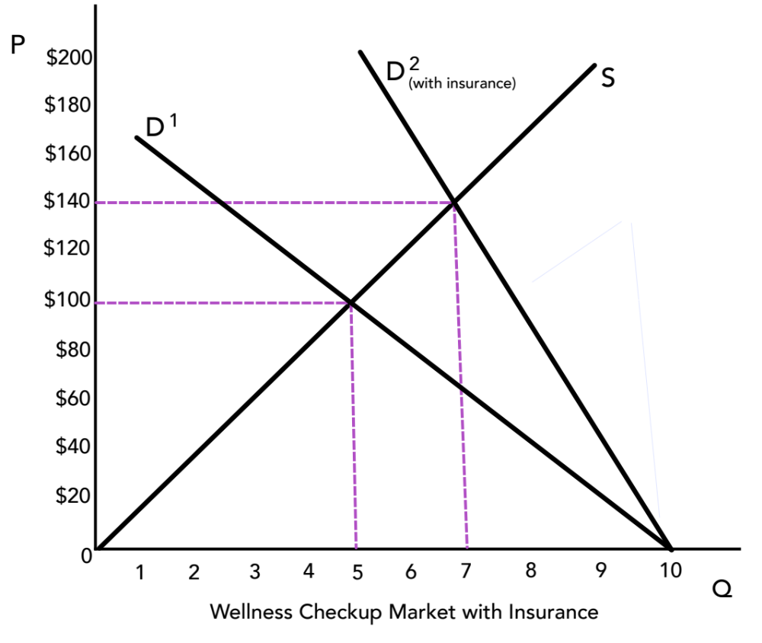
Section: Conventional Theory Tools, cont’d
Once supply is added to the graph, you can see that
health insurance (the third party) increases the quantity of wellness checkups … but it drives up the price.
From The VOTE Textbook Second Edition Copyright © 2023

Slide 45
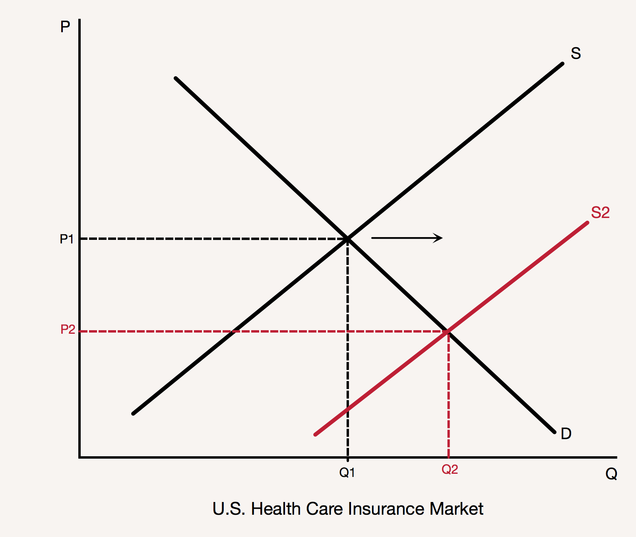
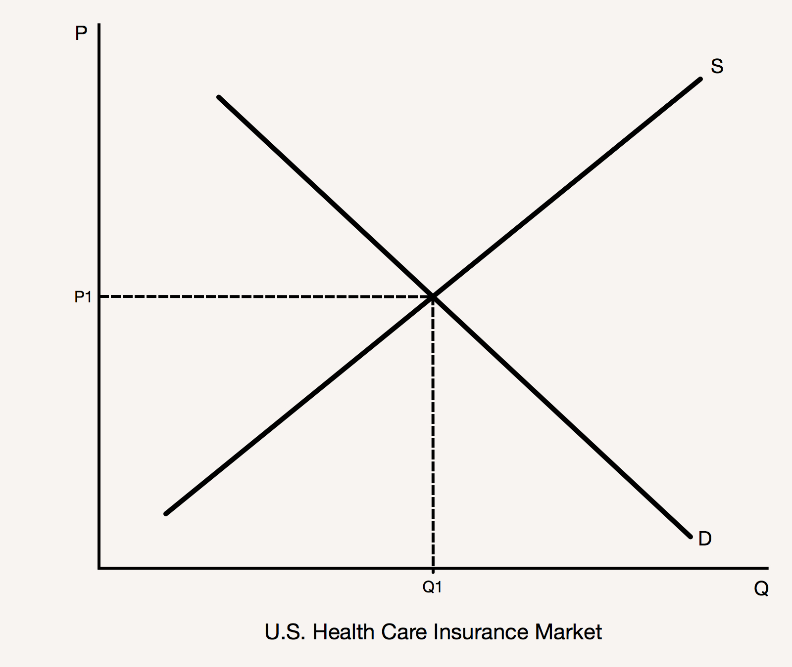
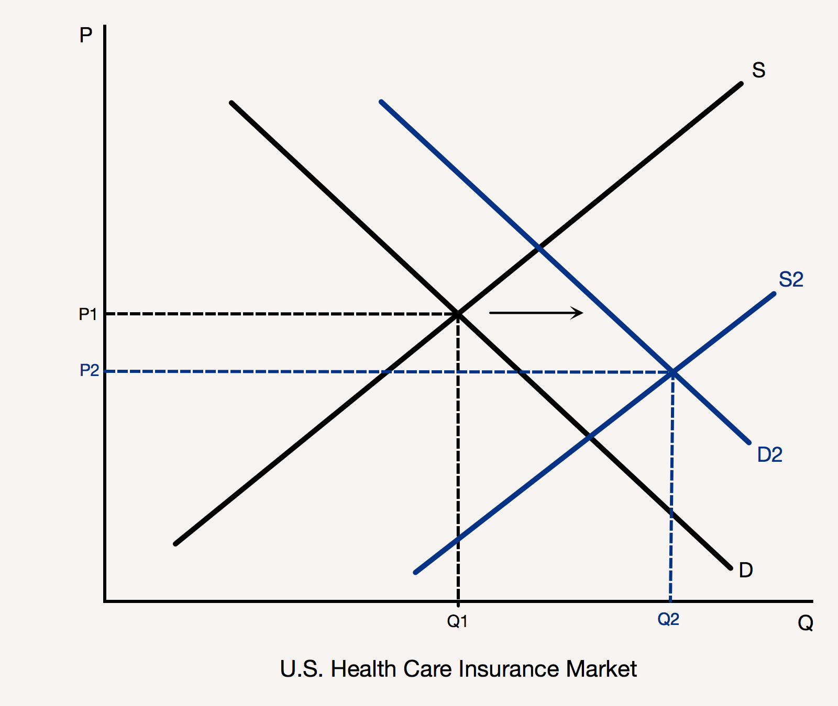
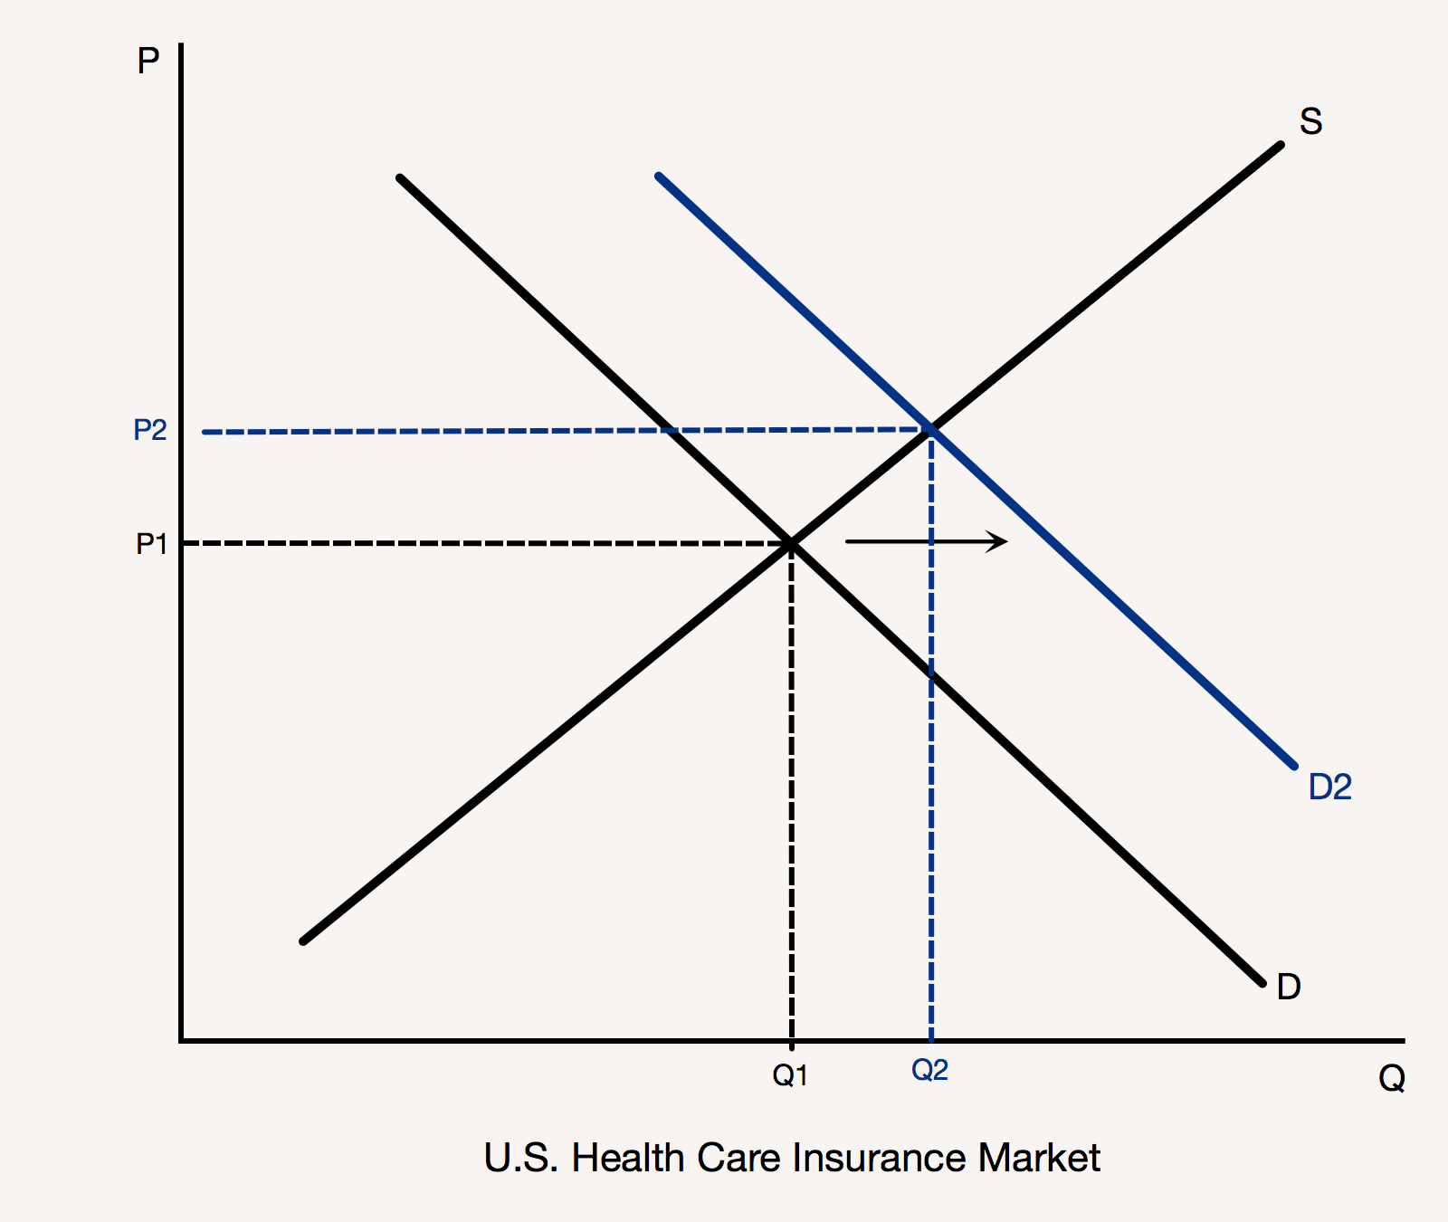
Section: Conventional Theory Tools, cont’d
Conservative
Liberal
Shift supply right.
a. Deregulate providers
b. Deregulate insurers
Result: Lower prices and more people insured.
Shift demand right.
a. Health insurance mandate
Shift supply right.
a. Regulate providers
b. Establish health care exchanges
Result: Lower prices and more people insured.
From The VOTE Textbook Second Edition Copyright © 2023

Slide 46
Section: Conventional Theory Tools, cont’d
Health Care Policies
Conservative
Liberal
Conservatives want a deregulated health-care system of private insurance.
Liberals want a regulated, for-profit health-care system and government health-care programs.
From The VOTE Textbook Second Edition Copyright © 2023

Slide 47
Section: Radical Theory Tools
Radical Theory Tools
Individuals at Risk and Social Safeguards
* These tools are built on the foundation presented in Chapter 6.
From The VOTE Textbook Second Edition Copyright © 2023

Slide 48




Section: Building Radical Theory in Two Parts, cont’d
Practice: Write the names of the six core points of economic
systems.
        Ownership
        Governance
        Meeting people’s
        material needs
        Production
        Sustainability
        Communities
(1)
(2)
(3)
(4)
(5)
(6)
The Six-Core Cube
of Every Economic System
From The VOTE Textbook Second Edition Copyright © 2023

Slide 49

Section: Radical Theory Tools, cont’d
Radicals use the core point that makes the most sense to analyze a particular issue, but there is no "right" core point. They are all relevant.
For retirement security, we use the core point of meeting people’s basic material needs.
        Ownership
        Governance
        Meeting people’s basic material needs
        Production
        Sustainability
        Communities
From The VOTE Textbook Second Edition Copyright © 2023

Slide 50
Section: Radical Theory Tools, cont’d
Health Care
Radical Tools, Part 1:
Drill down into meeting people’s basic material needs in capitalism
Radical Tools, Part 2:
Drill down into meeting people’s basic
material needs in democratic socialism
The Six-Core Cube
of Every Economic System
From The VOTE Textbook Second Edition Copyright © 2023

Slide 51
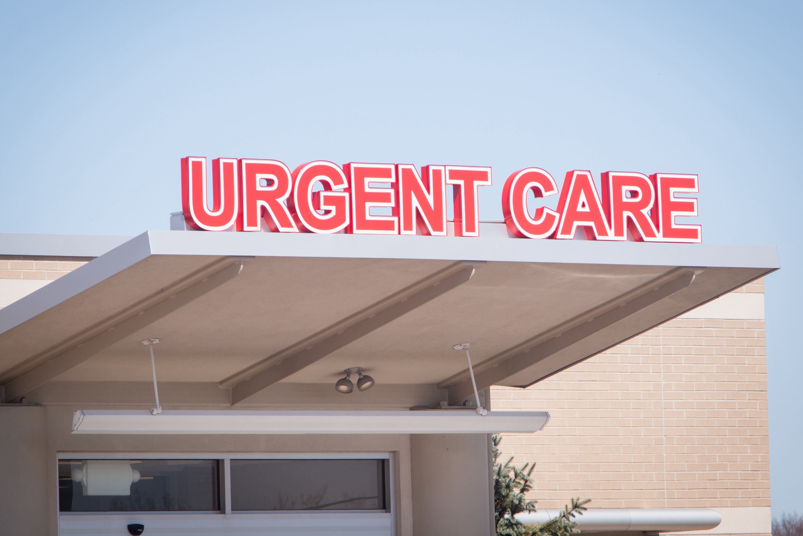

Section: Radical Theory Tools, cont’d
Workplace Exploitation
+
Capitalist Competition
The Pressure for Bad
leads to
The Visible Suffering
… and is represented by the Six-Core Cube of capitalism, which can never be solved.
From The VOTE Textbook Second Edition Copyright © 2023

Slide 52
Section: Radical Theory Tools, cont’d
The Unsolvable
Six-Core Cube of Capitalism
        Private Ownership
        Top-Down Governance
        Individuals at Risk
        Production for Profit
        Unsustainable Growth
        Unhealthy Communities
Why unsolvable?
It is built around six core points that are rotten to the core!
Individuals at Risk: There is no guarantee that basic material needs will be met, so people live in fear about their well-being.
From The VOTE Textbook Second Edition Copyright © 2023

Slide 53
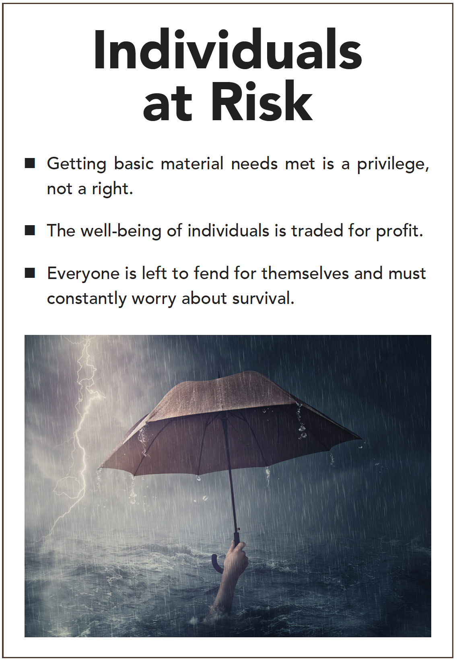

Section: Radical Theory Tools, cont’d
From The VOTE Textbook Second Edition Copyright © 2023

Slide 54
Section: Radical Theory Tools, cont’d
Individuals at Risk
Competitor #1:
“We’ve cut our full-time employees to part time. Now I don’t have to provide any of them with health-care benefits. I’m saving a bundle. You should do the same.”
Owner:
Competitor:
Owner:
“I don’t want to be a part of…”
“So don’t do it.”
“But if I don’t do it and you do,
I won’t survive.”
“I’m saving money by buying the cheapest possible medical supplies, scaling back on the number of doctors and nurses I employ, and outsourcing the lab work and X-rays.”
Competitor #2:
"So don’t do it.”
Competitor #3:
“I bought a chain of imaging centers. Now, every patient who comes to my urgent care centers gets an X-ray whether they need it or not. Insurance pays and I make a bundle.
“So don’t do it.”
PRESSURE FOR BAD
From The VOTE Textbook Second Edition Copyright © 2023

Slide 55
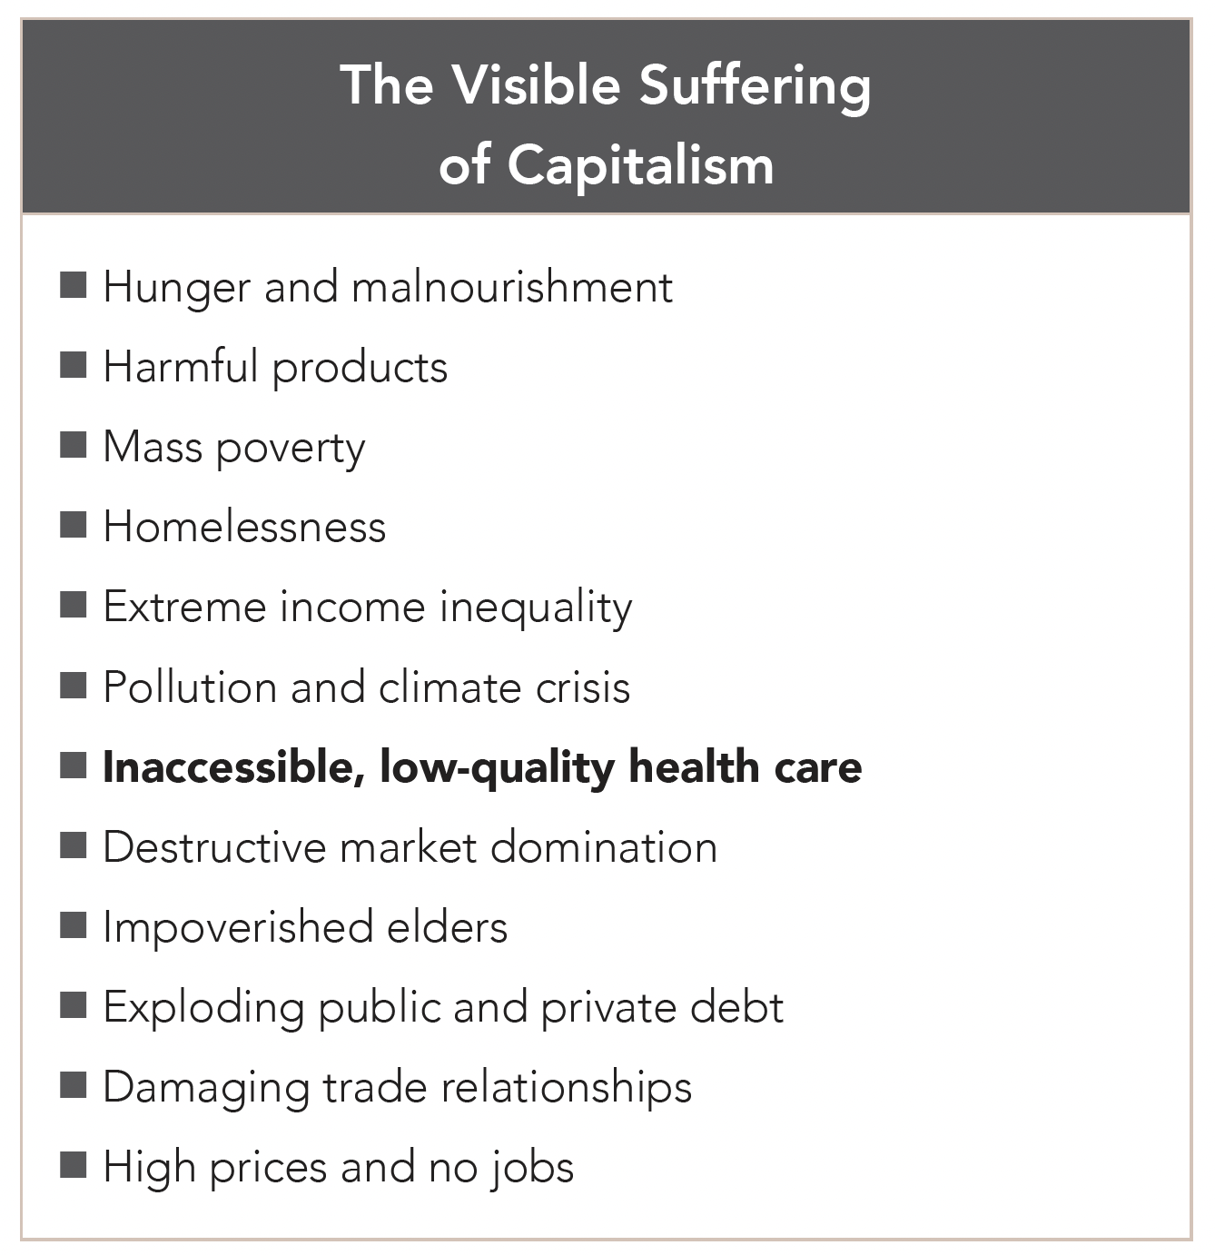
Section: Radical Theory Tools, cont’d
From The VOTE Textbook Second Edition Copyright © 2023

Slide 56
Section: Radical Theory Tools, cont’d
Health Care
Radical Tools, Part 1:
Drill down into meeting people’s basic material needs in capitalism
Radical Tools, Part 2:
Drill down into meeting people’s basic material needs in democratic socialism
The Six-Core Cube
of Every Economic System
From The VOTE Textbook Second Edition Copyright © 2023

Slide 57

Section: Radical Theory Tools, cont’d
Workplace Justice
Coordination Among Competitors
The Pressure for Good leads to
The Invisible Synergy
+
…and is represented by the Six-Core Cube of democratic socialism, which can be solved.
From The VOTE Textbook Second Edition Copyright © 2023

Slide 58
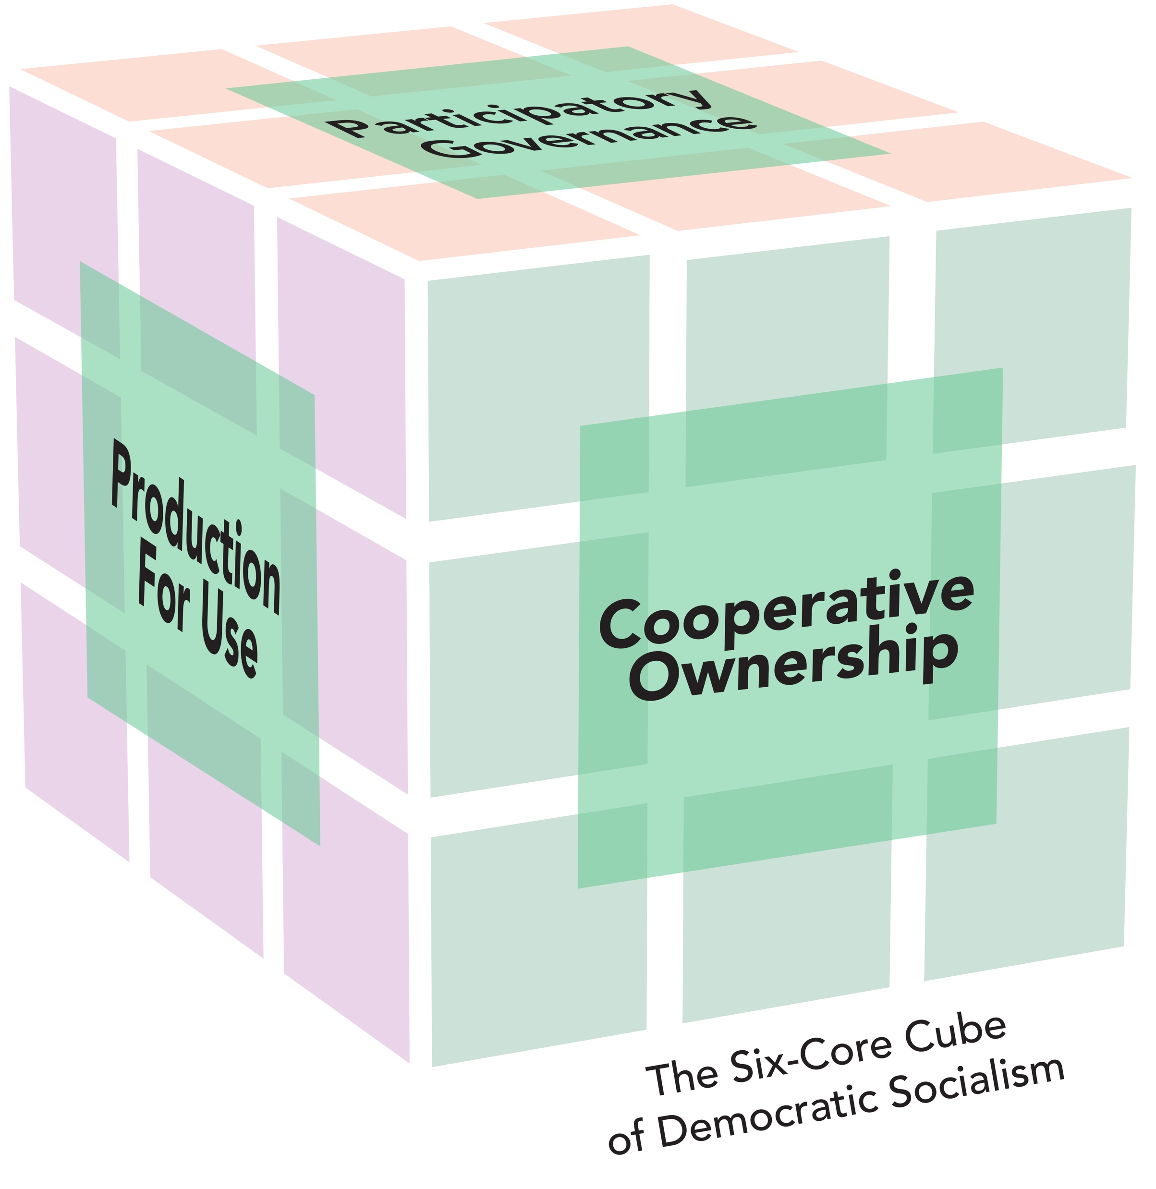
Section: Radical Theory Tools, cont’d
The Solvable
Six-Core Cube of Democratic Socialism
        Cooperative Ownership
        Participatory Governance
        Social Safeguards
        Production for Use
        Sustainable Development
        Healthy Communities
Cooperative Ownership
Why solvable?
It is built around six core points that are beneficial to the core!
Social Safeguards: Meeting everyone’s basic material needs is everyone’s guaranteed right and responsibility.
From The VOTE Textbook Second Edition Copyright © 2023

Slide 59
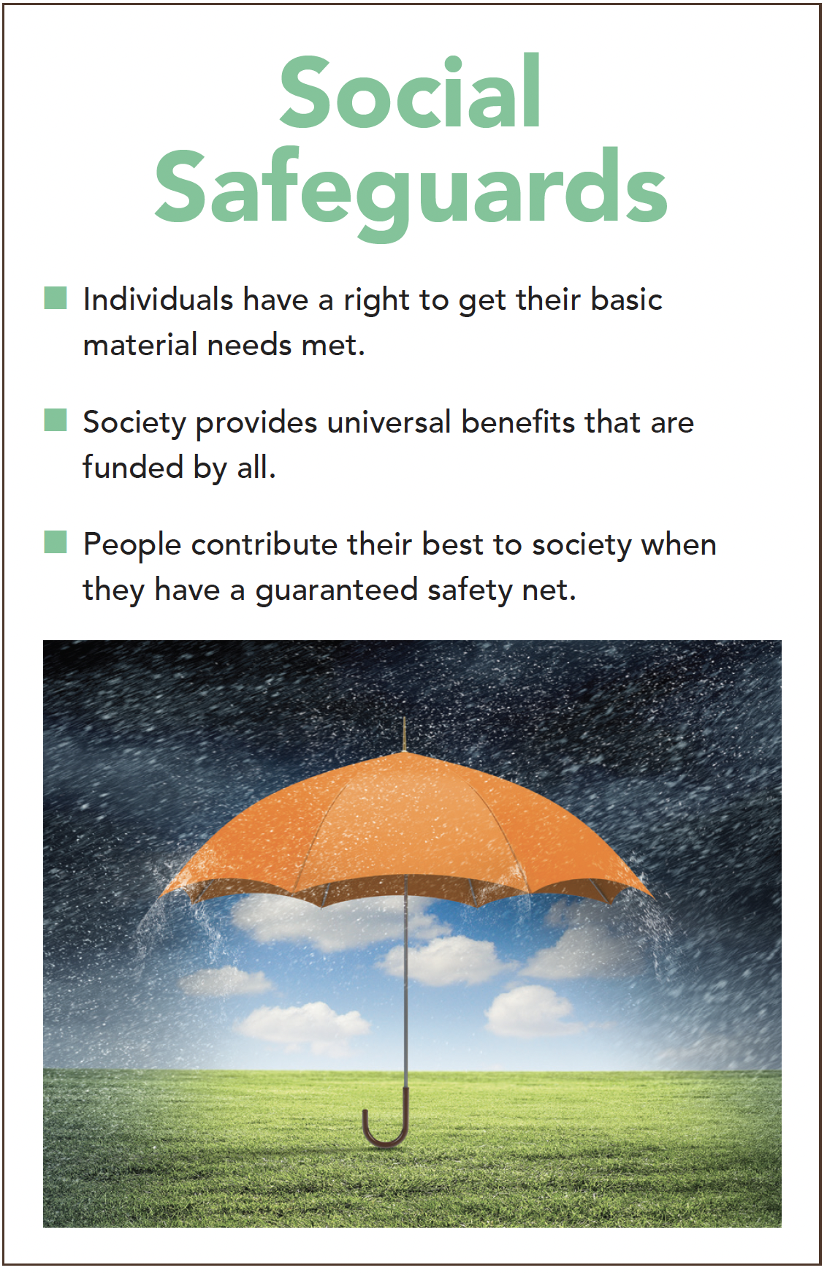
Section: Radical Theory Tools, cont’d
From The VOTE Textbook Second Edition Copyright © 2023

Slide 60

Section: Radical Theory Tools, cont’d
Health Care Policy:
Radical
Single-Payer Health-Care System
Universal health care is available to everyone, equally. It is financed through taxes, and results in affordable, high-quality health care for the whole society.
From The VOTE Textbook Second Edition Copyright © 2023

Slide 61
Section: Radical Theory Tools, cont’d
Social Safeguards
Competitor #1:
“A national single-payer health-care system is expensive, but nothing compared the cost if one of us were to get ill. I’m completely in favor of supporting this important guarantee.”
Owner:
Competitor:
Owner:
“That’s a great idea…“
“You should do it!“
“I’ll definitely propose
it to my co-owners.“
“The required audit of our lab tests makes sure that we aren’t wasting any resources. We put new procedures in place and our costs are down. We’re more efficient than ever.”
Competitor #2:
“You should do it.”
Competitor #3:
“To deliver the kind of care we’d want our families to receive, we expanded in-house testing, purchased high-quality medical supplies, and added more providers.”
“You should do it.”
PRESSURE FOR GOOD
From The VOTE Textbook Second Edition Copyright © 2023

Slide 62
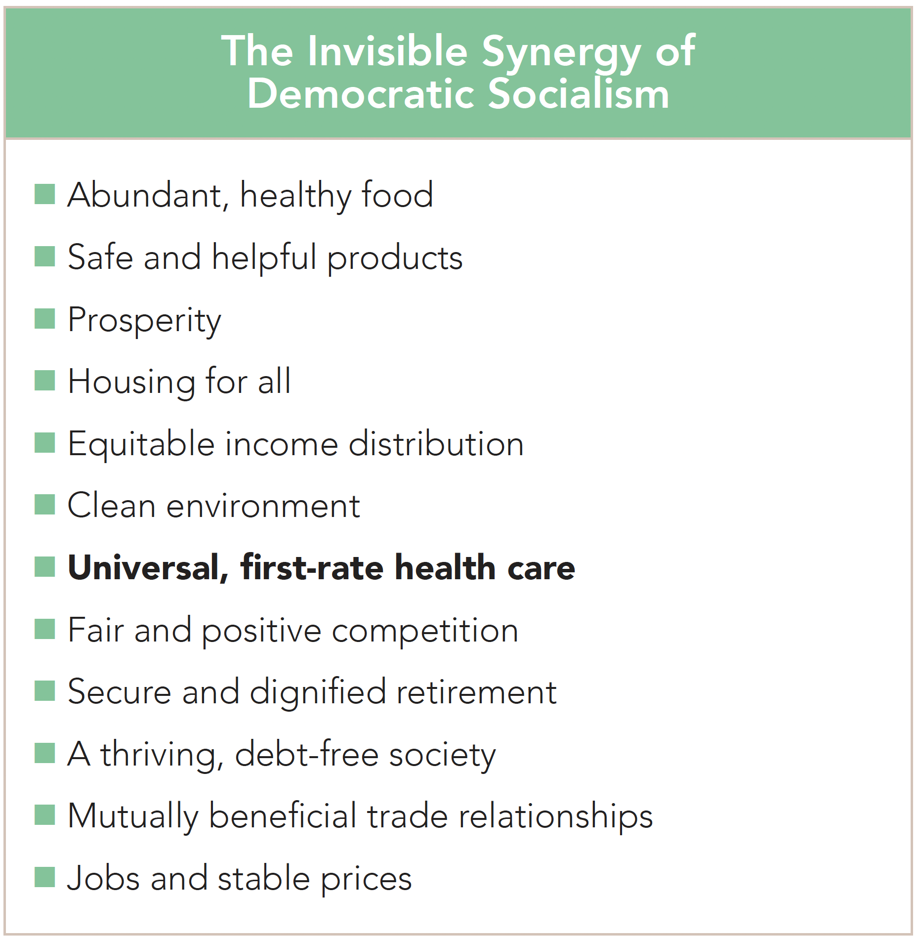
Section: Radical Theory Tools, cont’d
From The VOTE Textbook Second Edition Copyright © 2023

Slide 63
THE BLAME GAME
What causes lack of access to high-quality health care?
Conservative
Liberal
Radical
Too much government interference
in capitalism
We need
free-market capitalism.
Not enough government intervention
in capitalism
We need
fair-market capitalism.
The drive for profit in capitalism
We need
democratic socialism.
From The VOTE Textbook Second Edition Copyright © 2023

Slide 64
The VOTE Jingle
Conservatives say,
“Government, NO! Free markets let prosperity flow.”
Liberals say,
“Government’s a GO! Fair markets make the economy grow.”
Radicals say,
“Capitalism, WHOA! Democratic socialism is the way to go.”
From The VOTE Textbook Second Edition Copyright © 2023

Slide 65
Part B
From The VOTE Textbook Second Edition Copyright © 2023

Slide 66

Discussion story: The heart attack
Health Care
Discussion Story
The Heart Attack
Health Care
From The VOTE Textbook Second Edition Copyright © 2023

Slide 67
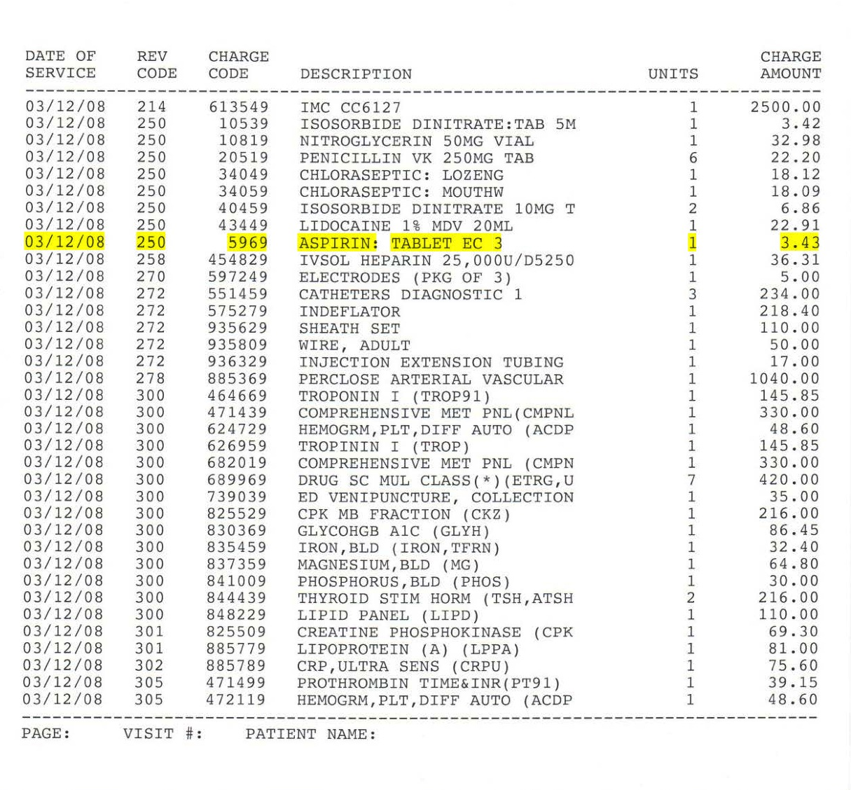
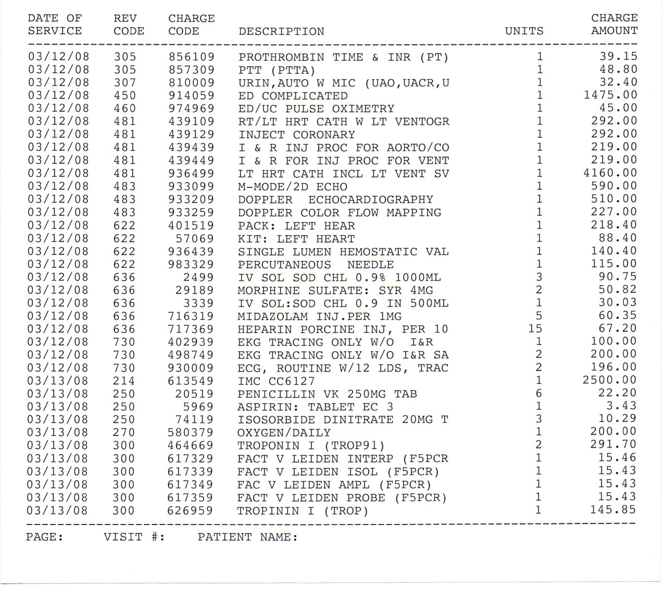
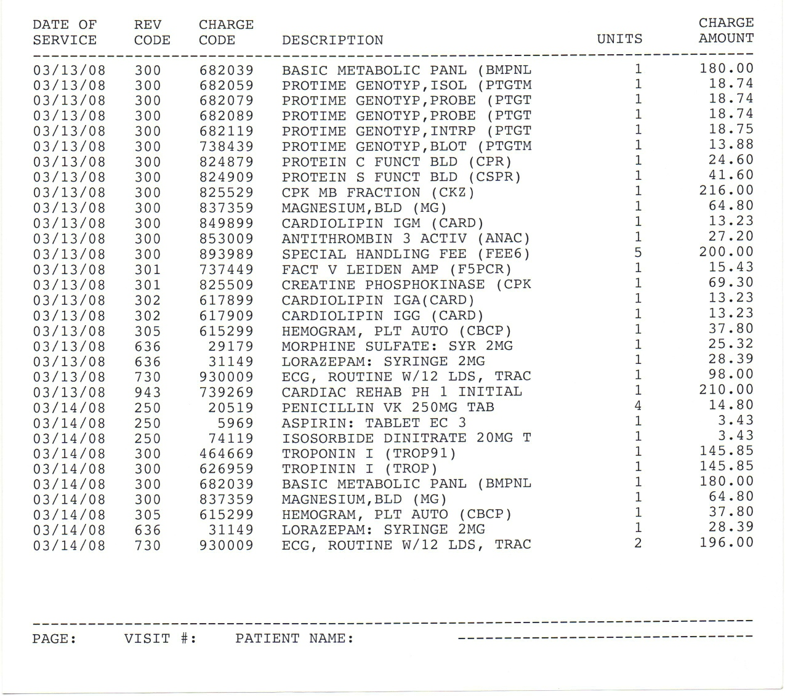
Discussion story: The heart attack, cont’d
Grand Total
One overnight in the hospital for a minor heart attack, March 12, 2008
$25,938.80
From The VOTE Textbook Second Edition Copyright © 2023

Slide 68
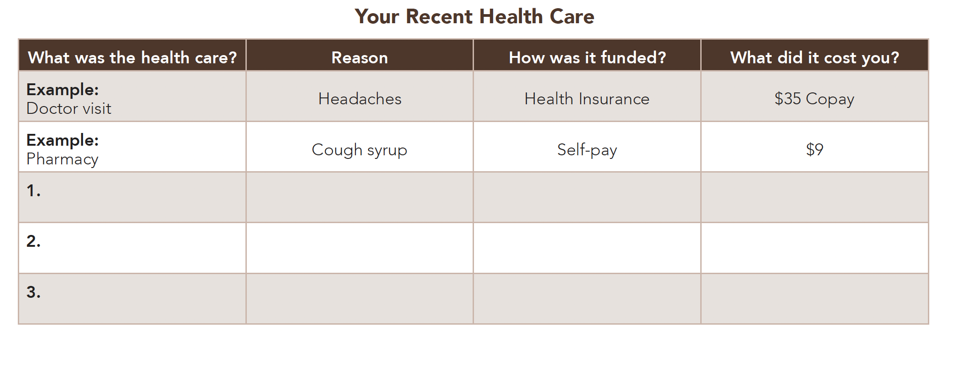

Section: Understanding Health Care
From The VOTE Textbook Second Edition Copyright © 2023
Notes:
68

Slide 69
Section: Understanding Health Care, cont’d
These four insurance terms are important to know.
Please match the terms with the definitions.
Premium Portion of health care expenses
paid by policyholder.
Annual Limit Annual amount policyholder pays
before coverage commences.
Deductible Yearly or lifetime cap on
insurance coverage.
Copayment Annual price of insurance policy.
From The VOTE Textbook Second Edition Copyright © 2023
Notes:
69

Slide 70
Section: Understanding Health Care, cont’d
Two Complicating Factors of Health Insurance
1. Moral Hazard: People take undue risks because they don’t bear the full costs of those risks. They act more recklessly and/or demand more health care than they would if they had to pay the full costs.
Conventional Solutions:
Copays
Deductibles
Radical Solution: Democratic socialism. With single-payer health care, moral hazard is not a problem because everyone pays in together to fund the system, so it is in everyone’s mutual interest not to waste resources.
From The VOTE Textbook Second Edition Copyright © 2023

Slide 71
Section: Understanding Health Care, cont’d
Two Complicating Factors of Health Insurance
2. Adverse Selection: the tendency of people who are sick to be the most likely to buy health insurance, and the tendency of healthy people not to want to shell out money for health insurance.
Conventional Solutions:
Legally binding application forms that give a truthful health history.
Charge different rates based on smoking, age, and geography.
Conservative Solution: Lifetime or annual caps on insurance benefits plus allowing factors such as pre-existing conditions, gender, level of education, and more to determine rates.
Liberal Solution: Mandate health insurance coverage for all.
Radical Solution: Democratic socialism. With single-payer health care, adverse selection is not a problem because there is no private health insurance.
From The VOTE Textbook Second Edition Copyright © 2023

Slide 72
Section: Understanding Health Care, cont’d
Health Insurance Providers
Public
Medicare:
Medicaid:
CHIP:
Tricare:
IHS:
Private
Conventional Indemnity Plan
HMO:
PPO:
HDHP:
Guaranteed health-care plan for elderly and disabled people
Health-care plan for low-income people
“Low paid – Medicaid; Grey hair – Medicare”
Children’s Health Insurance Program
Health-care plan for military personnel and their families
Indian Health Service
•Policyholder is reimbursed for treatment regardless of network.
Health maintenance organization
•Primary care physician (PCP) coordinates care within a network.
Preferred provider organization
•Network of health-care providers available without PCP approval.
High-deductible health plan
•Policyholder pays for health care until high deductible is reached.
From The VOTE Textbook Second Edition Copyright © 2023

Slide 73
Polling Question
Types of Insurance
I just turned sixty-six years old and retired after thirty years on the job. The program I qualify for is called:
Medicare
Medicaid
HMO
PPO
CHIP
From The VOTE Textbook Second Edition Copyright © 2023

Slide 74
Section: Understanding Health Care, cont’d
What’s Your Health Care?
I just turned sixty-six years old and retired after
thirty years on the job. The program
I qualify for is called:
We earn too much to qualify for Medicaid, but we can’t afford health insurance for our kids. The program they qualify for is called:
Medicare
Children’s Health Insurance Program (CHIP)
From The VOTE Textbook Second Edition Copyright © 2023
Notes:
74

Slide 75
Section: Understanding Health Care, cont’d
What’s Your Health Care?, cont’d
I just got a new full-time job, and I signed up for the health insurance offered by my employer. The plan I chose requires a referral from a primary care physician before I can see a specialist. My plan is called:
I serve in the Army. My family and I get our health insurance through the military. Our benefit is called:
My plan has the lowest monthly premium but I have to pay the most out of pocket before the insurance kicks in. My plan is called:
Health Maintenance Organization (HMO)
TRICARE
High-Deductible Health Plan (HDHP)
From The VOTE Textbook Second Edition Copyright © 2023
Notes:
75

Slide 76
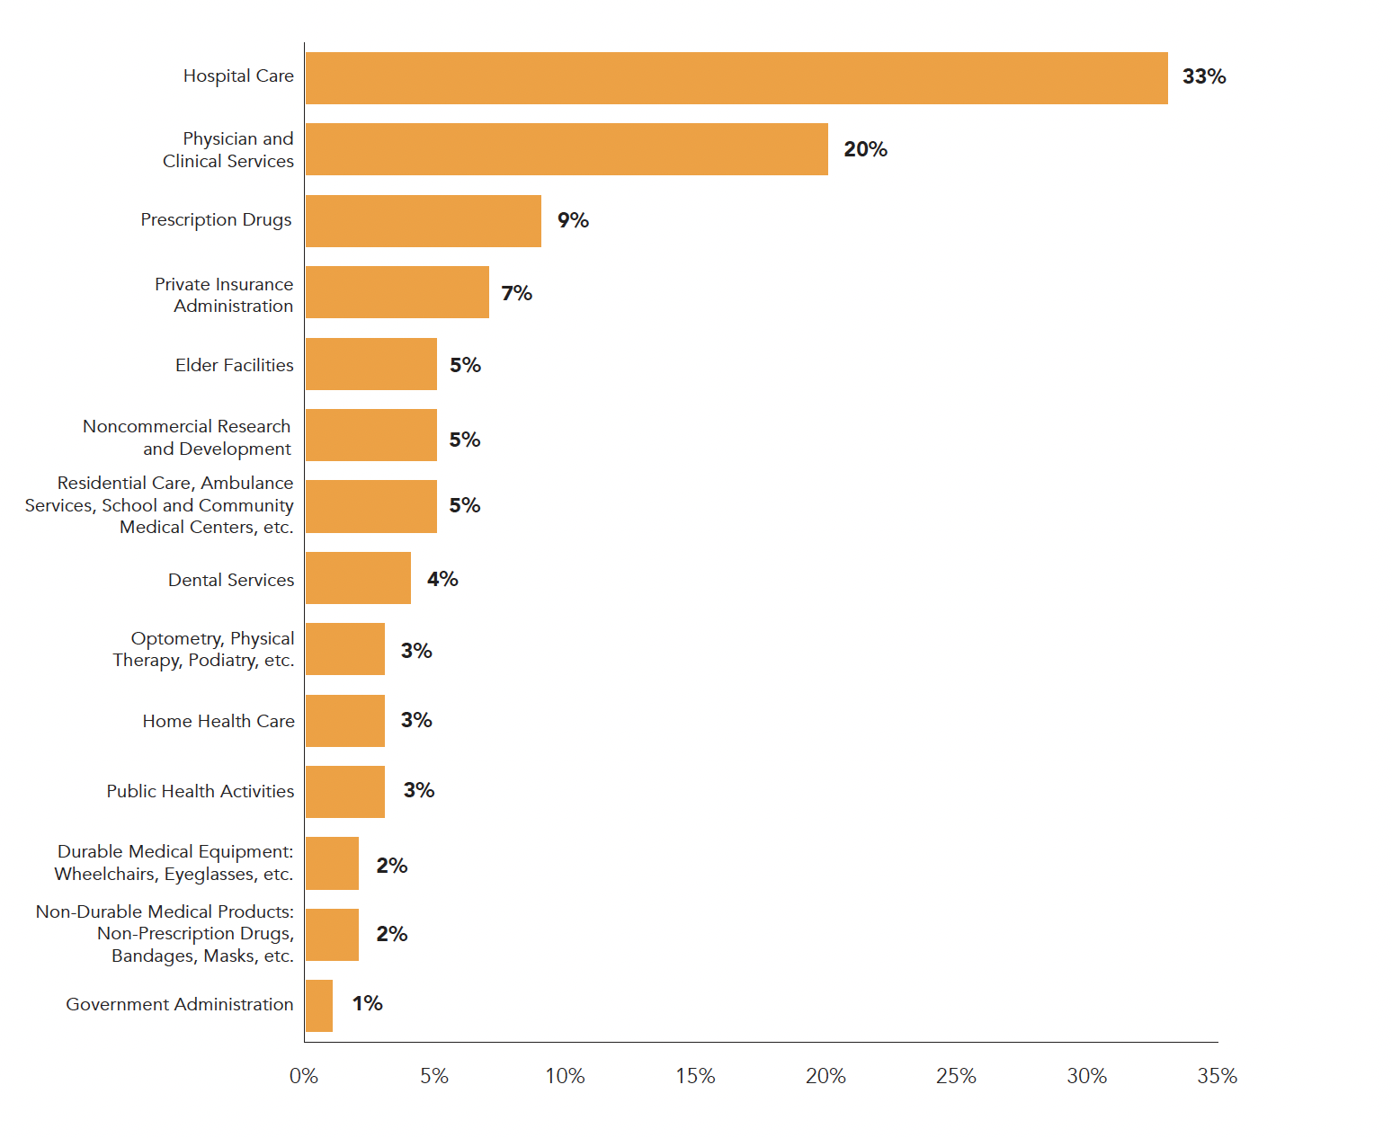
Section: Understanding Health Care, cont’d
How the U.S. Spent $3.6 Trillion on Health Care in 2018
From The VOTE Textbook Second Edition Copyright © 2023
Notes:
76

Slide 77

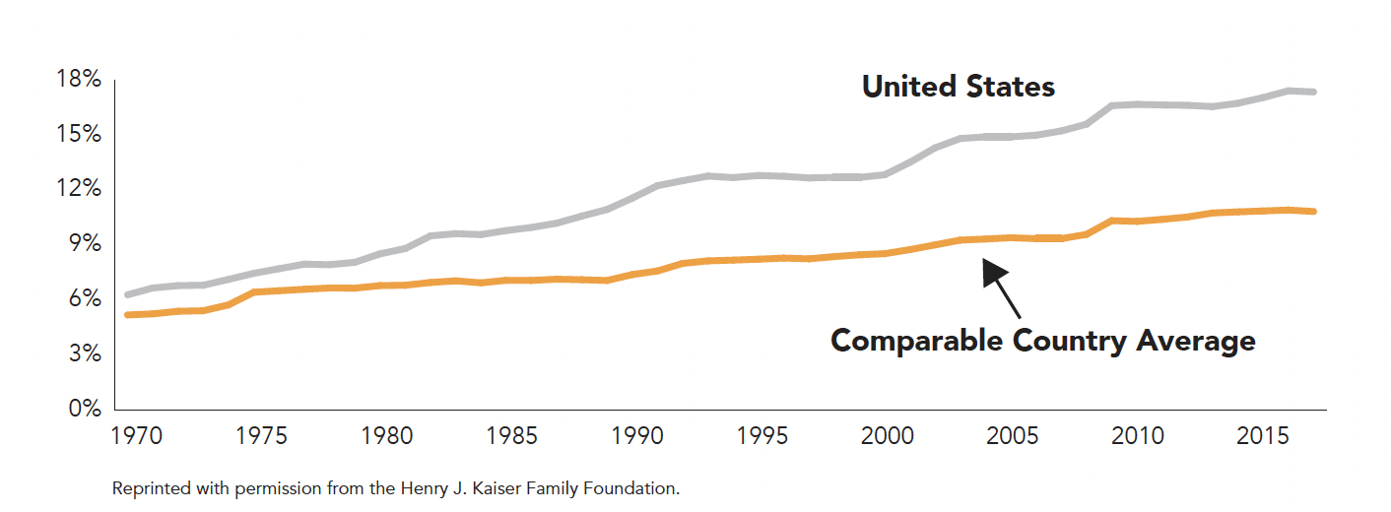
Section: Understanding Health Care, cont’d
2017:
17.5%
1980:
8.8%
Health Care Costs as a Percentage of GDP, 1970 - 2017
From The VOTE Textbook Second Edition Copyright © 2023
Notes:
77

Slide 78
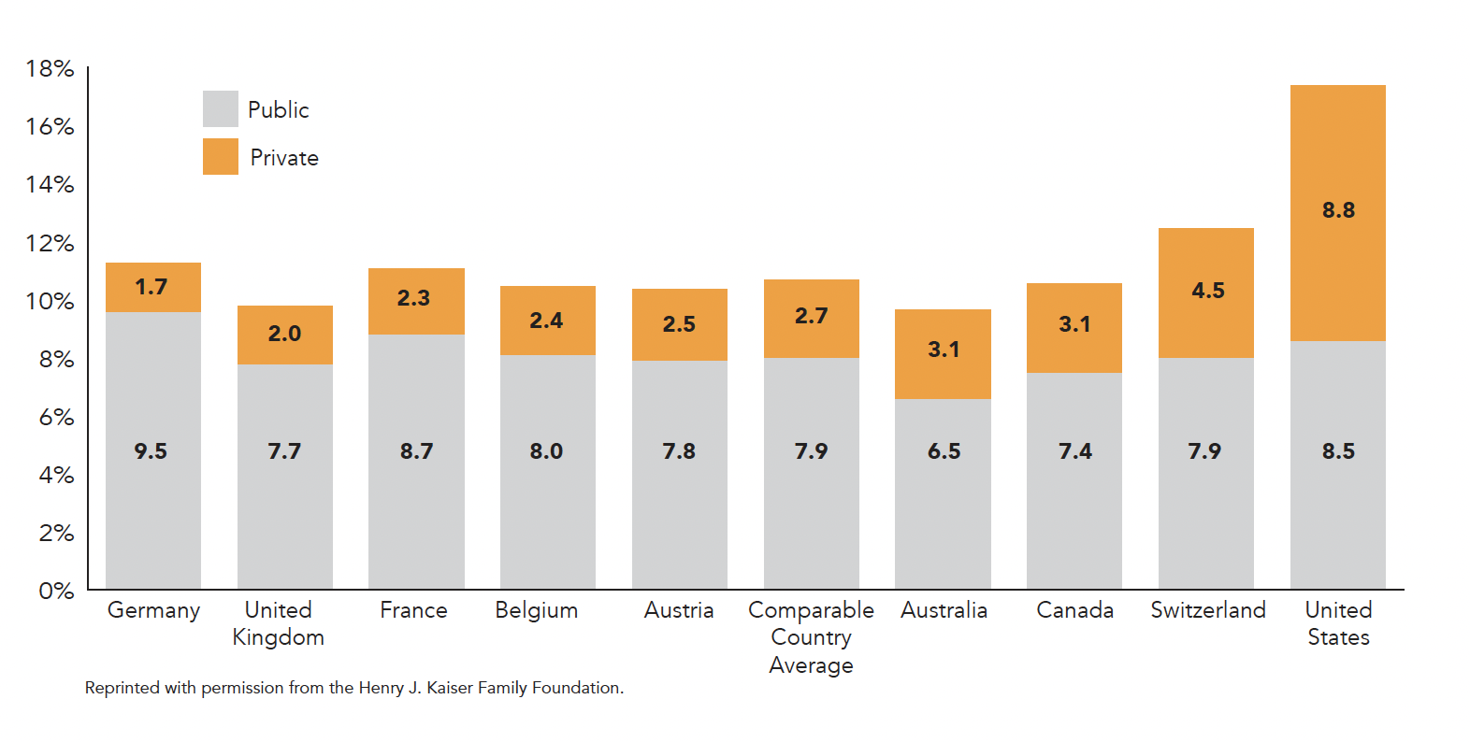
Section: Understanding Health Care, cont’d
Public versus Private Spending on Health Care, 2016
From The VOTE Textbook Second Edition Copyright © 2023
Notes:
78

Slide 79
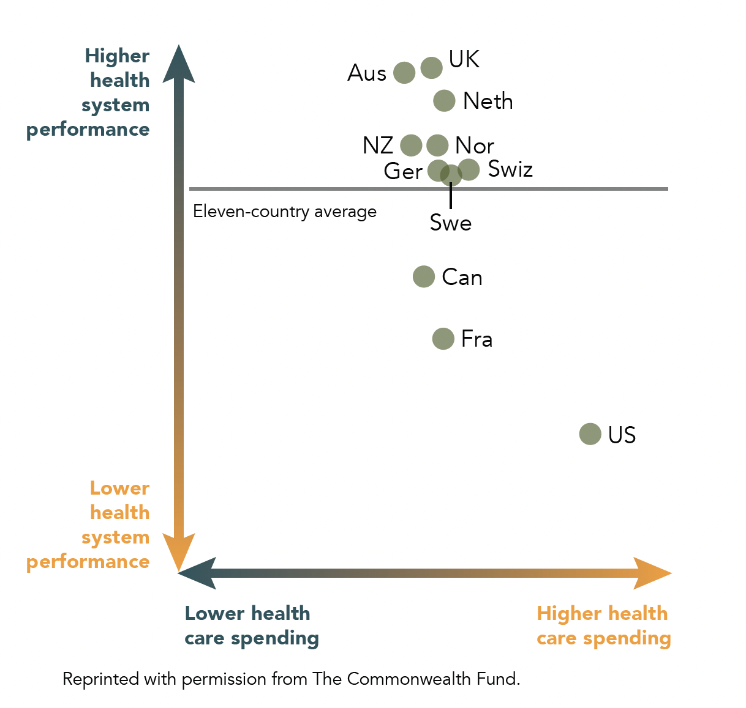
Section: Understanding Health Care, cont’d
Health Care Spending and Performance Comparison, 2017
From The VOTE Textbook Second Edition Copyright © 2023
Notes:
79

Slide 80
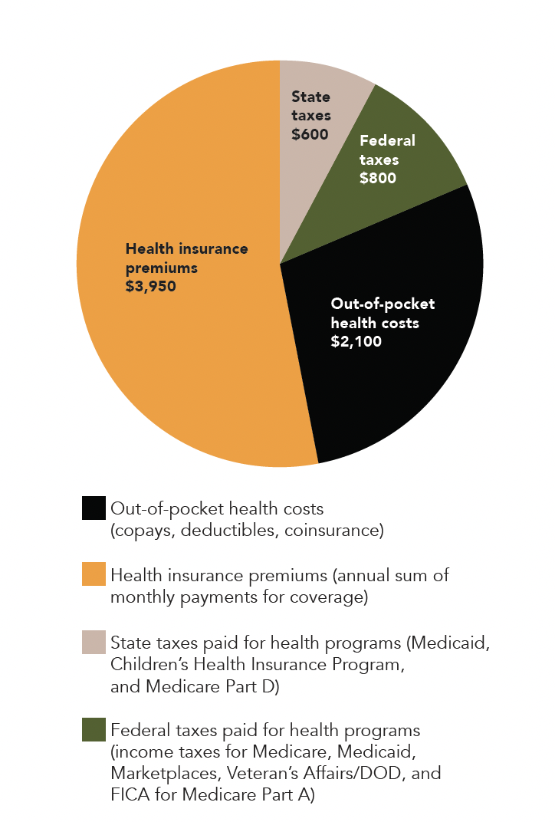
Section: Understanding Health Care, cont’d
Estimate of What a Middle-Class Family of Four Spent on Health Care in 2017
Total
$7,450
From The VOTE Textbook Second Edition Copyright © 2023
Notes:
80

Slide 81

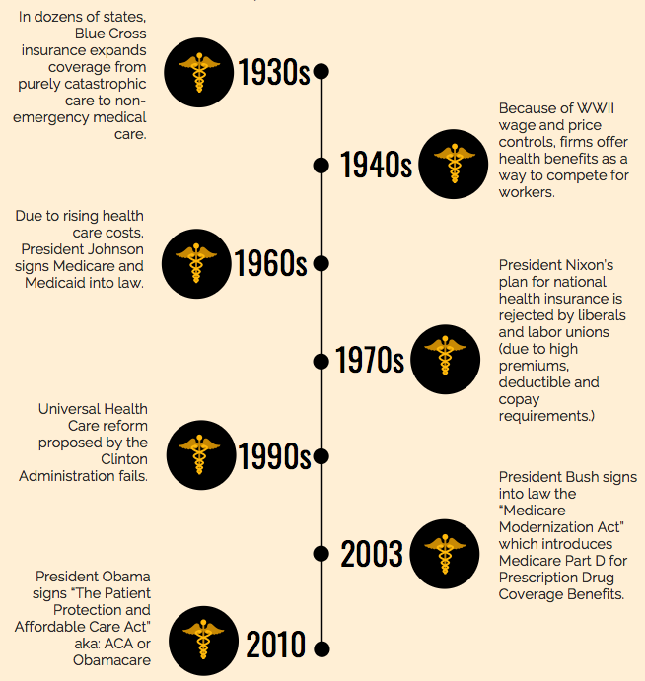
Section: Understanding Health Care, cont’d
A brief look at the history of funding health care.
Non-emergency
insurance plans
Insurance bundled
with employment
Medicaid and
Medicare
President Nixon calls for
national health insurance
Clinton Administration calls
for health-care reform
Medicare Part D
(prescription drugs)
The Affordable Care Act
(ACA or Obamacare)
From The VOTE Textbook Second Edition Copyright © 2023
Notes:
81

Slide 82
Section: Understanding Health Care, cont’d
The Patient Protection and Affordable Care Act (ACA)
“Obamacare”
Health insurance mandate
Young-adult coverage
Ban on exclusions
Workplace insurance requirement
Standardized policies
Limits and caps
Rebates to consumers
Needs-based coverage
Health insurance exchanges
Affordable health care defined
(in 2020, it was 9.78% of annual household income)
From The VOTE Textbook Second Edition Copyright © 2023
Notes:
82

Slide 83
The Trump Administration (2017 – 2020) pushed to repeal Obamacare. The law was upheld, in part due to Supreme Court rulings, but several provisions were overturned.
The Biden Administration (2021 – 2024) pushed to expand Obamacare with some success.
Going forward, the only certain thing is that health-care policy will continue to be a hotly debated issue.
Section: Understanding Health Care, cont’d
From The VOTE Textbook Second Edition Copyright © 2023

Slide 84

Section: Three-in-One Activity
Three-in-One Activity
“First, Do No Harm”
Participation in this activity = Daily Double
Any takers?
DAILY
DOUBLE
*This Three-in-One Activity can be found at the end of Chapter 15, after the ribbon pages.
From The VOTE Textbook Second Edition Copyright © 2023

Slide 85
Section: Three-in-One Activity, cont’d
In each group, there are six roles:
Doctor
Insurance agent
Patient 1
Patient 2
Patient 3
Patient 4
From The VOTE Textbook Second Edition Copyright © 2023

Slide 86
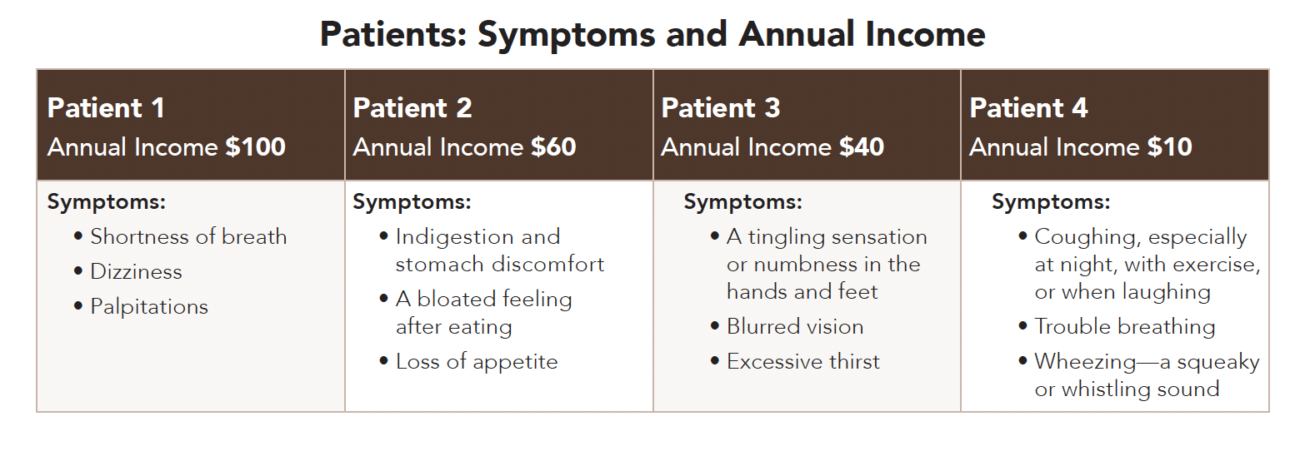
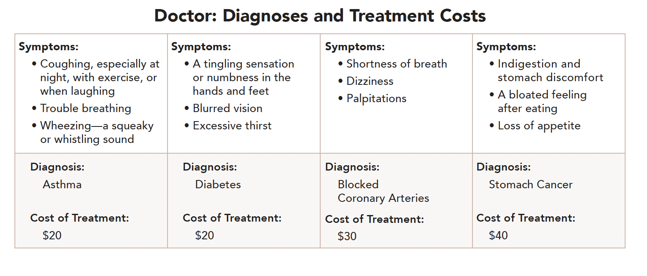
Section: Three-in-One Activity, cont’d
Round I: Neutral—Self-Pay
One at a time, each patient describes their symptoms to the doctor.
The doctor checks the list and gives the correct diagnosis and cost of treatment.
From The VOTE Textbook Second Edition Copyright © 2023

Slide 87
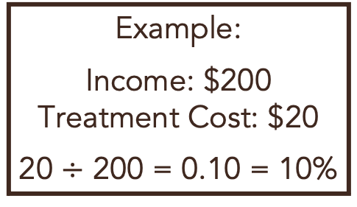
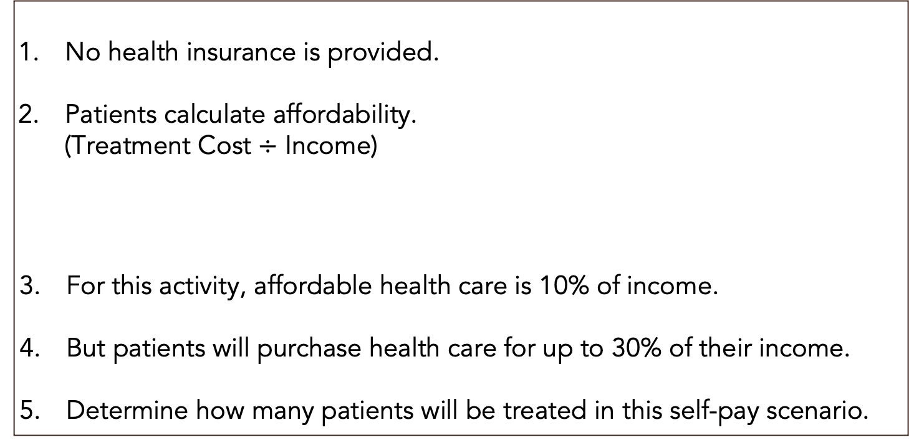
Section: Three-in-One Activity, cont’d
Round I: Neutral—Self-Pay, cont’d
No health insurance is provided.
Patients calculate affordability.
(Treatment Cost $÷$ Income)
For this activity, affordable health care is 10% of income.
But patients will purchase health care for up to 30% of their income.
Determine how many patients will be treated in this self-pay scenario.
Example:
Income: $200
Treatment Cost: $20
20 $÷$ 200 = 0.10 = 10%
From The VOTE Textbook Second Edition Copyright © 2023

Slide 88
Section: Three-in-One Activity, cont’d
Round I: Neutral—Self-Pay, cont’d
 | Calculation | Patient 1 | Patient 2 | Patient 3 | Patient 4 | Number Treated
Round I Self-Pay | Affordability Treatment Cost ÷ Income
Income:
$100
Treatment:
$30
Income:
$60
Treatment:
$40
Income:
$40
Treatment:
$20
Income:
$10
Treatment:
$20
?
 | Calculation | Patient 1 | Patient 2 | Patient 3 | Patient 4 | Number Treated
Round I Self-Pay | Affordability Treatment Cost ÷ Income
From The VOTE Textbook Second Edition Copyright © 2023

Slide 89
Polling Question
Patient 1
What is Patient 1’s health-care cost relative to their income?
5%
10%
20%
30%
40%
66%
From The VOTE Textbook Second Edition Copyright © 2023

Slide 90

Section: Three-in-One Activity, cont’d
Round I: Neutral—Self-Pay, cont’d
 | Calculation | Patient 1 | Patient 2 | Patient 3 | Patient 4 | Number Treated
Round I Self-Pay | Affordability Treatment Cost ÷ Income
Income:
$100
Treatment:
$30
Income:
$60
Treatment:
$40
Income:
$40
Treatment:
$20
Income:
$10
Treatment:
$20
?
 | Calculation | Patient 1 | Patient 2 | Patient 3 | Patient 4 | Number Treated
Round I Self-Pay | Affordability Treatment Cost ÷ Income | 30% $30 ÷ $100 | 67% $40 ÷ $60 | 50% $20 ÷ $40 | 200% $20 ÷ $10 | 1 out of 4 (25%)
Only 25% treated is unacceptable from every perspective!
From The VOTE Textbook Second Edition Copyright © 2023

Slide 91
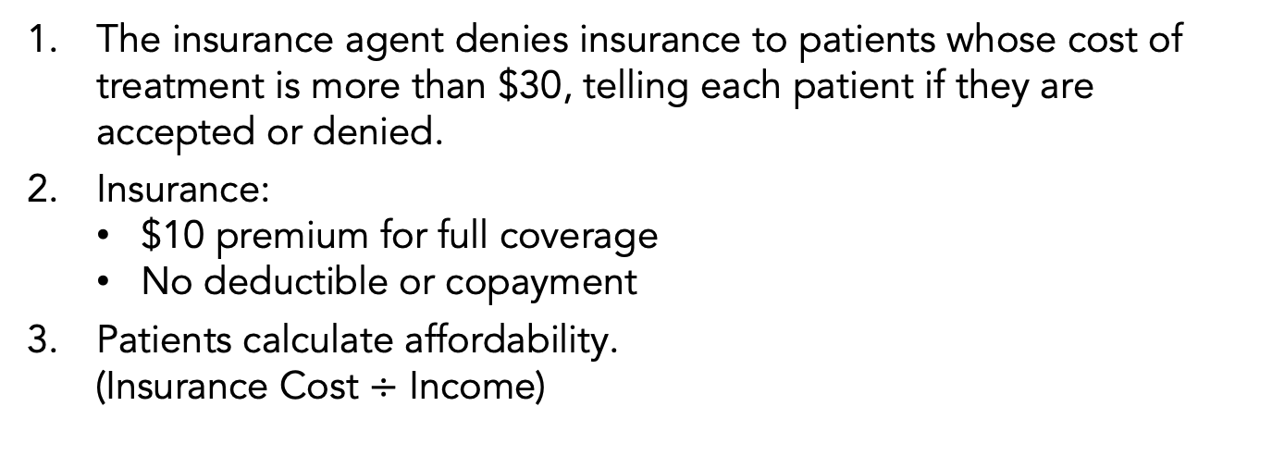
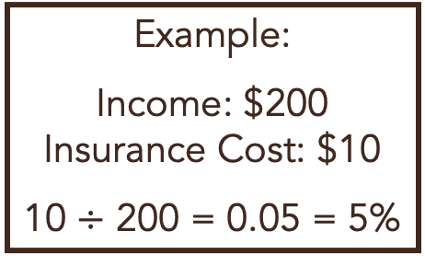
Section: Three-in-One Activity, cont’d
Round II: Neutral—Insurance
The insurance agent denies insurance to patients whose cost of treatment is more than $30, telling each patient if they are accepted or denied.
Insurance:
        $10 premium for full coverage
        No deductible or copayment
Patients calculate affordability.
(Insurance Cost $÷$ Income)
Example:
Income: $200
Insurance Cost: $10
10 $÷$ 200 = 0.05 = 5%
 | Calculation | Patient 1 | Patient 2 | Patient 3 | Patient 4 | Number Treated
Round II Insurance | Affordability Insurance Cost ÷ Income
Income:
$100
Treatment:
$30
Income:
$60
Treatment:
$40
Income:
$40
Treatment:
$20
Income:
$10
Treatment:
$20
?
 | Calculation | Patient 1 | Patient 2 | Patient 3 | Patient 4 | Number Treated
Round II Insurance | Affordability Insurance Cost ÷ Income | 10% $10 ÷ $100 | Insurance Denied | 25% $10 ÷ $40 | 100% $10 ÷ $10 | 2 out of 4 (50%)
From The VOTE Textbook Second Edition Copyright © 2023

Slide 92
Section: Three-in-One Activity, cont’d
Round II: Neutral—Insurance
 | Calculation | Patient 1 | Patient 2 | Patient 3 | Patient 4 | Number Treated
Round II Insurance | Affordability Insurance Cost ÷ Income
Income:
$100
Insurance:
$10
Income:
$60
Insurance:
$10
Income:
$40
Insurance:
$10
Income:
$10
Insurance:
$10
?
 | Calculation | Patient 1 | Patient 2 | Patient 3 | Patient 4 | Number Treated
Round II Insurance | Affordability Insurance Cost ÷ Income | 10% $10 ÷ $100 | Insurance Denied | 25% $10 ÷ $40 | 100% $10 ÷ $10 | 2 out of 4 (50%)
It’s better, at 50% treated, but it’s still completely unacceptable from every perspective.
From The VOTE Textbook Second Edition Copyright © 2023

Slide 93

Note: We present each perspective as if we wholeheartedly agree with it. We do this on purpose to present each point of view in its best light, but please imagine each time that we are wearing a mask—as if we are actors playing three different roles.
From The VOTE Textbook Second Edition Copyright © 2023

Slide 94
C
Section: Voices on Health Care, cont’d
onservative
Free-Market Capitalism
Health Care
We can’t access affordable health care because burdensome government regulations drive up prices and lower the quality.
From The VOTE Textbook Second Edition Copyright © 2023

Slide 95
C
Section: Voices on Health Care, cont’d
onservative
Free-Market Capitalism
BIG PICTURE
We get the best choices, the highest efficiency, the most cutting-edge
innovations, and the lowest prices for health care when we let the market
be guided by the invisible hand of price signals.
POLICY POSITION
There is lack of access to high-quality health care, but…
Liberal policies narrow choices, raise prices and taxes, lower quality, and interfere with our most personal decisions about our health care.
Radical policies stifle innovation, kill competition, and clear
a path for tyranny by giving government control over who
will and won’t get medical care.
SOLUTION
Reject a regulated health-care system and government
programs and replace them with private health insurance to
ensure health and well-being for all:
We get more choices, lower prices, and better outcomes.
Private philanthropy steps in as a safety net.
Health Care
From The VOTE Textbook Second Edition Copyright © 2023

Slide 96
Section: Voices on Health Care, cont’d
Health Care Talking Points: Conservative
1. There’s an easy-to-swallow prescription for fixing health care: we tell government to stop interfering, and the system self-heals. We can count on the profit motive to deliver the most advanced medicine, biotech, and medical research on the planet. Free-market competition means only the best and the brightest doctors and nurses rise to the top, so we have the most skilled surgeons, the most talented diagnosticians, and the best caregivers. Ultimately, that’s what delivers the best possible health outcomes for all of us.
2. Self-regulation works to deliver the best possible health care because if people are unhappy with a company’s policies, prices, or practices, they vote with their wallets and move to another firm. By eliminating government interference and harnessing the profit interest of firms in free-market capitalism, our healthcare system is cured. We get the lowest prices for health insurance. This throws open the door for millions more people who want and need it. Now they, too, can benefit from our world-class medicine and state-of-the-art health care.
3. Going to the doctor, having a test done, taking a medication, being fed in a nursing home—these are deeply private experiences that should be between you and your health-care provider. But you liberals invite the government into the treatment room. You give it power over our most personal decisions, including whether a dying person can try a life-saving drug. That’s absurd, but you make absurdity the norm in our health-care system.
4. The government should not be in the business of providing health care. Liberals created a system that bleeds us dry with high taxes and delivers clunky government programs that provide mediocre health care. In the meantime, firms can’t operate profitably, families are buried in medical debt, providers can’t deliver the best care, and insurance companies are forced to keep raising premiums and deny treatments that could help people. Liberal policies condemn us to death by a thousand cuts.
5. Radicals, when everything, including health care, is handed out for free, there is no motivation to work. When people don’t work, they don’t generate any revenue, so there is nothing to tax. Therefore, your universal health-care system is a nonstarter. But even if it could get off the ground, without a reward incentive there won’t be any new advances in medicine. No one will pursue medicine as a career without a profit incentive, so get ready for substandard health care and public health crises.
6. Picture the misery of waiting for hours or even days to get approval to have a broken arm set. In a single-payer system, radicals, waiting is your only option. When you’re finally seen, it’s the health-care council, not your doctor, who has the final say about your treatment. Plus, everyone demands to see a top specialist because why wouldn’t they—there are no copays or deductibles. That causes shortages, so health-care councils have to ration health care. Let’s bury the single-payer policy before it buries us.
7. A deregulated health-care system of private health insurance in a free market makes us all better off. Firms offer a wide assortment of policies to appeal to every budget and need. Healthy people can pay less to get basic coverage, while those with complicated health histories can buy more coverage. If people choose a high-deductible plan with lower premiums, expanded health savings accounts help mitigate the risks of a costly medical emergency. Their pretax dollars grow over time and cover future out-of-pocket expenses.
8. To heal our broken health-care system, all we need to do is dismantle government health programs. We get rid of Medicare and let working people save and invest their own hard-earned dollars to afford the health care they choose when they retire. We don’t need Medicaid, because the free market makes insurance affordable at every income level. And in the rare case when someone can’t afford the rock-bottom premiums, then private and corporate philanthropy step in to help.
From The VOTE Textbook Second Edition Copyright © 2023

Slide 97

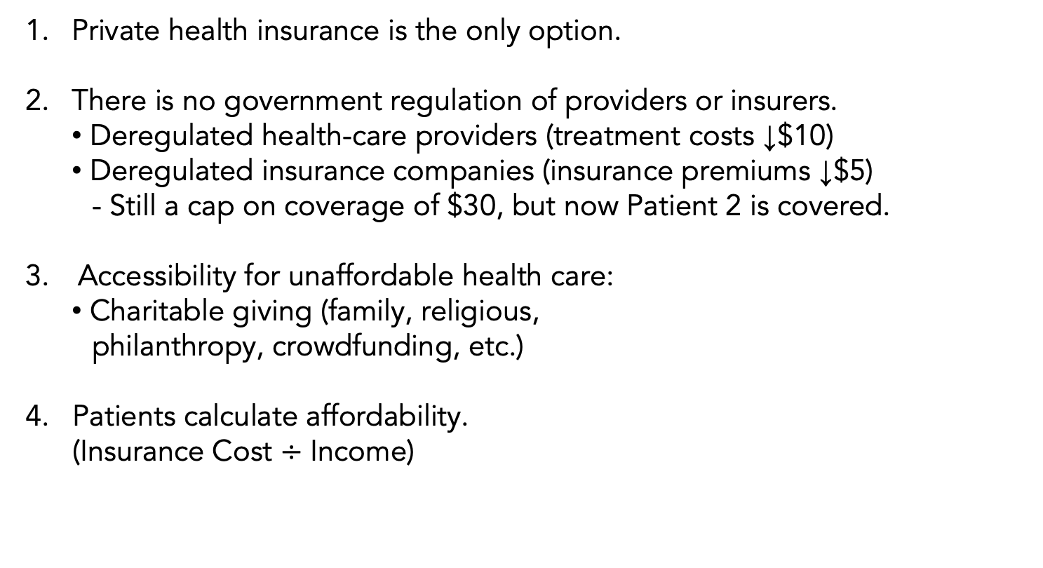
Section: Three-in-One Activity, cont’d
Round III: Conservative Perspective
Private health insurance is the only option.
There is no government regulation of providers or insurers.
  Deregulated health-care providers (treatment costs ↓$10)
  Deregulated insurance companies (insurance premiums ↓$5)
  - Still a cap on coverage of $30, but now Patient 2 is covered.
Accessibility for unaffordable health care:
Charitable giving (family, religious,
philanthropy, crowdfunding, etc.)
Patients calculate affordability.
(Insurance Cost $÷$ Income)
Example:
Income: $20
Cost of Insurance: $5
5 ÷ 20 = 0.25 = 25%
Charity needed: $3
since
2 ÷ 20 = 0.10 = 10%
From The VOTE Textbook Second Edition Copyright © 2023

Slide 98
Section: Three-in-One Activity, cont’d
Round III: Conservative Perspective
 | Calculation | Patient 1 | Patient 2 | Patient 3 | Patient 4 | Number Treated
Round III Conservative | Affordability Insurance Cost ÷ Income (Donations)
Income:
$100
Insurance:
$5
Income:
$60
Insurance:
$5
Income:
$40
Insurance:
$5
Income:
$10
Insurance:
$5
?
 | Calculation | Patient 1 | Patient 2 | Patient 3 | Patient 4 | Number Treated
Round III Conservative | Affordability Insurance Cost ÷ Income (Donations) | 5% $5 ÷ $100 | 8% $5 ÷ $60 | 10% $5 ÷ $40 (+$1 Donation) | 10% $5 ÷ $10 (+$4 Donation) | 4 out of 4 (100%) Solved
100% insured!
From The VOTE Textbook Second Edition Copyright © 2023

Slide 99
L
Section: Voices on Health Care, cont’d
iberal
Fair-Market Capitalism
Health Care
We are vulnerable to fraud and abuse by insurers and providers. The helpful hand of government makes sure that health care remains accessible.
From The VOTE Textbook Second Edition Copyright © 2023

Slide 100
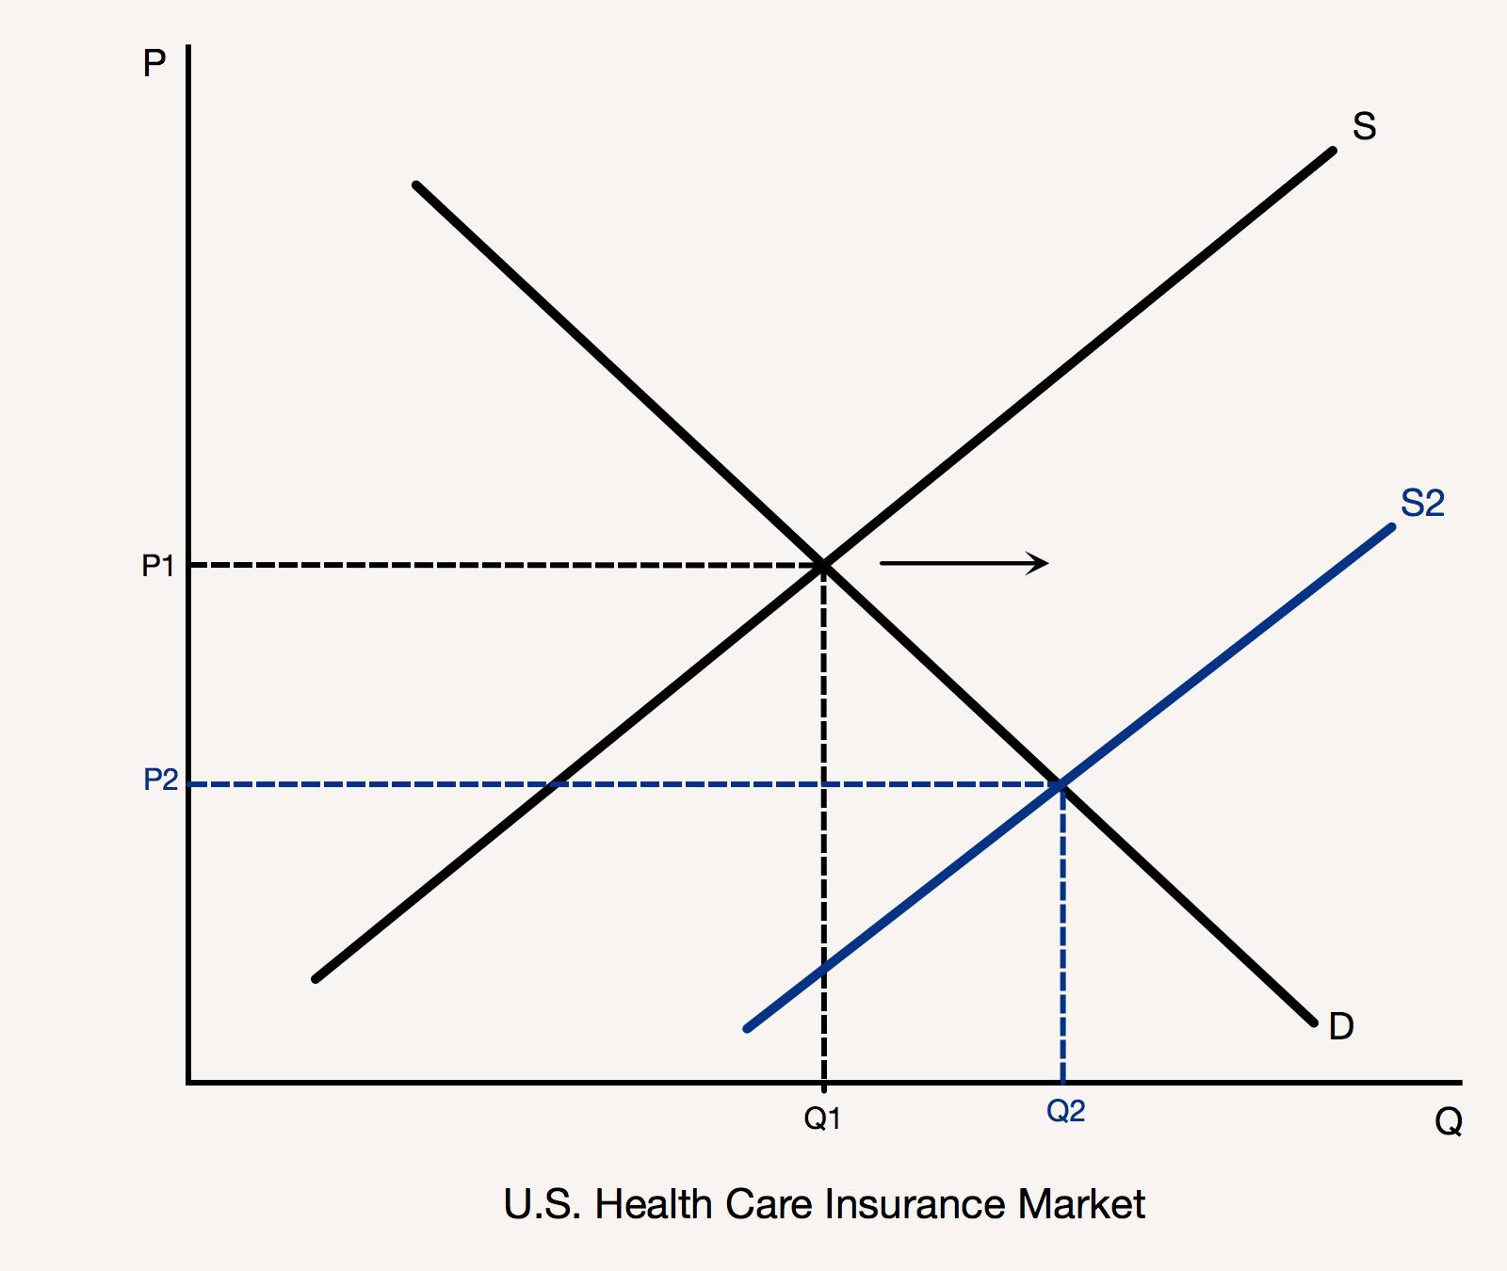
L
Section: Voices on Health Care, cont’d
iberal
Fair-Market Capitalism
BIG PICTURE
Working together, government and the profit-motivated private sector create
an affordable health-care system with the best-quality treatments and providers,
groundbreaking innovations, and access for all.
POLICY POSITION
There is lack of access to high-quality health care, but…
Radical policies lead to deadly results by killing motivation, destroying healthy competition, and leaving us with zero choice, inefficiency, and apathy.
Conservative policies lead to skyrocketing premiums,
outrageous profits, dangerous medicine, public health
crises, and masses of uninsured people.
SOLUTION
Strengthen our regulated, for-profit health-care system and
government health-care programs to ensure health and
well-being for all:
Effective oversight and accountability protect us.
Expand subsidies and Medicaid by taxing the wealthy.
Health Care
From The VOTE Textbook Second Edition Copyright © 2023

Slide 101
Section: Voices on Health Care, cont’d
Health Care Talking Points: Liberal
1. Each one of us absolutely needs health care, but we’re vulnerable to fraud and abuse by insurance firms and providers. That’s why we need government to watch our backs. It partners with industry to establish best practices and oversight to keep us physically—and financially—healthy. Fair-market capitalism brings us the highest-quality, most affordable, and most accessible health-care system in the world. The best medicine for society is a strong public-private partnership.
2. The liberal approach gives us the best of all possible worlds because we enjoy the gifts of the profit motive and the security of a government that has our best interests at heart. Because of the profit reward system, firms innovate and bring to market amazing, life-saving devices, smarter models for comprehensive care, and highly accurate medical tests. And because of the government, everyone in society—including low-income and elderly people—have access to the care they need.
3. Doctors today can perform life-saving surgeries and regenerate damaged nerves because our regulated health-care system in fair-market capitalism offers the appropriate rewards and incentives for talent and hard work. Say farewell to all this when your democratic socialism delivers the death blow to innovation and motivation by making the drive for profit something to be ashamed of instead of celebrated. We’ll lose our best and our brightest, and that brain drain will set us back decades.
4. Call a code blue right now, because we’re all going into cardiac arrest when the government becomes the sole funder and provider of health care. Sure, a public option for health care is important, but imposing it on everyone is a terrible idea. Radicals, no competition on top of no profit on top of non-experts at them helm will leave us limping along with a mediocre system run on apathy. Democratic socialism sends us back to the dark ages of sickness, suffering, and death.
5. Conservatives, your plan to throw all regulations out the window and leave it to health insurance firms and providers to self-regulate is foolhardy, naïve, and deadly. Because health care is something we all need, we end up with sky-high prices, masses of uninsured people, and scary, low-quality care. While insurance firms rake in billions of dollars in profit, people suffer. Their claims are denied, their premiums shoot up, and their policies get canceled when they get sick.
6. The poor can’t pull themselves up by their bootstraps when they’re too sick to get out of bed, but conservatives want to get rid of Medicaid and subsidies. With so many workers out sick, our whole economy tanks. What’s the first thing that gets cut? Private philanthropy. There goes the conservative fix for the legions of low-income people who can’t afford health insurance. Untreated illnesses create epidemics. Oops—conservatives got rid of our public health institutions. Thanks to the free market, we’re all doomed.
7. The Affordable Care Act gives us all access to high-quality, affordable care with insurance that covers the basics. Because health care is both regulated and mandated, no one is denied coverage for a preexisting condition. The unemployed buy insurance on government-run health insurance exchanges. Those who need extra help use health insurance subsidies and expanded Medicaid. We fund it by taxing the wealthy. Since their businesses benefit from a society of healthy workers, it’s only fair that they contribute more.
8. Government is always watching out for our interests by curtailing fraud, waste, and abuse. It keeps hospitals accountable and transparent in their billing practices and requires providers to use cost-saving and life-saving electronic medical records. Public programs for the elderly, veterans, and federal employees are expanded so that anyone can choose the public option. In every case, it makes financial sense to invest in public options while supporting and regulating private industry.
From The VOTE Textbook Second Edition Copyright © 2023

Slide 102

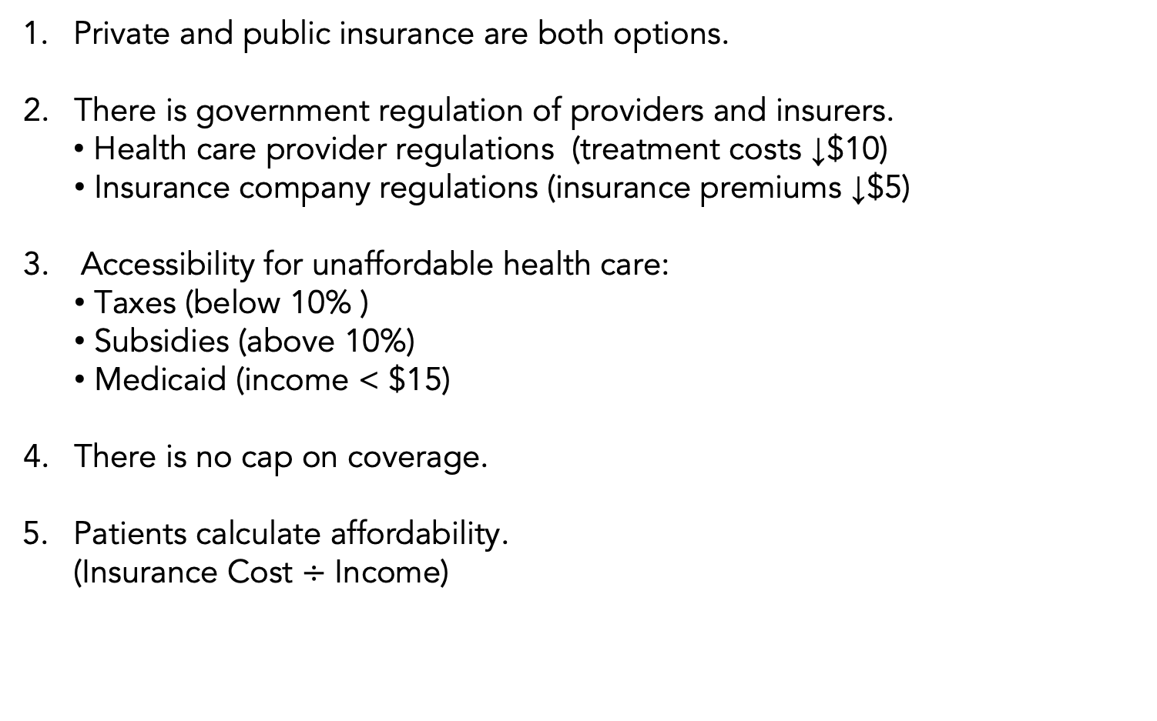
Section: Three-in-One Activity, cont’d
Round IV: Liberal Perspective
Private and public insurance are both options.
There is government regulation of providers and insurers.
Health care provider regulations (treatment costs ↓$10)
  Insurance company regulations (insurance premiums ↓$5)
Accessibility for unaffordable health care:
  Taxes (below 10% )
  Subsidies (above 10%)
  Medicaid (income < $15)
There is no cap on coverage.
Patients calculate affordability.
(Insurance Cost $÷$ Income)
Example:
Income: $80
Cost of Insurance: $5
5 ÷ 80 = 0.06 = 6%
Tax needed: $3
since
8 ÷ 80 = 0.10 = 10%
From The VOTE Textbook Second Edition Copyright © 2023

Slide 103
Section: Three-in-One Activity, cont’d
Round IV: Liberal Perspective
 | Calculation | Patient 1 | Patient 2 | Patient 3 | Patient 4 | Number Treated
Round IV Liberal | Affordability Insurance Cost ÷ Income (Taxes/Subsidies/Medicaid)
Income:
$100
Insurance:
$5
Income:
$60
Insurance:
$5
Income:
$40
Insurance:
$5
Income:
$10
Insurance:
$5
?
 | Calculation | Patient 1 | Patient 2 | Patient 3 | Patient 4 | Number Treated
Round IV Liberal | Affordability Insurance Cost ÷ Income (Tax/Subsidize/Medicaid) | 10% $5 ÷ $100 (+5 Tax Paid) | 10% $5 ÷ $60 (+1 Tax Paid) | 10% $5 ÷ $40 (+$1 Subsidies) | Income < $15 (Medicaid) | 4 out of 4 (100%) Solved
100% insured!
From The VOTE Textbook Second Edition Copyright © 2023

Slide 104
R
Section: Voices on Health Care, cont’d
adical
Democratic Socialism
Health Care
The for-profit health-care system forces people to choose between getting the health care they need or facing financial ruin.
From The VOTE Textbook Second Edition Copyright © 2023

Slide 105
R
Section: Voices on Health Care, cont’d
adical
Democratic Socialism
BIG PICTURE
As a society, we guarantee health care for all and fund it together to deliver
gold-standard medicine that brings us optimal well-being from cradle to grave.
POLICY POSITION
There is lack of access to high-quality health care, but…
Conservative policies throw us to the wolves of profit-driven health care providers and insurers, which leads to more illness, more suffering, and more financial ruin.
Liberal policies prop up the for-profit health insurance industry,
mire us in administrative quicksand, and still leave tens of
millions of people without health care.
SOLUTION
Replace a regulated health-care system and government programs
in capitalism with a single-payer health-care system in democratic
socialism to ensure health and well-being for all:
We get the highest quality health care at the lowest cost
to society.
Universal access to health care is guaranteed.
Health Care
From The VOTE Textbook Second Edition Copyright © 2023

Slide 106
Section: Voices on Health Care, cont’d
Health Care Talking Points: Radical
1. In democratic socialism, we have a social contract to take care of one another by making sure everyone’s basic material needs are met. That way, everyone is able to contribute their talents and skills to the world, to the best of their abilities. This means no one has to worry about how to pay for medical care if they fall ill, or are injured in an accident, or have a child with a disability. Society guarantees health care to all of us from womb to tomb.
2. All it takes is the will of the people to decide that we want health care to be a human right for everyone in society. Then we invest together in a system that provides outstanding care to all, with state-of-the-art medical facilities and equipment; top-notch medical education, research, and development; and robust public health initiatives. Because we fund it together, we can afford to get the highest-quality care, which we all want and need.
3. Conservatives, your idea to leave it up to individuals to sink or swim on their own when it comes to their health care is barbaric. The elderly, the disabled, the sick, and the poor will suffer and die from preventable illnesses because they won’t be able to afford health care in your free-market system. The so-called rock-bottom rates you say private insurers will offer for low budgets won’t actually cover anything, so the poor and middle class will continue to be bankrupted by medical emergencies.
4. Free-market capitalism is a threat to human life. For-profit pharmaceutical firms will rush new medications to market, and more people will suffer and die from harmful side effects. Insurance firms will write policies with hidden clauses that get them out of actually paying claims when people get sick. Hospitals will inflate prices, and people will avoid getting care. Letting the free-market profit motive guide our health-care system is a deadly prescription that will ultimately hurt us all.
5. Liberals, propping up the for-profit insurance industry to fix the health-care system is like handing out cigarettes to cure lung cancer. It’s a business that spends billions of dollars a year on needless administration. Every hospital has to employ multitudes of people who don’t actually provide any health care, keep the facility clean, or prepare the meals for patients. In every doctor’s office, lab, imaging center, and clinic, they are just moving around paper. What a colossal waste of energy, time, and resources.
6. With liberal policies, millions remain uninsured, while the people in poverty who manage to get on Medicaid are given the bare-minimum benefits, and the elderly still have to pay for part of their Medicare coverage out of their pockets. Private insurance institutionalizes stratification, so the rich buy their way up to better health care, and everyone else is left scraping the bottom of the barrel. The fair-market plan fails because it doesn’t pull the plug on capitalism. There’s nothing “fair” about it.
7. In democratic socialism, no one lies awake at night worrying about how they will pay for treatments, because a single-payer system is a guarantee that people get the medicine, surgeries, therapies, and everything else they need. And it’s not just a right we enjoy; it’s our collective responsibility. We fund it through taxes, and it ends up costing far less than paying for health care individually in a for-profit system. That’s because all the money we pay as a society actually goes toward health care. It's a for-people system.
8. Single-payer health care uses resources and public funds wisely. Health-care councils made up of stakeholders, experts, and government representatives design the best mechanisms for oversight, accountability and transparency. Because the system is funded with their own tax dollars, the worker-owned firms that manage the centers, hospitals, and clinics are highly motivated to prevent fraud, waste, and abuse. In addition, because they serve friends, family, and neighbors, they offer the best possible care.
From The VOTE Textbook Second Edition Copyright © 2023

Slide 107

Section: Three-in-One Activity, cont’d
Round V: Radical Perspective
Single-payer health care is the only option.
Universal health care is a social safeguard that is funded by
the government through a 10% across-the-board tax on income.
Treatment costs ↓$10
  There are no insurance caps or premiums
Universal accessibility is guaranteed
Patients calculate affordability.
(10% of income)
Example:
Income: $80
8 ÷ 80 = 0.1 = 10%
Tax needed: $8
From The VOTE Textbook Second Edition Copyright © 2023

Slide 108
Section: Three-in-One Activity, cont’d
Round V: Radical Perspective
 | Calculation | Patient 1 | Patient 2 | Patient 3 | Patient 4 | Number Treated
Round V Radical | Affordability Tax ÷ Income
Income:
$100
10% Tax
Income:
$60
10% Tax
Income:
$40
10% Tax
Income:
$10
10% Tax
?
 | Calculation | Patient 1 | Patient 2 | Patient 3 | Patient 4 | Number Treated
Round V Radical | Affordability Tax ÷ Income | 10% $10 ÷ $100 | 10% $6 ÷ $60 | 10% $4 ÷ $40 | 10% $1 ÷ $10 | 4 out of 4 (100%) Solved
100% insured!
From The VOTE Textbook Second Edition Copyright © 2023

Slide 109

Section: Three-in-One Activity, cont’d
From The VOTE Textbook Second Edition Copyright © 2023

Slide 110

Section: The Shared Outcome
Now you’ve heard the arguments from all three perspectives.
They all share the goal of
health and well-being for all.
It’s time for you to join the conversation!
From The VOTE Textbook Second Edition Copyright © 2023

Slide 111

Suggested Additional Activity
Health Care Activity: Skit
“All the World’s a Stage”
From The VOTE Textbook Second Edition Copyright © 2023

Slide 112
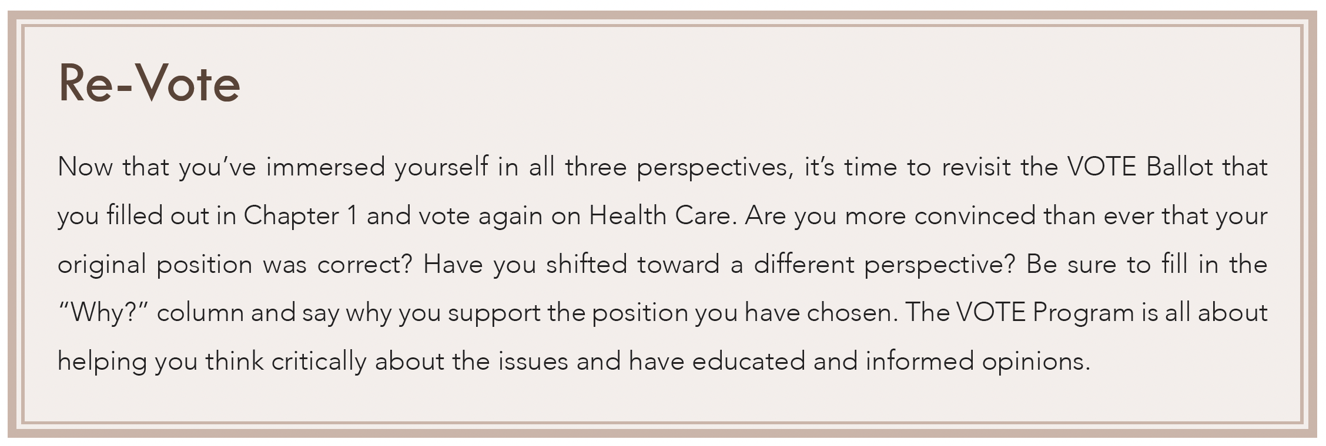
Section: Three-in-One Activity, cont’d
Health Care: Re-Vote
From The VOTE Textbook Second Edition Copyright © 2023

Slide 113

Chapter 15
Check out the book for more!
Test Yourself • Key Terms • Answer Key
From The VOTE Textbook Second Edition Copyright © 2023

