Slide 1

From The VOTE Textbook Second Edition Copyright © 2023

Slide 2


From The VOTE Textbook Second Edition Copyright © 2023
Notes:
2

Slide 3
From The VOTE Textbook Second Edition Copyright © 2023
Notes:
3

Slide 4
The VOTE Textbook Chapters
From The VOTE Textbook Second Edition Copyright © 2023
Notes:
4

Slide 5
1
2
3
4
5
6
7
8
9
10
11
12
13
14
15
16
17
18
19
20
21
From The VOTE Textbook Second Edition Copyright © 2023
Notes:
5

Slide 6

From The VOTE Textbook Second Edition Copyright © 2023

Slide 7


Discussion story: The game of Monopoly
Housing
Discussion Story
The game of Monopoly
Housing
From The VOTE Textbook Second Edition Copyright © 2023

Slide 8

Discussion story: The game of Monopoly, cont’d
The Golden Moment
Shared Problem:
Shared Goal:
Unaffordable housing leads to homelessness
Affordable housing for all
From The VOTE Textbook Second Edition Copyright © 2023
Notes:
8

Slide 9
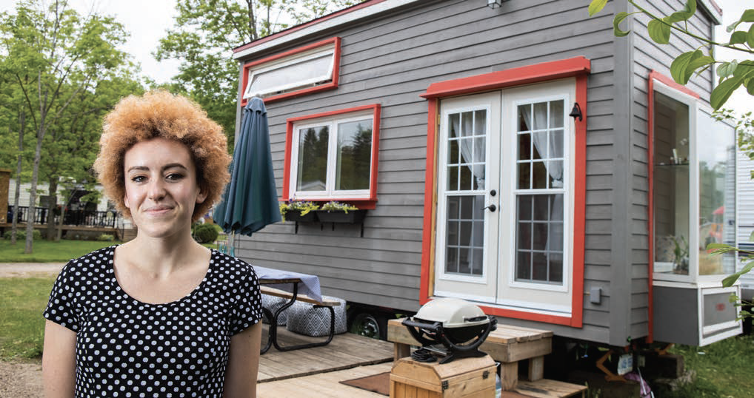
Section: Understanding the Issue of Housing
Activity
In the area you live (or want to live), check out an apartment rental site and look up what it costs to rent a one-bedroom apartment. What is the absolute cheapest rent you can find? Now find out what the minimum wage is in your area. Write these figures down. We’ll come back to this later.
From The VOTE Textbook Second Edition Copyright © 2023

Slide 10

Section: Understanding the Issue of Housing, cont’d
Housing simply refers to places where people live.
Includes single-family homes, cabins, mansions, nursing homes, mobile homes, palaces, low-end apartments, RVs, group homes, cooperative housing, manufactured homes, castles, condominiums, yurts, luxury apartments, trailers, lofts, boxcar homes, assisted-living facilities, and more.
From The VOTE Textbook Second Edition Copyright © 2023

Slide 11

Section: Understanding the Issue of Livelihood, cont’d
Privately Owned Housing
Apartments: landlord owns the property; tenant pays rent
Condominiums: private ownership with shared land and shared
common spaces
Single-family homes: private ownership of home and land
From The VOTE Textbook Second Edition Copyright © 2023

Slide 12
Section: Understanding the Issue of Livelihood, cont’d
Cooperative Housing (Resident-Owned Communities)
Co-op apartments: own shares in a resident-owned nonprofit
corporation that owns the property
Co-housing / Intentional communities: spaces are designed for
community and social interaction
Commune: residents share incomes and spaces
From The VOTE Textbook Second Edition Copyright © 2023

Slide 13
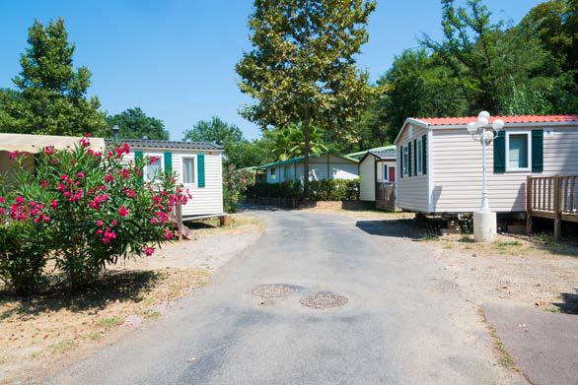
Section: Understanding the Issue of Livelihood, cont’d
Do You Live in Affordable Housing?
Federal definition:
30% of gross annual income (including utilities)
If not, you are considered cost burdened.
Remember the activity you did earlier looking at rent prices for a one-bedroom apartment and the minimum wage in your area? Is the apartment affordable? Will you need a car in that area? Are there grocery stores nearby? Is it an area where you are willing to live?
From The VOTE Textbook Second Edition Copyright © 2023

Slide 14
Polling Question
Affordable Housing
If your rent plus utilities are $2,000 a month ($24,000 a year) and you earn $40,000 per year, are you cost burdened? Remember, the official definition of affordable housing is 30% of gross income.
Yes, you are paying more than half of your income (60%) on rent plus utilities.
No, you are not cost burdened. At least you have a roof over your head.
Yes, you are paying 40% of your income on rent plus utilities.
No, your rent plus utilities has nothing to do with your income.
From The VOTE Textbook Second Edition Copyright © 2023

Slide 15
Section: Understanding the Issue of Livelihood, cont’d
Do You Live in Affordable Housing?
Federal definition:
30% of gross annual income (including utilities)
If not, you are considered cost burdened.
Who would like to guess what percentage of U.S. renters were cost burdened in 2021 (according to the Joint Center for Housing Studies at Harvard University)?
DAILY
DOUBLE
49.0% of all renters.
From The VOTE Textbook Second Edition Copyright © 2023

Slide 16
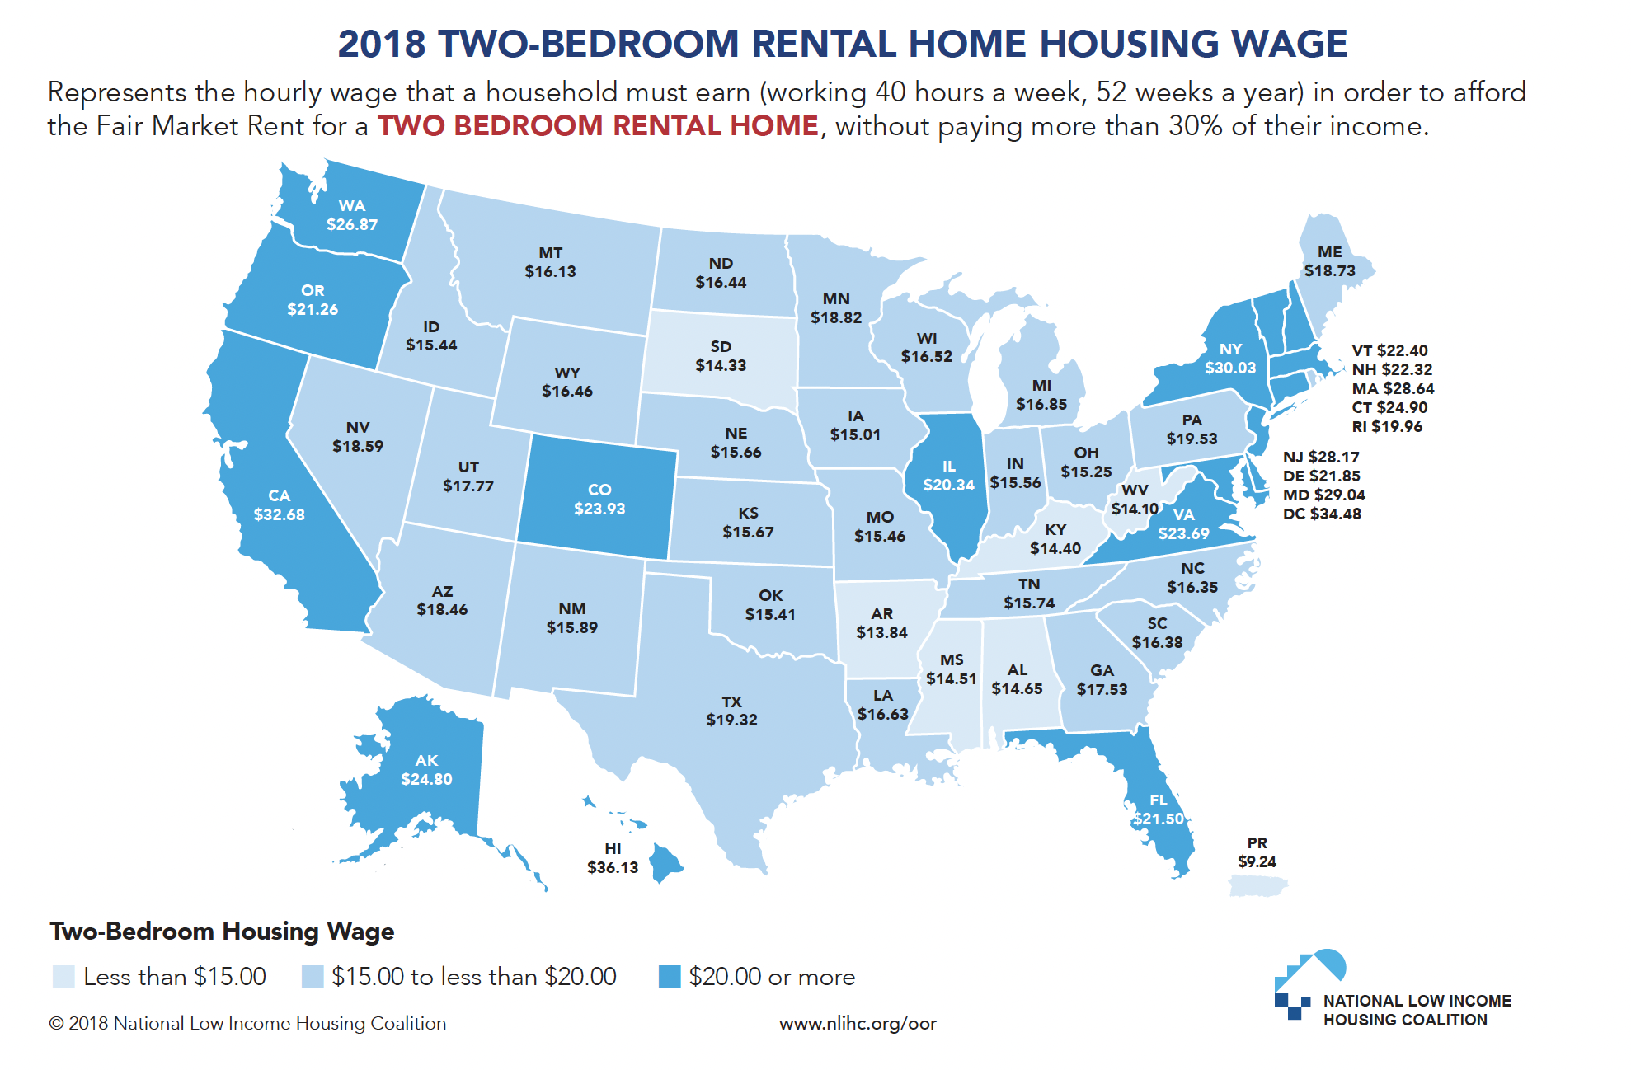
In no state, metropolitan area or county in the United States could a full-time worker in 2018 earning the prevailing minimum wage afford a modest two-bedroom apartment.
From The VOTE Textbook Second Edition Copyright © 2023
Notes:
16

Slide 17

Section: Understanding the Issue of Livelihood, cont’d
To be homeless is to be terribly vulnerable. One cold snap or heat wave or bad storm could mean death—not to mention the violence, hunger, illness, and deprivation that goes along with homelessness.
From The VOTE Textbook Second Edition Copyright © 2023
Notes:
17

Slide 18

Section: Understanding the Issue of Livelihood, cont’d
Private Housing Programs
  Nonprofit organizations
  Religious and community organizations
  Private Foundations
  Corporations
From The VOTE Textbook Second Edition Copyright © 2023
Notes:
18

Slide 19

Section: Understanding the Issue of Livelihood, cont’d
Government Housing Programs
  Public housing
  Section 8 housing
  Project-based rental assistance
  or
  Tenant-based housing choice vouchers
  Low-Income Housing Tax Credit (LIHTC)
  Inclusionary zoning
  Rent control and rent stabilization
From The VOTE Textbook Second Edition Copyright © 2023
Notes:
19

Slide 20

Section: Understanding the Issue of Livelihood, cont’d
Rent control laws are highly controversial. Some states have laws banning it, while other states allow it. (There are significantly more of the former than the latter.)
As of 2022, Oregon was the only state to legalize rent control in all of its cities and towns. Rent control is also legal in some of our largest cities:
New York City
San Francisco
Washington D.C.
Los Angeles
.
Of all the government policies and programs meant to
address affordable housing, rent control laws affect the most households in our nation.
From The VOTE Textbook Second Edition Copyright © 2023
Notes:
20

Slide 21

Note: We present each perspective as if we wholeheartedly agree with it. We do this on purpose to present each point of view in its best light, but please imagine each time that we are wearing a mask—as if we are actors playing three different roles.
From The VOTE Textbook Second Edition Copyright © 2023

Slide 22
C
Section: Voices on Housing, cont’d
onservative
Free-Market Capitalism
Housing
Affordable housing is available to all if we look for opportunities, stay nimble, and change course as needed. That’s Monopoly’s lesson.
From The VOTE Textbook Second Edition Copyright © 2023

Slide 23
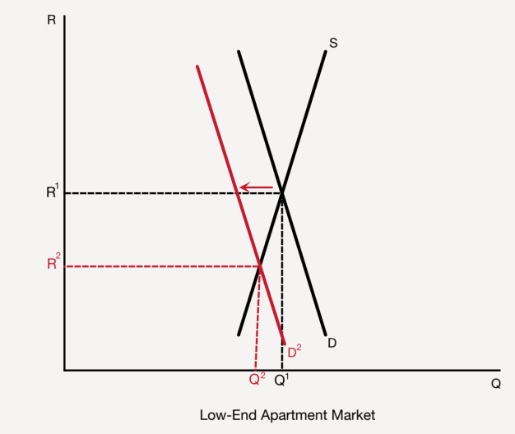
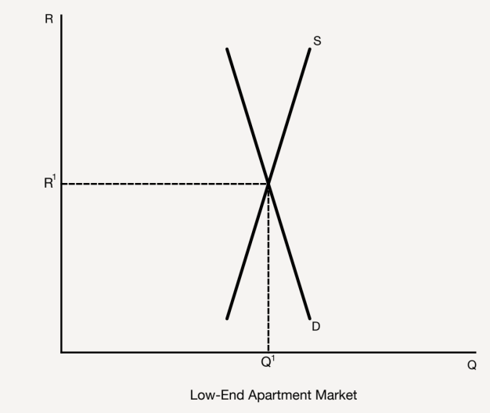
C
Section: Voices on Housing, cont’d
onservative
Free-Market Capitalism
Housing
BIG PICTURE
When the invisible hand of free-market capitalism guides people’s choices, we
get the housing we want and producers are motivated to supply it.
POLICY POSITION
Unaffordable housing leads to homelessness, but...
Radical policies undermine the sanctity of our homes and trade
price signals for central planning, which creates a chaos of bad
decisions about allocating land for housing.
Liberal policies oppress landlords and hurt tenants, creating
shortages of affordable housing and no incentives to keep
the few available in good repair.
SOLUTION
Reject rent-control laws and replace them with free-market
rent signals to ensure affordable housing for all:
People optimize their circumstances.
Private philanthropy serves as the safety net.
From The VOTE Textbook Second Edition Copyright © 2023

Slide 24
Section: Voices on Housing, cont’d
Housing Talking Points: Conservative
1. When Gotham City is in trouble, the commissioner calls for Batman by beaming a signal into the sky. Today,there are areas of the country that are frantically signaling that they need people to move there, and their signal is price. When housing is unaffordable in one area, people move to a more affordable area. This strategy is good for the nation. This is how we attract the doctors, the businesspeople, and the teachers to the communities that need them the most.
2. In our country, we must support visionary entrepreneurship. When it comes to housing, it’s the developers and investors who take the risks to supply it, and they are the ones who should reap the well-earned rewards. We would never want to discourage anyone from being in the business of providing us with everything that brings us a good life. This is what guarantees milk in the grocery store, an airline that is willing to fly you across the country, and a roof over your head.
3. Radicals, your plan of resident-owned communities sounds like a nightmare of mutual cooperative destruction. I don’t want to live in a place where everyone is in my business and there are constant meetings to regulate whether people are allowed to cook fish because it stinks up the hallways. I work my butt off to have a roof over my head, and my home is my castle. Your plan would turn my sanctuary into a nightmare of nosy neighbors, endless bickering, and no one taking responsibility for basic maintenance.
4. Radicals, no community land trust can possibly plan for what the best use of that land should be. There are too many moving parts. It’s the profit motive and price signals that move resources to their optimal use so that we get the housing we need. Disrupting that delicate balance by pulling land out of the private market means we’ll end up with too much or too little housing relative to the jobs available, to the population, or to the available drinking water.
5. Liberals, rent control isn’t fair to owners. They’re the ones who take the risks and who should reap the well-earned rewards for providing housing. And your policies of public housing and Section 8 are not the solutions. Those government programs create more homelessness. They send a signal to people to expect free or heavily subsidized housing. Instead of taking action to put a roof over their heads, people continue to live out of their cars or languish in shelters waiting for their handout.
6. Rent control laws cause shortages of affordable housing, which leads to more homelessness. If you lower the price for something, of course more demanders want it, and of course fewer suppliers provide it. Investors become unwilling to be landlords, so developers don’t build low-cost housing. And current landlords have no motivation to keep their properties in good repair, so tenants who somehow manage to find an affordable home can thank a liberal for the leaky faucets, peeling paint, and broken screens.
7. With unfettered rent signals, developers build the variety of affordable housing that people want because there is a market for it, and investors are willing to become landlords because it’s profitable to do so. Then, people optimize their circumstances by moving to the places that give them the best combination of a high-paying job and affordable housing. The whole country is better off in free-market capitalism because communities attract the workforces they need and there are homes for all.
8. For those who fall through the cracks, philanthropy provides a safety net. Individuals participate because it’s in our nature to take care of our friends, families, and communities. Firms participate because it enhances their reputation where they do business. And religious groups and nonprofit organizations participate because it’s their mission to care for others. When we allow price signals to direct housing choices, and combine that with private philanthropy, everyone who wants housing can have it.
From The VOTE Textbook Second Edition Copyright © 2023

Slide 25
R
Section: Voices on Housing, cont’d
adical
Democratic Socialism
Housing
In capitalism, housing is only about making a profit. One person wins while everyone else is wiped off the board. That’s Monopoly’s lesson.
From The VOTE Textbook Second Edition Copyright © 2023

Slide 26

R
Section: Voices on Housing, cont’d
adical
Democratic Socialism
Housing
BIG PICTURE
When housing is cooperatively owned, we get a wide variety of affordable and desirable options, and individuals have a vote and a voice in their living situations.
POLICY POSITION
Unaffordable housing leads to homelessness, but...
Liberal policies, whether tax credits, vouchers, or public housing,
can’t ever be sustainable solutions because they don’t challenge
the core problems of private ownership and the drive for profit.
Conservative policies leave people in the lurch because they can’t
all simply move when private owners jack up the rent, plus landlords
are forced to maximize rents and minimize upkeep to turn a profit.
SOLUTION
Replace rent control laws in capitalism with resident-owned coop-
eratives in democratic socialism to ensure affordable housing for all:
A home is a basic human right.
People choose the type of housing they want.
From The VOTE Textbook Second Edition Copyright © 2023

Slide 27
Section: Voices on Housing, cont’d
Housing Talking Points: Radical
1. In democratic socialism cooperative ownership of housing gives us hands-on control over where we live. Co-owners make decisions together using a democratic process of one person, one vote. That means you can feel secure knowing your monthly fees won’t just go up arbitrarily and things that need to be repaired will actually get fixed. And when bad luck strikes—like a plumbing problem or a tornado—co-owners come together and take care of it.
2. Housing is not a luxury; it’s a necessity for our survival. Communities make it a priority to ensure there are affordable options for people at every stage of their lives. When housing is an investment in people and not an investment for profit, there are plenty of resources in our communities to afford everything we need to produce decent and sustainable options. No one has to live in fear of being homeless. People have the housing they need and the whole society benefits.
3. Liberals, rent control is not a solution. Even if there were rent control laws across the whole nation, capitalism feeds on profit, so by making housing less profitable for landlords, you discourage them from providing housing. That leads to more homelessness. Liberals, your efforts are futile. You’re trying to fix what can’t be fixed: the systemic failure of capitalism. It’s a sinking ship that leaves millions without a roof over their heads, and millions more waiting in dread to join them.
4. Liberals, first you came up with public housing to replace slums—and then your housing projects turned into slums. Section 8 housing isn’t much better, so you introduced the voucher system. Now people wait for years just to get on the five-year waiting list! Low-Income Housing Tax Credits are a scam to line the pockets of developers and investors, so please don’t pretend it’s bringing us the affordable housing we need. Your housing policies fail because residents have no ownership stake, voice, or vote.
5. Conservatives, the American Dream in free-market capitalism means that millions of hardworking people toil away, day and night, and still have to worry about keeping a roof over their heads. Your solution is a bad joke. People who are unable to find affordable housing can’t just move themselves and their families to another city. Even if it were possible, the disruption to everyone’s lives and their social networks and communities would be devastating. Your plan would create masses of domestic migrants.
6. Conservatives think price signals will magically save the day and cure us of homelessness. They won’t. In free-market capitalism landlords will always raise rents as high as they can get away with, and they maximize their profit by doing the minimum upkeep and repairs. Even if they don’t want to evict tenants who can’t pay or turn their affordable housing into profitable vacation rentals, they will. In capitalism, a landlord who isn’t doing that is a landlord who doesn’t survive.
7. People must have homes to succeed in life. That’s why we all contribute to ensure that housing is a basic right. For those who need help beyond the social safeguards already provided in democratic socialism, government-assisted ROCs ensure that they have adequate, affordable housing. Also, housing councils are made up of stakeholders in local areas. They use community land trusts to plan the best uses of land so that society can fulfill its guarantee of housing for all—now and into the future.
8. With resident-owned communities, we get a wide range of affordable housing choices. You like being around other people? Choose co-housing, where everyone shares meals and responsibilities, or a co-op apartment, where neighbors make decisions together, or a resident-owned mobile home park. You’d rather do your own thing? Choose a single-family home. The point is that no one is making a profit off your need to put a roof over your head, and that’s how we solve the problem of the lack of affordable housing.
From The VOTE Textbook Second Edition Copyright © 2023

Slide 28
L
Section: Voices on Housing, cont’d
iberal
Fair-Market Capitalism
Housing
Unlike in Monopoly, we don’t all start with the same resources. The game is rigged, and no amount of strategy or skill changes that reality.
From The VOTE Textbook Second Edition Copyright © 2023

Slide 29
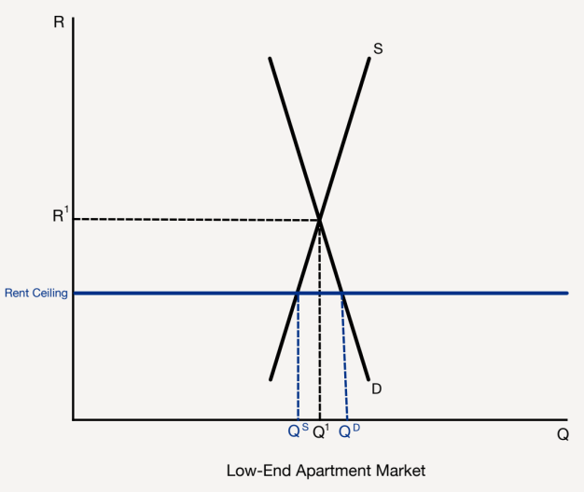
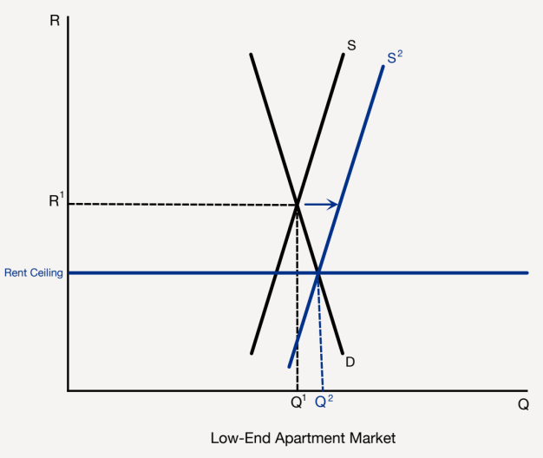
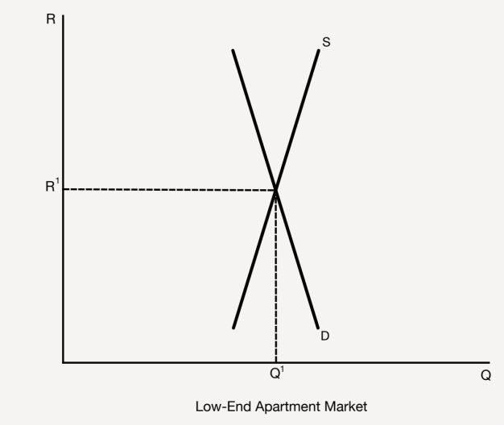
L
Section: Voices on Housing, cont’d
iberal
Fair-Market Capitalism
BIG PICTURE
Liberal government programs and policies create a stable supply of affordable
housing so that people can keep a roof over their heads.
POLICY POSITION
Unaffordable housing leads to homelessness, but...
Conservative policies lead to even more homelessness because landlords can and do take advantage of tenants’ economic vulnerability.
Radical policies lead to cronyism, corruption, shoddy
construction—if buildings even go up at all—and a
nightmare of endless meetings.
SOLUTION
Strengthen rent control policies to ensure affordable housing
for all:
Expand incentives for landlords to keep them in the game.
Taxpayers save billions when homelessness ends.
Housing
From The VOTE Textbook Second Edition Copyright © 2023

Slide 30
Section: Voices on Housing cont’d
Housing Talking Points: Liberal
1. A home isn’t a luxury—it’s a basic necessity for every human being. It’s the foundation for well-being—for decent nutrition, good hygiene, a good night’s rest, and personal safety. No matter whether it’s a tiny attic apartment or a palace, home is our personal sanctuary. Homelessness derails people’s lives, and we all miss out on the contributions they could be making if they weren’t so dragged down with the business of daily survival.
2. It’s in everyone’s self-interest to ensure that each of us can afford a decent place to live. Why? Because homelessness traps people in poverty, which ultimately ends up draining our country’s resources. We’re fortunate to have a government that does the right thing by partnering with private industry to create more affordable public housing and affordable private housing options. Instead of turning our backs on the homeless, we build a thriving economy and stronger society.
3. Conservatives, relocating is expensive, and these are poor people, so telling low-income people to pack up and move to a new city is not a practical solution. And even if they managed to move, without rent control, they’ll just be at the mercy of a new landlord who will gouge them with impunity. You’re the first to preach about hard work and people needing to pull themselves up by their bootstraps. But then you turn around and want to take away their boots.
4. Conservatives, you have faith in the invisible hand to make all things right, but our higher moral value as a society is to care for one another. When it comes to a product that is a basic necessity, such as housing, the profit motive needs to be tempered with compassion and reined in. There are no real substitutes for affordable housing—not the car, not the park bench, not the temporary shelter. And private philanthropy won’t house everyone, while doing nothing gets us nothing—except more homelessness.
5. Radicals, without the profit motive, your cooperative housing never gets built because no one bothers to show up at the work site. It’s naïve to think every project is motivated by altruism. Those builders are not always building housing for only their own family and friends. But let’s say they do miraculously show up at the building site. Those worker-owners get paid the same whether they do a good job or a bad job, so your housing is guaranteed to be poorly made.
6. Radicals, community land trusts are rife with potential for cronyism and corruption. There is a limited amount of land on which housing can be built, so which group of wannabe cooperative owners gets the lease from the housing councils? It is the group that knows the most people who show up to the meeting, has the most friends, knows the stakeholders on the committee, and so forth. That is the end of democracy and the opening for totalitarianism to creep in.
7. Rent control should be expanded to more areas of the country where affordable housing is desperately needed. It makes decent housing available to low-income people and also helps landlords, because they can rely on a steady income stream and low turnover of their tenants. Let’s expand the role of government by giving landlords more options and more incentives to invest in affordable housing—property tax breaks, funds for repairs, and so forth. This is fair, and it also creates buy-in from owners.
8. There is not one state in the union that doesn’t struggle with a lack of sufficient affordable housing. Getting people into affordable homes saves our nation billions in programs that address the fallout from homelessness—hunger, crime, drug addiction, and disease. When the government partners with the private sector, we get the affordable housing we need. The government has the power to use programs and regulations to fix the problem. When we can fix a problem, we should.
From The VOTE Textbook Second Edition Copyright © 2023

Slide 31

Section: The Shared Outcome
Now you’ve heard the arguments from all three perspectives.
They all share the goal of
affordable housing for all.
It’s time for you to join the conversation!
From The VOTE Textbook Second Edition Copyright © 2023

Slide 32


Section: Activity: Poster
Housing Activity: Poster
“A Picture Is Worth a Thousand Words”
From The VOTE Textbook Second Edition Copyright © 2023

Slide 33
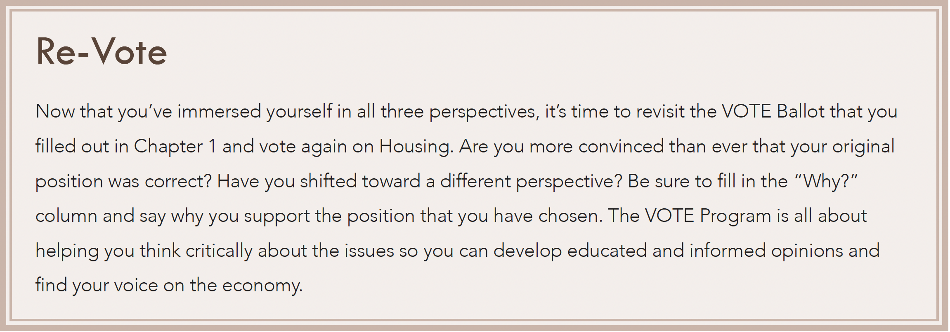
Section: Activity: Poster
Housing: Re-Vote
From The VOTE Textbook Second Edition Copyright © 2023

Slide 34

Chapter 12
Check out the book for more!
Test Yourself • Key Terms • Answer Key
From The VOTE Textbook Second Edition Copyright © 2023

