Slide 1
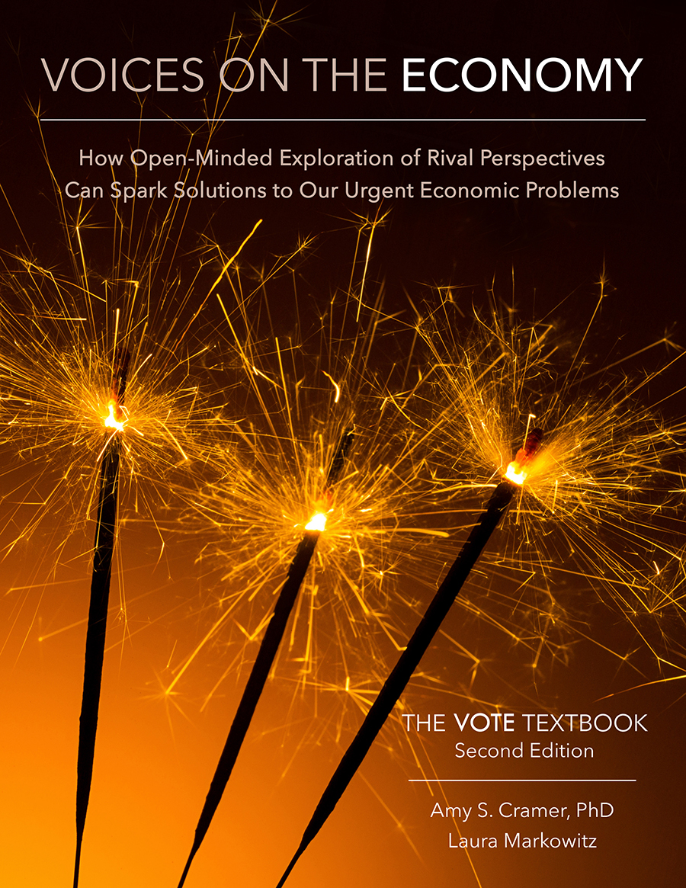
From The VOTE Textbook Second Edition Copyright © 2023

Slide 2


From The VOTE Textbook Second Edition Copyright © 2023
Notes:
2

Slide 3
From The VOTE Textbook Second Edition Copyright © 2023
Notes:
3

Slide 4
The VOTE Textbook Chapters
From The VOTE Textbook Second Edition Copyright © 2023
Notes:
4

Slide 5
1
2
3
4
5
6
7
8
9
10
11
12
13
14
15
16
17
18
19
20
21
From The VOTE Textbook Second Edition Copyright © 2023
Notes:
5

Slide 6

From The VOTE Textbook Second Edition Copyright © 2023

Slide 7


Discussion story: Poverty in a sixth-grade class
Livelihood
Discussion Story
Poverty in a sixth-grade class
Livelihood
From The VOTE Textbook Second Edition Copyright © 2023

Slide 8
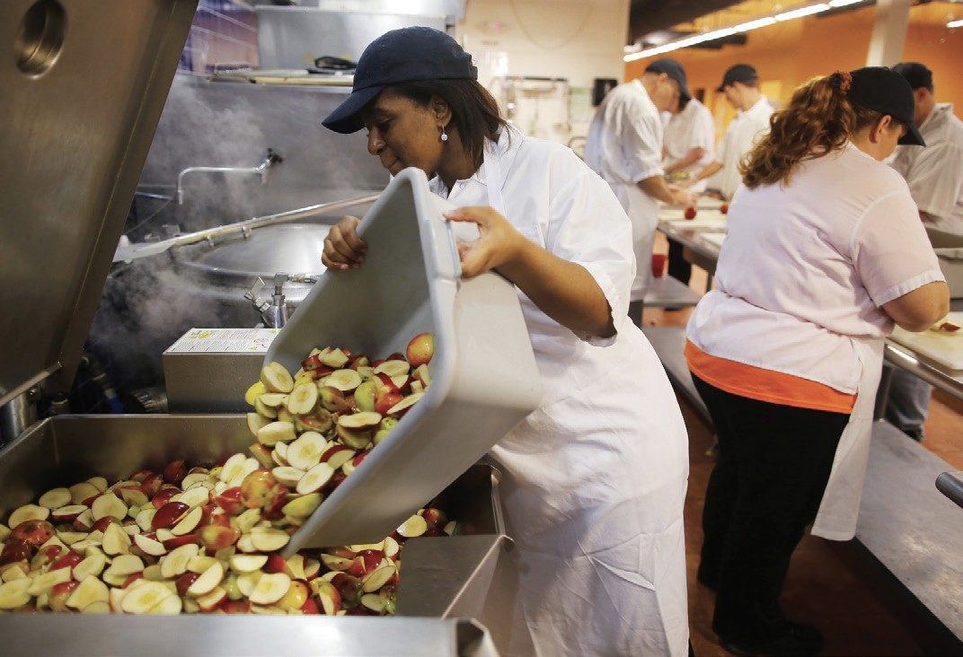
Discussion story: Poverty in a sixth-grade class, cont’d
The Golden Moment
Shared Problem:
Shared Goal:
Poverty causes suffering and deprivation
An end to poverty
From The VOTE Textbook Second Edition Copyright © 2023
Notes:
8

Slide 9

Section: Understanding the Issue of Livelihood
Livelihood is the means through which people earn money to pay for the necessities of life—shelter, food, clothing, health care, electricity, heat, and more.
From The VOTE Textbook Second Edition Copyright © 2023

Slide 10
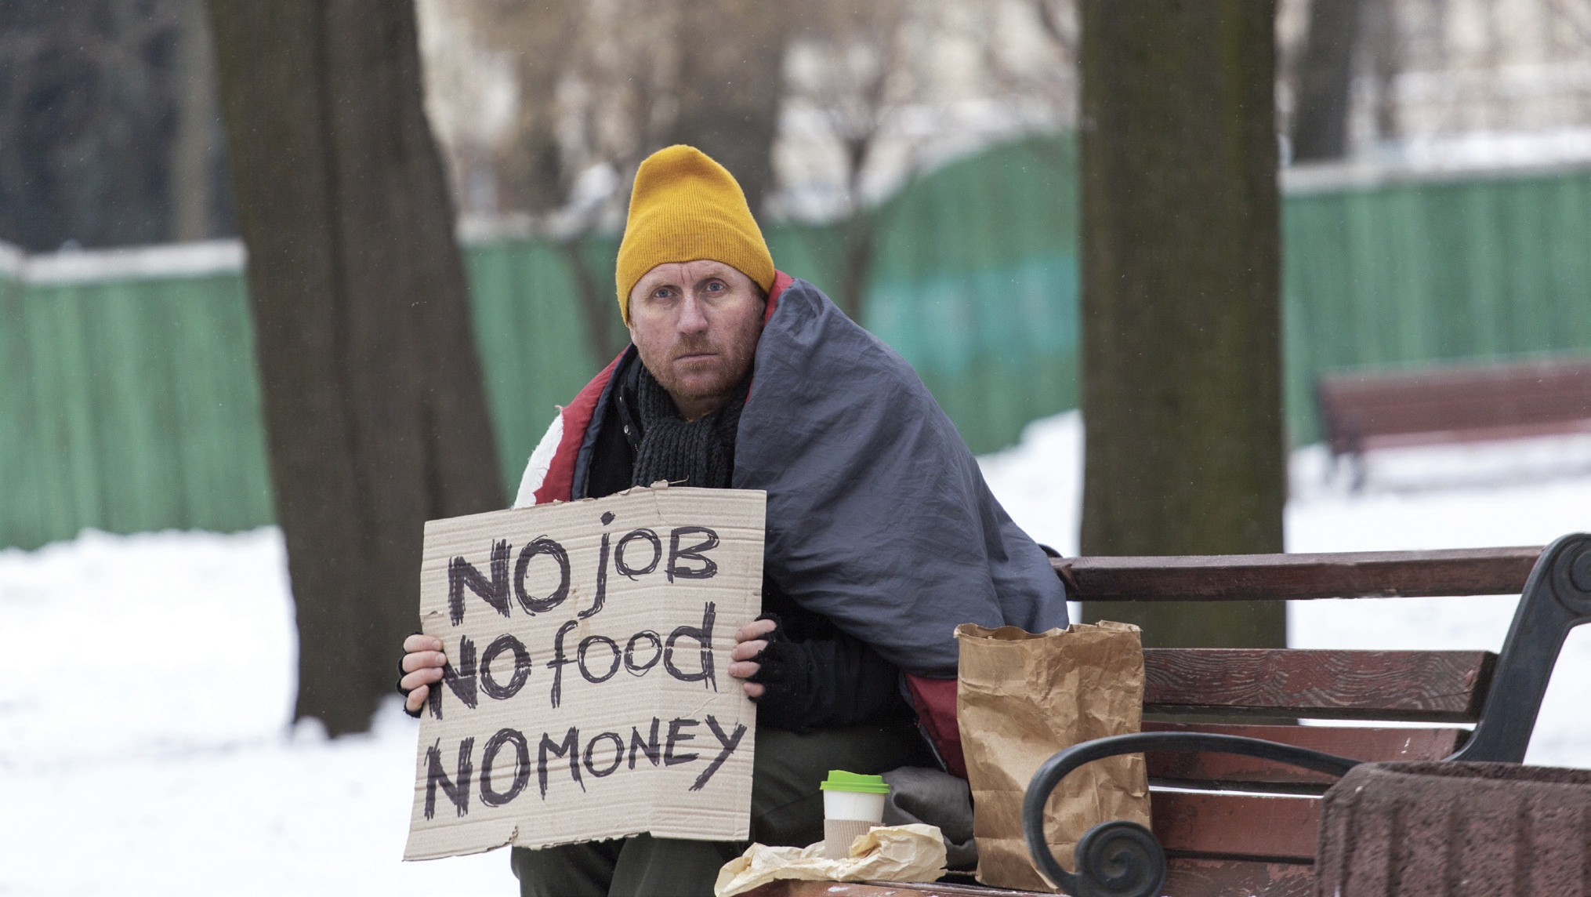
Section: Understanding the Issue of Livelihood, cont’d
Poverty is having an insufficient livelihood to afford the things needed to survive.
From The VOTE Textbook Second Edition Copyright © 2023

Slide 11
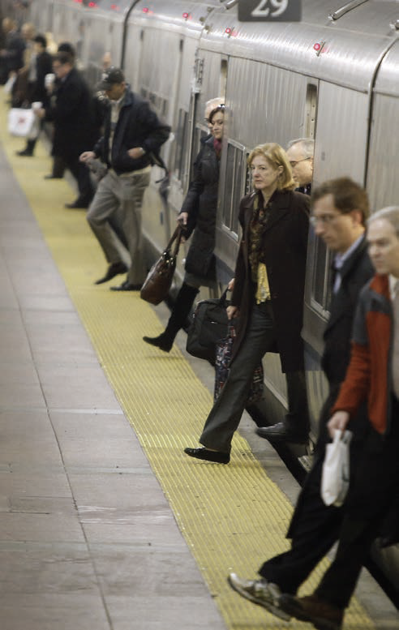
Section: Understanding the Issue of Livelihood, cont’d
Activity
Write down your (or your family’s) annual income. Then write down the average cost of your (or your family’s) monthly expenses, and multiply by twelve. We’ll come back to this later.
Don’t forget groceries, housing, utilities, transportation, debt payments, communication, medical expenses, emergencies, clothes, entertainment, insurance, education, and anything else on which you spend your money.
From The VOTE Textbook Second Edition Copyright © 2023

Slide 12
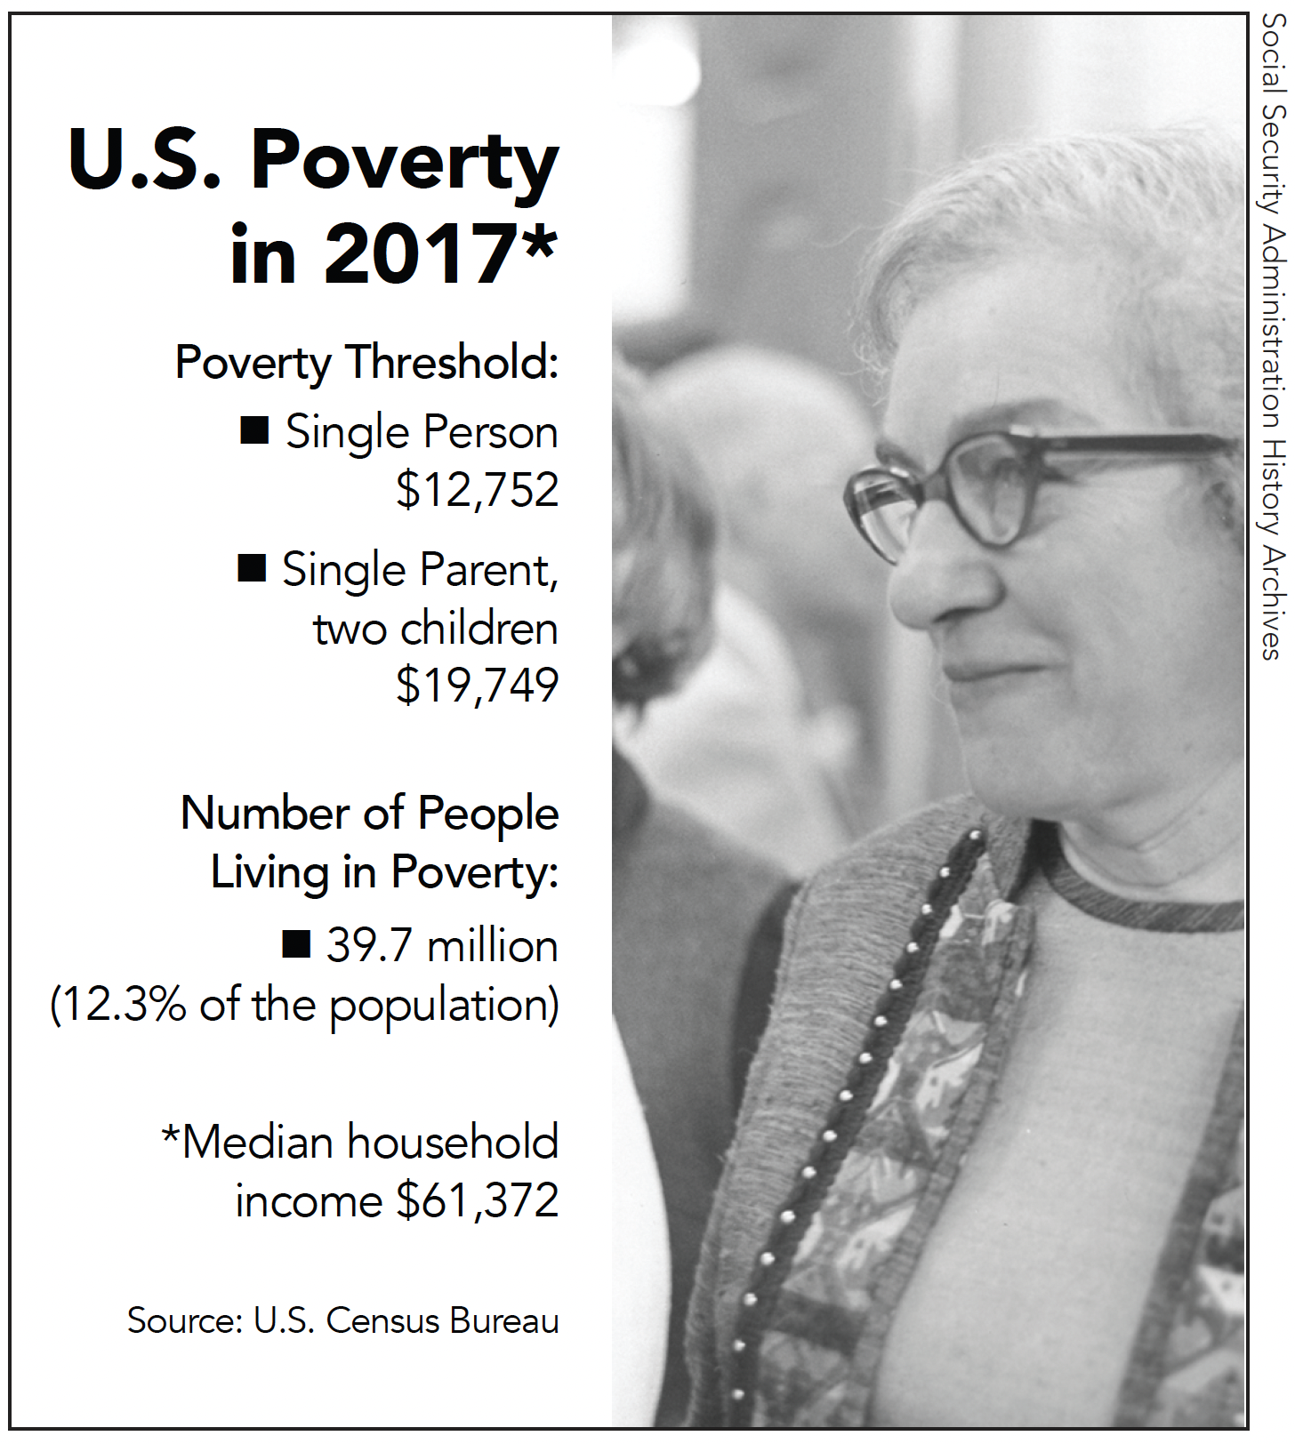
Section: Understanding the Issue of Livelihood, cont’d
Take a minute and think about these numbers. Who knows or would like to guess how they are calculated?
DAILY
DOUBLE
From The VOTE Textbook Second Edition Copyright © 2023

Slide 13
Section: Understanding the Issue of Livelihood, cont’d
In 1963, economist Mollie Orshansky invented a way to measure poverty that is still used today—the Official Poverty Measure (OPM). It determines the income level officially considered to be “poverty.”
When people’s income before taxes falls below that poverty threshold, they may qualify for both government assistance and privately funded assistance.
Another measurement, the 2010 Supplemental Poverty Measure (SPM), is calculated differently, and as of 2022 was not used to determine people’s eligibility for assistance.
From The VOTE Textbook Second Edition Copyright © 2023

Slide 14
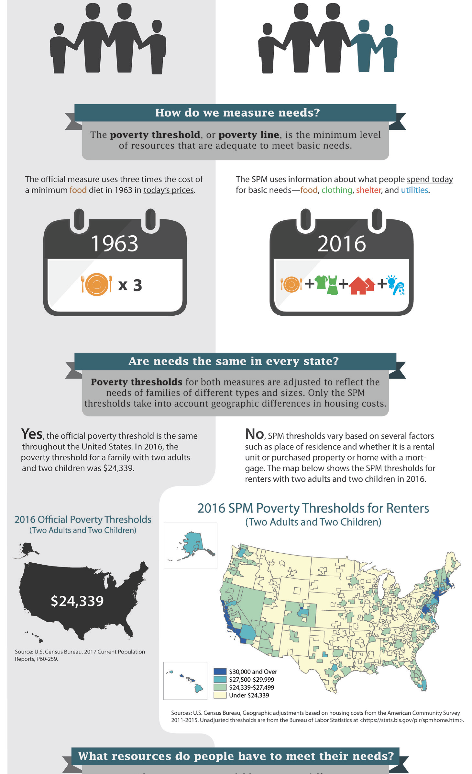
Section: Understanding the Issue of Livelihood, cont’d
Two Different Poverty Measures
OPM
Official Poverty Measure
SPM
Supplemental Poverty Measure
First, calculate…
First, calculate…
Three times the cost of a minimum food diet in 1963, in today’s prices
Average cost of
food, clothing, shelter, utilities
(FCSU)
now compare that to…
now compare that to…
A person or family’s cash income before taxes, regardless of local cost of living
Cash income (with local cost of living adjustment)
Add: Noncash benefits
(e.g. SNAP, housing subsidies, school lunches)
Subtract: Necessary expenses
(e.g. taxes, childcare, medical, work)
Income below the OPM is officially considered “poverty.“
Income below the SPM is officially considered “poverty.“
*Source: U.S. Census Bureau
From The VOTE Textbook Second Edition Copyright © 2023

Slide 15
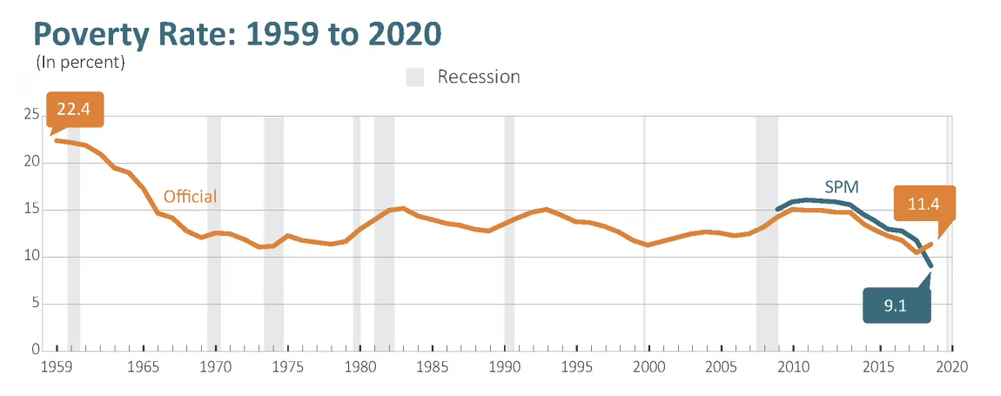
Section: Understanding the Issue of Livelihood, cont’d
*Source: U.S. Census Bureau
The orange line is the OPM and the blue line is the SPM. You can see here why it matters how poverty is measured. In 2017, there were close to 40 million people below the OPM and nearly 45 million below the SPM. So just think about this: if the SPM had been the measure used to determine who qualifies for public assistance, there would have been an additional 4.5 million recipients that year.
From The VOTE Textbook Second Edition Copyright © 2023

Slide 16
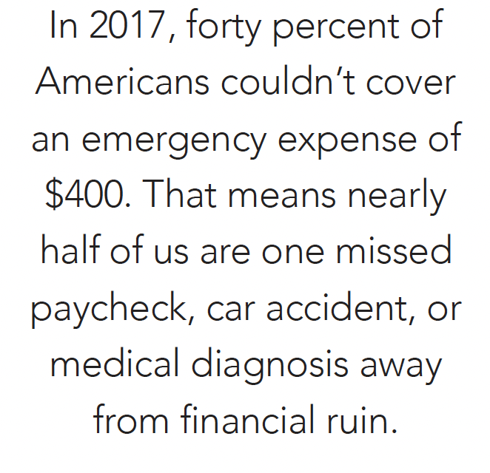

Section: Understanding the Issue of Livelihood, cont’d
Reflect back on the budget activity from a few minutes ago. If you fall above the poverty line but still worry about money all the time, you’re not alone.
From The VOTE Textbook Second Edition Copyright © 2023

Slide 17
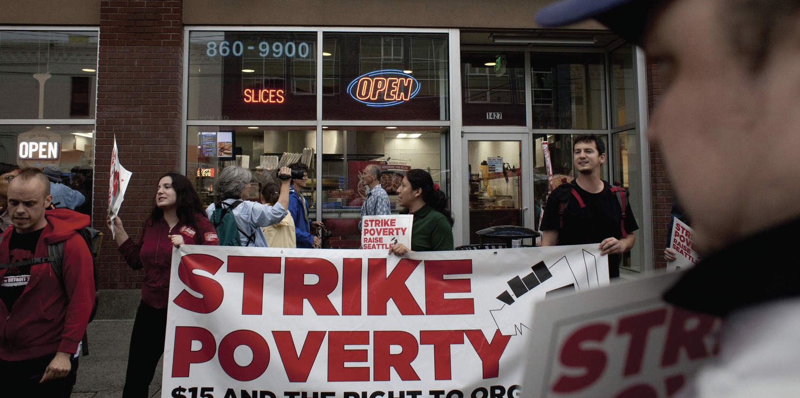
Labor Unions versus Right to Work Movement
Section: Understanding the Issue of Livelihood, cont’d
Labor Unions
Organized associations of workers for the purpose of collective negotiation. Workers pay dues to the organization.
Right to Work Movement
Against mandatory membership in unions.
From The VOTE Textbook Second Edition Copyright © 2023

Slide 18
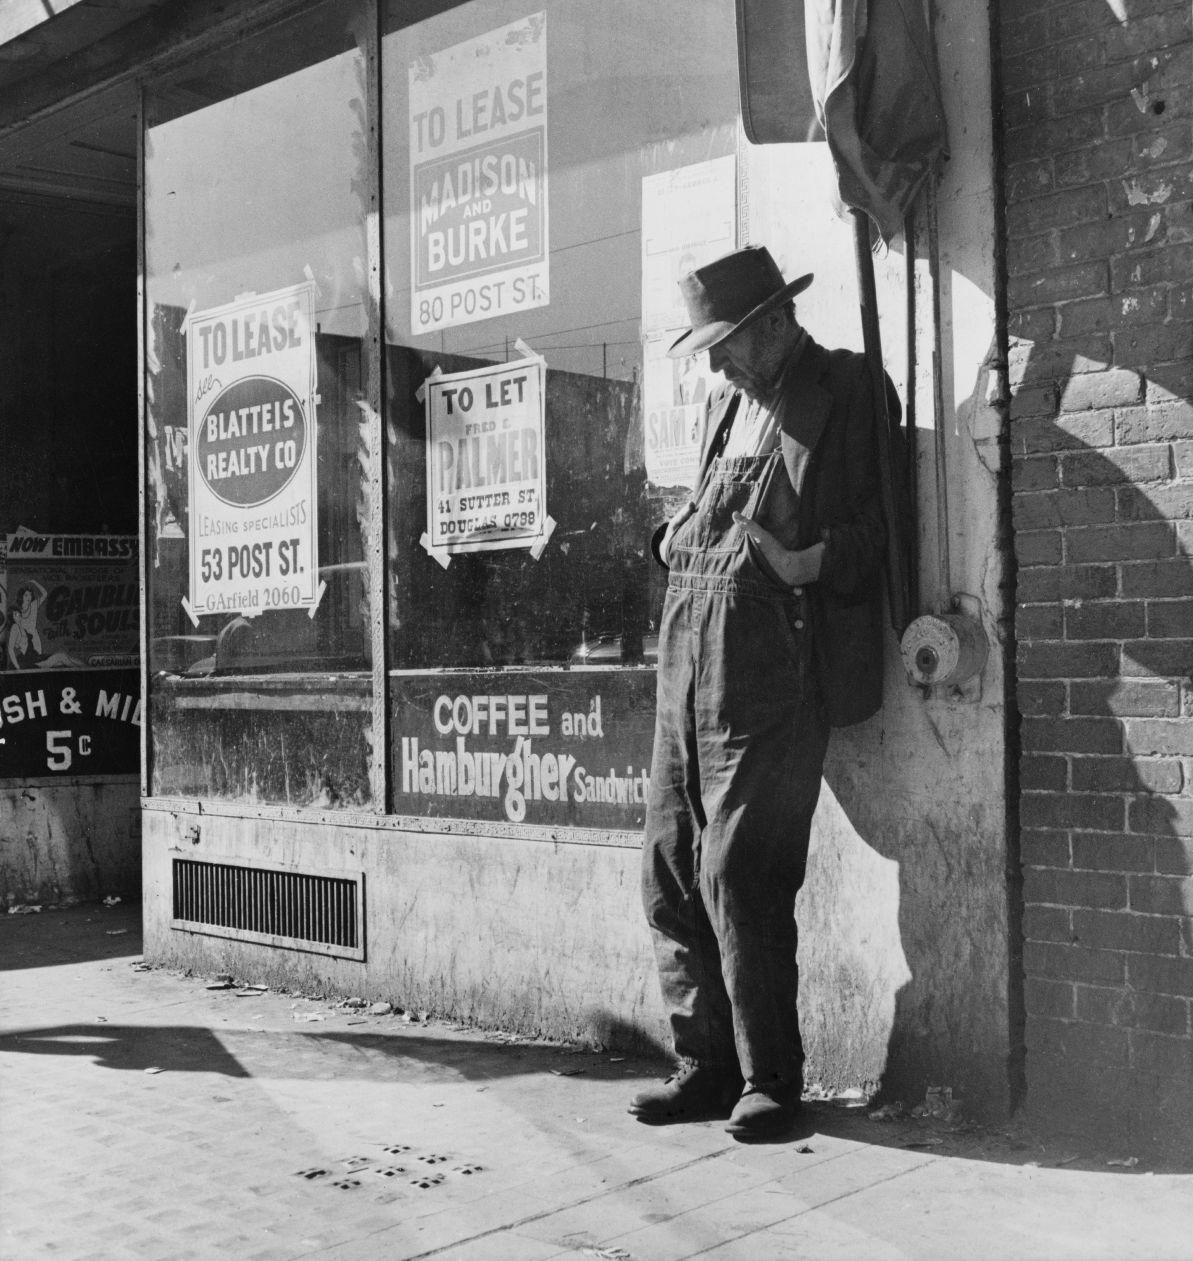
Section: Understanding the Issue of Livelihood, cont’d
Two notable government initiatives to combat poverty during the 20th century:
1930s: FDR’s “New Deal”
included minimum wage legislation
1960s: Johnson’s War on Poverty
From The VOTE Textbook Second Edition Copyright © 2023

Slide 19

Section: Understanding the Issue of Livelihood, cont’d
Johnson’s War on Poverty programs continue today:
AmeriCorps VISTA
Federal TRIO
Programs
Head Start for
School Readiness
Job Corps
Medicaid
Supplemental Nutrition
Assistance Program (SNAP)
From The VOTE Textbook Second Edition Copyright © 2023

Slide 20
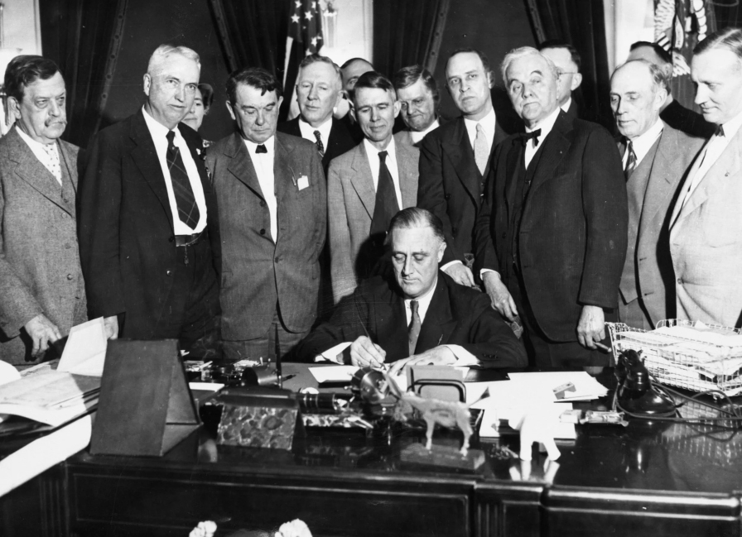
Section: Understanding the Issue of Livelihood, cont’d
FDR’s minimum wage legislation continue today.
Established in 1938 as part of the Federal Labor Standards Act (FLSA).
“The proposition is simply this: if all employers will act together to shorten hours and to raise wages, we can put people back to work. No employer will suffer because the relative level of competitive cost will advance by the same amount for all of them.”
Franklin Delano Roosevelt
From The VOTE Textbook Second Edition Copyright © 2023

Slide 21

Minimum Wage Legislation
Section: Understanding the Issue of Livelihood, cont’d
The federal minimum wage traditionally doesn’t change very often. It requires an act of Congress and the president’s signature. As of 2022, it had been $7.25 per hour for 13 years.
States, counties, and municipalities can and often do set their own minimum wage rates. In 2022, minimum-wage workers in 20 states earned $7.25 per hour while the highest-paid minimum-wage workers in the country earned $15.50.
From The VOTE Textbook Second Edition Copyright © 2023

Slide 22

Section: Understanding the Issue of Livelihood, cont’d
Don’t suffer under Money Illusion!
When thinking about your hourly income, be sure to think about what your dollar can buy (the real value), not just the face value (the nominal value) of the dollar. When prices go up, you can buy less and less with each dollar. In other words, your purchasing power falls.
From The VOTE Textbook Second Edition Copyright © 2023

Slide 23
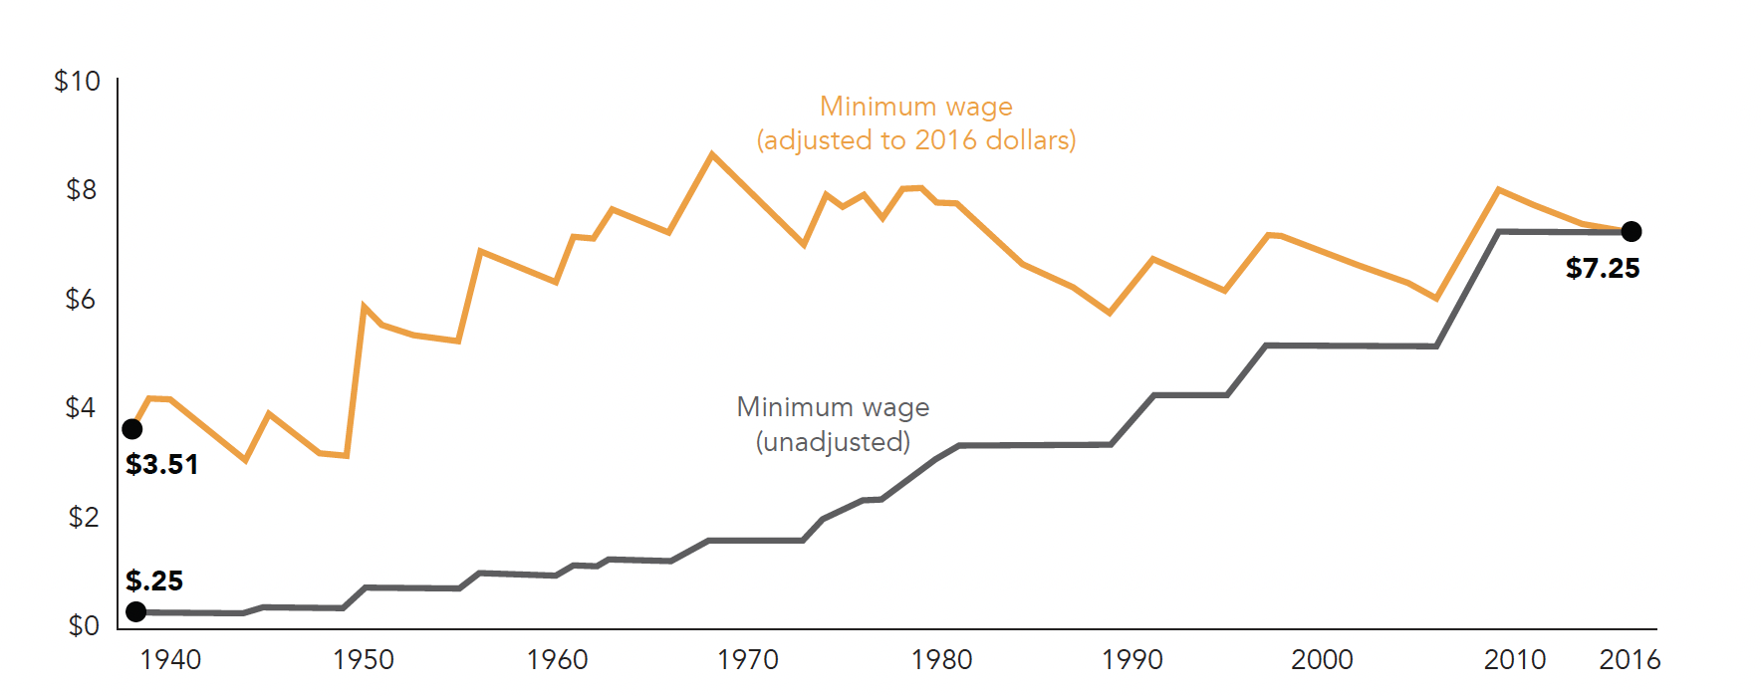
Federal Minimum Wage
(Nominal and Real), 1938–2016
Section: Understanding the Issue of Livelihood, cont’d
Consider the purchasing power of the hourly minimum wage over time (adjusted to 2016 dollars). In what year did people get the most income in terms of what they could buy with it?
From The VOTE Textbook Second Edition Copyright © 2023

Slide 24
Polling Question
Real versus Nominal Minimum Wage
In what year did people get the most income in terms of what they could buy with it?
1938
1969
1990
2010
From The VOTE Textbook Second Edition Copyright © 2023

Slide 25

Note: We present each perspective as if we wholeheartedly agree with it. We do this on purpose to present each point of view in its best light, but please imagine each time that we are wearing a mask—as if we are actors playing three different roles.
From The VOTE Textbook Second Edition Copyright © 2023

Slide 26
R
Section: Voices on Livelihood, cont’d
adical
Democratic Socialism
Livelihood
Poverty is baked into the system of capitalism because there are only two choices anyone gets with private ownership: exploit or be exploited.
From The VOTE Textbook Second Edition Copyright © 2023

Slide 27
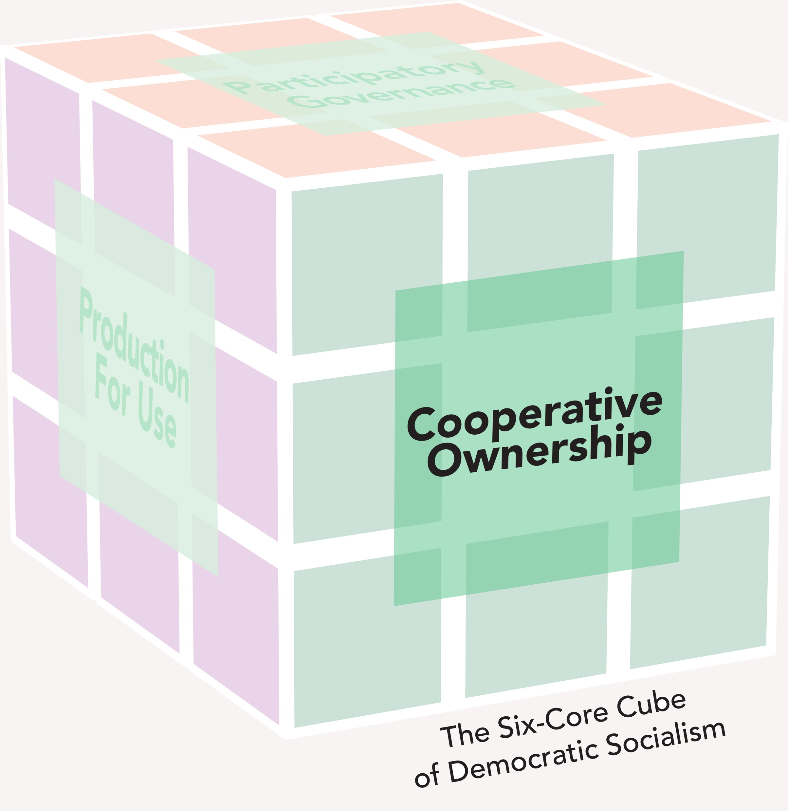
R
Section: Voices on Livelihood, cont’d
adical
Democratic Socialism
Livelihood
BIG PICTURE
When workers own the means of production and use democratic processes to
make decisions, it ensures that everyone can earn a decent livelihood.
POLICY POSITION
Poverty causes suffering and deprivation, but...
Conservative policies lead to more poverty because survival in
capitalism depends on increasing rates of workplace exploitation
and a reserve army of the unemployed.
Liberal policies may lessen the theft—barely—but don’t fix
the underlying problem, and they leave workers with the false
belief that this is as good as it gets.
SOLUTION
Replace minimum wage legislation in capitalism with worker-owned
business incubators in democratic socialism to end poverty:
Support new enterprises to build the economy.
Generate wealth to alleviate everyone’s financial burdens.
From The VOTE Textbook Second Edition Copyright © 2023

Slide 28
Section: Voices on Livelihood, cont’d
Livelihood Talking Points: Radical
1. Across industries and in every community, cooperative ownership enables people to earn a decent living. We are the ones who benefit from the fruits of our own labor because we own it together. At the end of the month, after the firm’s bills are paid, there is more profit to share fairly among worker-owners. That means we can all earn a decent livelihood, create a better quality of life for ourselves and our families, and give back to our communities.
2. With cooperative ownership, we get more than a paycheck. We get a real say in what goes on at work, from how much we earn to what benefits we get. We decide together how the firm is run and the ways we want our companies to impact our community and the planet. We don’t have to worry that when we improve our business with the latest artificial intelligence it will put people’s jobs at risk. Our goal is to make life better for ourselves and for our whole society.
3. Conservatives, once again you try to sell us your free-market fantasy of the labor market, but every day in capitalism, private owners steal from their workers. And those low-skilled workers have no choice but to put up with this theft and spend their lives laboring for low pay and no benefits. And you do whatever is necessary to increase the rate of exploitation. You love to point the finger at imaginary “freeloaders” in democratic socialism, but capitalism is a system of freeloaders who live off the sweat of hardworking people.
4. Owners exploit workers because it brings them profit, and when we leave it alone, as conservatives want to do, then those owners have no constraints. When they buy new machines and productivity goes up, workers’ wages don’t. Then, because of those new machines, owners lay off workers and create a reserve army of the unemployed. While workers scramble to compete for the few jobs that remain, wages are driven down even more. Every way you look at it, the workers are the losers in free-market capitalism.
5. Liberals, you want to be the good guys who fight for a better livelihood for workers by pushing for a higher minimum wage. But the problem isn’t how much the hourly wage is; the problem is that the whole system of capitalism is based on private owners exploiting workers. A higher minimum wage won’t solve that. Minimum wage may limit the amount owners can steal, but the stealing continues. All you’re doing is trying to give us a slightly more palatable way to package the theft.
6. The minimum wage creates a dangerous illusion that all it takes to solve poverty is a few more dollars in workers’ paychecks. This keeps us from making the real changes that would eliminate poverty. It keeps workers’ bellies filled just enough so that they will go back to work the next day. And in our global economy, firms do an end-run around the minimum wage and move jobs to countries where labor is cheaper. Fair-market capitalism is a contradiction. There’s no fairness with workplace exploitation.
7. Worker-owned business incubators make it possible for more worker-owned firms to launch, and they help firms succeed by giving them technical and financial support—loans, mentoring, grants, research on best practices, and so forth. Through cooperative ownership, people enjoy the fruits of their own labor and prosper. Our tax dollars fund the incubators because our whole society benefits when entrepreneurs bring their new innovations to market and when businesses thrive.
8. By supporting more people in forming successful cooperatively owned enterprises, we raise everyone’s standard of living because a portion of the surplus that’s generated by every firm pays for everyone’s well-being—health care, higher education, transportation, and so forth. Sharing responsibility for these high-cost goods and services establishes the foundation of well-being across the nation: opportunities to prosper and freedom from worry about meeting our material needs.
From The VOTE Textbook Second Edition Copyright © 2023

Slide 29
C
Section: Voices on Livelihood, cont’d
onservative
Free-Market Capitalism
Livelihood
Government handouts and artificially inflated wages create a perfect storm of disincentives that keep people trapped in poverty.
From The VOTE Textbook Second Edition Copyright © 2023

Slide 30
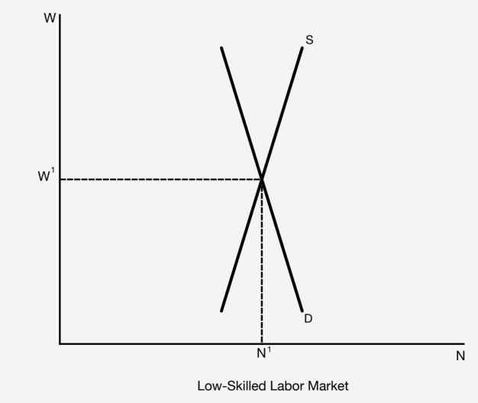
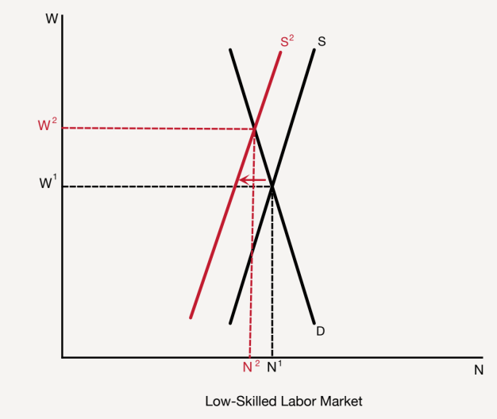
C
Section: Voices on Livelihood, cont’d
onservative
Free-Market Capitalism
Livelihood
BIG PICTURE
Through free-market capitalism and the profit motive, people follow price
signals and have incentives to make choices that allow them to prosper.
POLICY POSITION
Poverty causes suffering and deprivation, but...
Liberal policies make poverty worse by creating higher unemployment,
driving up prices, and forcing firms to go under.
Radical policies sap motivation to work hard, which
means nothing gets produced, and waste tax dollars
on enterprises that are doomed to fail.
SOLUTION
Reject minimum wage legislation and replace it with
free-market wages to end poverty:
People are motivated to move up the ladder.
Livable wages arise naturally.
From The VOTE Textbook Second Edition Copyright © 2023

Slide 31
Section: Voices on Livelihood, cont’d
Livelihood Talking Points: Conservative
1. Poverty solves itself when markets are free from government meddling. When the price signal for low-skilled work is free from interference, those who can do higher-skilled work are motivated to make choices that put them in a position to earn a better livelihood. They finish their education, learn marketable skills, work hard, and apply for better-paying jobs. They work their way up the ladder to prosperity.
2. We’ll always need low-skilled workers, and there are people whose skill levels are appropriate for low-skilled jobs. When the price for wages is left alone, the people who weren’t appropriate for those jobs leave the market. This is good because they shouldn’t have been in that market in the first place. We should let wages adjust naturally to where they should have been all along. Then people who belong in the low-skilled job market can finally earn a decent livelihood.
3. When you see a bird that looks hungry, you feel sorry for it, and you feed it. It seems like you’re doing the compassionate thing. But then what happens? The bird becomes dependent on your bird feeder and stops using its own innate abilities to find worms and seeds to feed itself. It becomes impoverished. Liberals, this is exactly what you do when you make low-skilled workers dependent on handouts and policies that supposedly protect them. You demotivate them and in the process leave them stranded in poverty.
4. The minimum wage jacks up employers’ costs so firms have to lay off workers or go out of business. Either way, we get more unemployment. Ouch. And now those firms have to raise the prices of their products because they’re paying higher wages. Cost of living goes up. Double ouch. So the great idea liberals have to solve poverty leaves people unemployed and paying more for everything. This is what they always do— attempt to solve a problem with government meddling and end up making things worse.
5. We all want to create wealth, but trading private ownership and wage labor for cooperative ownership means that some people coast along and grab a free ride on the backs of diligent, hardworking people. And those hard workers don’t want to be suckers, so they eventually stop working hard because why should they break a sweat if no one else is? Radicals, you poison the whole work ethic because in democratic socialism no one is motivated and nothing gets done.
6. Worker-owned business incubators are government-funded committees that use our tax dollars to fund start-ups. Here’s the problem with this idea: I won’t be dedicated to the success of my cooperatively owned business because it’s not my money I’m risking. So when my new enterprise fails because none of us really knows what we’re doing, it takes us forever to vote on every decision, and we have no expert at the helm, we’ll just go back to the committee and let the community fund our next dead-end idea.
7. Here’s why the free market is our only viable solution for people to make a good living. In the low-skilled labor market, the wage isn’t set by a government bureaucrat. It’s determined by the reality of supply and demand. That’s great news because it means everyone who wants a job gets a job at whatever wage naturally emerges. Those who stay in the low-skilled labor market finally can earn a decent wage, while others use it as the first step on the ladder to better opportunities.
8. When we pursue our self-interest in a system of private ownership and unregulated markets, we get the best outcomes. People are motivated to move up from the low-skilled labor market and use their talents and skills to bring the world inventions and innovations that make everyone better off. We get entertainment that moves and engages us, beautiful buildings where we can live and work, and everything else we want. People are guided to make decisions that improve their own well-being and also enrich the whole society.
From The VOTE Textbook Second Edition Copyright © 2023

Slide 32
L
Section: Voices on Livelihood, cont’d
iberal
Fair-Market Capitalism
Livelihood
It’s wrong that some people work day and night but stay stuck in poverty. With the help of government, everyone has a chance to succeed.
From The VOTE Textbook Second Edition Copyright © 2023

Slide 33
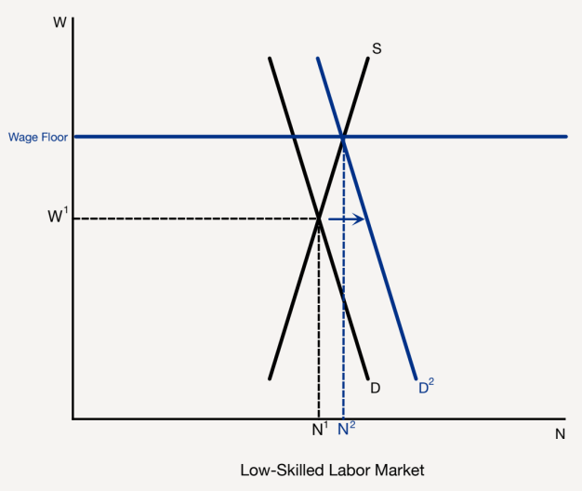

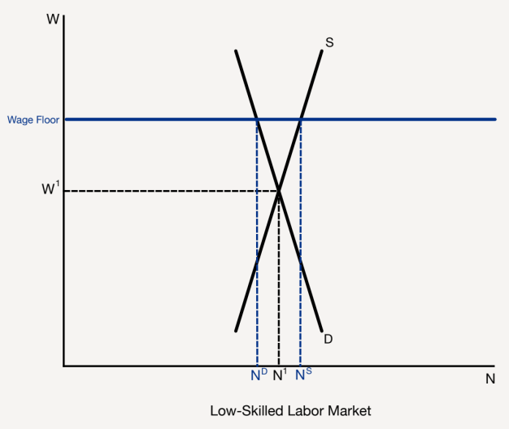
L
Section: Voices on Livelihood, cont’d
iberal
Fair-Market Capitalism
Livelihood
BIG PICTURE
When workers earn a decent living, they are able to buy the things they need,
and with increased demand, firms hire more workers, so more people thrive.
POLICY POSITION
Poverty causes suffering and deprivation, but...
Radical policies squelch entrepreneurial drive and impoverish
the whole society, while firms flounder and workers stagnate.
Conservative policies exacerbate poverty because working
people stay poor and firms go under when people can’t buy
their products.
SOLUTION
Strengthen minimum wage legislation to end poverty:
Raise it to a living wage.
Boost the whole economy.
From The VOTE Textbook Second Edition Copyright © 2023

Slide 34
Section: Voices on Livelihood, cont’d
Livelihood Talking Points: Liberal
1. Have you ever waited tables at a diner on a Sunday morning? Have you ever mowed lawns and trimmed trees at a resort? Have you ever cleaned motel rooms? Those jobs require hard work, focus, and expertise, but we dismiss them as “low-skilled” and don’t pay those workers a decent wage. Nobody who works full time should be living in poverty. The term working poor should be an oxymoron. Low-skilled workers deserve our thanks and should be paid a living wage.
2. Do you want to know how to end poverty? Guarantee all workers a living wage. That will lift millions of people out of poverty. And getting more money to low-income people stimulates the economy because they have so many material needs that they spend the money in their pockets right away. The boost in demand helps business and circles back around to workers when firms expand and start hiring. A living wage means more jobs, and more jobs mean more prosperity for all.
3. Radicals, you want to throw out the very thing that solves poverty, which is fair-market capitalism. Democratic socialism won’t generate wealth, because the entrepreneurs who bring us the new ideas that become tomorrow’s economic drivers have no motivation to spend years tinkering in the garage or toiling in the lab to perfect a new design. With cooperative ownership the rewards of genius, talent, and effort are shared with people who didn’t do all that hard work.
4. The radical policy of worker-owned business incubators has a major flaw. When people with no expertise are handed a voting share of the company, businesses fail. This problem can’t be fixed because in democratic socialism, firms aren’t allowed to hire wage laborers, so workers can’t get experience. Radicals prevent people from gaining the skills that could become the stepping stones to improving their lives and adding value to firms.
5. Conservatives blame the poor for being unmotivated to improve their lives. It’s naïve to think a person can just move into a better-paying job overnight. Have you looked at the price of tuition lately? How will they pay their bills while they’re in school? Most of the working poor have few options, which is why they get stuck in low-wage work. The free-market approach makes the odds worse that they’ll ever be able to work their way up to a decent livelihood.
6. When people are stuck in poverty because they can’t earn a fair wage, the whole economy suffers. Conservatives, you shoot yourselves in the foot by opposing the minimum wage because when people have no money in their pockets, businesses don’t thrive. Firms have to lay off more workers or go belly-up. So then we end up with higher rates of poverty. Once again, your idea to do nothing puts our whole economy at risk.
7. Strengthening minimum wage legislation is the best way to help people rise out of poverty. It’s a lifeline for motivated people who are struggling to earn a decent living and make their lives better. People who work forty hours or more a week at low-skilled jobs should, at the very least, be able afford the basic necessities of life for themselves and their families. By raising the minimum wage to a living wage, this becomes possible. It is the right and fair policy for our country.
8. We end the travesty of the “working poor” by expanding the minimum wage so there are no longer any exceptions—it includes commissioned salespeople, tipped workers, farm workers, and others. This policy is good for individuals, families, and businesses because all can prosper. We get more money into the pockets of low-income people, businesses expand, and people have more opportunities to rise out of poverty. This is how we create the optimal conditions for our whole nation to thrive.
From The VOTE Textbook Second Edition Copyright © 2023

Slide 35

Section: The Shared Outcome
Now you’ve heard the arguments from all three perspectives.
They all share the goal of achieving an
end to poverty.
It’s time for you to join the conversation!
From The VOTE Textbook Second Edition Copyright © 2023

Slide 36

Section: Activity: Skit
Livelihood Activity: Skit
“All the World’s a Stage”
From The VOTE Textbook Second Edition Copyright © 2023

Slide 37
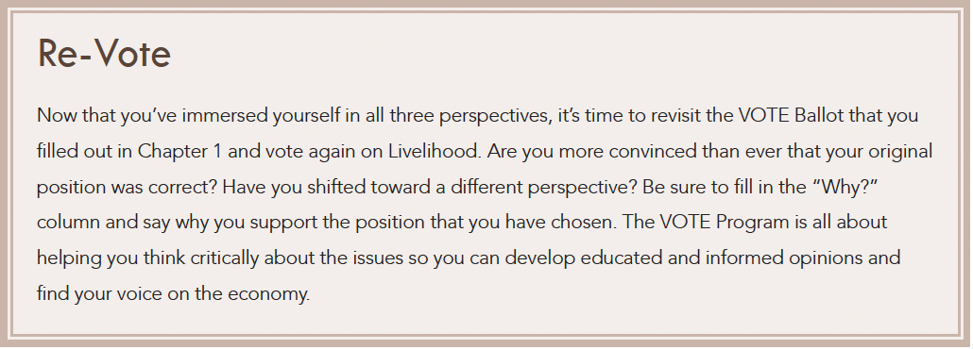
Section: Activity: Skit
Livelihood: Re-Vote
From The VOTE Textbook Second Edition Copyright © 2023

Slide 38

Chapter 11
Check out the book for more!
Test Yourself • Key Terms • Answer Key
From The VOTE Textbook Second Edition Copyright © 2023

