Slide 1
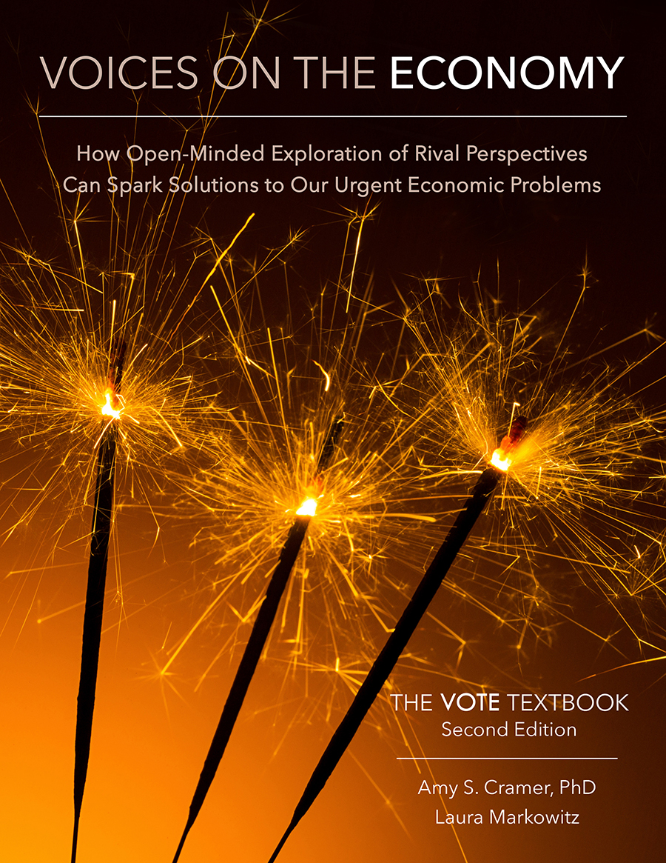
From The VOTE Textbook Second Edition Copyright © 2023

Slide 2


From The VOTE Textbook Second Edition Copyright © 2023
Notes:
2

Slide 3
From The VOTE Textbook Second Edition Copyright © 2023
Notes:
3

Slide 4
The VOTE Textbook Chapters
From The VOTE Textbook Second Edition Copyright © 2023
Notes:
4

Slide 5
1
2
3
4
5
6
7
8
9
10
11
12
13
14
15
16
17
18
19
20
21
From The VOTE Textbook Second Edition Copyright © 2023
Notes:
5

Slide 6

From The VOTE Textbook Second Edition Copyright © 2023

Slide 7


Opening Story: Is it wrong to steal life-saving medicine?
There are many ways people think about right and wrong and many gray areas that require nuanced thinking.
The goal here is not to get to agreement; it’s to understand what other people have to say and why they see the world the way they do.
From The VOTE Textbook Second Edition Copyright © 2023
Notes:
7

Slide 8
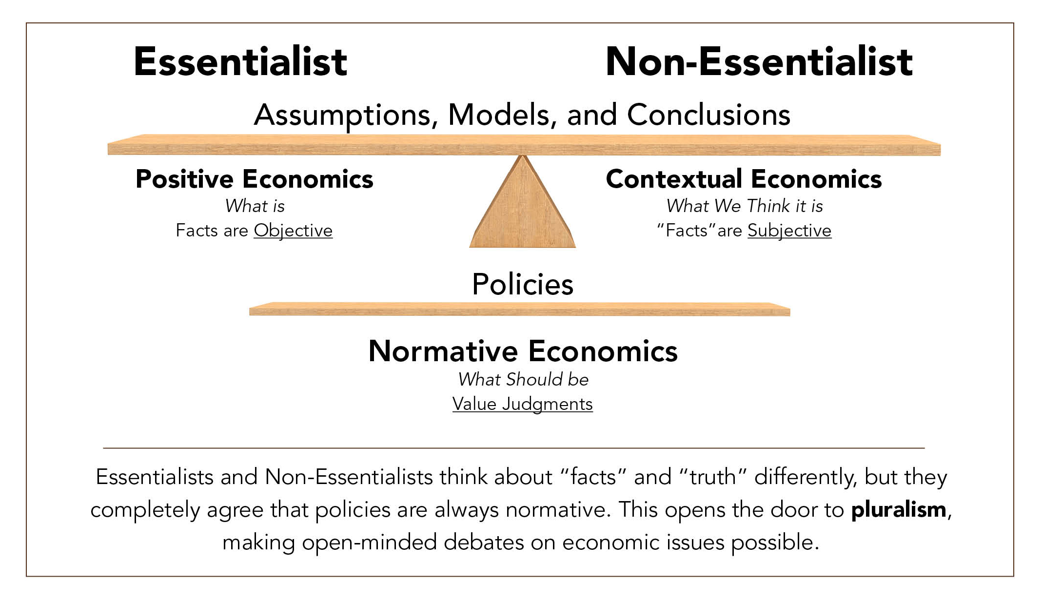

Section: Facts or Value Judgments?
But there is a stumbling block to having constructive conversations among rival perspectives. What is it? We addressed it in Chapter 3:
the different perceptions of “truth” and “facts.”
“8 percent of Americans go to
bed hungry every night.”
“What is meant by ‘hunger’? How was it measured? What questions were asked?”
* Please remember that people from any perspective may be essentialist or non-essentialist thinkers.
From The VOTE Textbook Second Edition Copyright © 2023

Slide 9

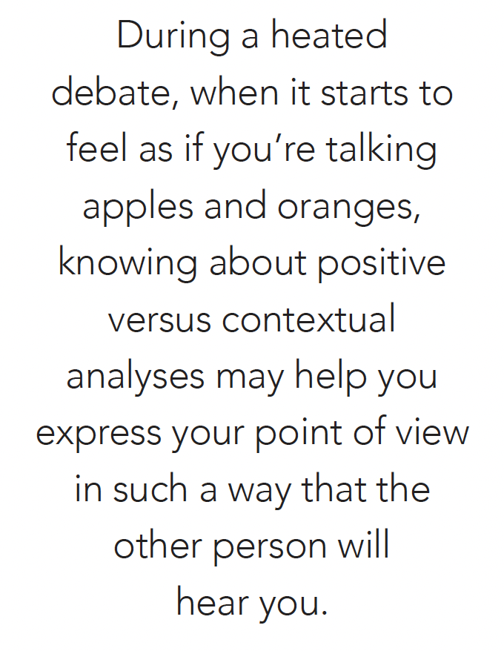
Section: Facts or Value Judgments?, cont’d
From The VOTE Textbook Second Edition Copyright © 2023

Slide 10
Section: Facts or Value Judgments?, cont’d
The ongoing debate about facts and truth is a speed bump, not a barrier, to pluralism because we all agree that policies (“What should we do?”) are based on value judgments.
“8% of Americans go to
bed hungry every night.”
“What is meant by hunger, how was is measured, what questions were asked.”
What should we do about hunger?
What should we do about hunger?
From The VOTE Textbook Second Edition Copyright © 2023

Slide 11
Section: Facts or Value Judgments?, cont’d
The ongoing debate about facts and truth is a speed bump, not a barrier, to pluralism because we all agree that policies (“What should we do?”) are based on value judgments.
“8% of Americans go to
bed hungry every night.”
“What is meant by hunger, how was is measured, what questions were asked.”
What should we do about hunger?
What should we do about hunger?
From The VOTE Textbook Second Edition Copyright © 2023

Slide 12
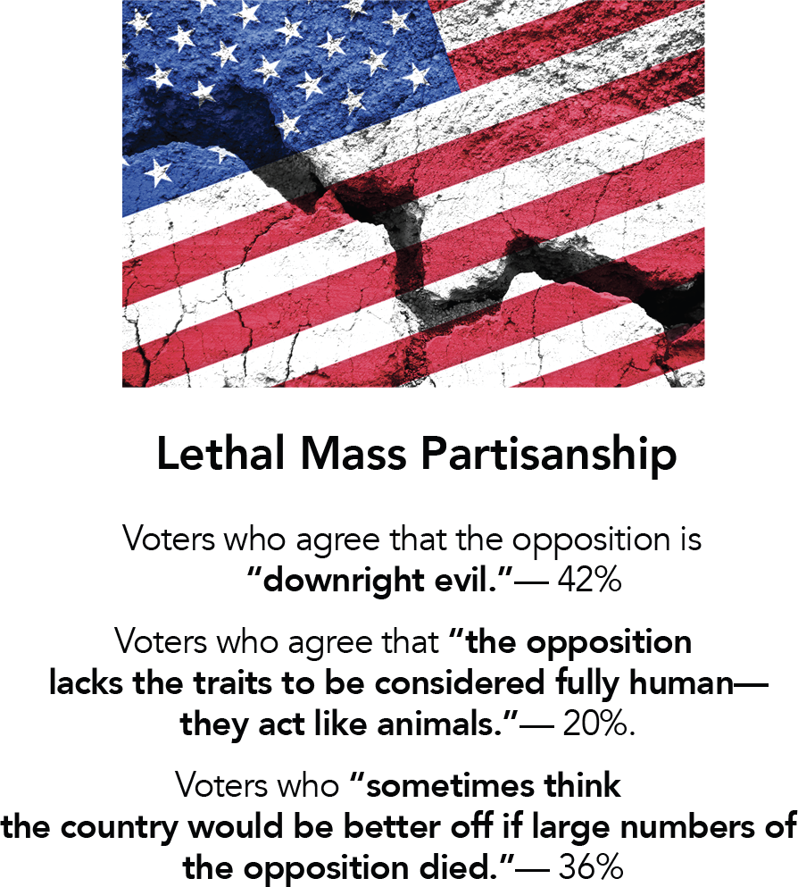
Section: Civil Discourse
It’s a challenge to engage in civil discourse—respectful conversations intended to enhance understanding—instead of retreating or attacking out of fear, moral outrage, or self-righteousness.
This is an alarming study from 2016.
In your opinion, has partisanship gotten better or worse since that time?
From The VOTE Textbook Second Edition Copyright © 2023

Slide 13

Section: Civil Discourse, cont’d
Diversity of ideas is a gift of democracy. We need different ways of thinking to intermingle and recombine to bring us new resilience, strength, and wisdom.
When a seed of an idea from someone else drifts into your mind, it could potentially blossom into a solution that the world needs.
From The VOTE Textbook Second Edition Copyright © 2023

Slide 14


Section: Civil Discourse, cont’d
Shared Tools
Civil Discourse
for all three perspectives
From The VOTE Textbook Second Edition Copyright © 2023

Slide 15
Section: Six Guidelines for Civil Discourse
Six Guidelines for Civil Discourse
Listen Thoughtfully
  Try to focus on really understanding what they are saying, even if you think you already know.
Critique Issues, Not Individuals
Don’t make it personal. You don’t have to like the other person to give their ideas a fair hearing.
Use Your Biofeedback
Be mindful of your physical and emotional reactions and remember to breathe.
From The VOTE Textbook Second Edition Copyright © 2023

Slide 16
Section: Six Guidelines for Civil Discourse, cont’d
Six Guidelines for Civil Discourse, cont’d
Remember That Empathy Helps
Remember that just as it was hard for you to hear their ideas, they may have a hard time hearing yours.
Aim for Peaceful Persuasion
Don’t be threatening or abusive. It won’t help you convert anyone to your way of thinking.
Be Open-Minded
Allow curiosity and try not to make assumptions. You might discover common ground or a great new idea.
From The VOTE Textbook Second Edition Copyright © 2023

Slide 17
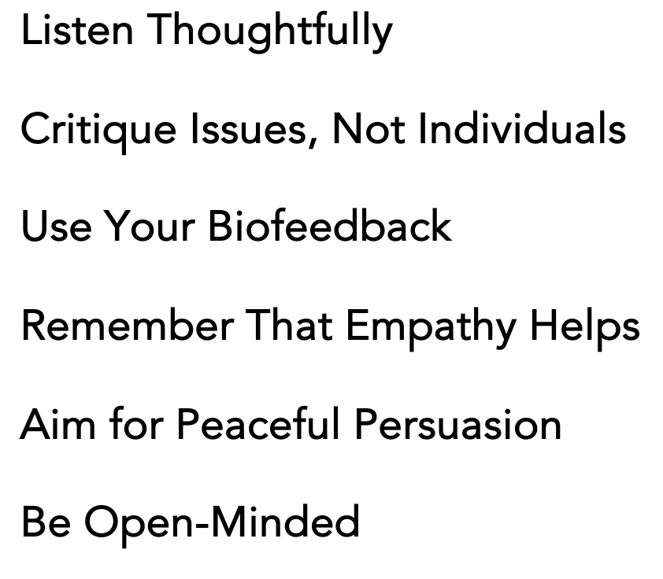

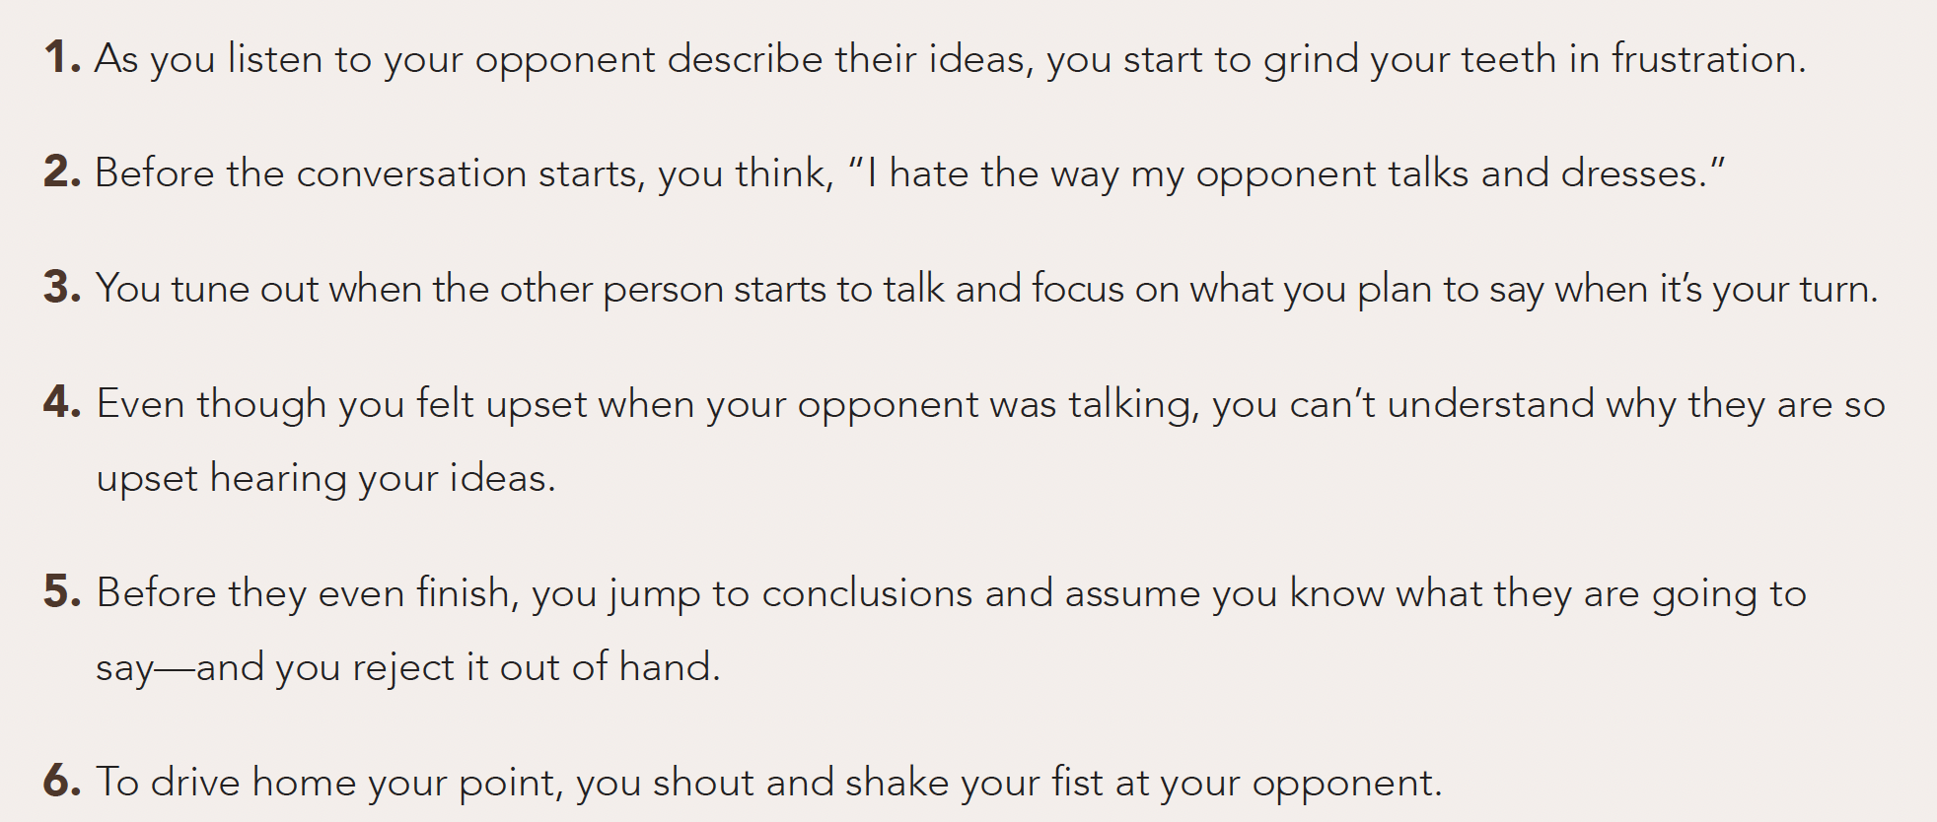

Exercise 10.1: Six Guidelines for Civil Discourse, cont’d
Exercise: Keep It Civil, cont’d
Choose the guideline that is most helpful to create civil discourse in each of the following situations.
From The VOTE Textbook Second Edition Copyright © 2023

Slide 18
Polling Question
Civil Discourse
Which civil discourse guideline best fits this description:
As you listen to your opponent describe their ideas, you start to grind your teeth in frustration.
Listen Thoughtfully
Critique Issues, Not Individuals
Use Your Biofeedback
Remember That Empathy Helps
Aim for Peaceful Persuasion
Be Open-Minded
From The VOTE Textbook Second Edition Copyright © 2023

Slide 19
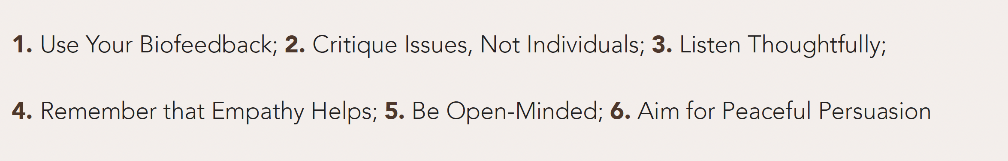
Exercise 10.1: Six Guidelines for Civil Discourse, cont’d
Exercise: Keep It Civil, cont’d
Choose the guideline that is most helpful to create civil discourse in each of the following situations.
From The VOTE Textbook Second Edition Copyright © 2023

Slide 20
Exercise 10.1: Six Guidelines for Civil Discourse, cont’d
Exercise: Keep It Civil, cont’d
Choose the guideline that is most helpful to create civil discourse in each of the following situations.
From The VOTE Textbook Second Edition Copyright © 2023

Slide 21
Exercise 10.1: Six Guidelines for Civil Discourse, cont’d
Exercise: Keep It Civil, cont’d
Choose the guideline that is most helpful to create civil discourse in each of the following situations.
From The VOTE Textbook Second Edition Copyright © 2023

Slide 22
Exercise 10.1: Six Guidelines for Civil Discourse, cont’d
Exercise: Keep It Civil, cont’d
Choose the guideline that is most helpful to create civil discourse in each of the following situations.
From The VOTE Textbook Second Edition Copyright © 2023

Slide 23
Exercise 10.1: Six Guidelines for Civil Discourse, cont’d
Exercise: Keep It Civil, cont’d
Choose the guideline that is most helpful to create civil discourse in each of the following situations.
From The VOTE Textbook Second Edition Copyright © 2023

Slide 24
Exercise 10.1: Six Guidelines for Civil Discourse, cont’d
Exercise: Keep It Civil, cont’d
Choose the guideline that is most helpful to create civil discourse in each of the following situations.
From The VOTE Textbook Second Edition Copyright © 2023

Slide 25
Exercise 10.1: Six Guidelines for Civil Discourse, cont’d
Six Guidelines for Civil Discourse
Listen Thoughtfully
Critique Issues, Not Individuals
Use Your Biofeedback
Remember That Empathy Helps
Aim for Peaceful Persuasion
Be Open-Minded
From The VOTE Textbook Second Edition Copyright © 2023

Slide 26
Section: Conventional Theory Tools
Conventional Theory Tools
(Conservative and Liberal)
Price Controls and Elasticity
* These tools are built on the foundation presented in Chapter 5.
From The VOTE Textbook Second Edition Copyright © 2023

Slide 27
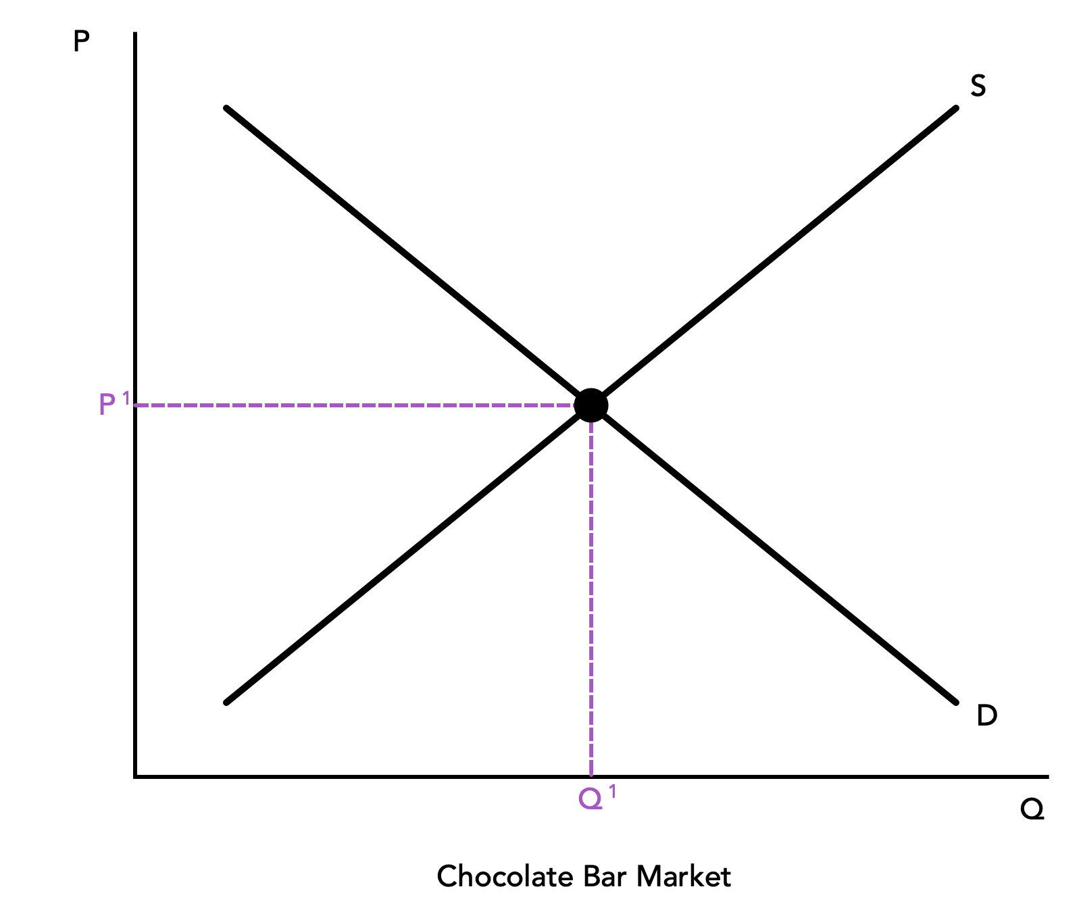
Section: Conventional Theory Tools, cont’d
  Practice: Draw the six components of the Chocolate Bar Market graph.
(1)
(4)
(5)
(3)
(2)
(6)
Chocolate Bar Market
From The VOTE Textbook Second Edition Copyright © 2023

Slide 28
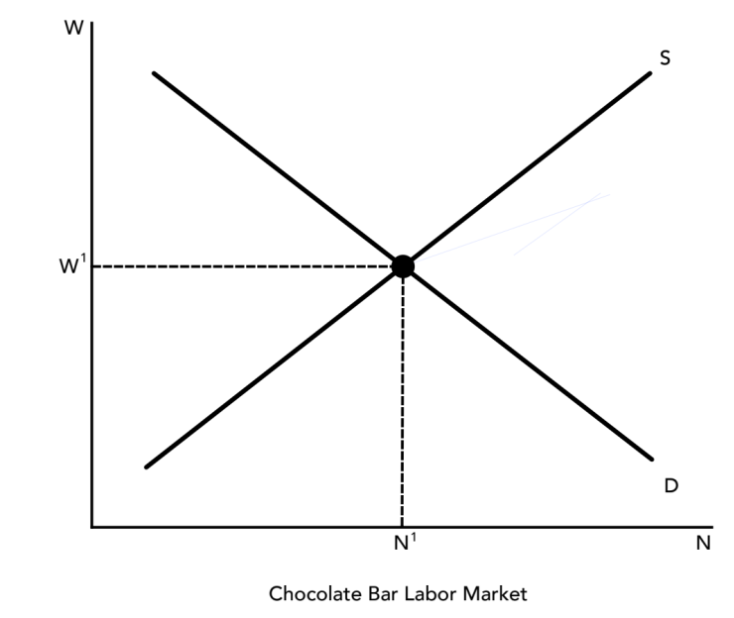
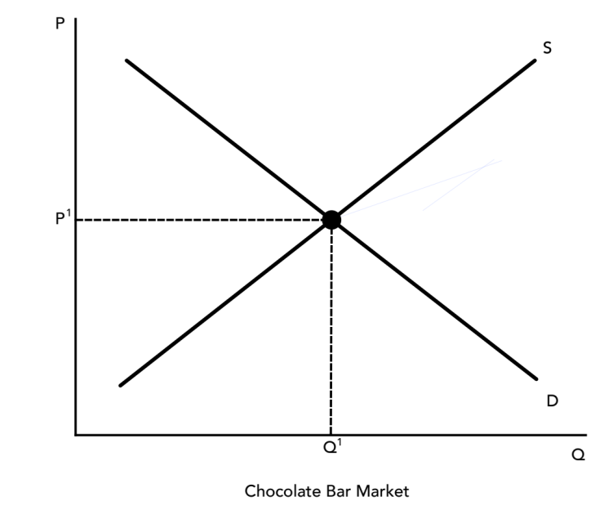
Section: Conventional Theory Tools, cont’d
  Input Markets versus Output Markets
  Input Market
  Output Market
  (Markets for land, labor, and capital)
  (Markets for final goods and services)
  W = Wage (Price of Labor)
  N = Number of Workers (Quantity)
  Demanders are firms
  Suppliers are workers
  P = Price of Chocolate Bars
  Q = Quantity of Chocolate Bars
  Demanders are individuals
  Suppliers are firms
From The VOTE Textbook Second Edition Copyright © 2023

Slide 29
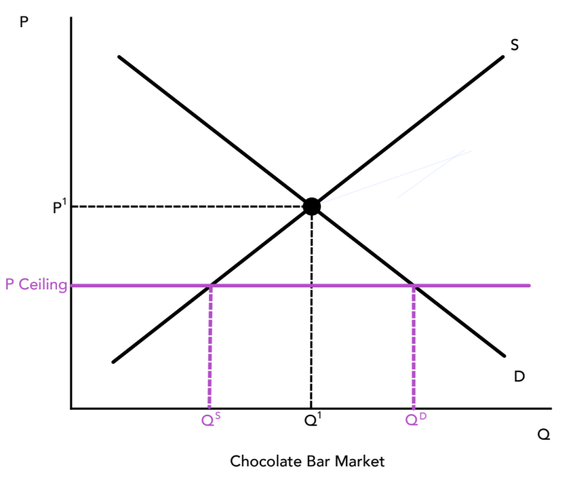
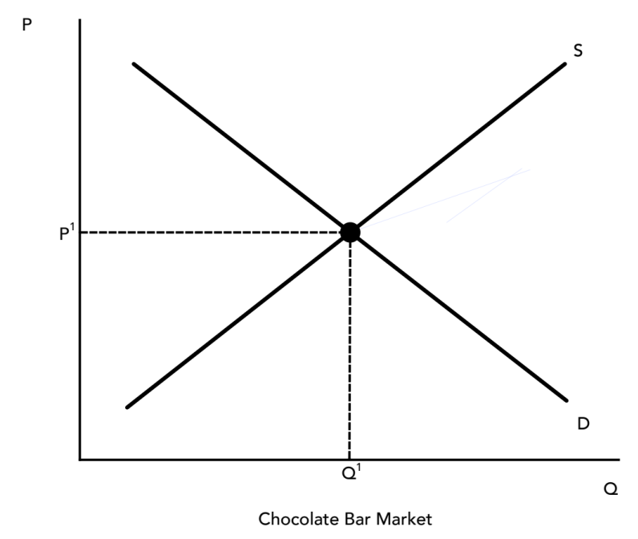

Section: Conventional Theory Tools, cont’d
Price Controls
Price Ceiling
It’s a legally established maximum price that a seller can charge. (Tends to cause a shortage.)
For example, lawmakers might want to motivate more people to eat chocolate after a study comes out linking chocolate consumption to higher intelligence.
From The VOTE Textbook Second Edition Copyright © 2023

Slide 30
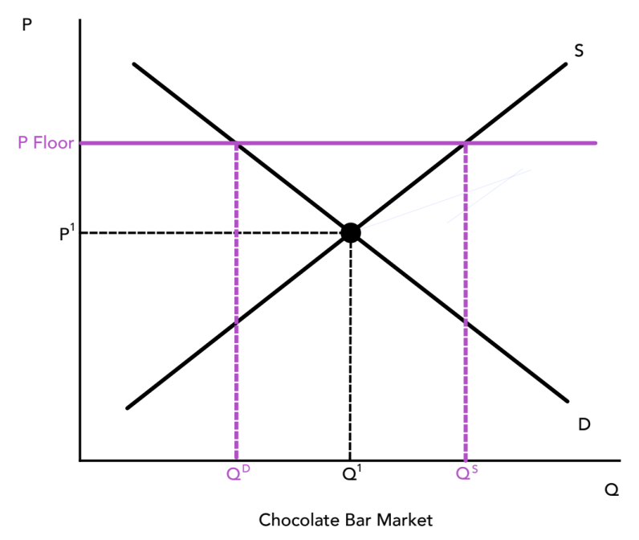
Section: Conventional Theory Tools, cont’d
Price Controls, cont’d
Price Floor
It’s a legally established minimum price that a seller can be paid. (Tends to cause a surplus.)
For example, lawmakers might want to push people out of the chocolate bar market because of the proven relationship between chocolate consumption and obesity.
From The VOTE Textbook Second Edition Copyright © 2023

Slide 31
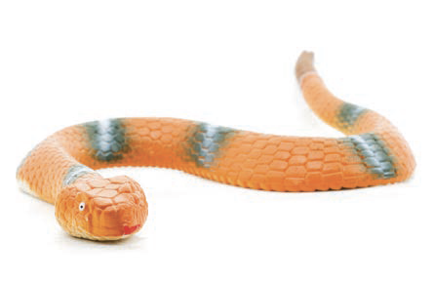
Section: Conventional Theory Tools, cont’d
Elasticity
Sensitivity or responsiveness to changes
This rubber snake is stretchy. We say it is elastic when it gets stretched between two people. A hard plastic snake is not stretchy. We say it is inelastic because it doesn’t respond when two people try to stretch it.
From The VOTE Textbook Second Edition Copyright © 2023
Notes:
31

Slide 32
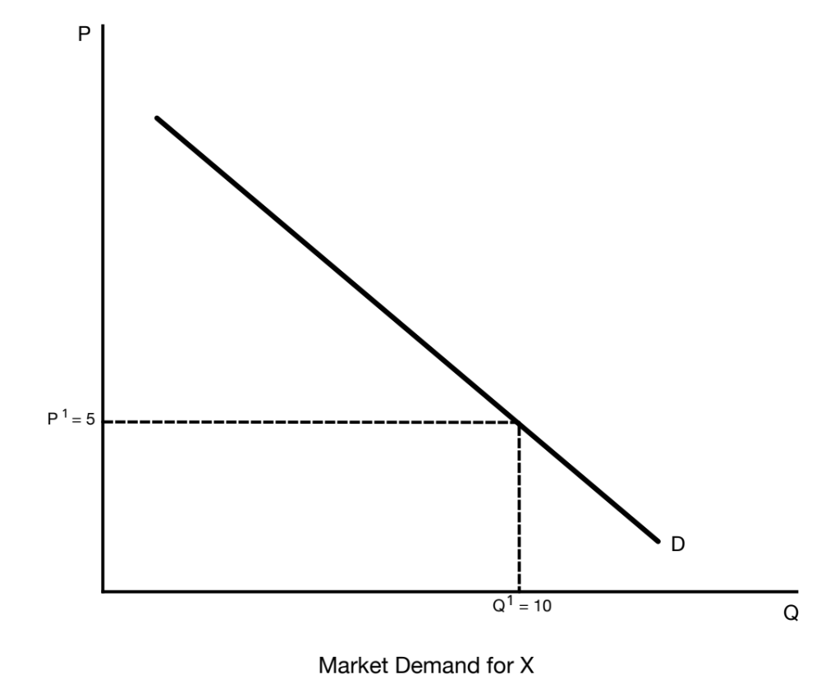
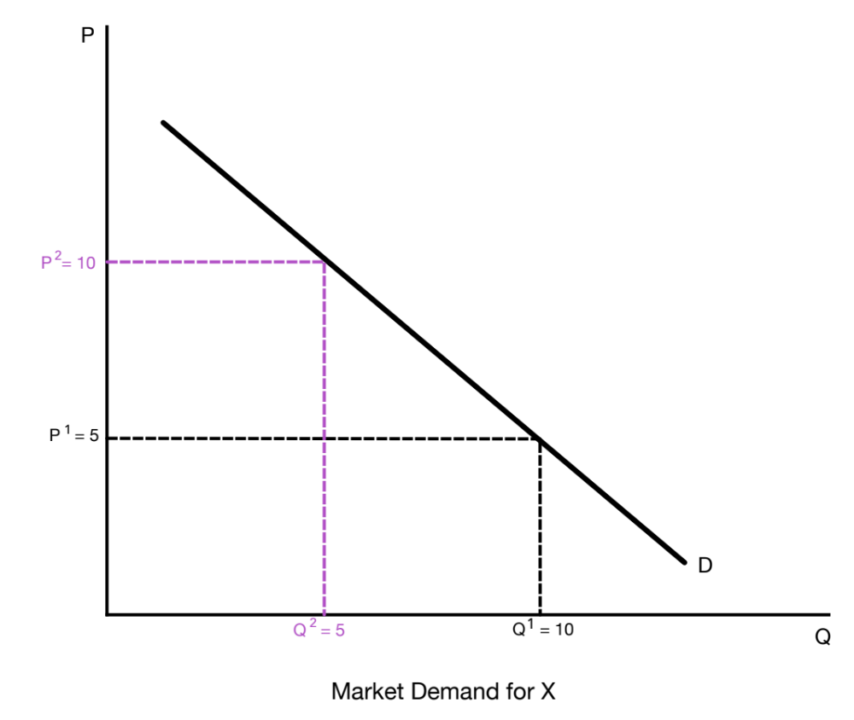
Section: Conventional Theory Tools, cont’d
Price Elasticity of Demand
Sensitivity of quantity demanded to a change in the price.
Why do we need elasticity when we already have slope?
Slope tells us that when price goes up, quantity demanded goes down. Elasticity tells us by how much.
From The VOTE Textbook Second Edition Copyright © 2023

Slide 33

Section: Conventional Theory Tools, cont’d
Soliris is one of the most expensive medications ever sold. It treats a type of anemia that affects fewer than 8,000 Americans, and at one point cost each patient $678,000 per year.
When the price went up, if it were a matter of life or death, would you buy it anyway?
Most people would. That means the price elasticity of demand is inelastic (meaning when the price goes up, people buy it anyway).
From The VOTE Textbook Second Edition Copyright © 2023

Slide 34
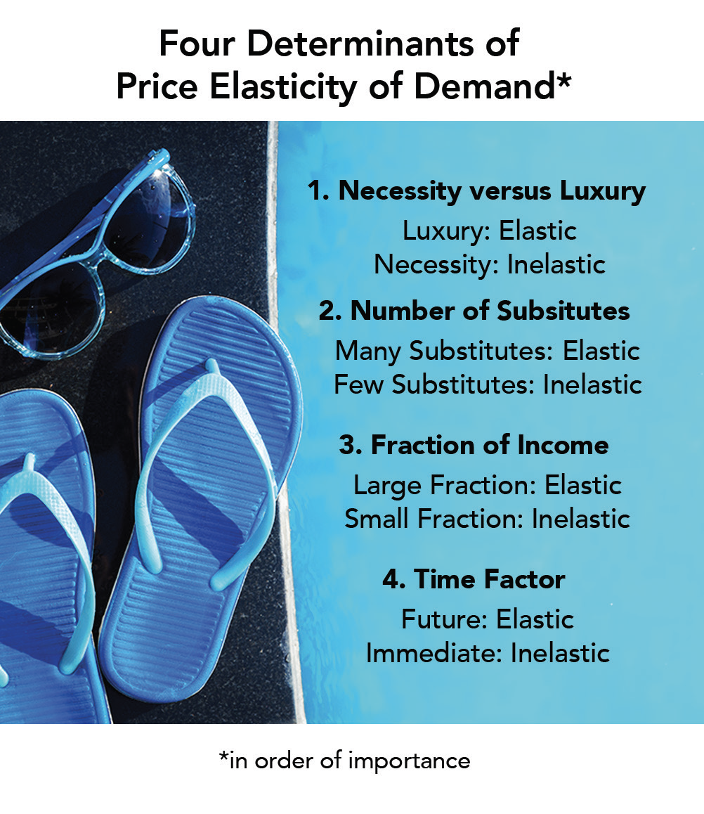

Section: Conventional Theory Tools, cont’d
From The VOTE Textbook Second Edition Copyright © 2023

Slide 35
Polling Question
Elasticity
If the product is a necessity, it is __________; if the product is a luxury, it is __________.
elastic; inelastic
elastic; elastic
inelastic; elastic
inelastic; inelastic
From The VOTE Textbook Second Edition Copyright © 2023

Slide 36
Section: Conventional Theory Tools, cont’d
From The VOTE Textbook Second Edition Copyright © 2023

Slide 37
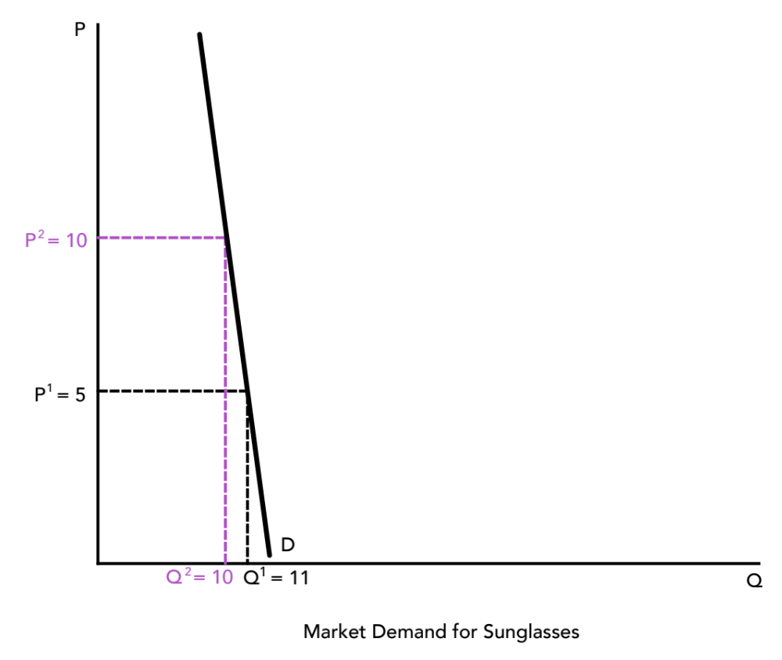
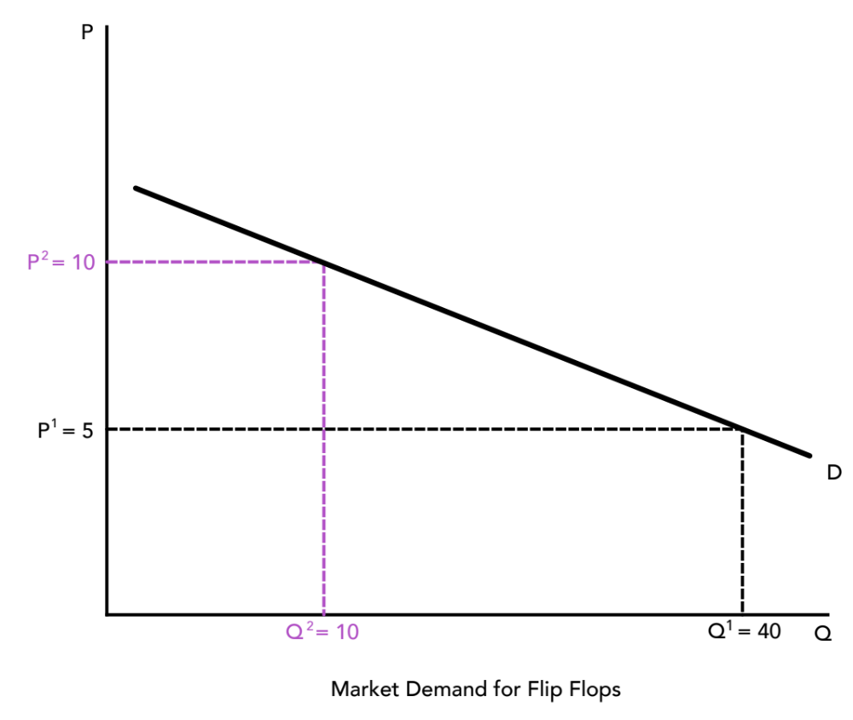
Section: Conventional Theory Tools, cont’d
Which of these is elastic? Which is inelastic?
(When price increases, which will you BUY ANYWAY?)
You’ll Buy It Anyway!
Inelastic (Steeper D)
Elastic (Flatter D)
From The VOTE Textbook Second Edition Copyright © 2023

Slide 38
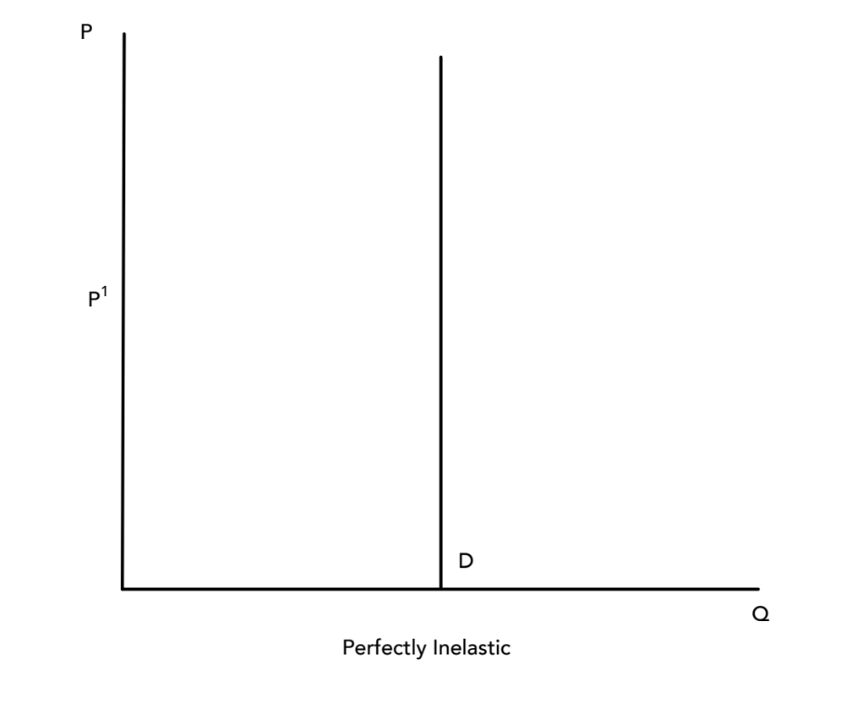
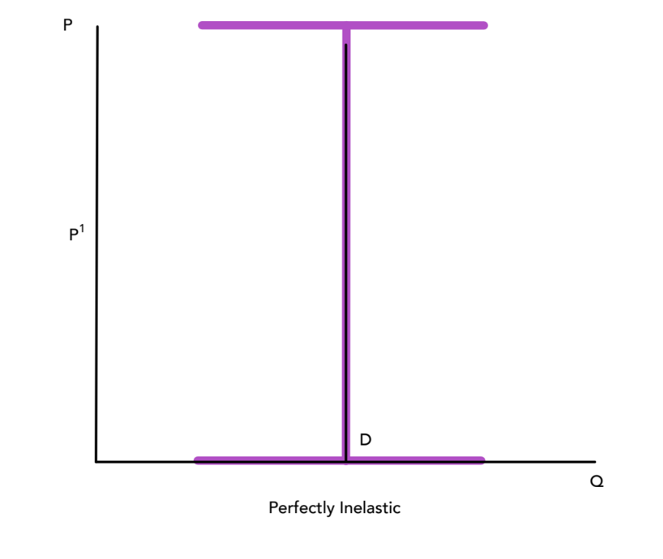
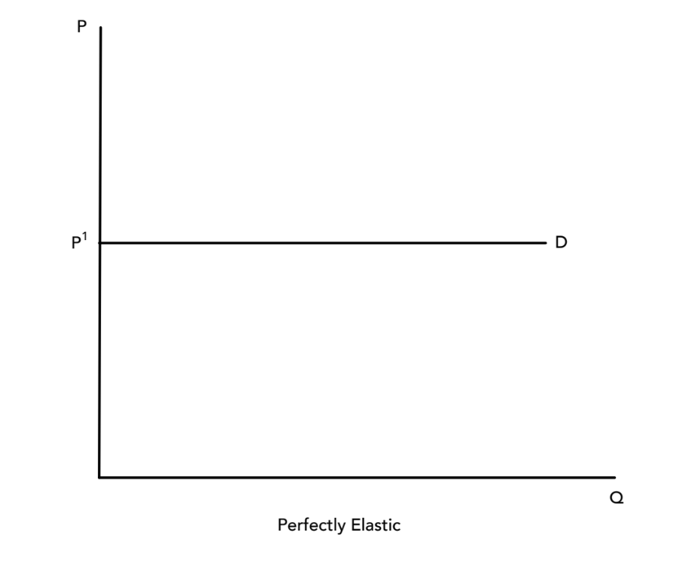
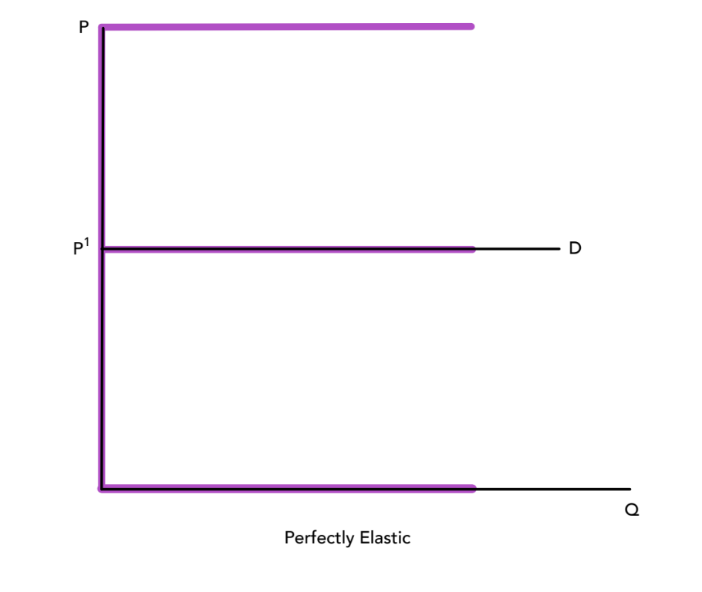
Section: Conventional Theory Tools, cont’d
When at the extremes, the I and E might help you remember!
Perfectly Inelastic
Perfectly Elastic
From The VOTE Textbook Second Edition Copyright © 2023

Slide 39
Section: Conventional Theory Tools, cont’d
Total Revenue (TR) Rule, Part I
TR = P x Q
If product is inelastic, RAISE PRICES!
TR at $5 = $55
< TR at $10 = $100
From The VOTE Textbook Second Edition Copyright © 2023

Slide 40
Section: Conventional Theory Tools, cont’d
Total Revenue (TR) Rule, Part II
TR = P x Q
If product is elastic, LOWER PRICES!
TR at $5 = $200
> TR at $10 = $100
From The VOTE Textbook Second Edition Copyright © 2023

Slide 41


Section: Conventional Theory Tools, cont’d
We’re ready to put price controls and elasticity together, but first let’s quickly list some of the determinants of the price elasticity of supply in output markets and the price elasticity of demand and supply in the input market for labor.
Price Elasticity of Supply
(output market)
Available Inputs
Inventories
Complexity of Production
Time Factor
Price Elasticity of Labor Demand
(input market for labor)
Ease of Labor Substitutions
Price Elasticity of Labor Supply
(input market for labor)
Adaptability of Labor Skill
From The VOTE Textbook Second Edition Copyright © 2023

Slide 42
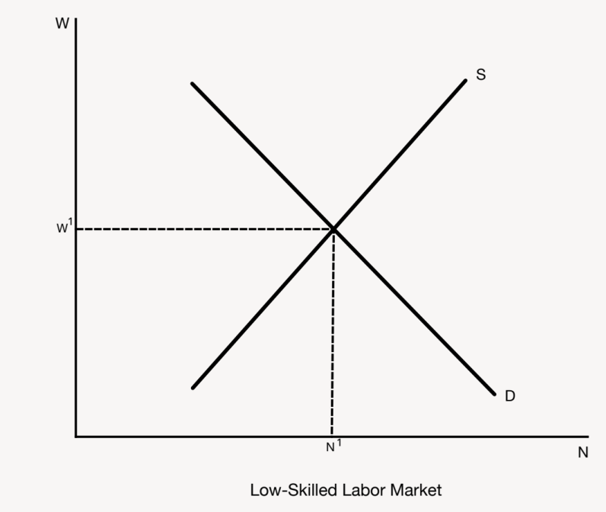
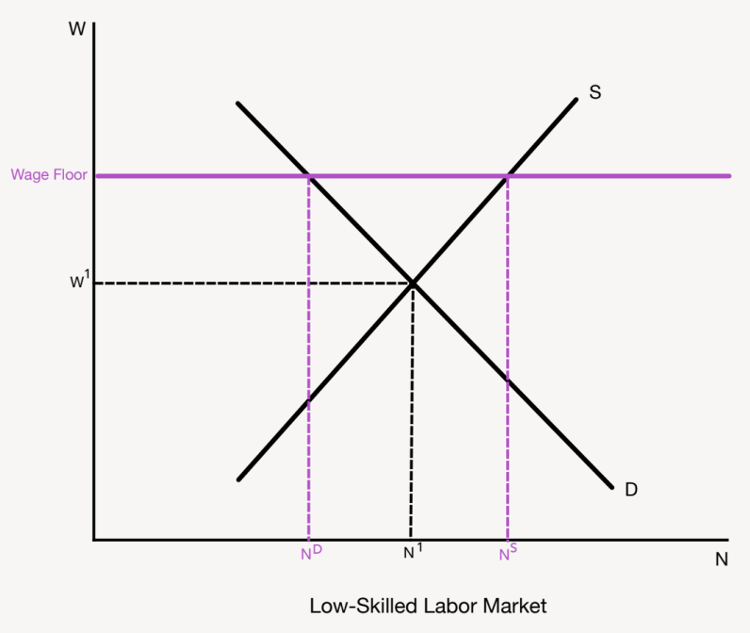
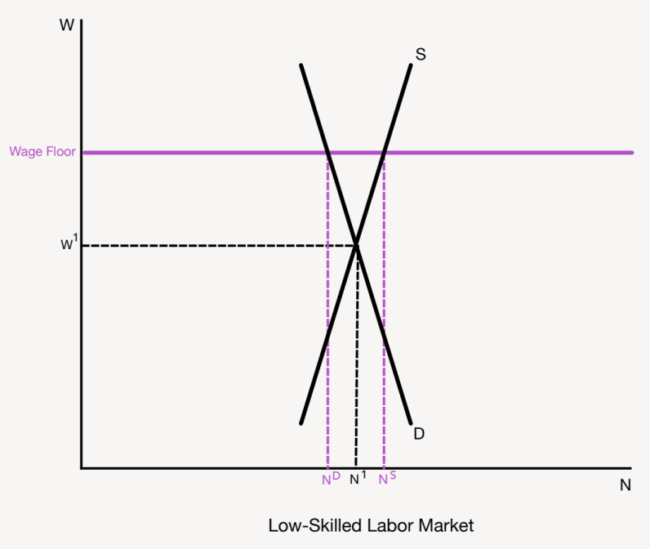
Section: Conventional Theory Tools, cont’d
Minimum Wage
The establishment of a price floor in the labor market.
Conservative
NO!
Government interference hurts society.
A minimum wage creates a surplus
of workers (unemployment!).
Left alone, the problem of poverty will self-correct.
Liberal
YES!
Government intervention helps society.
A minimum wage that is a living wage lifts millions out of poverty.
Workers’ spending creates even more jobs, which closes the gap.
This assumes that the price elasticity of both demand and supply are inelastic.
From The VOTE Textbook Second Edition Copyright © 2023

Slide 43
Section: Conventional Theory Tools, cont’d
Livelihood Policies
Conservative
Liberal
Conservatives want
free-market
wages.
Liberals want
minimum wage legislation.
From The VOTE Textbook Second Edition Copyright © 2023

Slide 44
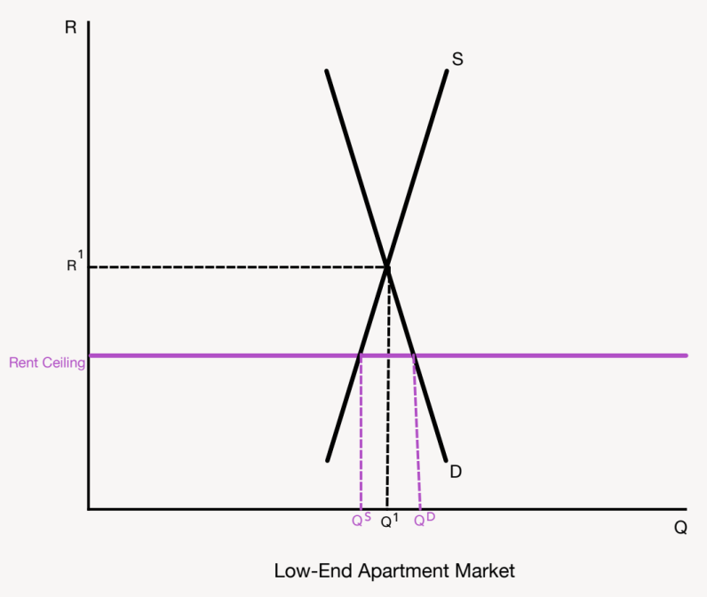

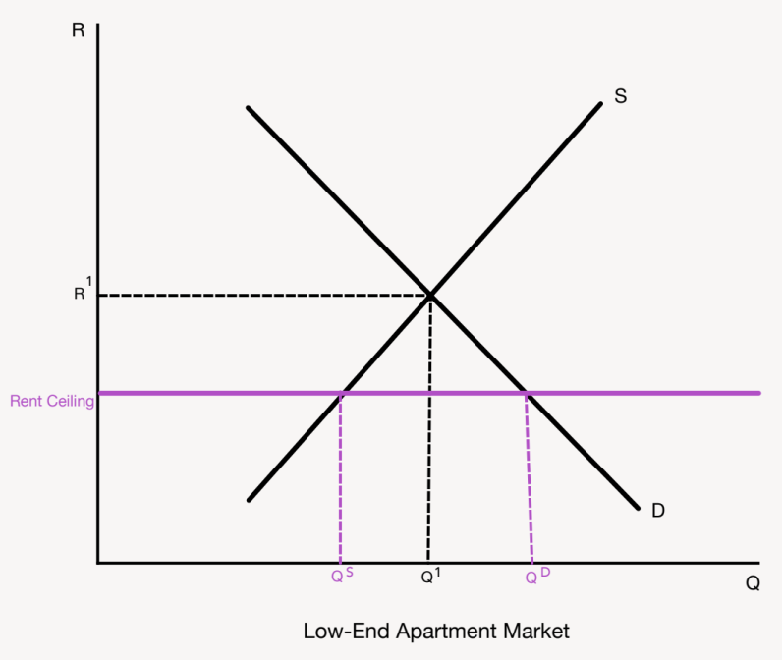
Section: Conventional Theory Tools, cont’d
Rent Control Laws
The establishment of a price ceiling in the housing market.
Liberal
YES!
Government intervention helps society.
Rent control laws make housing affordable.
Government housing programs and incentives close the gap.
Conservative
NO!
Government interference hurts society.
Rent control laws create a housing shortage.
Left alone, the problem of homelessness will self-correct.
This assumes that the price elasticity of both demand and supply are inelastic.
From The VOTE Textbook Second Edition Copyright © 2023

Slide 45
Section: Conventional Theory Tools, cont’d
Housing Policies
Liberal
Conservative
Liberals want
rent control laws.
Conservatives want
free-market rent signals.
From The VOTE Textbook Second Edition Copyright © 2023

Slide 46
Section: Radical Theory Tools
Radical Theory Tools
Private Ownership and Cooperative Ownership
* These tools are built on the foundation presented in Chapter 6.
From The VOTE Textbook Second Edition Copyright © 2023

Slide 47
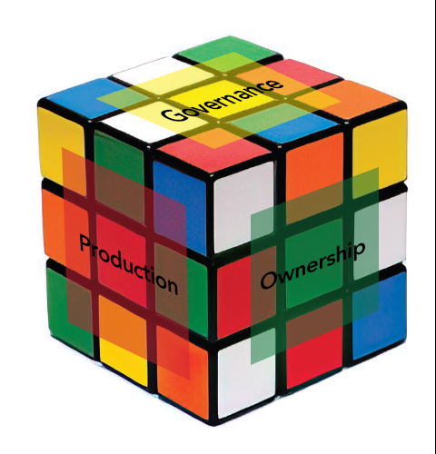
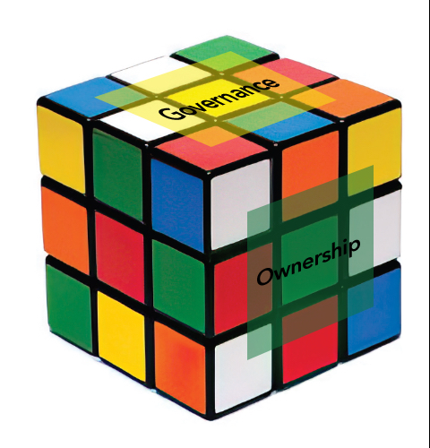


Section: Building Radical Theory in Two Parts, cont’d
Practice: Write the names of the six core points of economic
systems.
        Ownership
        Governance
        Meeting people’s
        material needs
        Production
        Sustainability
        Communities
(1)
(2)
(3)
(4)
(5)
(6)
The Six-Core Cube
of Every Economic System
From The VOTE Textbook Second Edition Copyright © 2023

Slide 48

Section: Radical Theory Tools, cont’d
Radicals use the core point that makes the most sense to analyze a particular issue, but there is no "right" core point. They are all relevant.
For livelihood and housing, we use the core point of ownership.
        Ownership
        Governance
        Meeting people’s basic material needs
        Production
        Sustainability
        Communities
From The VOTE Textbook Second Edition Copyright © 2023

Slide 49
Section: Radical Theory Tools, cont’d
Livelihood and Housing
Radical Tools, Part 1:
Drill down into ownership in capitalism
Radical Tools, Part 2:
Drill down into ownership in democratic socialism
The Six-Core Cube
of Every Economic System
From The VOTE Textbook Second Edition Copyright © 2023

Slide 50


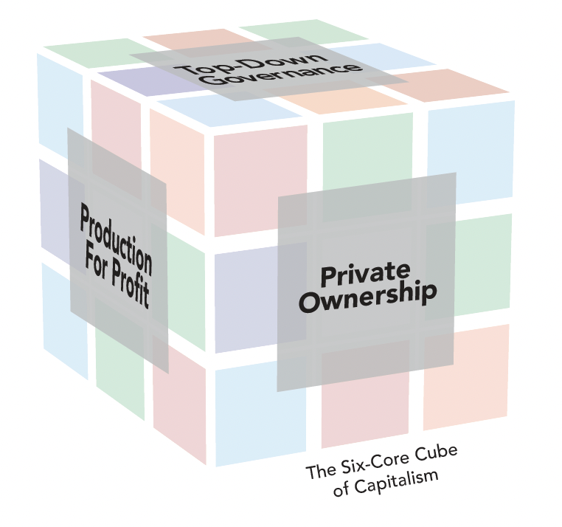
Section: Radical Theory Tools, cont’d
Workplace Exploitation
+
Capitalist Competition
The Pressure for Bad
leads to
The Visible Suffering
… and is represented by the Six-Core Cube of capitalism, which can never be solved.
From The VOTE Textbook Second Edition Copyright © 2023

Slide 51
Section: Radical Theory Tools, cont’d
The Unsolvable
Six-Core Cube of Capitalism
        Private Ownership
        Top-Down Governance
        Individuals at Risk
        Production for Profit
        Unsustainable Growth
        Unhealthy Communities
Why unsolvable?
It is built around six core points that are rotten to the core!
Private Ownership: Owners pay workers less than the value of what they produce and keep the profits for themselves.
From The VOTE Textbook Second Edition Copyright © 2023

Slide 52
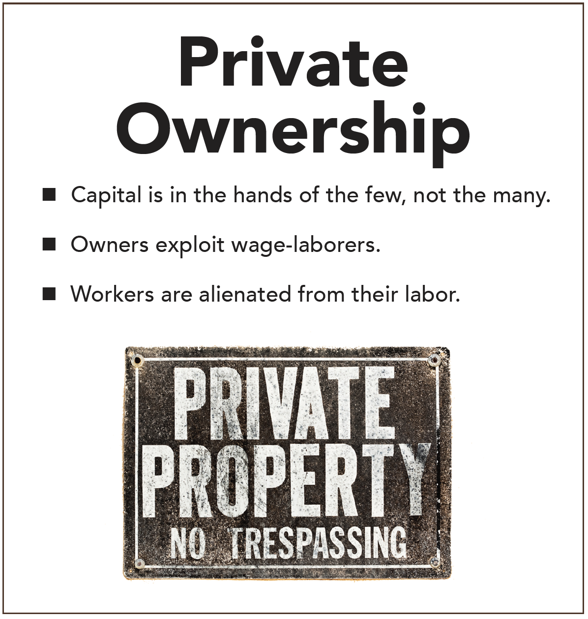

Section: Radical Theory Tools, cont’d
From The VOTE Textbook Second Edition Copyright © 2023

Slide 53
Section: Radical Theory Tools, cont’d
Private Ownership
Competitor #1:
“Our profits were down so we forced out the union and fired those high-paid workers. We hired low-skilled workers, trained them on the job, and only pay them a pittance.”
Owner:
Competitor:
Owner:
“I don’t want to be a part of…”
“So don’t do it.”
“But if I don’t do it and you do,
I won’t survive.”
“I buy dilapidated houses in the low-income part of town, kick out tenants, do a cheap renovation to make them look good, and then rent them out for a healthy profit.”
Competitor #2:
"So don’t do it.”
Competitor #3:
“Cities and states around the country throw incentives at us to move our businesses into their communities. But we just move away whenever we get a better deal somewhere else.”
“So don’t do it.”
PRESSURE FOR BAD
From The VOTE Textbook Second Edition Copyright © 2023

Slide 54
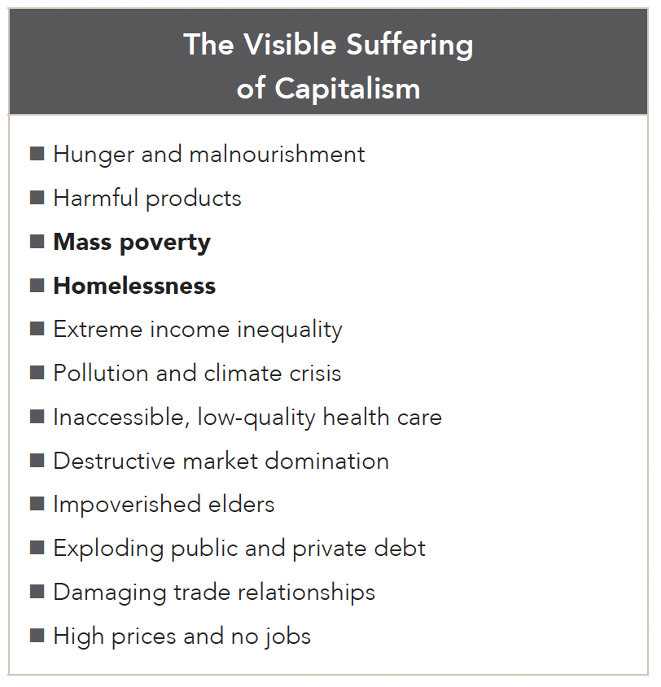
Section: Radical Theory Tools, cont’d
From The VOTE Textbook Second Edition Copyright © 2023

Slide 55
Section: Radical Theory Tools, cont’d
Livelihood and Housing
Radical Tools, Part 1:
Drill down into ownership in capitalism
Radical Tools, Part 2:
Drill down into ownership in democratic socialism
The Six-Core Cube
of Every Economic System
From The VOTE Textbook Second Edition Copyright © 2023

Slide 56

Section: Radical Theory Tools, cont’d
Workplace Justice
Coordination Among Competitors
The Pressure for Good leads to
The Invisible Synergy
+
…and is represented by the Six-Core Cube of democratic socialism, which can be solved.
From The VOTE Textbook Second Edition Copyright © 2023

Slide 57
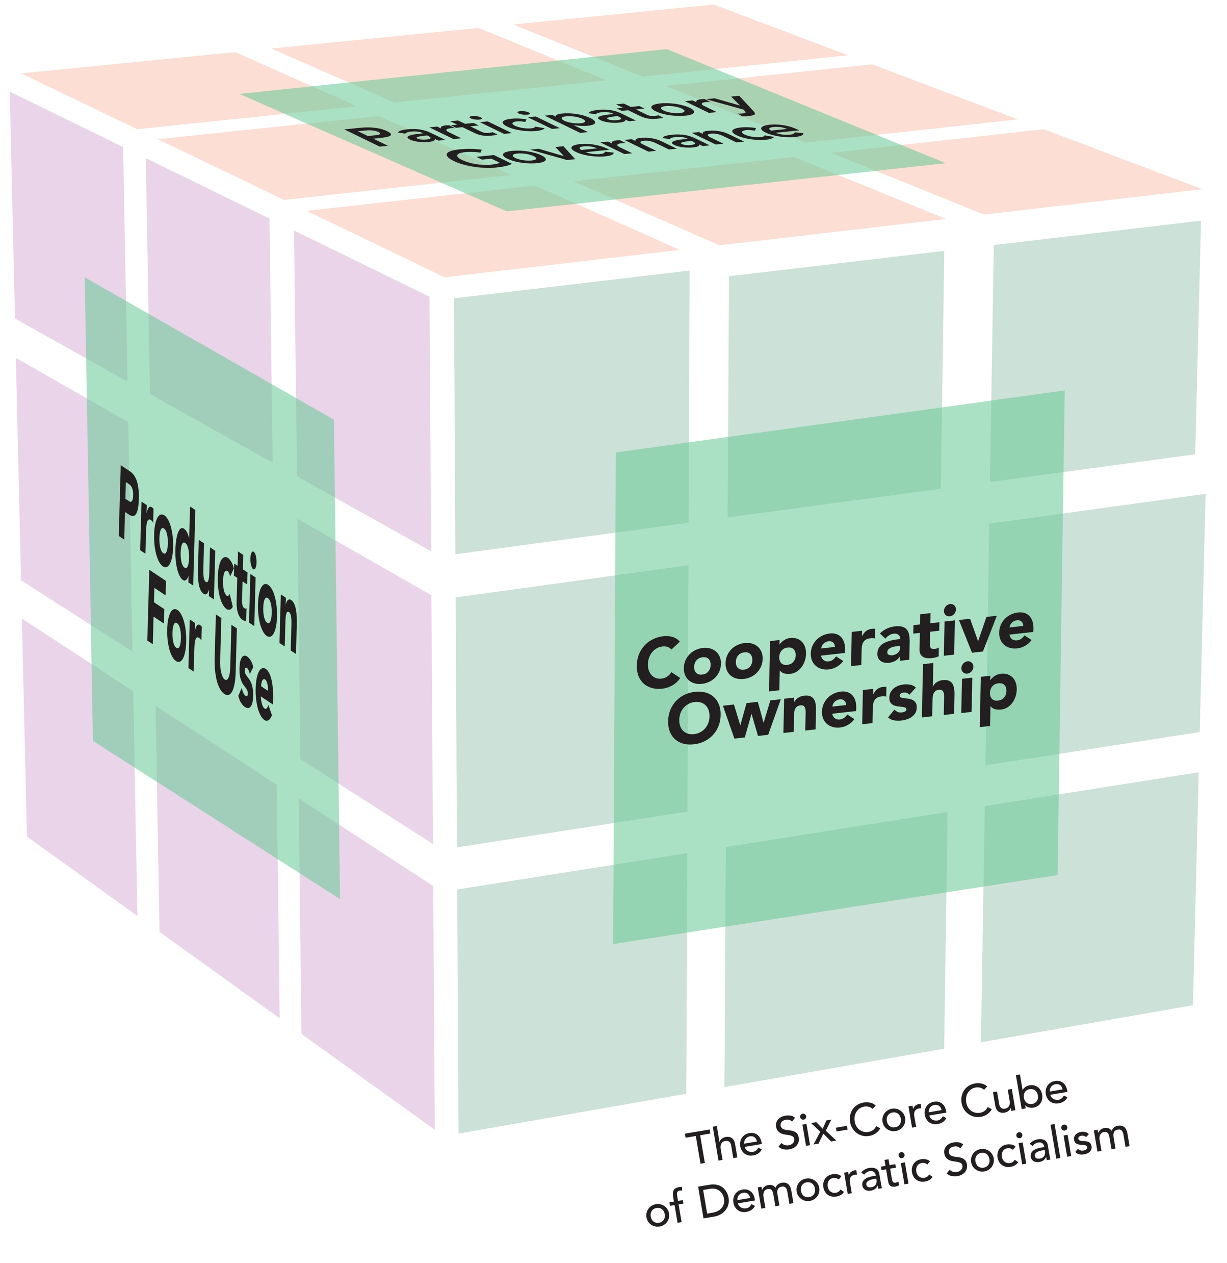
Section: Radical Theory Tools, cont’d
The Solvable
Six-Core Cube of Democratic Socialism
        Cooperative Ownership
        Participatory Governance
        Social Safeguards
        Production for Use
        Sustainable Development
        Healthy Communities
Cooperative Ownership
Why solvable?
It is built around six core points that are beneficial to the core!
Cooperative Ownership: People are joint owners of their firms and make decisions through a fair process of one person, one vote.
From The VOTE Textbook Second Edition Copyright © 2023

Slide 58
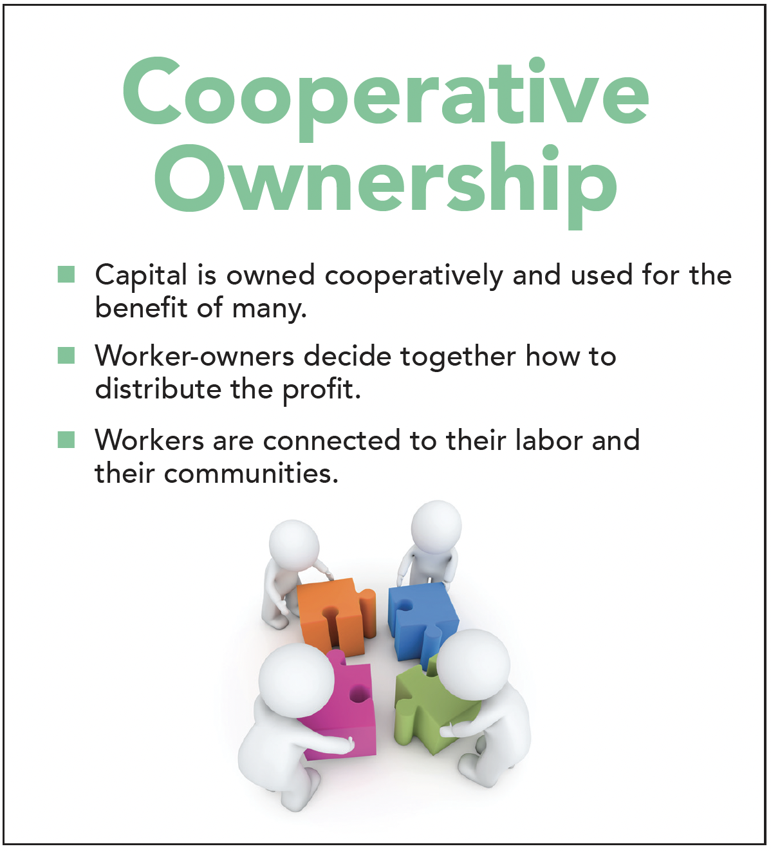
Section: Radical Theory Tools, cont’d
From The VOTE Textbook Second Edition Copyright © 2023

Slide 59
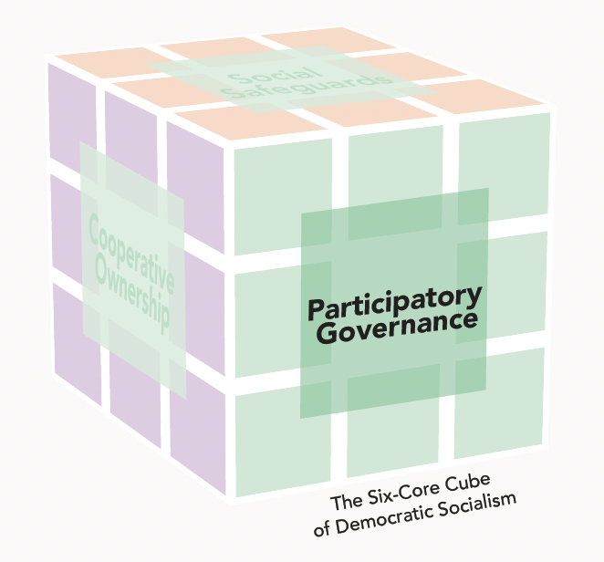
Section: Radical Theory Tools, cont’d
Livelihood and Housing Policies:
Radical
Livelihood
Worker-Owned Business Incubators
Support systems that offer cooperative owners financial resources, technical support, legal training, and
community networking for the start-up and success of
worker-owned enterprises.
Housing
Resident-Owned Communities (ROCs)
Housing structures of all shapes and sizes that are co-owned or co-leased by the residents, who make management decisions collaboratively. ROCs are often located on land set aside by community land trusts (CLTs) for this use.
From The VOTE Textbook Second Edition Copyright © 2023

Slide 60
Section: Radical Theory Tools, cont’d
Cooperative Ownership
Competitor #1:
“When our profits were down, the worker-owned business incubator recommended that we vote on taking pay cuts for three months so we could afford new equipment upgrades.”
Owner:
Competitor:
Owner:
“That’s a great idea…“
“You should do it!“
“I’ll definitely propose
it to my co-owners.“
“Our firm voted to put money into a fund that we worker-owners can borrow from so we can build or buy into resident-owned housing cooperatives in our community.”
Competitor #2:
“You should do it.”
Competitor #3:
“The worker-owned business incubator brokered a partnership between our company and a local university and hospital, which now use our services. It’s a win-win for all.”
“You should do it.”
PRESSURE FOR GOOD
From The VOTE Textbook Second Edition Copyright © 2023

Slide 61
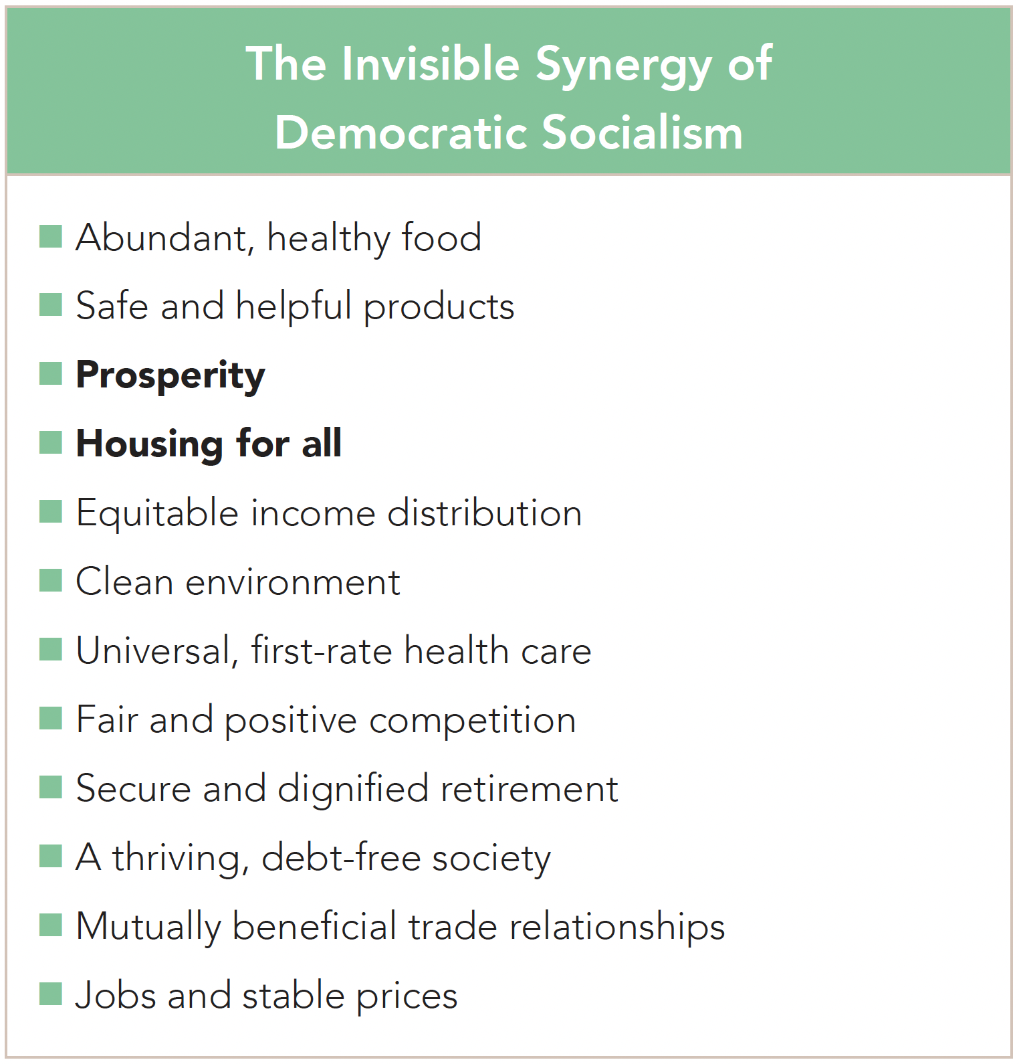
Section: Radical Theory Tools, cont’d
From The VOTE Textbook Second Edition Copyright © 2023

Slide 62
THE BLAME GAME
What causes poverty and homelessness?
Conservative
Liberal
Radical
Too much government interference
in capitalism
We need
free-market capitalism.
Not enough government intervention
in capitalism
We need
fair-market capitalism.
The drive for profit in capitalism
We need
democratic socialism.
From The VOTE Textbook Second Edition Copyright © 2023

Slide 63
The VOTE Jingle
Conservatives say,
“Government, NO! Free markets let prosperity flow.”
Liberals say,
“Government’s a GO! Fair markets make the economy grow.”
Radicals say,
“Capitalism, WHOA! Democratic socialism is the way to go.”
From The VOTE Textbook Second Edition Copyright © 2023

Slide 64

Chapter 10
Check out the book for more!
Test Yourself • Key Terms • Answer Key
From The VOTE Textbook Second Edition Copyright © 2023

