Slide 1

From The VOTE Textbook Second Edition Copyright © 2023

Slide 2


From The VOTE Textbook Second Edition Copyright © 2023
Notes:
2

Slide 3
From The VOTE Textbook Second Edition Copyright © 2023
Notes:
3

Slide 4
The VOTE Textbook Chapters
From The VOTE Textbook Second Edition Copyright © 2023
Notes:
4

Slide 5
1
2
3
4
5
6
7
8
9
10
11
12
13
14
15
16
17
18
19
20
21
From The VOTE Textbook Second Edition Copyright © 2023
Notes:
5

Slide 6


From The VOTE Textbook Second Edition Copyright © 2023

Slide 7
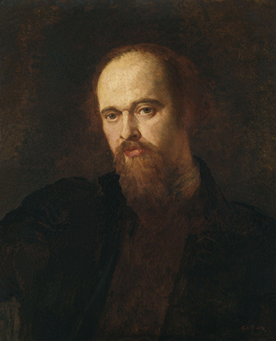
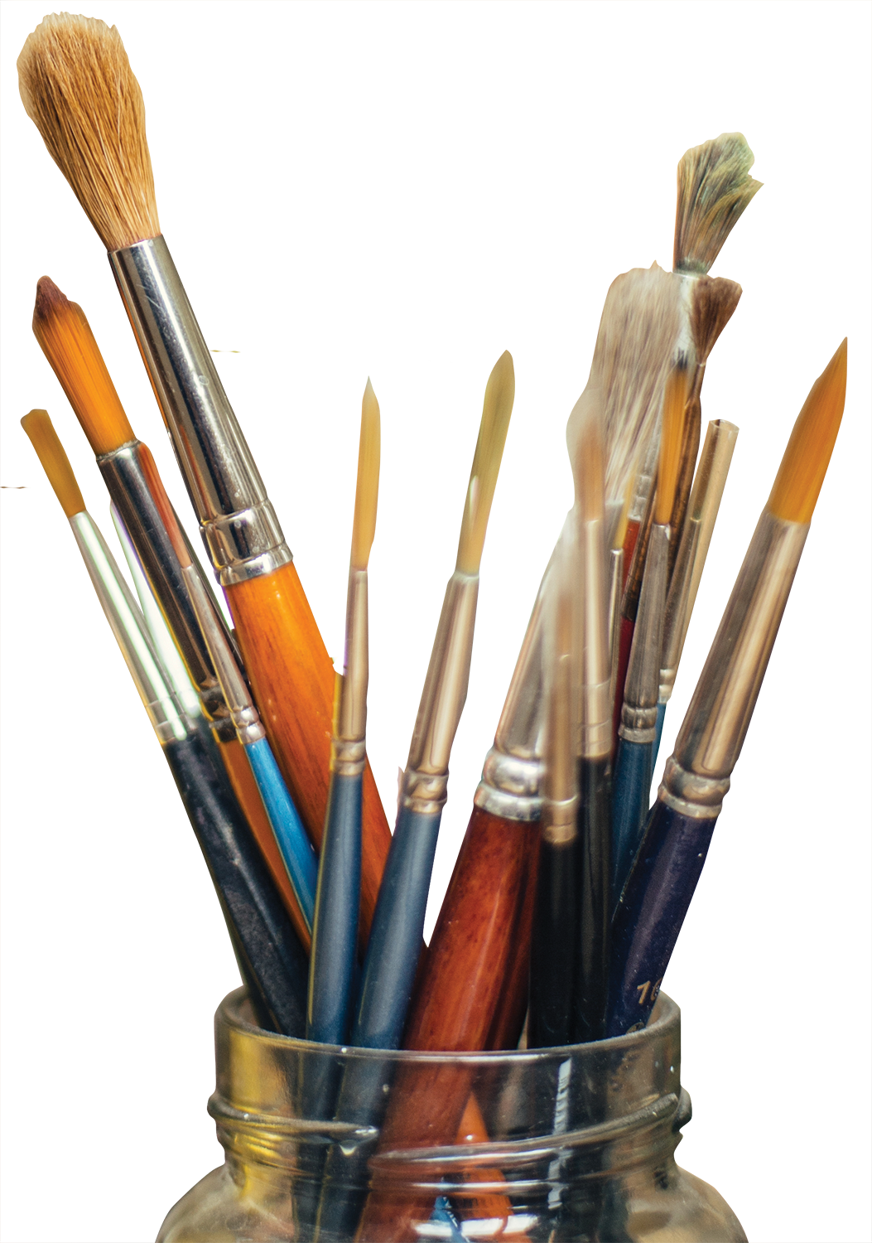
Opening story: Dante Rossetti and the old man
From The VOTE Textbook Second Edition Copyright © 2023

Slide 8

Section: Finding Your Voice
The VOTE Program
changes the conversation
Mission
To inspire new solutions to our country’s
urgent economic problems by building a
culture of respectful listening, passionate
advocacy, and intelligent debate.
Vision
A world in which people are freed from material worry so each of us can contribute our unique gifts, and society can reach its highest potential.
Method
Teach people from all walks of life to hear the voices of the great economic thinkers of the past echoed in today’s arguments. Then line up the conservative, liberal, and radical perspectives on economic issues—side-by-side, in a completely unbiased way. By using role plays and other activities, participants become fluent in each point of view, combative debate becomes solution-focused conversation, and the foundation is set for innovative thinking to emerge.
From The VOTE Textbook Second Edition Copyright © 2023

Slide 9

Section: Multiple Perspectives on Economic Issues
Obstacle
Partisan hostility and siloed thinking keep us from sparking the brilliant ideas we desperately need to create prosperity for all.
From The VOTE Textbook Second Edition Copyright © 2023

Slide 10

Section: Multiple Perspectives on Economic Issues, cont’d
The VOTE Program uses the terms “liberal,” “radical,” and “conservative” because these are the terms used in the popular media to describe the dominant ways of understanding economic issues in our society.
Understanding multiple perspectives on economic issues can change your world from black and white to Technicolor.
From The VOTE Textbook Second Edition Copyright © 2023

Slide 11

Section: Why Economics?
All choices available to you have been, are now, and will be shaped by economics. Economics is relevant to your life in every way.
.
From The VOTE Textbook Second Edition Copyright © 2023

Slide 12
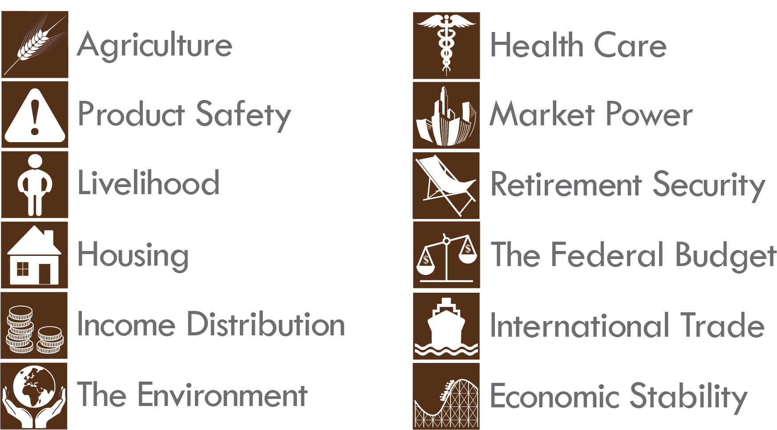
Form: VOTE Issues
From The VOTE Textbook Second Edition Copyright © 2023

Slide 13

Section: Why Economics?, cont’d
As you read this book, please repeat this to yourself:
“The VOTE Program is not advocating for any of the perspectives; it’s helping me make my own educated and
informed decisions about what I believe.”
From The VOTE Textbook Second Edition Copyright © 2023

Slide 14
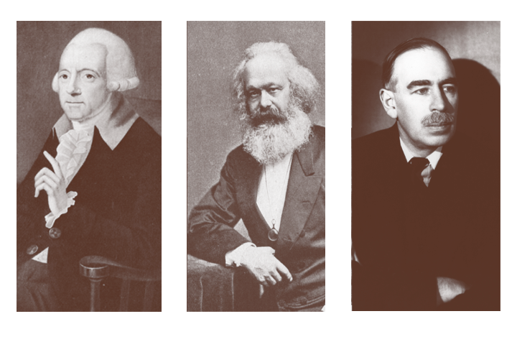
Section: Why Economics?, cont’d
Today’s debates trace back to these
three great economic thinkers.
Adam Smith
Karl Marx
John Maynard Keynes
From The VOTE Textbook Second Edition Copyright © 2023

Slide 15
Section: Your Voice Is Your Vote
The VOTE Program will educate, support, and encourage you, so that no matter what you end up doing in life as a career, you will know how to use your voice to contribute in a meaningful and productive way to the conversations—at the kitchen table, in the workplace, and at the ballot box.
From The VOTE Textbook Second Edition Copyright © 2023

Slide 16
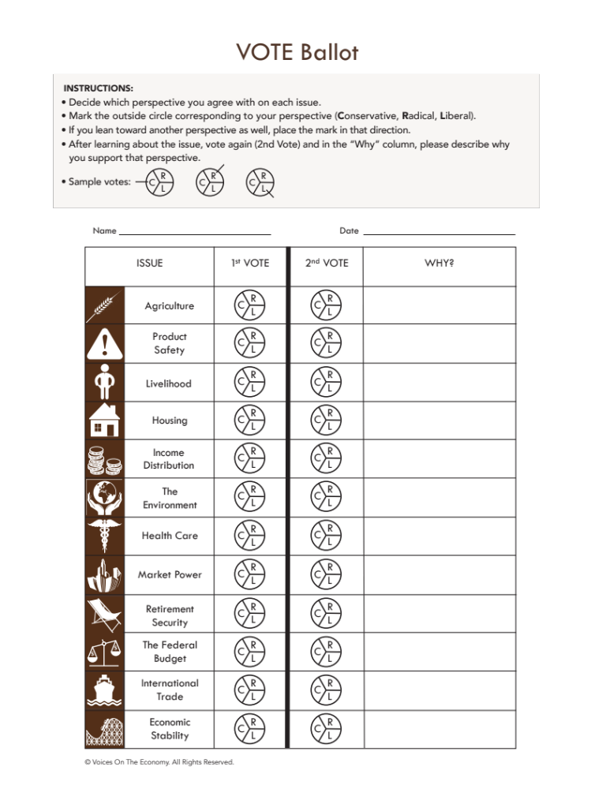

Form: The VOTE Ballot
The 2nd VOTE will be filled in later.
From The VOTE Textbook Second Edition Copyright © 2023

Slide 17

Section: Three Questions of Economics
Imagine you are stranded with others
on a deserted island.
You have to depend on yourselves to survive.
What’s the first thing you’re going to ask?
Questions that deal with survival—
food, shelter, and more—are the same questions we ask in economics.
From The VOTE Textbook Second Edition Copyright © 2023

Slide 18
Section: Three Questions of Economics, cont’d
1. What to Produce?
The Consumption question
3. For Whom to Produce?
The Distribution question
2. How to Produce?
The Production question
Economics:
The study of the
consumption, production,
and distribution of
goods and services
From The VOTE Textbook Second Edition Copyright © 2023

Slide 19

Section: Three Questions of Economics, cont’d
Materialism
Belief that money and possessions are the
most important things in life.
versus
✓
Material Well-Being
When one has the goods and services needed
to survive and thrive.
From The VOTE Textbook Second Edition Copyright © 2023

Slide 20
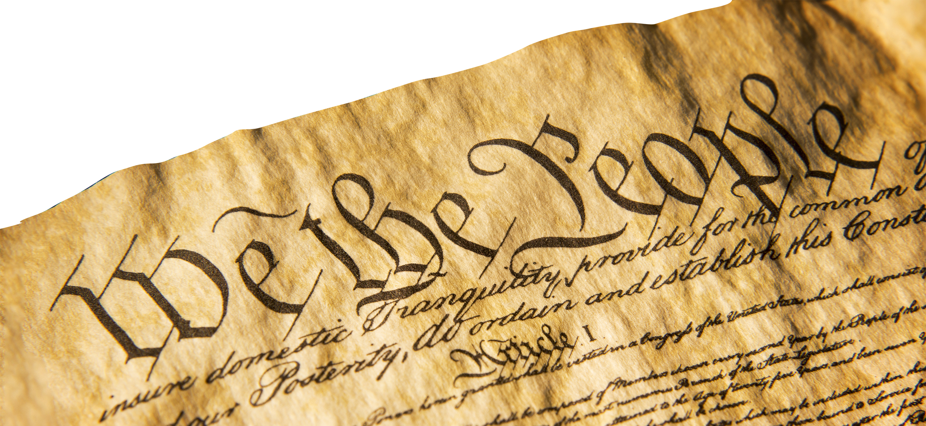
Section: Three Questions of Economics, cont’d
Political Economy
Politics is the study of governance.
Economics is the study of our material lives.
These two fields are interconnected.
While radicals, conservatives, and liberals agree
that a constitutional democracy, also called
a republic, is the best political system,
they disagree about which
economic system
is best.
From The VOTE Textbook Second Edition Copyright © 2023

Slide 21

Section: Important Economic Terms
Inputs
Outputs
also called:
also called:
Factors of Production
Resources
Land, Labor, Capital
Products
Goods & Services
Guns and Butter
4th Resource?
Entrepreneur
Not included because
all perspectives don’t agree.
From The VOTE Textbook Second Edition Copyright © 2023

Slide 22

Exercise 1.1: Inputs and Outputs
Exercise: Inputs and Outputs
Teeth Cleaning
From The VOTE Textbook Second Edition Copyright © 2023

Slide 23
Polling Question
Inputs and Outputs
When a dental hygienist cleans your teeth, is that an input or an output? If an input, is it land, labor, or capital? If an output, is it a good or a service?
Input – Capital
Output – Service
Input – Labor
Output - Good
From The VOTE Textbook Second Edition Copyright © 2023

Slide 24
Exercise 1.1: Inputs and Outputs
Exercise: Inputs and Outputs
Teeth Cleaning
        Output: Service
Gold for fillings
        Input: Land
Dental Technician
        Input: Labor
Mouth Guard
        Output: Good
Drill
        Input: Capital
DAILY
DOUBLE
From The VOTE Textbook Second Edition Copyright © 2023

Slide 25


Section: Important Economic Terms, cont’d
Microeconomics
Individual Markets
Macroeconomics
Economy as a Whole
Markets
Places where demanders and suppliers come together to buy and sell.
Gross Domestic Product (GDP)
Measurement of all goods and services produced by a nation.
Unemployment
Measurement of the number of people who want jobs and don’t have them.
Inflation
Measurement of overall price increases over time.
From The VOTE Textbook Second Edition Copyright © 2023

Slide 26

Section: Important Economic Terms, cont’d
Economic Theory
It’s an idea about consumption,
production, and distribution.
Economic System
It’s the actual consumption,
production, and distribution
in the real world.
From The VOTE Textbook Second Edition Copyright © 2023

Slide 27

Section: Choose Your Economic System, cont’d
The class is divided into three groups. Each is a country represented by a firm called Balance It!
Each group member is a producer who attempts to balance a book on their head while doing the hokey pokey. When the book falls, that person sits down.
The last person with a book on their head wins.
From The VOTE Textbook Second Edition Copyright © 2023

Slide 28
Section: Choose Your Economic System, cont’d
Country A
Private ownership of Balance It!
Country B
Private ownership of Balance It!
Country C
Cooperative ownership of Balance It!
From The VOTE Textbook Second Edition Copyright © 2023

Slide 29
Section: Choose Your Economic System, cont’d
Country A
Private ownership of Balance It!
In Country A, the winner of the hokey pokey gets a pile of money (might be represented by candy) and keeps it all. They start businesses that generate wealth for themselves while creating more jobs for others. They also voluntarily redistribute a portion of their wealth through philanthropy to help those who fall through the cracks meet their basic needs. With more people able to earn a good living because there are more jobs and boundless opportunities, the economy thrives.
From The VOTE Textbook Second Edition Copyright © 2023

Slide 30
Section: Choose Your Economic System, cont’d
Country B
Private ownership of Balance It!
In Country B, the winner of the hokey pokey gets a pile of money and keeps a substantial portion of it. The government redistributes the rest to fund programs that grow the middle class and create a robust safety net to meet people’s basic needs. With money in their pockets, the poor and middle class buy more goods and services, which leads firms to expand and create more jobs. This brings about a thriving economy.
From The VOTE Textbook Second Edition Copyright © 2023

Slide 31
Section: Choose Your Economic System, cont’d
Country C
Cooperative ownership of Balance It!
In Country C, the winner of the hokey pokey is
only the winner because all the workers contributed to Balance It!, so all the people in the firm share the pile of money. (The worker-owners might also vote to give the winner a special bonus.) A substantial portion of their incomes is paid into a government fund that ensures that all people in society get their material needs met. With more opportunities for new worker-owned businesses, the economy thrives.
From The VOTE Textbook Second Edition Copyright © 2023

Slide 32
Section: Choose Your Economic System, cont’d
Country A
Private ownership of Balance It!
Country B
Private ownership of Balance It!
Country C
Cooperative ownership of Balance It!
From The VOTE Textbook Second Edition Copyright © 2023

Slide 33
Polling Question
Choose Your Economic System Activity
In which country would you prefer to live?
Country A
Country B
Country C
From The VOTE Textbook Second Edition Copyright © 2023

Slide 34

Section: Choose Your Economic System, cont’d
CAPITALISM
THE DOMINANT ECONOMIC SYSTEM IN THE UNITED STATES
Private Ownership of Resources (land, labor, capital)
Conservatives embrace Free-Market Capitalism
Liberals embrace Fair-Market Capitalism
Radicals reject all forms of capitalism and embrace Democratic Socialism
From The VOTE Textbook Second Edition Copyright © 2023

Slide 35



Section: Choose Your Economic System, cont’d
These are the political parties that reflect the three
economic perspectives in the United States.
Democratic Socialist
(generally radicals)
Democrat
(generally liberals)
Republican
(generally conservatives)
Marx
Keynes
Smith
The problem isn’t that we disagree. Looking at issues from different points of view can and should make us stronger. Problems occur when we disagree without respectfully listening to the other sides, and when we dismiss out of hand the validity of rival points of view.
From The VOTE Textbook Second Edition Copyright © 2023

Slide 36
The VOTE Jingle
Conservatives say,
“Government, NO! Free markets let prosperity flow.”
Liberals say,
“Government’s a GO! Fair markets make the economy grow.”
Radicals say,
“Capitalism, WHOA! Democratic socialism is the way to go.”
From The VOTE Program Copyright © 2023

Slide 37
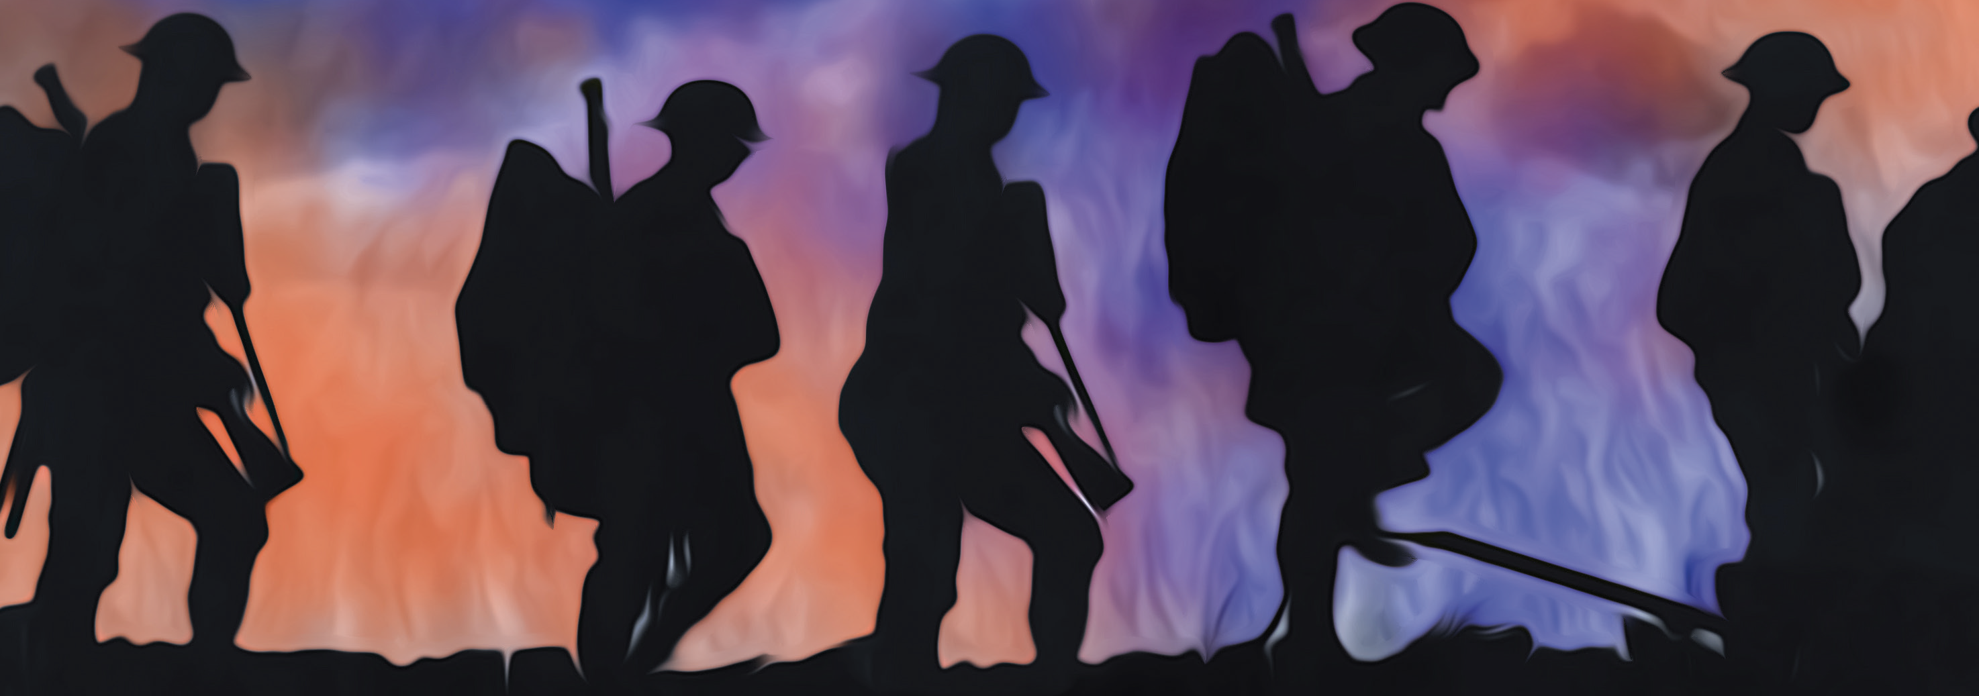
Section: Choose Your Economic System, cont’d
Major U.S. Wars Fought over Economic Systems
• Revolutionary War
• Civil War
• World War I
• World War II
• Korean War
• Vietnam War
• Cold War
• Gulf War
• War on Terror
From The VOTE Textbook Second Edition Copyright © 2023

Slide 38

Section: Choose Your Economic System, cont’d
The VOTE Program is all about helping you become engaged with the larger issues in the world around you. Only half of eligible voters actually cast their ballots in recent years.
This is alarming if you care about the future of our country, which has everything to do with your personal future well-being.
The first step to becoming civically engaged is very simply this: you have to care.
From The VOTE Textbook Second Edition Copyright © 2023

Slide 39

Section: The Next Great Economic Thinkers
Your voice is unique.
Your voice is desperately needed.
You could be the next great economic thinker!
From The VOTE Textbook Second Edition Copyright © 2023

Slide 40

Chapter 1
Check out the book for more!
Test Yourself • Key Terms • Answer Key
From The VOTE Textbook Second Edition Copyright © 2023

